Slide 1
Introduction to AI implementation in FPGA via VITIA-AI
(Wed) 27.01.2021
Colloquium at University of Seoul, Dept. of Physics
Sunyoung Yoo

Slide 2
Little About myself
MSc in Physics at University of Seoul
Training Program for Robotics of KAR
(Korea Association of Robot Industry)
Research Assistant at SDU
MMMI, AI and Data Science Lab

Slide 3
TABLE OF CONTENTS
01
02
03
Capsule Colon Endoscopy CCE project
FPGA
Ai Model training
*tutorial
What and Why
About the project
Object Detection Model Training
with Tensorflow

Slide 4
TABLE OF CONTENTS
04
05
06
ZYNQ, ZCU-102/104
VITIA-AI, AI Implementation
demo
*tutorial
*tutorial
Hardware
Information
How to implement trained model in FPGA via Vitis-AI
From image feeding
to visualizing results

Slide 5
01
FPGA
What is FPGA?
Why should we use it?

Slide 6
Field Programmable Gate Arrays

Slide 7
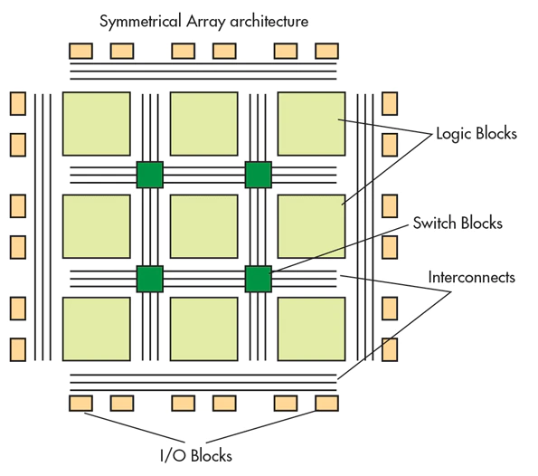
— XILINX
Field Programmable
Gate Arrays
Semiconductor devices based around a matrix of configurable logic blocks (CLBs) connected via programmable interconnects.
Can be reprogrammed to desired application or functionality requirements after manufacturing.
Ref:https://www.electronicdesign.com/technologies/fpgas/article/21801527/the-principles-of-fpgas
Notes:
Although one-time programmable (OTP) FPGAs are available, the dominant types are SRAM based which can be reprogrammed as the design evolves.

Slide 8
FPGA
Energy
Time
Prototyping
Various options
Low energy consumption
Low time consumption
Fast prototyping
Easy to integrate with other devices

Slide 9
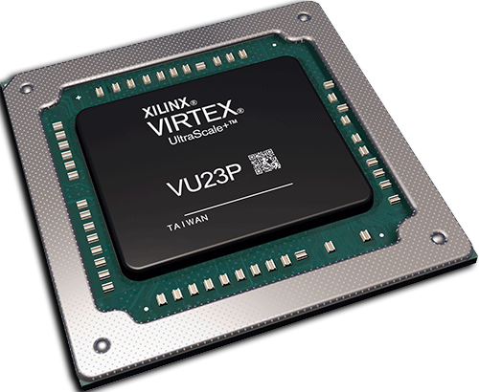
FPGA
Energy
Time
Prototyping
Various options
Low energy consumption
Low time consumption
Fast prototyping
Easy to integrate with other devices

Slide 10
Time & Energy Efficiency
LOW
High
High
LOW
Flexibility

Slide 11
02
Capsule Colon Endoscopy
About the project

Slide 12
Capsule Colon Endoscopy
Key Features
low energy consumption
long battery life
stable communication
small size
harmless inside human body

Slide 13
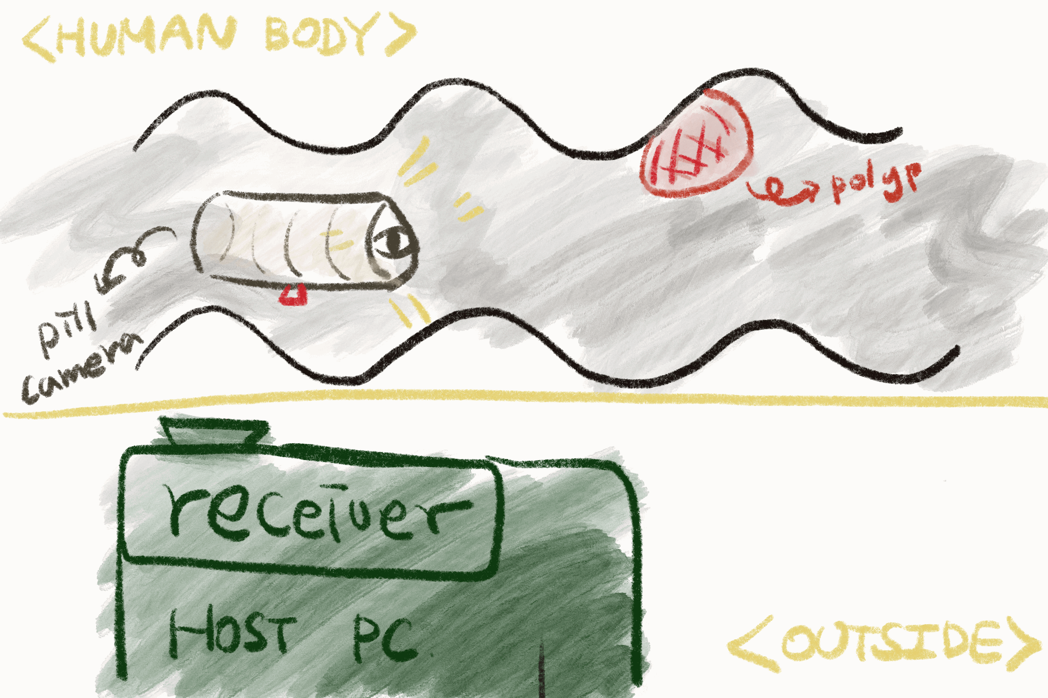
Capsule Colon Endoscopy
Key Features
low energy consumption
long battery life
stable communication
small size
harmless inside human body
=> processing images before sending to the host can be more efficient.

Slide 14
03
AI TRAINING
AI Model Design
Model Training

Slide 15
Model Design
Conv
Half
Fire
ReLU
ReLU
Conv
Input
227*227*3 polyp images
Conv
ReLU
Max
Pooling
Max
Pooling
Max
Pooling
Half
Fire
Half
Fire
Half
Fire
Half
Fire
Output
4*4*3*5
Location of box
& class
Conv
Reshape

Slide 16
Model Design
Input
227*227*3 polyp images
Conv
ReLU
Max
Pooling
Max
Pooling
Max
Pooling
Half
Fire
Half
Fire
Half
Fire
Half
Fire
Output
4*4*3*5
Location of box
& class
Conv
Reshape

Slide 17
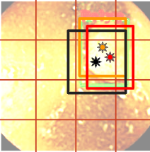
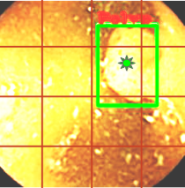
Output processing
- 4 X 4 cells on each Image
- 3 Candidates for each cell
- Remove Overlapped Candidates
=> Objectness (Class confidence)
+ Bounding Box

Slide 18
Can’t show you these images, sorry!

Slide 19
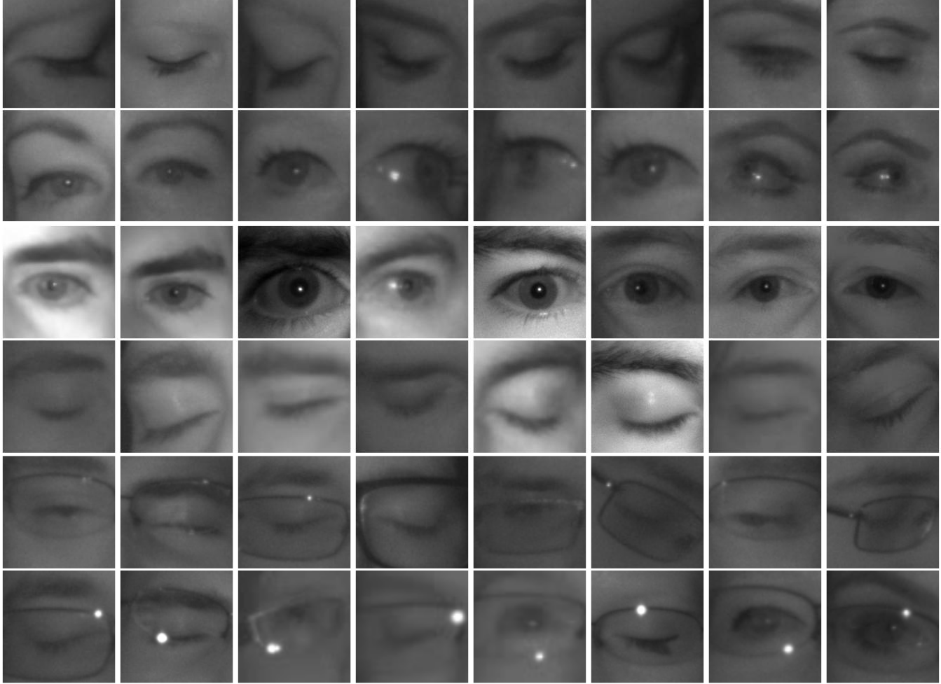
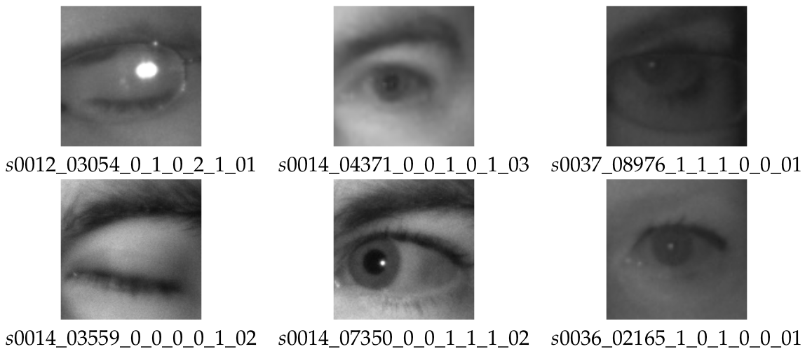
Binary classification
http://mrl.cs.vsb.cz/eyedataset
0: closed
1: open

Slide 20
Binary classification
http://mrl.cs.vsb.cz/eyedataset
https://github.com/YooSunYoung/binary_classification_vitis_ai_tutorial
Image Preprocess
randomly select images
rescale images into 50X50 gray images
split images into training and test set
save images into npy files
Model
small model for single class binary classification
Train
Test
Freeze
convert model into protobuf (.pb) format

Slide 21
Binary classification
http://mrl.cs.vsb.cz/eyedataset
https://github.com/YooSunYoung/binary_classification_vitis_ai_tutorial
Image Preprocess
randomly select images
rescale images into 50X50 gray images
split images into training and test set
save images into npy files
Model
small model for single class binary classification
Train
Test
Freeze
convert model into protobuf (.pb) format
Input
(50x50)
CNN
RELU
MAX
POOL
CNN
RELU
MAX
POOL
FC
RELU
Output
(0 or 1)
Loss: sigmoid_cross_entroy

Slide 22
04
ZYNQ Evaluation board Zcu-102
Hardware Information

Slide 23
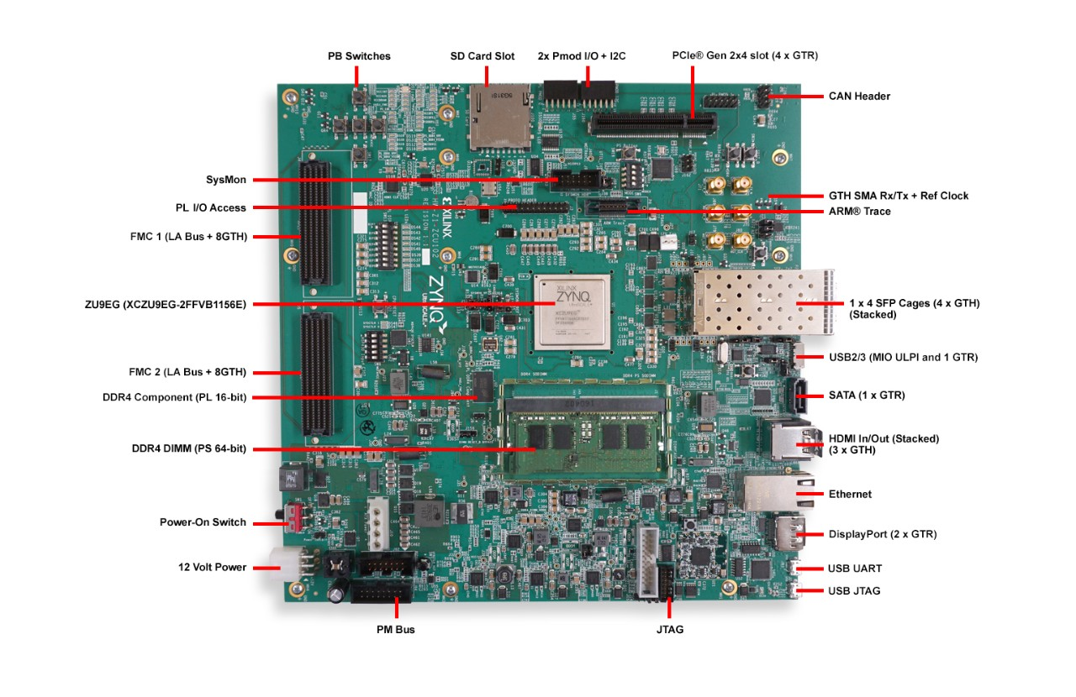
Zcu-102
- Evaluation board for FPGA with various peripheral options

Slide 24
Peripherals
A B C D E F
1 2 3 4 5 6
- Evaluation board for FPGA with various peripheral options

Slide 25
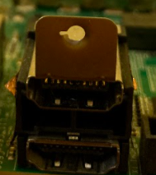
Peripherals
A B C D E F
1 2 3 4 5 6
- Evaluation board for FPGA with various peripheral options

Slide 26
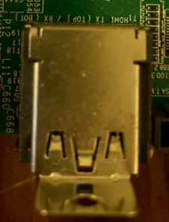
Peripherals
A B C D E F
1 2 3 4 5 6
- Evaluation board for FPGA with various peripheral options

Slide 27
Detail information
All pheripheral options can be found in the user guide linked below.
https://www.xilinx.com/support/documentation/boards_and_kits/zcu102/ug1182-zcu102-eval-bd.pdf
- Evaluation board for FPGA with various peripheral options

Slide 28
Example application
PC
IMGAES
FPGA
INFERENCE
RESULT

Slide 29
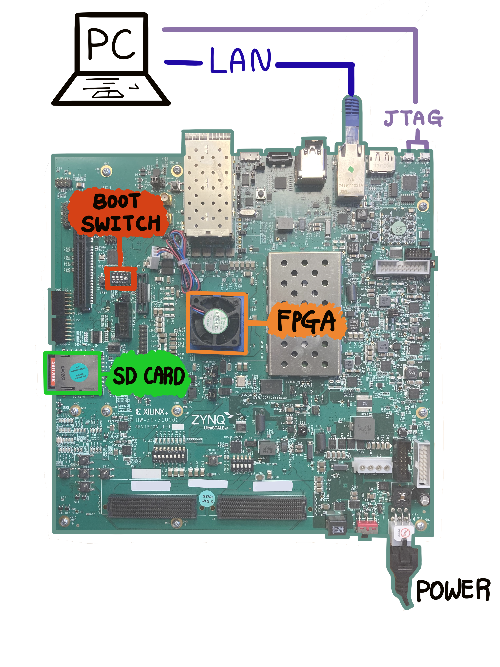
Zcu-102
SD boot and LAN connection set-up
Boot switch should be set as ↑↓↓↓ before power on

Slide 30
Zcu-102
Install Petalinux (pre-built) on SD card
Pre-built Peta Linux images:
https://xilinx-wiki.atlassian.net/wiki/spaces/A/pages/18842316/Linux+Prebuilt+Images
How to install linux on SD card:
- Windows: https://www.etcher.net/ *recommend
- Linux: use ‘dd’ command
Ref: https://xilinx-wiki.atlassian.net/wiki/spaces/A/pages/18841655/Prepare+Boot+Medium

Slide 31
Zcu-102
Install Petalinux (pre-built) on SD card
Pre-built Peta Linux images:
https://xilinx-wiki.atlassian.net/wiki/spaces/A/pages/18842316/Linux+Prebuilt+Images
How to install linux on SD card:
- Windows: https://www.etcher.net/ *recommend
- Linux: use ‘dd’ command
Ref: https://xilinx-wiki.atlassian.net/wiki/spaces/A/pages/18841655/Prepare+Boot+Medium
UART Connection
Ref: https://xilinx-wiki.atlassian.net/wiki/spaces/A/pages/18842446/Setup+a+Serial+Console

Slide 32
Zcu-102
Install Petalinux (pre-built) on SD card
Pre-built Peta Linux images:
https://xilinx-wiki.atlassian.net/wiki/spaces/A/pages/18842316/Linux+Prebuilt+Images
How to install linux on SD card:
- Windows: https://www.etcher.net/ *recommend
- Linux: use ‘dd’ command
Ref: https://xilinx-wiki.atlassian.net/wiki/spaces/A/pages/18841655/Prepare+Boot+Medium
UART Connection
Ref: https://xilinx-wiki.atlassian.net/wiki/spaces/A/pages/18842446/Setup+a+Serial+Console
LAN Connection (Static IP Configuration)

Slide 33
StatiC IP configuration
ZCU-102 board
PC (Ubuntu)

Slide 34
StatiC IP configuration
ZCU-102 board
PC (Ubuntu)
*DNS might need to be configured

Slide 35
StatiC IP configuration
ZCU-102 board
PC (Ubuntu)
*dns might need to be configured

Slide 36
StatiC IP configuration
ZCU-102 board
PC (Ubuntu)
PC

Slide 37
StatiC IP configuration
ZCU-102 board
PC (Ubuntu)

Slide 38
Zcu-102
Install Petalinux (pre-built) on SD card
Pre-built Peta Linux images:
https://xilinx-wiki.atlassian.net/wiki/spaces/A/pages/18842316/Linux+Prebuilt+Images
How to install linux on SD card:
- Windows: https://www.etcher.net/ *recommend
- Linux: use ‘dd’ command
Ref: https://xilinx-wiki.atlassian.net/wiki/spaces/A/pages/18841655/Prepare+Boot+Medium
UART Connection
Ref: https://xilinx-wiki.atlassian.net/wiki/spaces/A/pages/18842446/Setup+a+Serial+Console
LAN Connection (Static IP Configuration)
- Evaluation board for FPGA with various peripheral options

Slide 39
05
VITIs-AI, AI Implementation
How to implement trained model in FPGA via Vitis-AI

Slide 40
Hardware programming

Slide 41
Hardware programming
VHDL

Slide 42
Hardware programming
VHDL
VERILOG

Slide 43
Hardware programming
VHDL
VERILOG

Slide 44
Hardware programming
VHDL
VERILOG

Slide 45
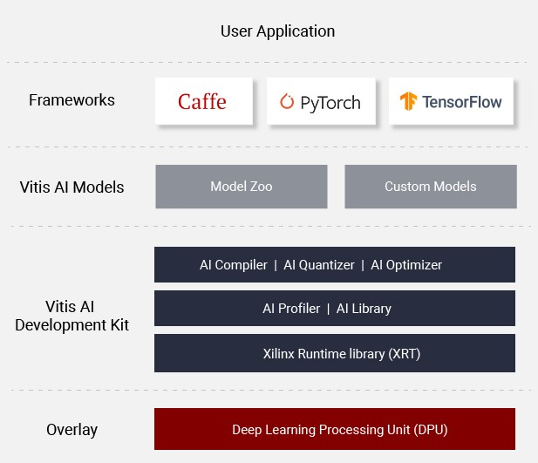
Hardware programming
VHDL
VERILOG

Slide 46
VITIs-ai environment set-up

Slide 47
VITIs-ai environment set-up

Slide 48
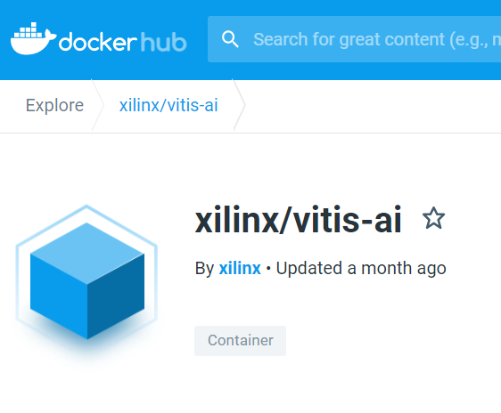
VITIs-ai environment set-up
https://hub.docker.com/r/xilinx/vitis-ai

Slide 49
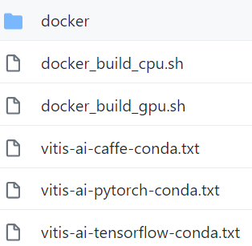
VITIs-ai environment set-up
https://github.com/Xilinx/Vitis-AI/tree/master/setup/docker
https://hub.docker.com/r/xilinx/vitis-ai

Slide 50
VITIs-ai environment set-up
https://github.com/Xilinx/Vitis-AI/tree/master/setup/docker
-v {pwd} /workspace
By default

Slide 51
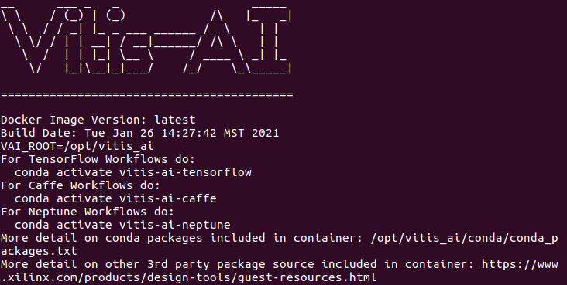
VITIs-ai environment set-up
-v {pwd} /workspace
By default

Slide 52
VITIs-ai environment set-up
-v {pwd} /workspace
By default
In Docker Container
vitis-ai-neptune
vitis-ai-caffe

Slide 53
VITIs-ai environment set-up
-v {pwd} /workspace
By default
In Docker Container
-> python path

Slide 54
VITIs-ai AI implementation
Ref: https://github.com/Xilinx/Vitis-AI-Tutorials/tree/CIFAR10-Classification-with-TensorFlow
Ref: https://beetlebox.org/category/tutorials/
https://github.com/YooSunYoung/binary_classification_vitis_ai_tutorial
Docker Container

Slide 55
VITIs-ai AI implementation
Ref: https://github.com/Xilinx/Vitis-AI-Tutorials/tree/CIFAR10-Classification-with-TensorFlow
Ref: https://beetlebox.org/category/tutorials/
Environment Setting
Training
Freeze Model
Evaluate Frozen Graph
Quantize
Evaluate Quantized Graph
Compile
Docker Container

Slide 56
VITIs-ai AI implementation
Ref: https://github.com/Xilinx/Vitis-AI-Tutorials/tree/CIFAR10-Classification-with-TensorFlow
Ref: https://beetlebox.org/category/tutorials/
Environment Setting
Training
Freeze Model
Evaluate Frozen Graph
Quantize
Evaluate Quantized Graph
Compile
Docker Container

Slide 57
VITIs-ai AI implementation
Ref: https://github.com/Xilinx/Vitis-AI-Tutorials/tree/CIFAR10-Classification-with-TensorFlow
Ref: https://beetlebox.org/category/tutorials/
Environment Setting
Training
Freeze Model
Evaluate Frozen Graph
Quantize
Evaluate Quantized Graph
Compile
Docker Container

Slide 58
VITIs-ai AI implementation
Ref: https://github.com/Xilinx/Vitis-AI-Tutorials/tree/CIFAR10-Classification-with-TensorFlow
Ref: https://beetlebox.org/category/tutorials/
/workspace/object_detection/
|-- img
|-- log
|-- output
|-- quantize_results
|-- target
|-- calib_list.txt
|-- compile.sh
|-- input_fn.py
|-- quantize_recipe.sh
`-- model.pb
Docker Container

Slide 59
VITIs-ai AI implementation
Ref: https://github.com/Xilinx/Vitis-AI-Tutorials/tree/CIFAR10-Classification-with-TensorFlow
Ref: https://beetlebox.org/category/tutorials/
/workspace/object_detection/
|-- img : png images for calibration
|-- log : log files
|-- output : output of compiler, DPU executable files
|-- quantize_results : output of quantizer
|-- target : application and DPU executable files
|-- calib_list.txt : list of images for calibration
|-- compile.sh : bash script for compiling
|-- input_fn.py : calibration function for quantization
|-- quantize_recipe.sh : bash script for quantization
`-- model.pb : frozen model
*ls img > calib_list.txt
Docker Container

Slide 60
VITIs-ai AI implementation
Ref: https://github.com/Xilinx/Vitis-AI-Tutorials/tree/CIFAR10-Classification-with-TensorFlow
Ref: https://beetlebox.org/category/tutorials/
Quantize
vai_q_tensorflow quantize \ : vitis-ai command
--input_frozen_graph model.pb \ : frozen model
--input_nodes normalized_gray_image \
--input_shapes ?,50,50,1 \
--output_nodes final_output \
--input_fn input_fn.calib_input \ : input_fn.py
--method 0 \
--gpu 0 \
--calib_iter 30 \
--output_dir ./quantize_results \ : output directory
--weight_bit 8 \ : from 32-bit to 8-bit
--activation_bit 8 \
quantize_recipe.sh
Docker Container

Slide 61
VITIs-ai AI implementation
Ref: https://github.com/Xilinx/Vitis-AI-Tutorials/tree/CIFAR10-Classification-with-TensorFlow
Ref: https://beetlebox.org/category/tutorials/
Quantize
vai_q_tensorflow quantize \
--input_frozen_graph model.pb \
--input_nodes normalized_gray_image \
--input_shapes ?,50,50,1 \
--output_nodes final_output \
--input_fn input_fn.calib_input \
--method 0 \
--gpu 0 \
--calib_iter 30 \
--output_dir ./quantize_results \
--weight_bit 8 \
--activation_bit 8 \
quantize_recipe.sh
Already determined in the frozen model
Docker Container

Slide 62
VITIs-ai AI implementation
Ref: https://github.com/Xilinx/Vitis-AI-Tutorials/tree/CIFAR10-Classification-with-TensorFlow
Ref: https://beetlebox.org/category/tutorials/
Quantize
quantize_recipe.sh
Docker Container

Slide 63
VITIs-ai AI implementation
Ref: https://github.com/Xilinx/Vitis-AI-Tutorials/tree/CIFAR10-Classification-with-TensorFlow
Ref: https://beetlebox.org/category/tutorials/
Compile
compile() {
vai_c_tensorflow \
--frozen_pb ./quantize_results/deploy_model.pb \
--arch /opt/vitis_ai/compiler/arch/DPUCZDX8G/ZCU102/arch.json \
--output_dir ./output/ \
--net_name simple_net \
--options "{'mode':'normal'}"
}
compile | tee ./log/compile_log_zcu102
compile.sh
Docker Container

Slide 64
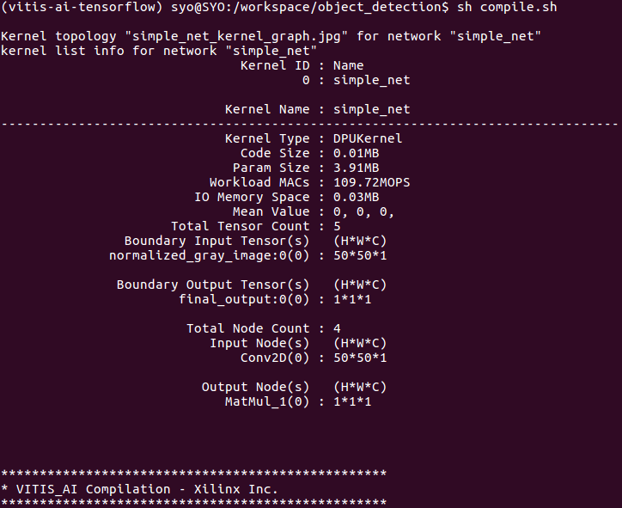
VITIs-ai AI implementation
Ref: https://github.com/Xilinx/Vitis-AI-Tutorials/tree/CIFAR10-Classification-with-TensorFlow
Ref: https://beetlebox.org/category/tutorials/
Compile
compile.sh
Docker Container

Slide 65
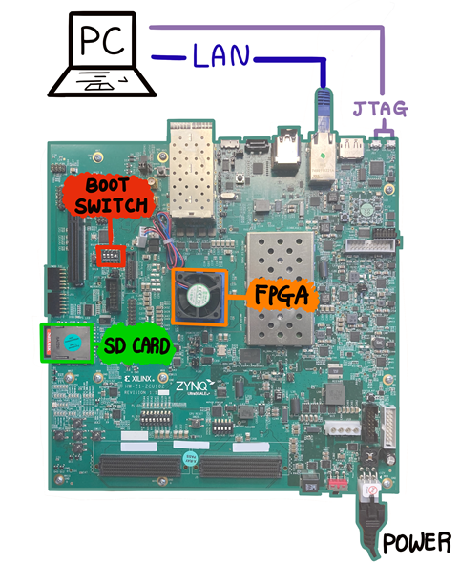
VITIs-ai AI implementation
Ref: https://github.com/Xilinx/Vitis-AI-Tutorials/tree/CIFAR10-Classification-with-TensorFlow
Ref: https://beetlebox.org/category/tutorials/
File Transfer
/object_detection/target/
|-- dpuv2_rundir
|-- images
|-- single_image
|-- app.py
|-- compile_so.sh
|-- dpu_simple_net.elf
|-- runner.py
`-- simple_net_kernel_graph.gv
target.tar.gz
Docker Container

Slide 66
VITIs-ai AI implementation
Image Feeding
https://github.com/YooSunYoung/binary_classification_vitis_ai_tutorial/blob/master/image_feeder.py
Feed images Via Socket Communication
PC

Slide 67
VITIs-ai AI implementation
Ref: https://github.com/Xilinx/Vitis-AI-Tutorials/tree/CIFAR10-Classification-with-TensorFlow
Ref: https://beetlebox.org/category/tutorials/
Compile
FPGA Board

Slide 68
VITIs-ai AI implementation
Ref: https://github.com/Xilinx/Vitis-AI-Tutorials/tree/CIFAR10-Classification-with-TensorFlow
Ref: https://beetlebox.org/category/tutorials/
Runner.py
DPU library wrapper
FPGA Board

Slide 69
VITIs-ai AI implementation
Ref: https://github.com/Xilinx/Vitis-AI-Tutorials/tree/CIFAR10-Classification-with-TensorFlow
Ref: https://beetlebox.org/category/tutorials/
Runner.py
FPGA Board

Slide 70
VITIs-ai AI implementation
Ref: https://github.com/Xilinx/Vitis-AI-Tutorials/tree/CIFAR10-Classification-with-TensorFlow
Ref: https://beetlebox.org/category/tutorials/
Runner.py
FPGA Board

Slide 71
VITIs-ai AI implementation
Ref: https://github.com/Xilinx/Vitis-AI-Tutorials/tree/CIFAR10-Classification-with-TensorFlow
Ref: https://beetlebox.org/category/tutorials/
App.py
https://github.com/YooSunYoung/binary_classification_vitis_ai_tutorial/blob/master/object_detection/target/app.py
FPGA Board

Slide 72
Demonstration
06

Slide 73
THANKS!
Do you have any questions?
syo@mmmi.sdu.dk

