Slide 1
DAMSA, a Novel Dark Matter Search Experiment
Physics Department Colloquium
University of Seoul
June 13, 2024
Dr. Jaehoon Yu
University of Texas at Arlington
Outline
Introduction
DUNE, the next generation ν experiments
What is Dark Matter and how do we make them?
The DAMSA Experiment
Conclusions

Slide 2
What is DAMSA?
A very short baseline dark sector particle (DSP) search and discovery experiment at high intensity p beams
Stands for Dump produced Aboriginal Matter Search at an Accelerator (DAMSA)
담사 (潭思) = 깊은생각 – Rumination or Reflection
J. Yu et al., PRD 107, L031901 (2023)
Aims to discover DSP’s in the low mass regime at an accelerator ➔ E_{beam} below the pion threshold beneficial
Originally developed for 600MeV proton beams at a nuclear rare isotope facility
The 800MeV PIP-II and the ACE beams at Fermilab fit the bill
DAMSA can be at any accl. facility, including CERN

Slide 3
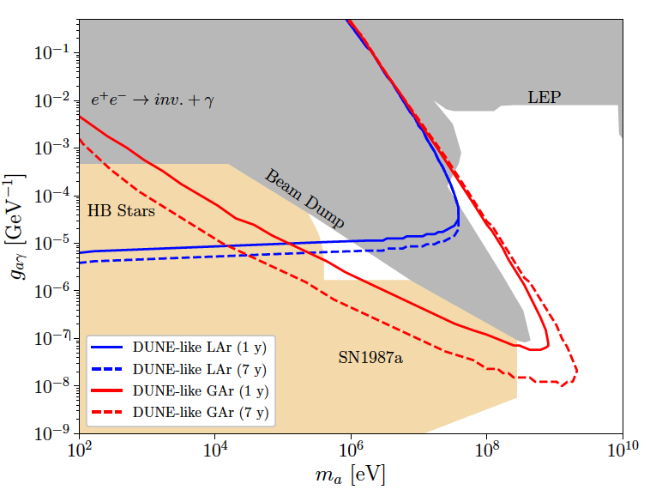
DAMSA Physics Strategy
Photons are sources for dark sector particle production
Use case: Search for Axion-like particles (ALP) in two-photon final state via the Primakoff process
Brdar, Yu et al., PRL126, 201801 (2021)
Produce as many photons as possible in the dump
Capture as many ALPs as possible in as wide a mass range as possible
Mitigate the backgrounds from neutral particles, leveraging two EM particle final states
Place the detector very close to the beam
Note : ND-GAr only in DUNE Phase-II
Focus here

Slide 4
Physics Driven DAMSA Detector
Discover dark sector particles beyond 2γ ALP, such as
Dark photon / ALP to e+e-
Low mass dark matter, etc
Based on the signal and neutron background mitigation studies, using GEANT4 ➔ Detector assumptions
Fine granularity for a superb shower position and angular resolutions for 2 EM particle vertex pointing & DCA precision better than 1cm in the vacuum decay volume
Fast timing capability at sub-ns level (~100ps) for two EM particle arrival time differences
Capability of measuring up to 500 MeV photons with as fine a mass resolution as accomplishable

Slide 5
The Little DAMSA That Could!
The question: Can we access the targeted parameter space with a dramatically smaller scale experiment (2401.09529)?
Further studied the combinations of the following cases
Reduce the detector radius to 0.1m from 1.1m, same depth (10⁻²)
Reduce the vacuum chamber radius and length to 0.1m from 1m (10⁻³)
Reduce the W dump length to 0.5m (case 1) & 0.25m (case 2)
W Dump
L=0.5/0.25m
R=0.5m
Vacuum
L=0.1m,
R=0.1m
Proton
Detector
R=0.1m

Slide 6
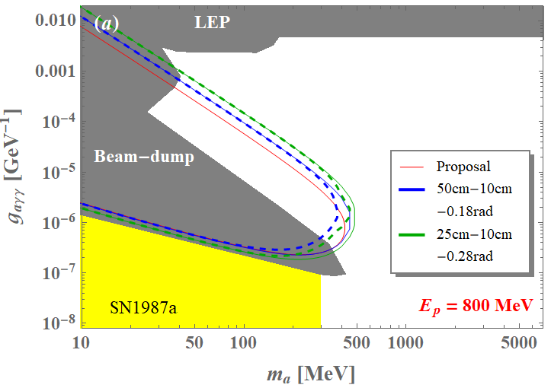
The Little DAMSA Sensitivity
3mo data taking
1m-1m-0.05rad

Slide 7
The Little DAMSA Pilot Experiment!
Goal: Mount and complete a physics demonstrator in the next 2 yrs
Beam: 300MeV e-beams at Fermilab FAST or ESA @ SLAC➔ greatly reduced neutron backgrounds, compared to proton beams
Target: 5cmx5cmx10cm W block (~28.5X₀)
Vacuum decay chamber : 10cm (r) x 30cm (L)
Enable the two EM particles from the vertex in vacuum to be separated
Detector: 6 x 10cmx10cm Si tracker + 44 x 12cmx12cmx1cm (24.5X₀) 4D CsI total absorption ECal
e
W
Detector array
Si trk: 6x 0.1x0.1 m²
ECAL: 44 x 0.12x0.12x0.01 m³
Vacuum
R=0.1m, L=0.3m
Target
0.05x0.05x0.1m³

Slide 8
Conclusions
DUNE is making good progress ➔ Full scale construction to begin now with cryostats followed by the detector in 2026
DAMSA is a DSP search and discovery experiment
DAMSA has been making serious and steady progress
Collaboration building ongoing and in its final stage ➔ half the collaborators are from Korea!!
First beam measurements of background expected in June
Fermilab established a task force to define the facility
Whitepaper released to the archive on PIP-II Beam Dump physics opportunities (2311.09915)
DAMSA presents an excellent opportunity for Korea to take the leadership in DSP search and discovery at beams

