Slide 1
Thermal current distribution
near the surface
in topological states of matter
서울시립대학교
조상우

Slide 2
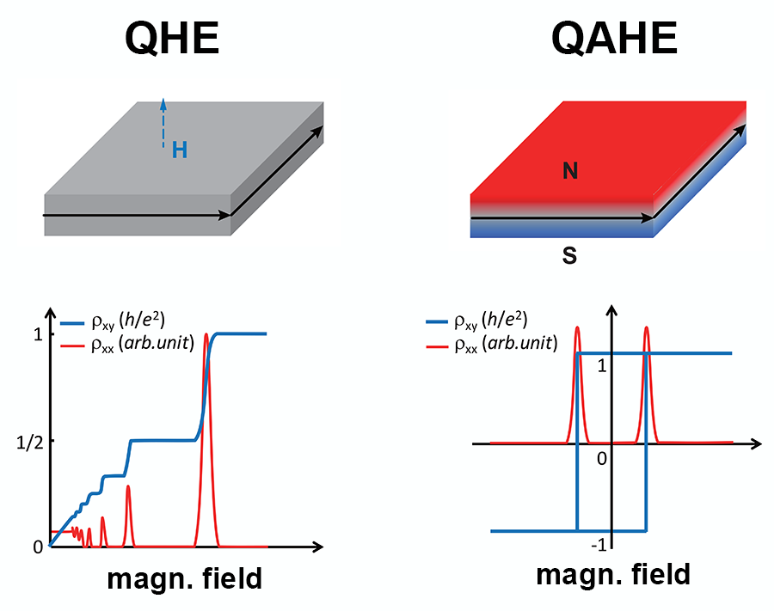
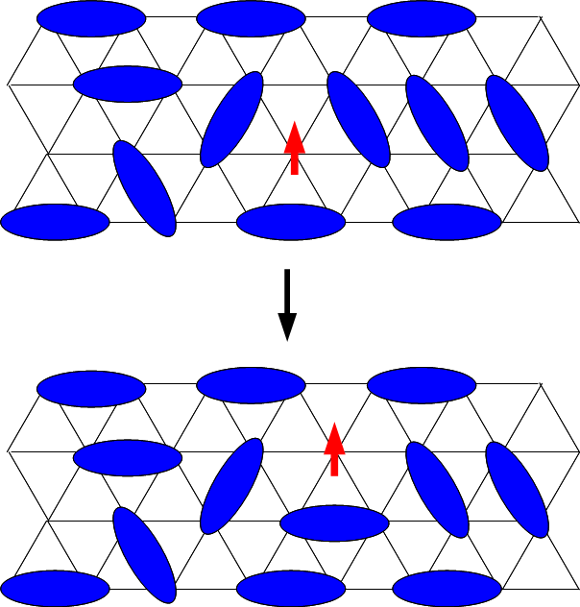
Introduction
Topological materials:
materials whose properties are invariant under topological transformation
그림출처: Bestwick, Andrew J. et al. “A Viewpoint on : Precise Quantization of the Anomalous Hall Effect near Zero Magnetic Field.” (2015).
그림출처: Quantum spin liquid - Wikipedia

Slide 3
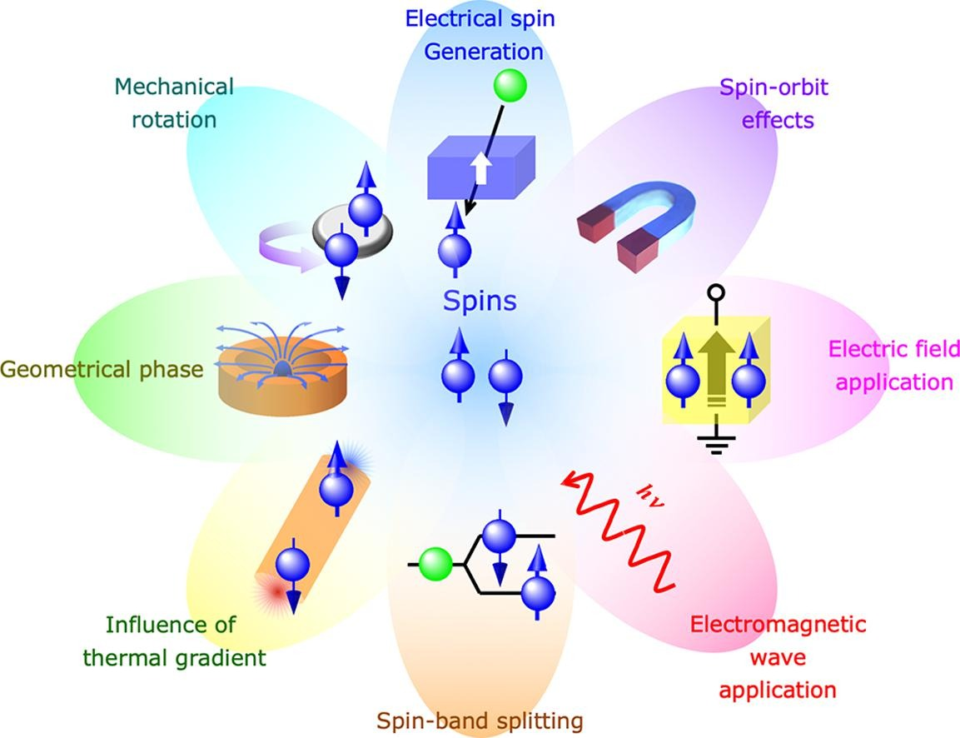
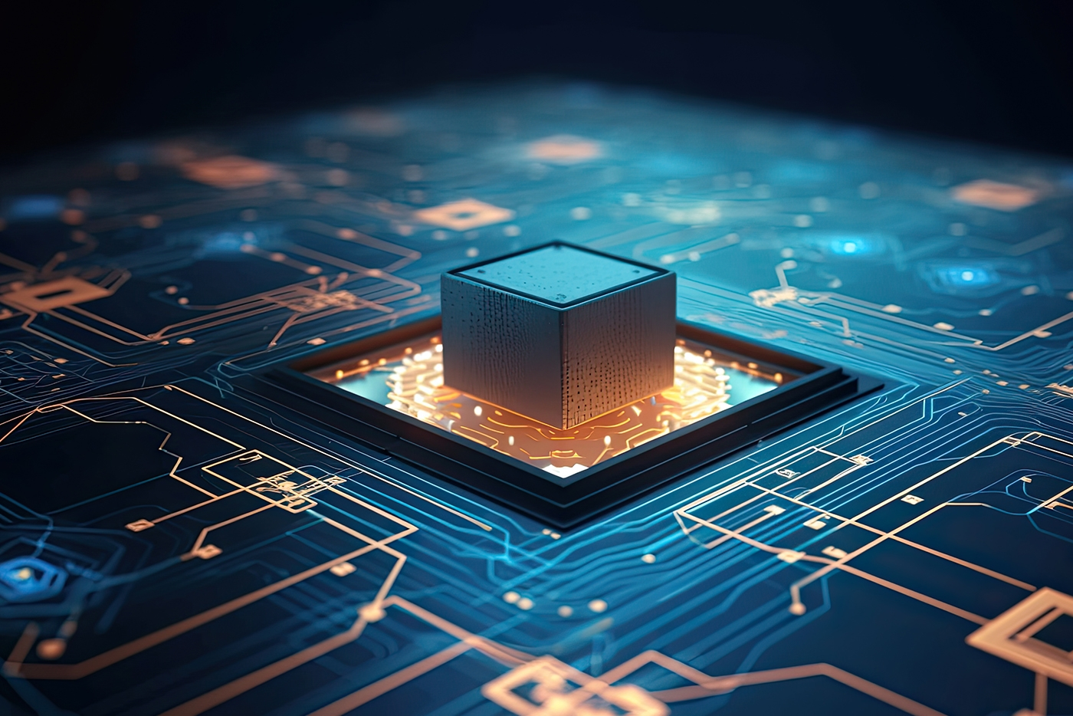
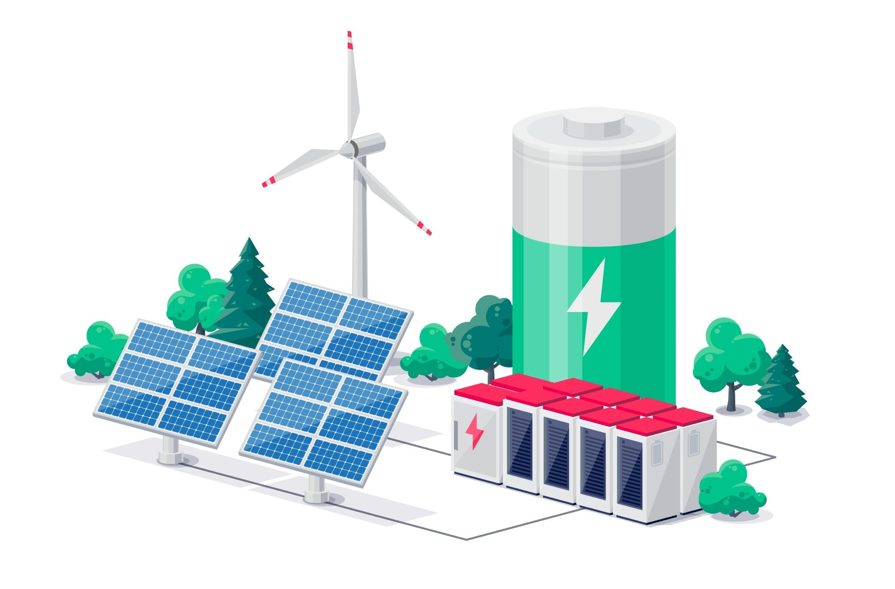
Introduction
Application of Topological materials
Energy Conversion
& Storage
Quantum computing
Spintronics
그림출처: Quantum Computing: What Every CEO Needs to Know | Bernard Marr
A. Hirohata, K. Yamada, Y. Nakatani, I. Prejbeanu, B. Di ́eny, P. Pirro, and B. Hillebrands. Review on spintronics: Principles and device applications. Journal of Magnetism and Magnetic Materials, 509:166711, 2020.38
The Most Recent Developments In Energy Storage Technology (azom.com)

Slide 4
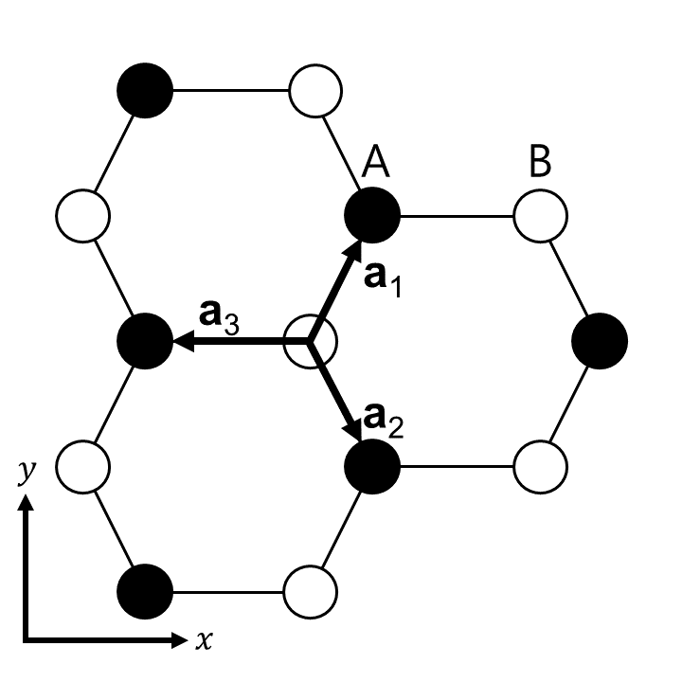
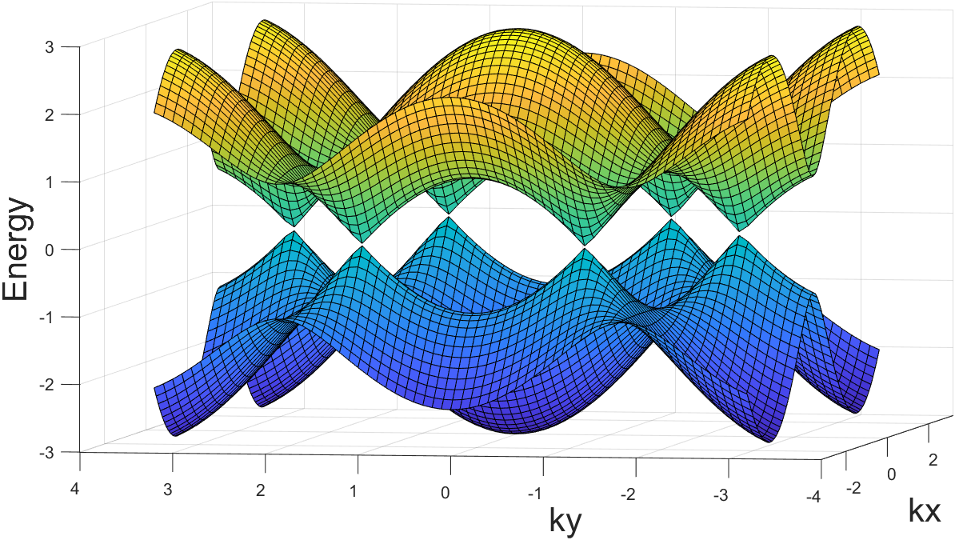
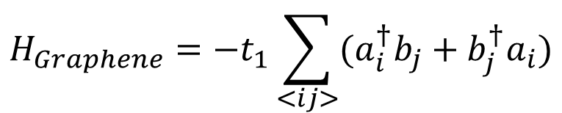
Quantum anomalous Hall effect
$$H_{Graphene}=−t_{1}\sum_{<ij>}{(a_{i}^{†}b_{j}+b_{j}^{†}a_{i})}$$

Slide 5
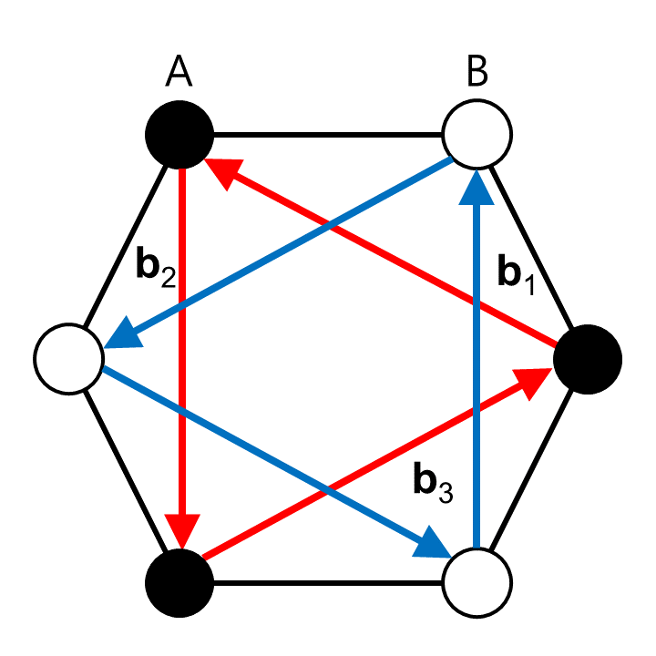
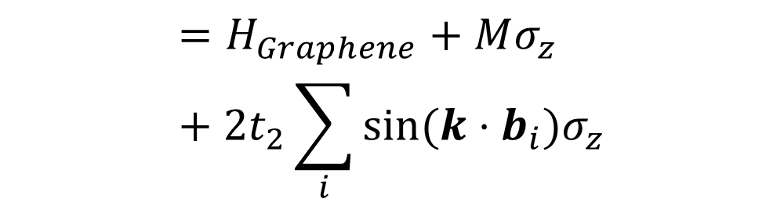
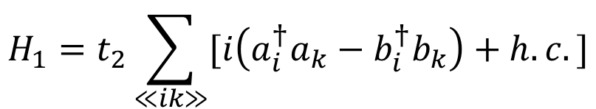
Quantum anomalous Hall effect
$$H_{Haldane}=H_{Graphene}+Mσ_{z}+H_{1}$$
$$=H_{Graphene}+Mσ_{z}+2t_{2}\sum_{i}{sin⁡(k⋅b_{i})σ_{z}}$$
$$H_{1}=t_{2}\sum_{≪ik≫}{[i\left(a_{i}^{†}a_{k}−b_{i}^{†}b_{k}\right)+h.c.]}$$

Slide 6
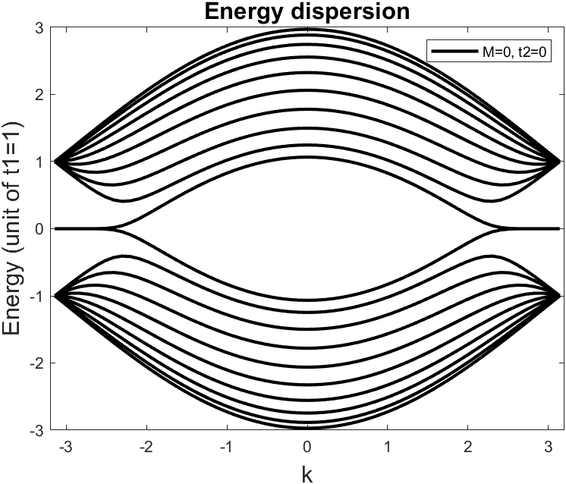

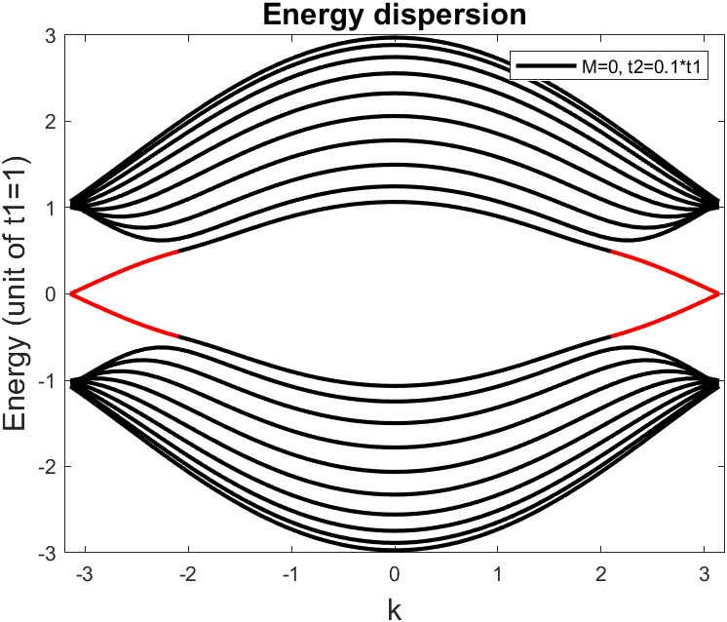
Quantum anomalous Hall effect
Energy dispersion of graphene
(M, t2 = 0)
When M = 0.2*t1, t2 = 0
When t2 = 0.1*t1, M = 0

Slide 7
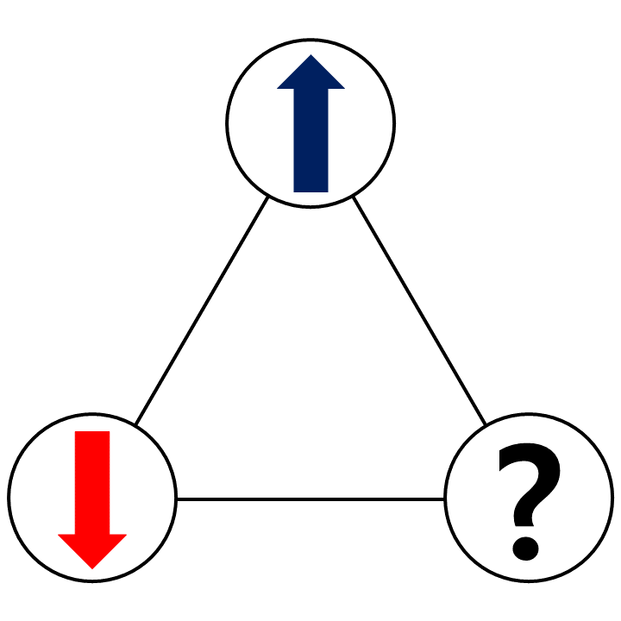
Kitaev quantum spin liquid
Spin Liquid state
Long-range entanglement
Fractional quasiparticle
Frustrated

Slide 8
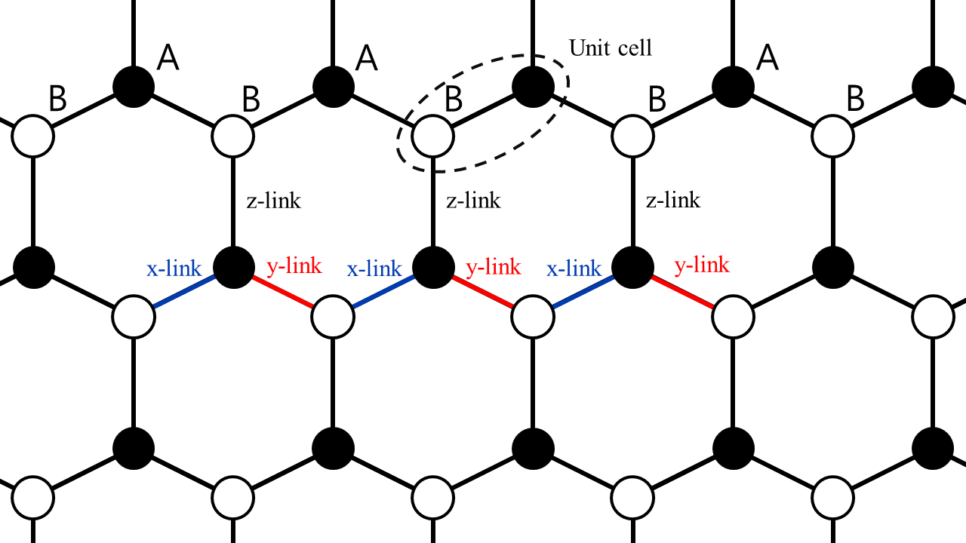
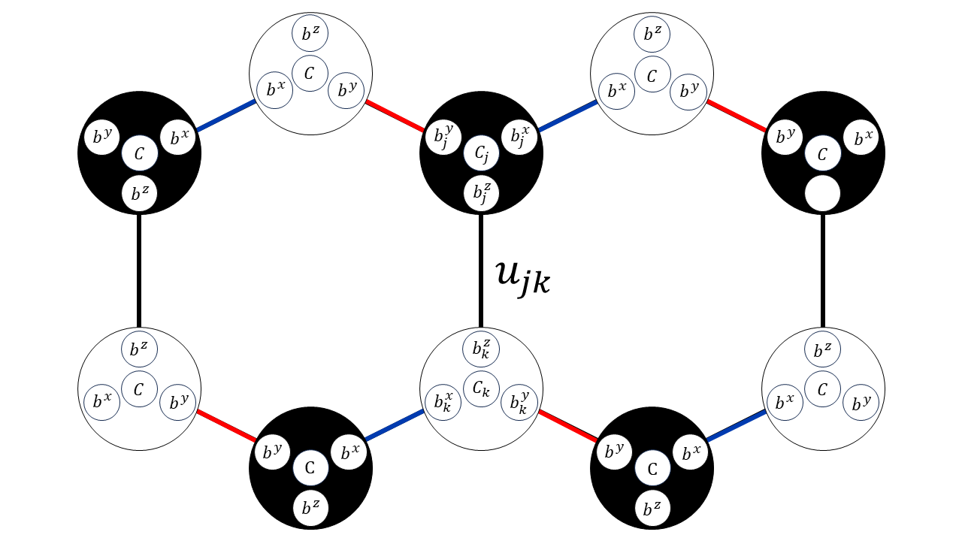

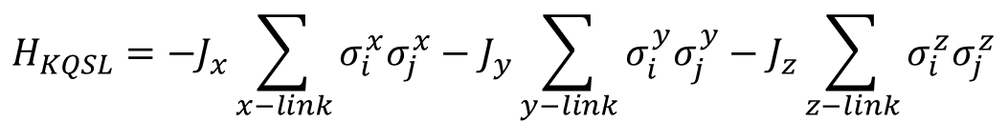
Kitaev quantum spin liquid
$$H_{KQSL}=−J_{x}\sum_{x−link}{σ_{i}^{x}σ_{j}^{x}}−J_{y}\sum_{y−link}{σ_{i}^{y}σ_{j}^{y}}−J_{z}\sum_{z−link}{σ_{i}^{z}σ_{j}^{z}}$$
Majorana representation
$$σ_{i}^{α}=ib_{i}^{α}c_{i}$$

Slide 9

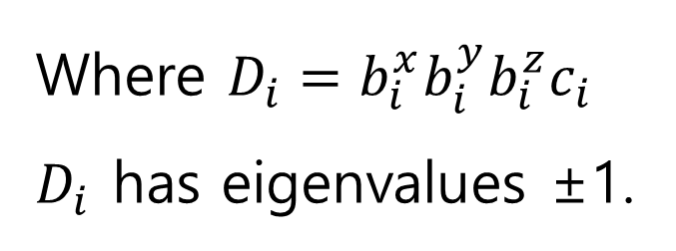


Kitaev quantum spin liquid
Majorana fermion: a fermion that is its own antiparticle (${b^{α}}^{†}=b^{α},$ $c^{†}=c$)
satisfies the spin operator properties:
$$[σ^{α},σ^{β}]=2iε^{αβγ}σ^{γ}$$
$$=2iε^{αβγ}D(ib^{γ}c)$$
$$σ^{α}σ^{β}=−σ^{β}σ^{α}$$
$${(σ^{α})}^{2}=1$$
Where $D_{i}=b_{i}^{x}b_{i}^{y}b_{i}^{z}c_{i}$
$D_{i}$ has eigenvalues ±1.

Slide 10
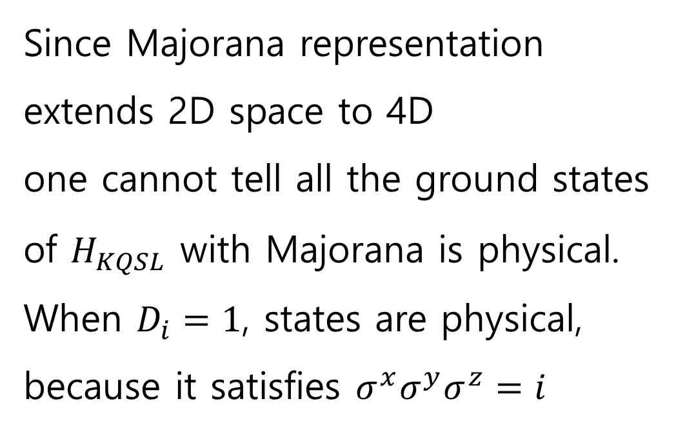
Kitaev quantum spin liquid
Since Majorana representation extends 2D space to 4D
one cannot tell all the ground states of $H_{KQSL}$ with Majorana is physical.
When $D_{i}=1$, states are physical,
because it satisfies $σ^{x}σ^{y}σ^{z}=i$

Slide 11


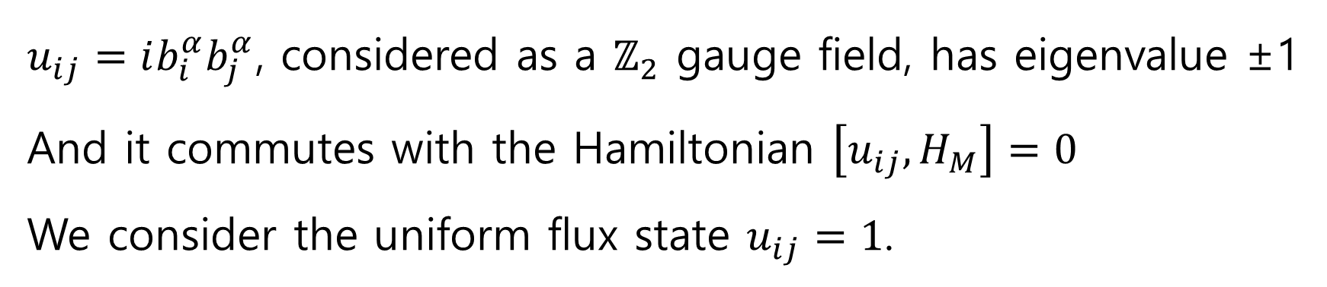
Kitaev quantum spin liquid
The Hamiltonian in Majorana representation(when $J_{x}=J_{y}=J_{z}=J$):
$$H_{M}=−iJ\sum_{{<ij>}_{α}}{u_{ij}c_{i}c_{j}}$$
$u_{ij}=ib_{i}^{α}b_{j}^{α}$, considered as a $ℤ_{2}$ gauge field, has eigenvalue ±1
And it commutes with the Hamiltonian $\left[u_{ij},H_{M}\right]=0$
We consider the uniform flux state $u_{ij}=1$.
$$H_{u.f}=−iJ\sum_{{<ij>}_{α}}{c_{i}c_{j}}$$

Slide 12
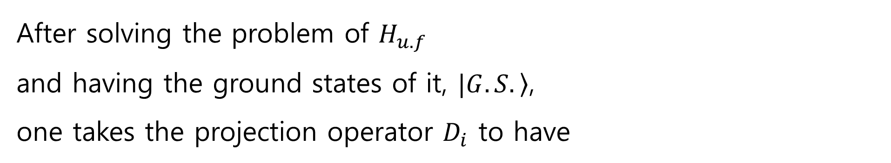
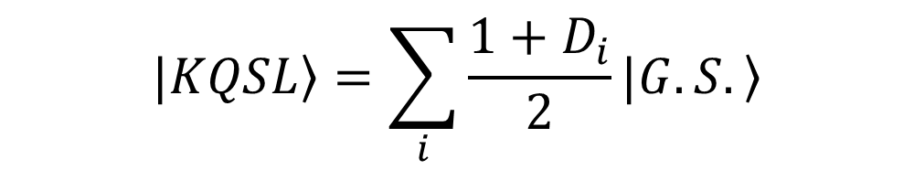
Kitaev quantum spin liquid
After solving the problem of $H_{u.f}$
and having the ground states of it, $\left.|G.S.\right\rangle$,
one takes the projection operator $D_{i}$ to have
$$\left.|KQSL\right\rangle =\sum_{i}{\frac{1+D_{i}}{2}}\left.|G.S.\right\rangle$$

Slide 13
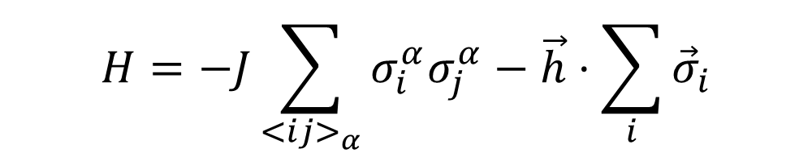
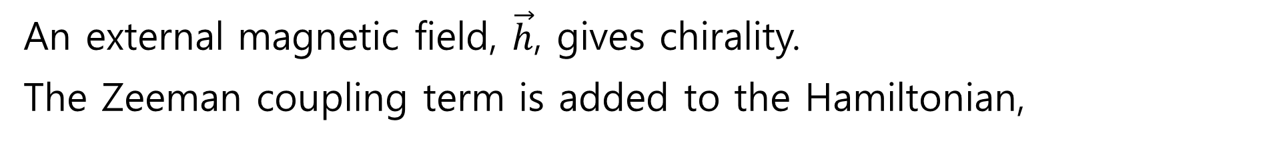


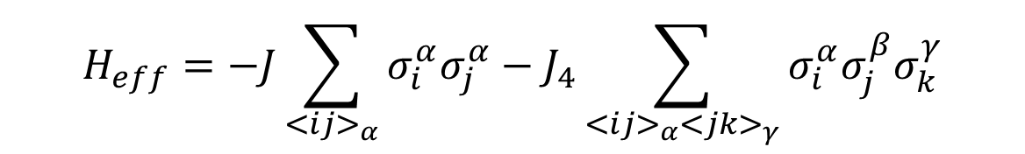
Kitaev quantum spin liquid
An external magnetic field, $\vec{h}$, gives chirality.
The Zeeman coupling term is added to the Hamiltonian,
$$H=−J\sum_{{<ij>}_{α}}{σ_{i}^{α}σ_{j}^{α}}−\vec{h}⋅\sum_{i}{{\vec{σ}}_{i}}$$
It cannot be solved exactly. One takes the Zeeman term perturbatively,
$$H_{eff}=−J\sum_{{<ij>}_{α}}{σ_{i}^{α}σ_{j}^{α}}−J_{4}\sum_{{<ij>}_{α}{<jk>}_{γ}}{σ_{i}^{α}σ_{j}^{β}σ_{k}^{γ}}$$
($J_{4}\sim \frac{h_{x}h_{y}h_{z}}{J}$)
$$=−J\sum_{{<ij>}_{α}}{ic_{i}c_{j}}−J_{4}\sum_{≪ik≫}{ic_{i}c_{k}}$$

Slide 14
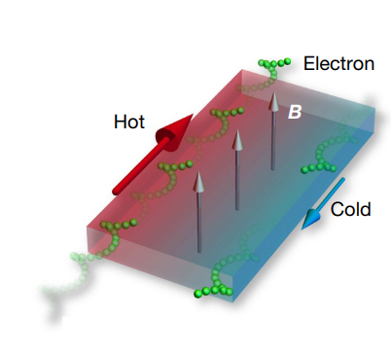
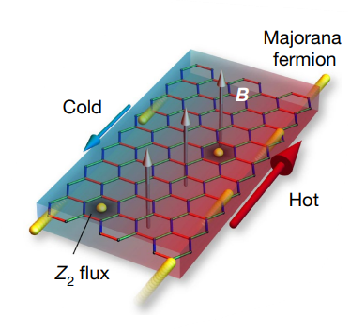
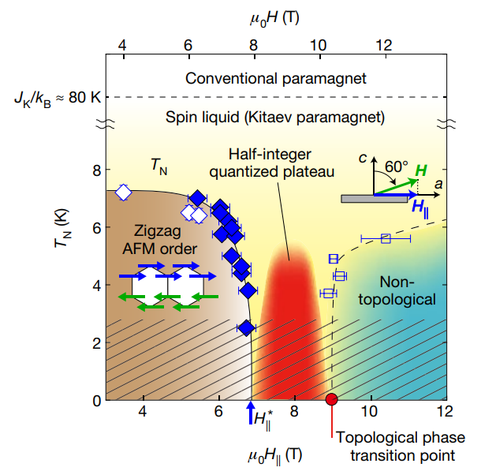
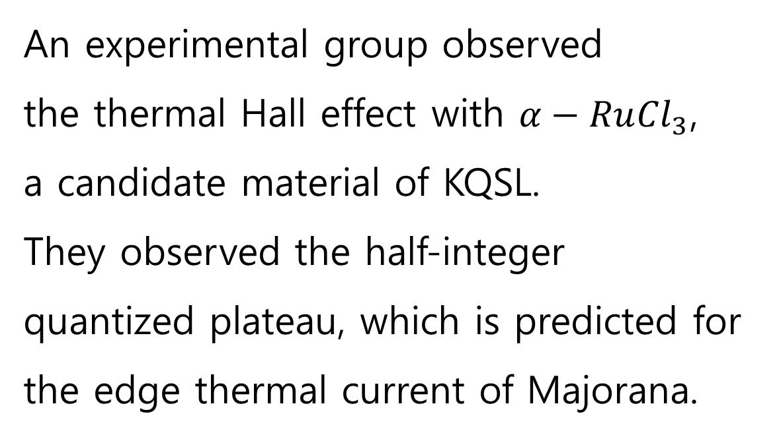
Former experiment
An experimental group observed
the thermal Hall effect with $α−Ru{Cl}_{3}$,
a candidate material of KQSL.
They observed the half-integer quantized plateau, which is predicted for the edge thermal current of Majorana.
그림 출처: Y. Kasahara, T. Ohnishi, Y. Mizukami, O. Tanaka, Sixiao Ma, K. Sugii,
N. Kurita, H. Tanaka, J. Nasu, Y. Motome, T. Shibauchi, and Y. Mat-
suda. Majorana quantization and half-integer thermal quantum hall ef-
fect in a kitaev spin liquid. Nature, 559(7713):227–231, Jul 2018

Slide 15
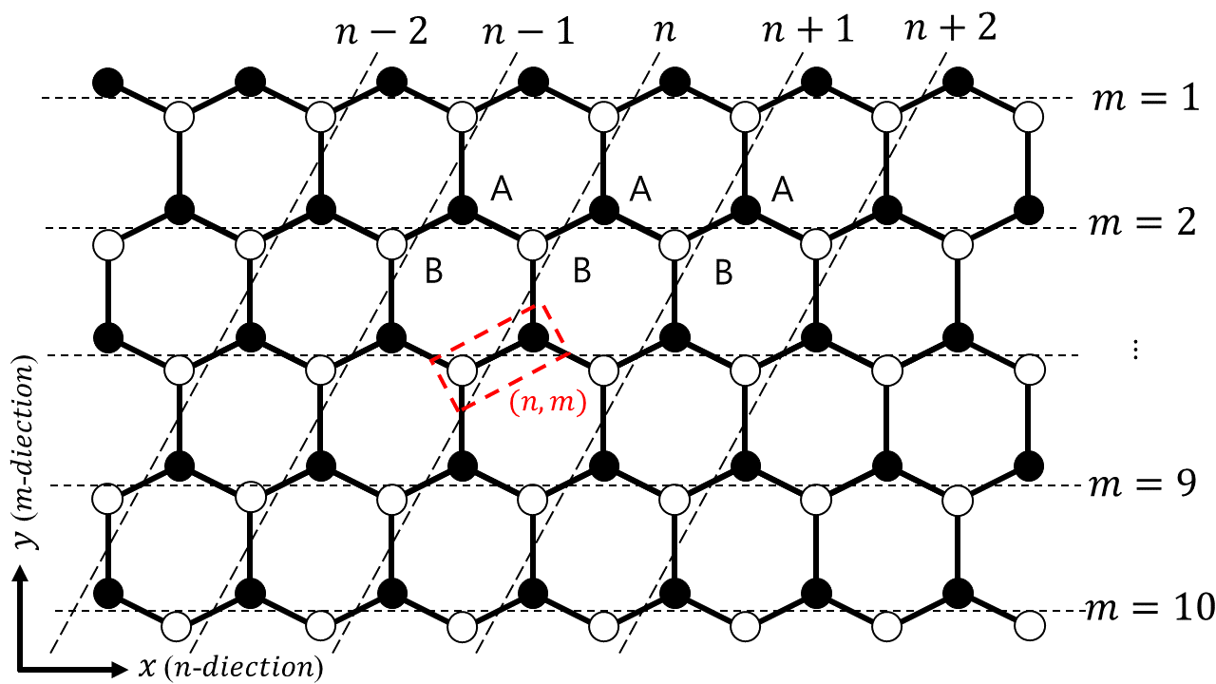
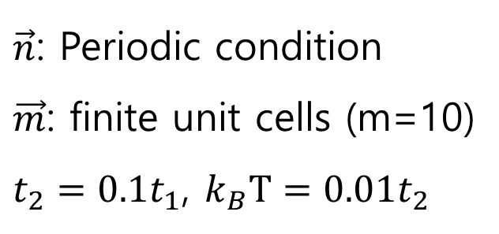
Numerical computation
$\vec{n}$: Periodic condition
$\vec{m}$: finite unit cells (m=10)
$t_{2}=0.1t_{1}$, $k_{B}T={0.01t}_{2}$

Slide 16
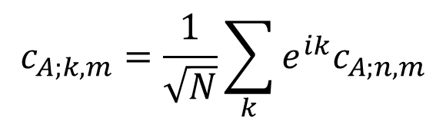
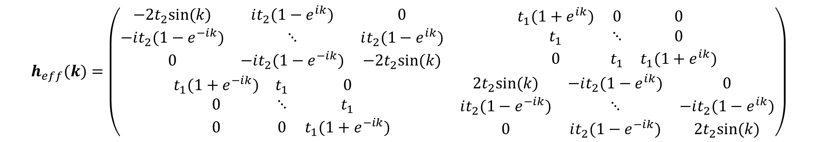
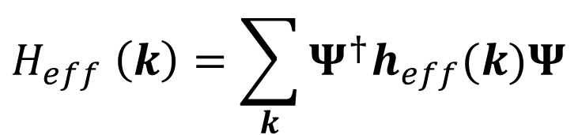
Numerical computation
The Hamiltonian is diagonalized by Fourier transformation
$$c_{A;k,m}=\frac{1}{\sqrt{N}}\sum_{k}{e^{ik}c_{A;n,m}}$$
In the basis of $Ψ={(c_{A;k,1}⋯c_{A;k,10}c_{B;k,1}⋯c_{B;k,10})}^{T}$
$$H_{eff} \left(k\right)=\sum_{k}{Ψ^{†}h_{eff}(k)Ψ}$$
$$h_{eff}(k)=\left(\begin{matrix}\begin{matrix}−2t_{2}sin⁡(k) & it_{2}(1−e^{ik}) & 0 \\ −it_{2}(1−e^{−ik}) & ⋱ & it_{2}(1−e^{ik}) \\ 0 & −it_{2}(1−e^{−ik}) & −2t_{2}sin⁡(k)\end{matrix} & \begin{matrix}t_{1}(1+e^{ik}) & 0 & 0 \\ t_{1} & ⋱ & 0 \\ 0 & t_{1} & t_{1}(1+e^{ik})\end{matrix} \\ \begin{matrix}t_{1}(1+e^{−ik}) & t_{1} & 0 \\ 0 & ⋱ & t_{1} \\ 0 & 0 & t_{1}(1+e^{−ik})\end{matrix} & \begin{matrix}2t_{2}sin⁡(k) & −it_{2}(1−e^{ik}) & 0 \\ it_{2}(1−e^{−ik}) & ⋱ & −it_{2}(1−e^{ik}) \\ 0 & it_{2}(1−e^{−ik}) & 2t_{2}sin⁡(k)\end{matrix}\end{matrix}\right)$$

Slide 17
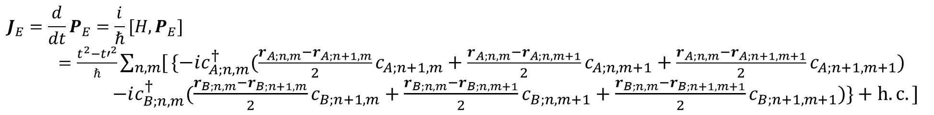
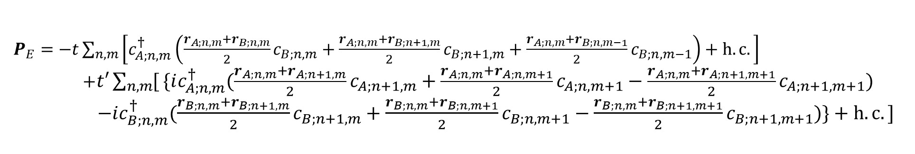
Numerical computation
Energy current operator is defined with energy polarization
$P_{E}=−t\sum_{n,m}{\left[c_{A;n,m}^{†}\left(\frac{r_{A;n,m}+r_{B;n,m}}{2}c_{B;n,m}+\frac{r_{A;n,m}+r_{B;n+1,m}}{2}c_{B;n+1,m}+\frac{r_{A;n,m}+r_{B;n,m−1}}{2}c_{B;n,m−1}\right)+h.c.\right]}$
$+t′\sum_{n,m}{[}\{ic_{A;n,m}^{†}(\frac{r_{A;n,m}+r_{A;n+1,m}}{2}c_{A;n+1,m}+\frac{r_{A;n,m}+r_{A;n,m+1}}{2}c_{A;n,m+1}−\frac{r_{A;n,m}+r_{A;n+1,m+1}}{2}c_{A;n+1,m+1})$
$−ic_{B;n,m}^{†}(\frac{r_{B;n,m}+r_{B;n+1,m}}{2}c_{B;n+1,m}+\frac{r_{B;n,m}+r_{B;n,m+1}}{2}c_{B;n,m+1}−\frac{r_{B;n,m}+r_{B;n+1,m+1}}{2}c_{B;n+1,m+1})\}+h.c.]$
Where $r_{A/B;n,m}$ is a position vector of site A/B
$$J_{E}=\frac{d}{dt}P_{E}=\frac{i}{ℏ}[H,P_{E}]$$
$=\frac{t^{2}−{t′}^{2}}{ℏ}\sum_{n,m}{[}\{−ic_{A;n,m}^{†}(\frac{r_{A;n,m}−r_{A;n+1,m}}{2}c_{A;n+1,m}+\frac{r_{A;n,m}−r_{A;n,m+1}}{2}c_{A;n,m+1}+\frac{r_{A;n,m}−r_{A;n+1,m+1}}{2}c_{A;n+1,m+1})$
$−ic_{B;n,m}^{†}(\frac{r_{B;n,m}−r_{B;n+1,m}}{2}c_{B;n+1,m}+\frac{r_{B;n,m}−r_{B;n,m+1}}{2}c_{B;n,m+1}+\frac{r_{B;n,m}−r_{B;n+1,m+1}}{2}c_{B;n+1,m+1})\}+h.c.]$
$j_{E}^{(n,m)}=\frac{t^{2}−{t^{′}}^{2}}{ℏ}[\{−ic_{A;n,m}^{†}(\frac{r_{A;n,m}−r_{A;n+1,m}}{2}c_{A;n+1,m}+\frac{r_{A;n,m}−r_{A;n,m−1}}{2}c_{A;n,m−1}+\frac{r_{A;n,m}−r_{A;n+1,m+1}}{2}c_{A;n+1,m+1})$
$−i c_{B;n,m}^{†}(\frac{r_{B;n,m}−r_{B;n+1,m}}{2}c_{B;n+1,m}+\frac{r_{B;n,m}−r_{B;n,m−1}}{2}c_{B;n,m−1}+\frac{r_{B;n,m}−r_{B;n+1,m+1}}{2}c_{B;n+1,m+1})\}+h.c.]$

Slide 18
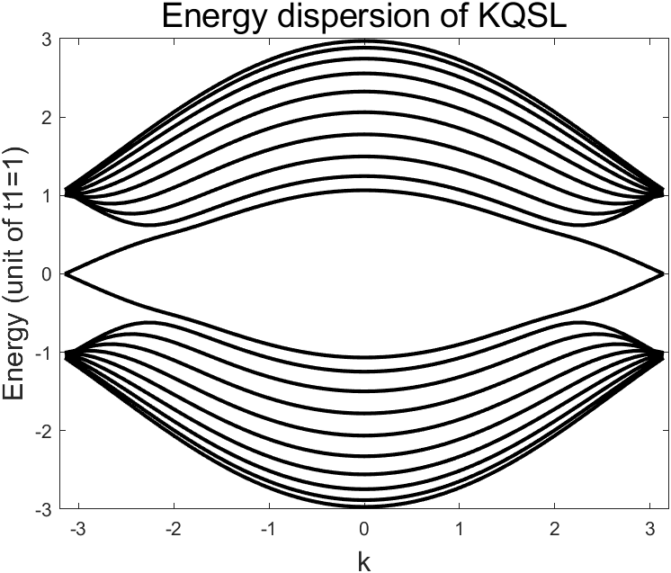
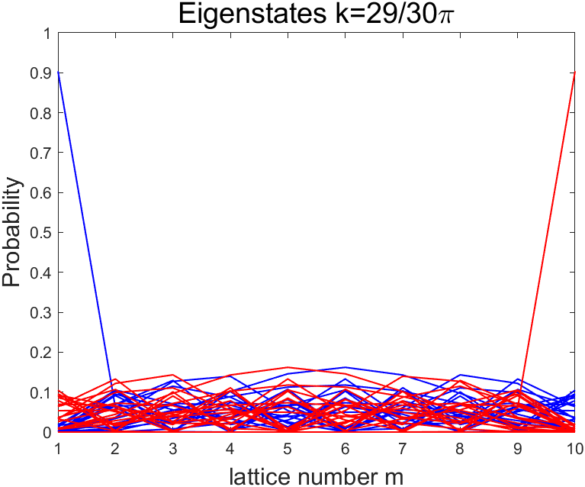
Numerical computation

Slide 19
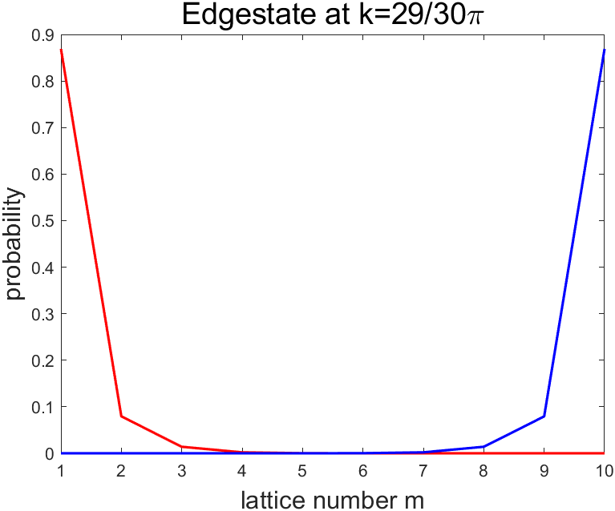
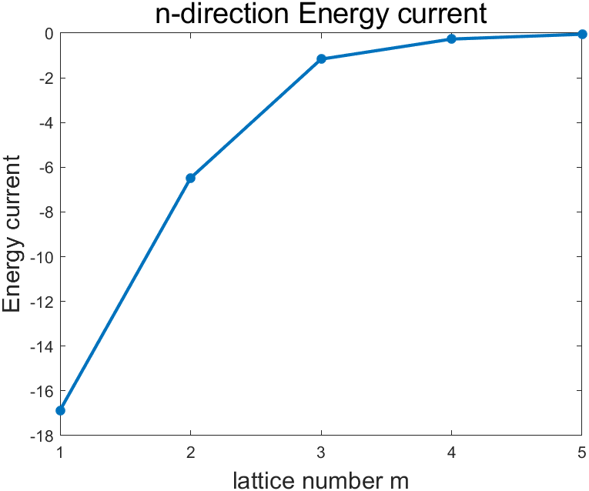
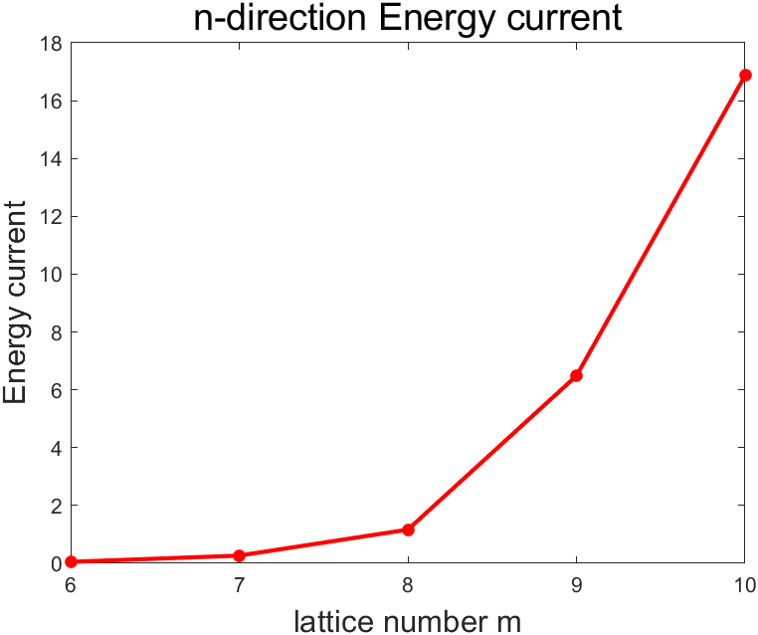
Numerical computation
Edge state
The energy current distribution.
We can verify at the edges the currents flow opposite direction.
Also, we can see that the currents decrease as it goes to bulk.

Slide 20
Summary
Numerical computation of thermal energy current of two different topological states.
We verify
the currents flowing at the edges
and further the distribution of the
current by numerical computation.

Slide 21
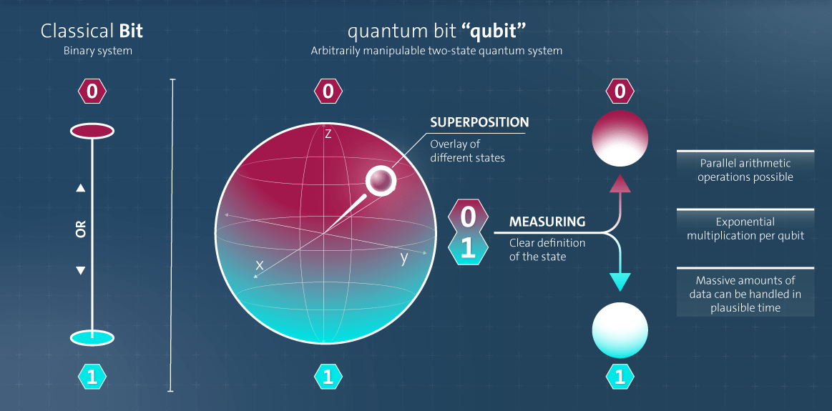
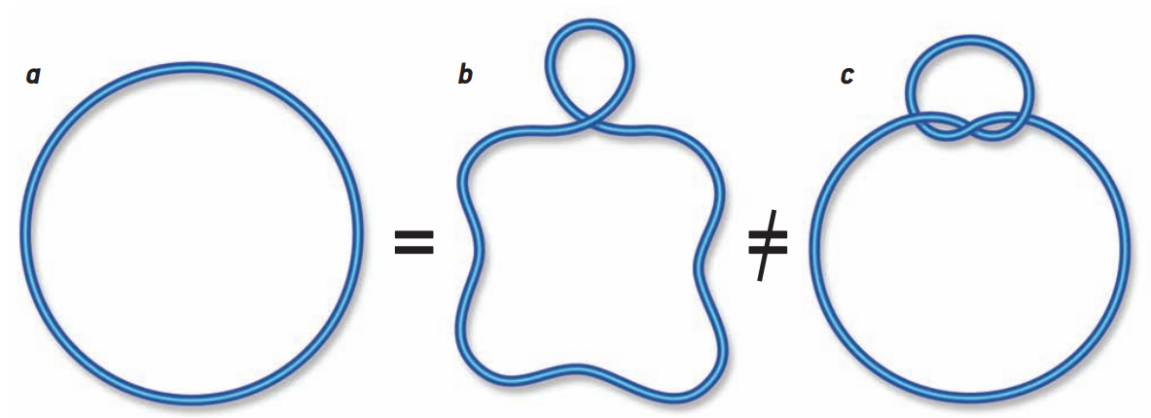
Discussion
그림출처: https://devopedia.org/images/article/376/3669.1640606814.svg
Graham P Collins. Computing with quantum knots. Scientific American, 294(4):56–63, 2006

Slide 22
Question?

