Slide 1
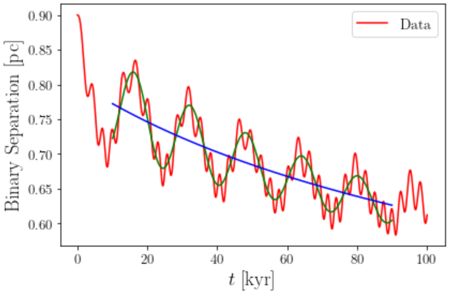
$$D\left(t\right)=D_{1}\left(t\right)+a_{0}e^{−a_{1}t}\cos\left(a_{2}t+a_{3}\right)+b_{0}\cos\left(b_{1}t+b_{2}\right)$$
$$\frac{1}{D_{1}}\frac{dD_{1}}{dt}=−\frac{Q_{0}D_{1}^{3}}{1+B_{0}D_{1}^{3}} ⇒ Q_{0}\left(t−t_{I}\right)=\frac{1}{3}\left(\frac{1}{D_{1}^{3}}−\frac{1}{D_{10}^{3}}\right)+B_{0}\ln{\frac{D_{10}}{D_{1}}}$$

Slide 2
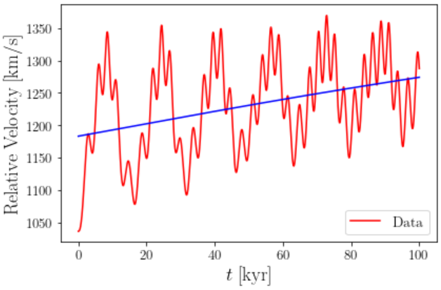
$$\frac{1}{D_{1}}\frac{dD_{1}}{dt}=−\frac{Q_{0}D_{1}^{3}}{1+B_{0}D_{1}^{3}} ⇒ Q_{0}\left(t−t_{0}\right)=\frac{1}{3}\left(\frac{1}{D_{1}^{3}}−\frac{1}{D_{0}^{3}}\right)+B_{0}\ln{\frac{D_{0}}{D_{1}}}$$
For small $B_{0}D_{1}^{3}$, $D_{1}\left(t\right)≅D_{0}{\left\{1+3Q_{0}D_{0}^{3}\left(t−t_{0}\right)\right\}}^{−\frac{1}{3}}$.
$$v_{rel}=\sqrt{\frac{2GM\left(1+4B_{0}D_{1}^{3}\right)}{D_{1}}}$$

Slide 3
Using $B_{0}$ we got, we perturbatively expanded as below:
$$D_{1}\left(t\right)≅D_{0}^{\left(1\right)}{\left\{1+3Q_{0}^{\left(1\right)}{\left(D_{0}^{\left(1\right)}\right)}^{3}\left(t−t_{0}\right)\right\}}^{−\frac{1}{3}}$$
$$Q_{0}^{\left(2\right)}\left(t−t_{0}\right)=\frac{1}{3}\left\{\frac{1}{D_{1,new}^{3}}−\frac{1}{{\left(D_{0}^{\left(2\right)}\right)}^{3}}\right\}+B_{0}\ln{\frac{D_{0}^{\left(1\right)}}{D_{1,old}}}$$
$$D_{1,new}\left(t\right)=D_{0}^{\left(2\right)}\left[1+{\left(D_{0}^{\left(2\right)}\right)}^{3}\left\{3Q_{0}^{\left(2\right)}\left(t−t_{0}\right)−B_{0}\ln\left(1+3Q_{0}^{\left(1\right)}{\left(D_{0}^{\left(1\right)}\right)}^{3}\left(t−t_{0}\right)\right)\right\}\right]$$
Now, $D_{0}^{\left(2\right)}$ and $Q_{0}^{\left(2\right)}$ are fitting parameters via $B_{0}$ now!

Slide 4
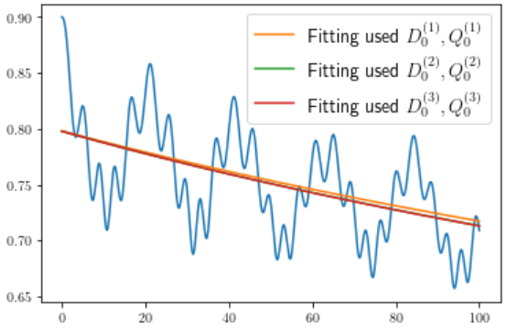
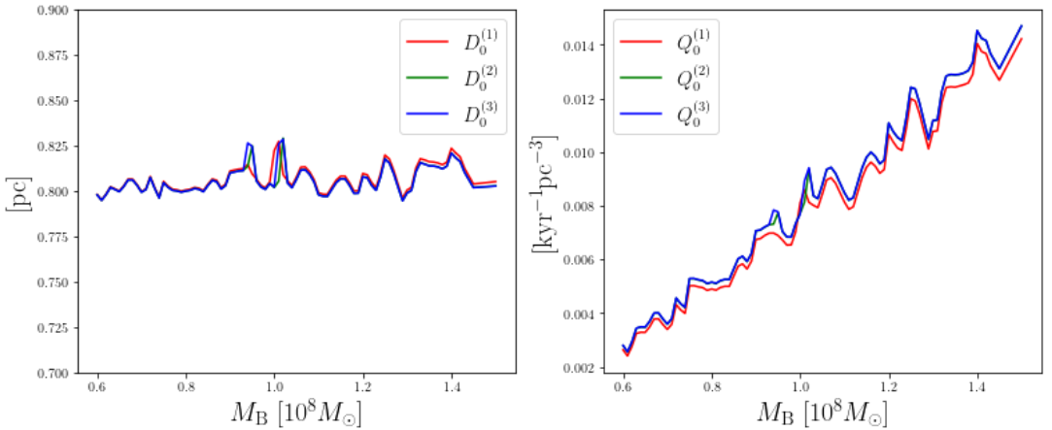
We don’t have to doubt that $D_{0}≅0.8pc$!

Slide 5
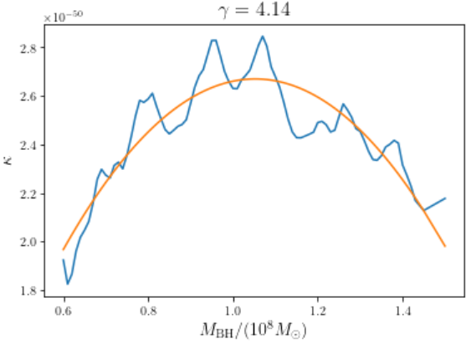
$$Q_{0}\left(M_{BH}\right)=κ\frac{{\left(M_{S}+2γM_{BH}\right)}^{6}}{M_{BH}} \left(M_{S}={10}^{9}M_{⊙} for ours\right)$$
$$κ=κ_{0}\left\{1+α \left(\frac{M_{BH}}{{10}^{8}M_{⊙}}−0.6\right)\left(\frac{M_{BH}}{{10}^{8}M_{⊙}}−1.5\right)\right\}$$
$$κ_{0}≅1.96689752\frac{1}{{\left({10}^{10}M_{⊙}\right)}^{5}[kyr⋅{pc}^{3}]}$$
$$α≅−1.765$$
$$γ≅4.14$$

Slide 6
