Slide 1
FDM Halo Mass $M_{S}={10}^{10}M_{⊙} \left(Fixed\right)$
Particle Mass $M_{P}=\left(0.6\sim 1.5\right)×{10}^{9}M_{⊙}$
Initial Separation = 9pc
Time Duration = 1Myr (1000kyr)
Box Size = 401pc
Unit Cell Size = 0.802pc

Slide 2
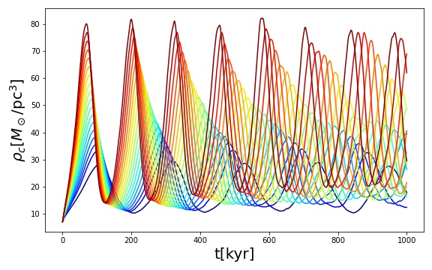
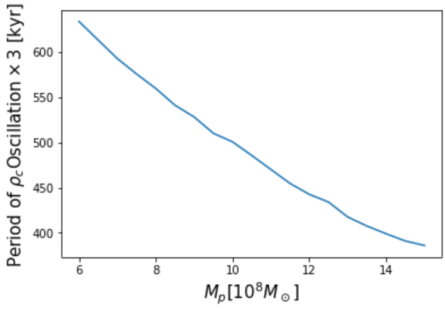
$$M_{tot}=M_{S}+2γM_{P}$$
The gravitational cooling timescale $τ$ of total system of mass $M_{tot}$ has a relation as:
$$τ∝\frac{1}{M_{tot}^{2}}$$
The oscillational period of $ρ_{c}$ is proportional to $τ$ with:
$$γ=2.001±0.023$$

Slide 3
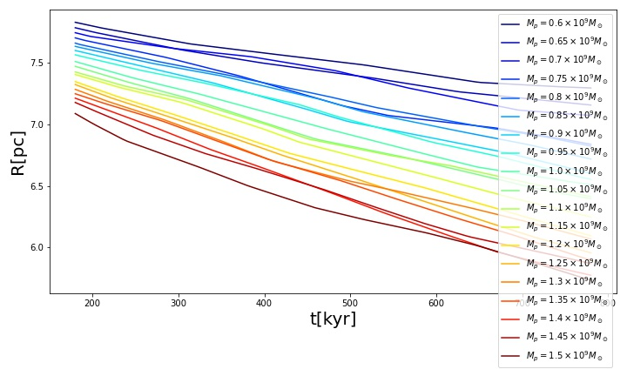
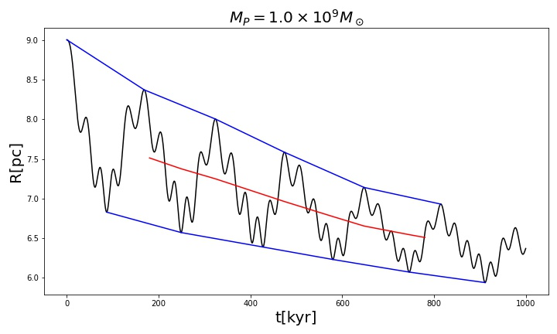
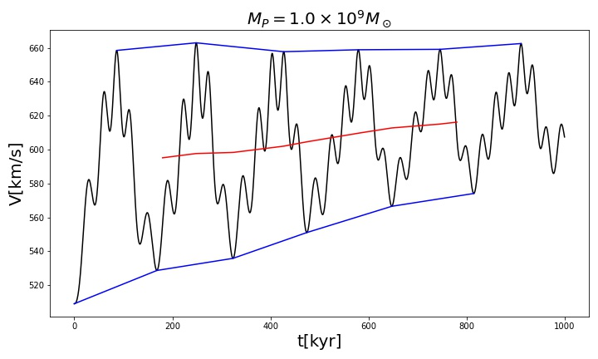
Some Complicated Analytic Calculation…
$$\frac{dR}{dt}=−\frac{B}{T_{0}}\frac{R^{4}}{R_{0}^{3}} → R\left(t\right)=R_{0}{\left(1+\frac{3B}{T_{0}}t\right)}^{−\frac{1}{3}}$$
(Initial Time is moved to $t_{0}=180kyr$)
Fits very well : $\frac{δ_{R_{0}}}{R_{0}}\sim O\left({10}^{−3}\right)$, $\frac{δ_{B/T_{0}}}{B{/T}_{0}}\sim O\left({10}^{−2}\right)$

Slide 4
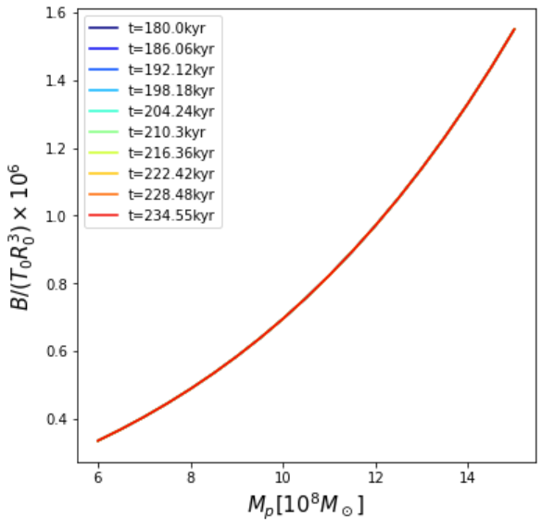
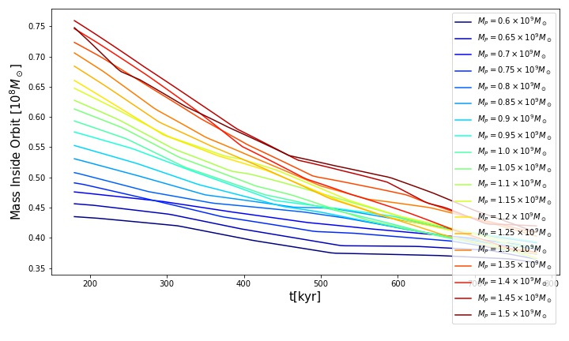
Some Complicated Analytic Calculation…
$$R\left(t\right)=R_{0}{\left(1+\frac{3B}{T_{0}}t\right)}^{−\frac{1}{3}}$$
$$\frac{B}{T_{0}R_{0}^{3}}=κ\frac{{\left(M_{S}+2γM_{BH}\right)}^{6}}{M_{BH}+4ΔM_{S}}$$
($ΔM_{S}$ is the mass of FDM halo inside the orbit!)
Not very significant for $B/T_{0}R_{0}^{3}$…

