Slide 1
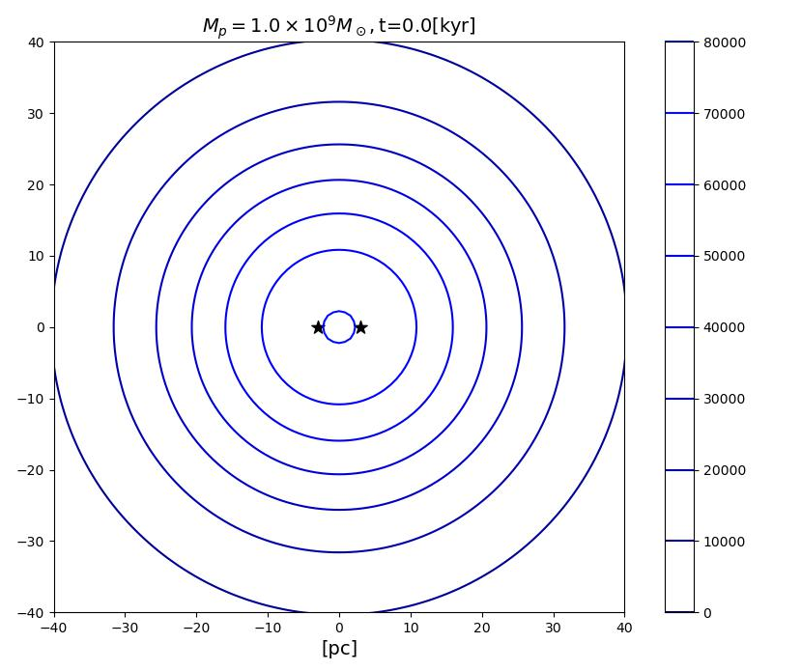
$M_{Sol}={10}^{10}M_{⊙}$
$$ρ_{c}=7.05×{10}^{4}M_{⊙}/{pc}^{3}$$
$$r_{12}=33.5pc$$
$M_{BH}={10}^{9}M_{⊙}$
Initial Separation $R=9pc$
Resolution $Δx=\frac{L}{N}=\frac{401pc}{500}=0.802pc$

Slide 2
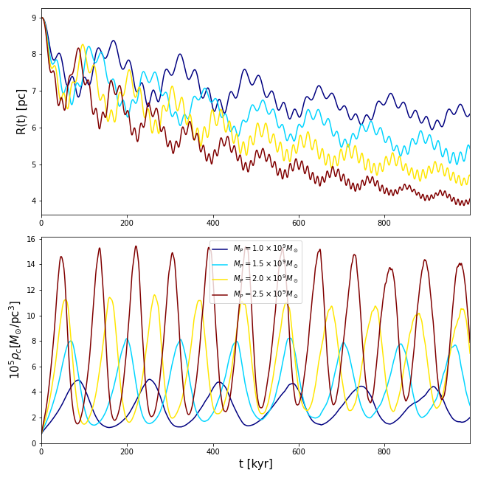
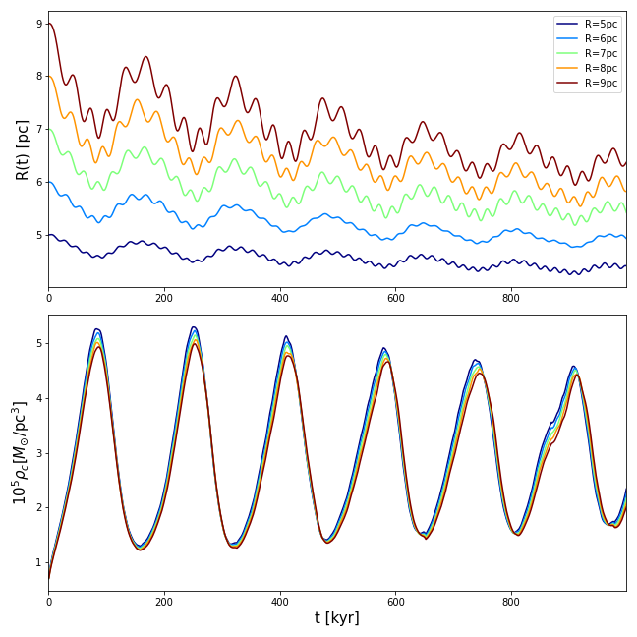
Varying Particle Mass
Varying Initial Separation

