Slide 1
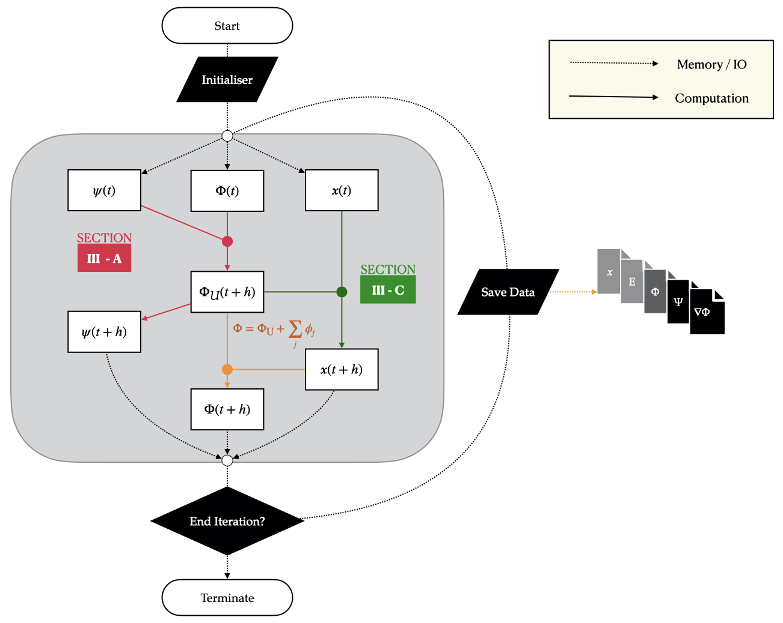
PyUltraLight2 : Modified version of PyUltralight that enables the gravitational interaction of Fuzzy Dark Matter with N-body Particle!
N-body particles have a softening kernel:
$$Φ_{i}\left(\vec{x}\right)=−\frac{GM_{i}}{\sqrt{r_{i}^{2}+ε^{2}}}$$
We can apply Sponge Boundary Condition! (For original PyUltraLight, Periodic Boundary Condition is only available.)

Slide 2
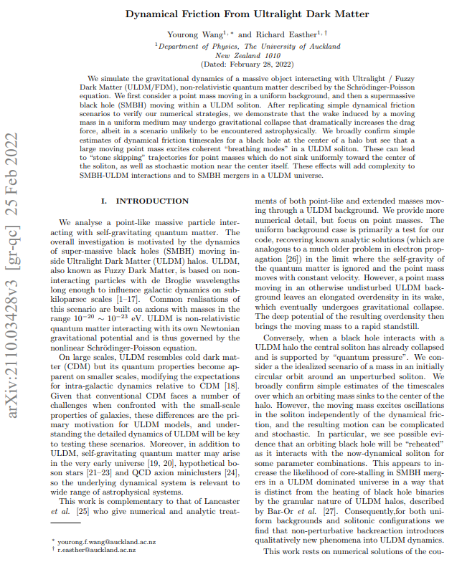
He is also the advisor of Faber Edwards, the creator of the original PyUltraLight code, at the University of Auckland.
WE CAN TRUST THIS CODE!!!

Slide 3
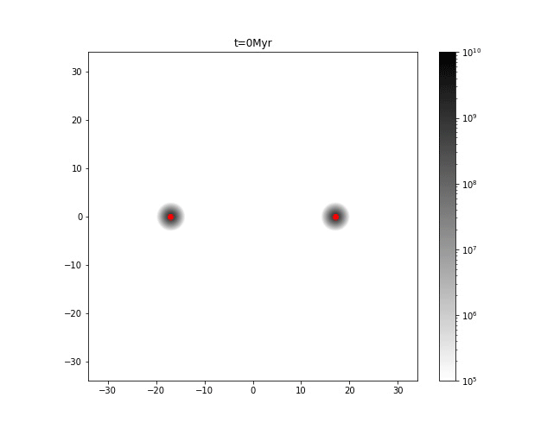
Test : Put 1 particle for each FDM halo in my previous work!
Box Size : 68kpc
Initial Distance : 34kpc
$M_{Tot}=M_{FDM}+M_{Particle}=2π×{10}^{8}M_{⊙}$
For $M_{FDM}:M_{Particle}=6:4$…
$$v_{i}=100km/s$$
$$v_{i}=50km/s$$

Slide 4
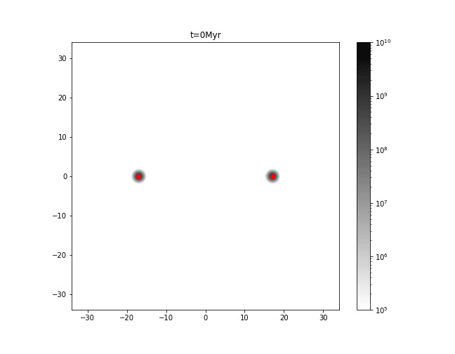
For $M_{FDM}:M_{Particle}=99:1$…
The separation of N-body particle from FDM halo is very noteworthy.

Slide 5
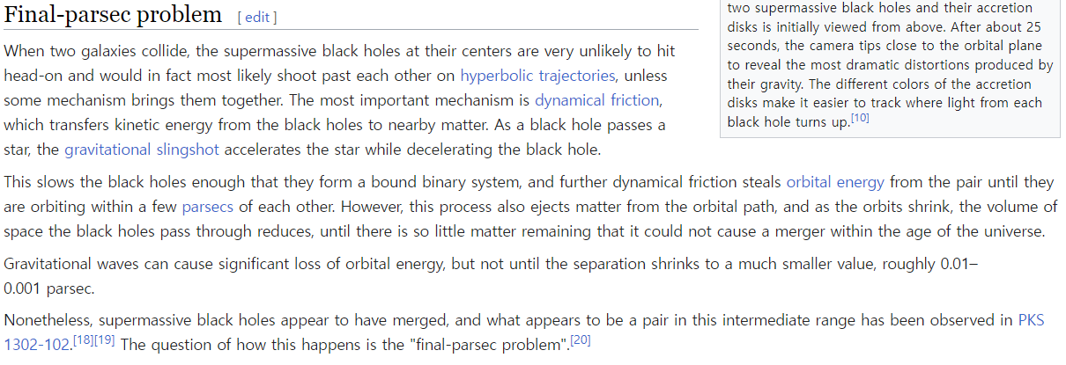
The orbital radius of Binary Black Hole is reduced by gravitational cooling of Fuzzy Dark Matter?

