Slide 1
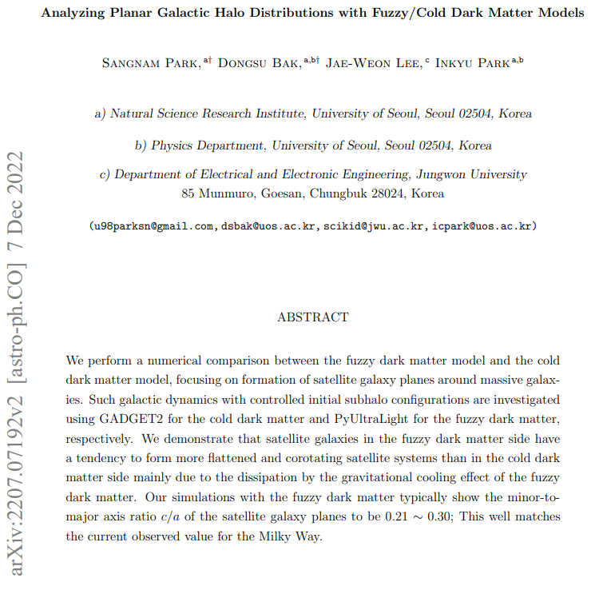
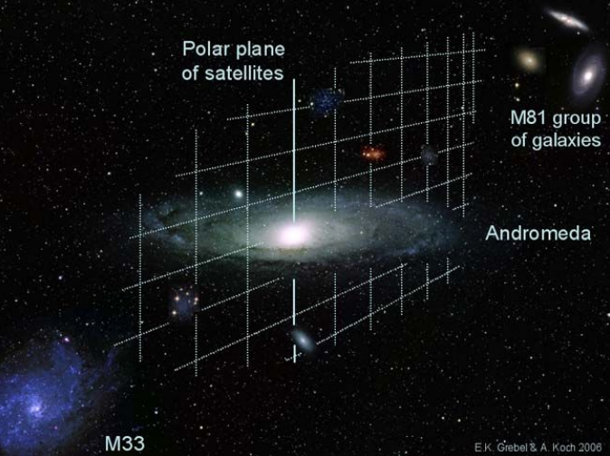

Slide 2
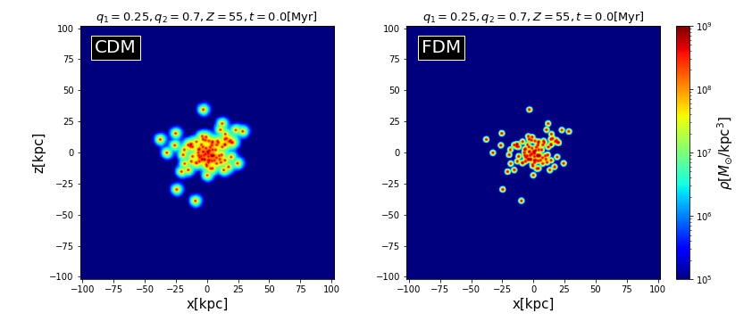
Each Planar System has a quantity of:
Number of Halo(Hernquist Profile Seed) : 100
Each mass of Halo(Seed) : $π×{10}^{8}M_{⊙}$
Profile of System : Plummer Profile $ρ\left(r\right)=\frac{3M_{0}}{4πa^{3}}{\left(1+\frac{r^{2}}{a^{2}}\right)}^{−5/2}$
Half-Light Radius of System : $a=13.6kpc$
Radius Cut of System : $R_{max}=40.8kpc$

Slide 3
$${\vec{v}}_{ini}=q_{1}{\vec{v}}_{P}+q_{2}{\vec{v}}_{±}$$
$Z=51, 52, 53, 54, 55$
Whatever, the spin param. $λ≡\frac{J_{tot}{\left|E_{tot}\right|}^{1/2}}{GM_{tot}^{5/2}}≅0.0422±0.005$
Random Velocity of Equilibrium Plummer Model
$$q_{1}=0.25, 0.3, 0.35, 0.4, 0.45$$
Rotational Velocity
${\vec{v}}_{+}=\sqrt{\frac{GM\left(r\right)}{r}}sinθ\hat{φ}$ for $Z$ particles
${\vec{v}}_{−}=−\frac{1}{2}\sqrt{\frac{GM\left(r\right)}{r}}sinθ\hat{φ}$ for $100−Z$ particles
$$q_{2}=0.7, 0.75$$

Slide 4
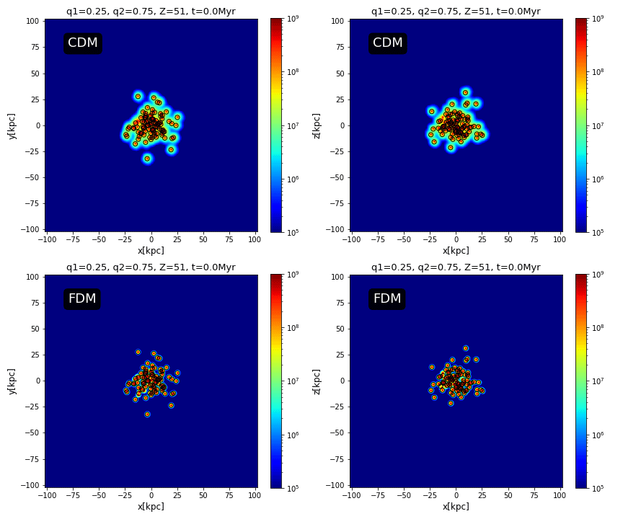
Boxsize=204kpc
Resolution=900
I got coordinates of each cell whose density is larger than ${10}^{7}M_{⊙}/{kpc}^{3}$, in other words, $M_{cell}≥{10}^{7}×{\left(\frac{204}{900}\right)}^{3}M_{⊙}≅1.164×{10}^{6}M_{⊙}$.
Then, clustered with DBSCAN algorithm: linking length 1.4kpc and minimum particles per each cluster 10(Except Centroid).
Black circles are the center of each clusters.

Slide 5
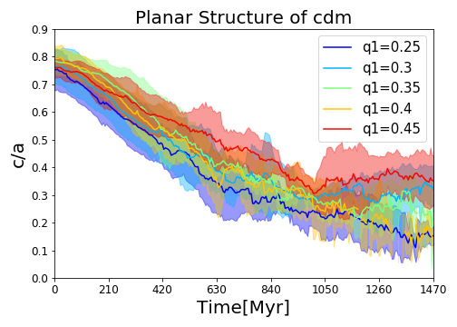
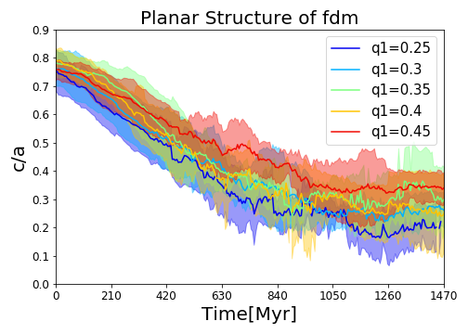
I got the ellipticity from the eigenvalue of Inertia Tensor given as: $$I_{ij}=\frac{1}{N}\sum_{k}{x_{i}^{\left(k\right)}x_{j}^{\left(k\right)}} ⇒ \frac{c}{a}=\frac{\sqrt{min\left(eigenvalues\right)}}{\sqrt{max\left(eigenvalues\right)}}$$

Slide 6
