Slide 1
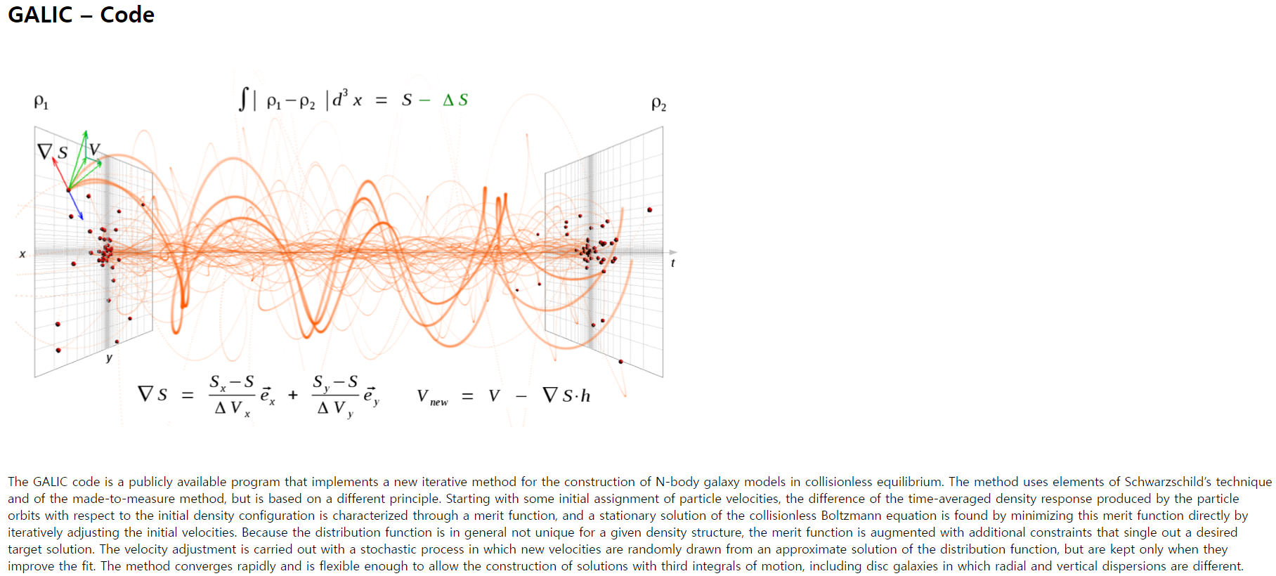
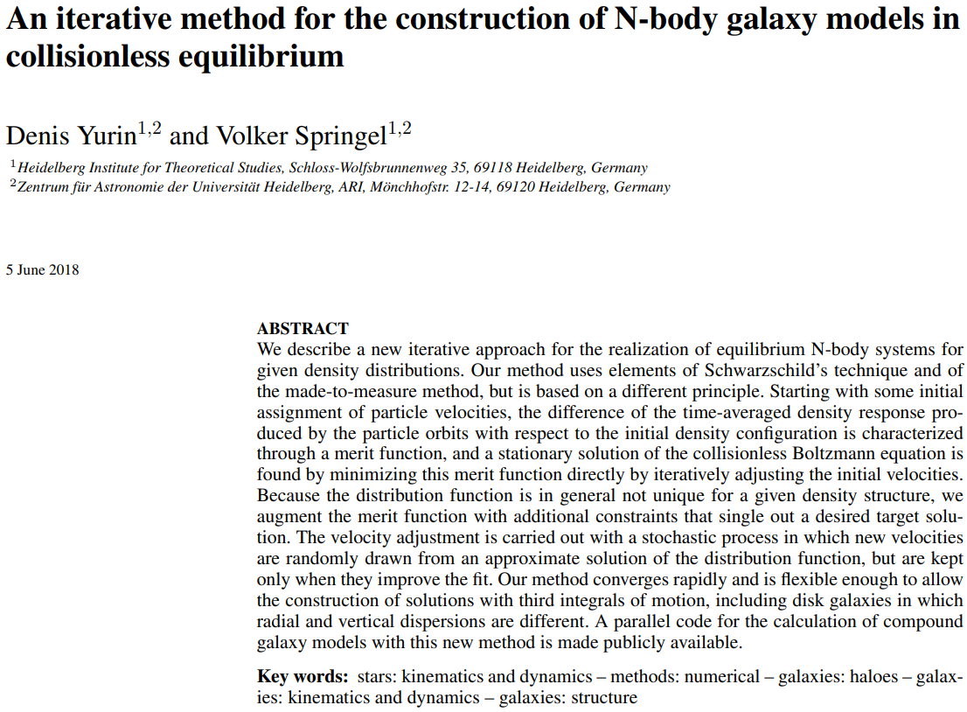
Also made GADGET code!

Slide 2
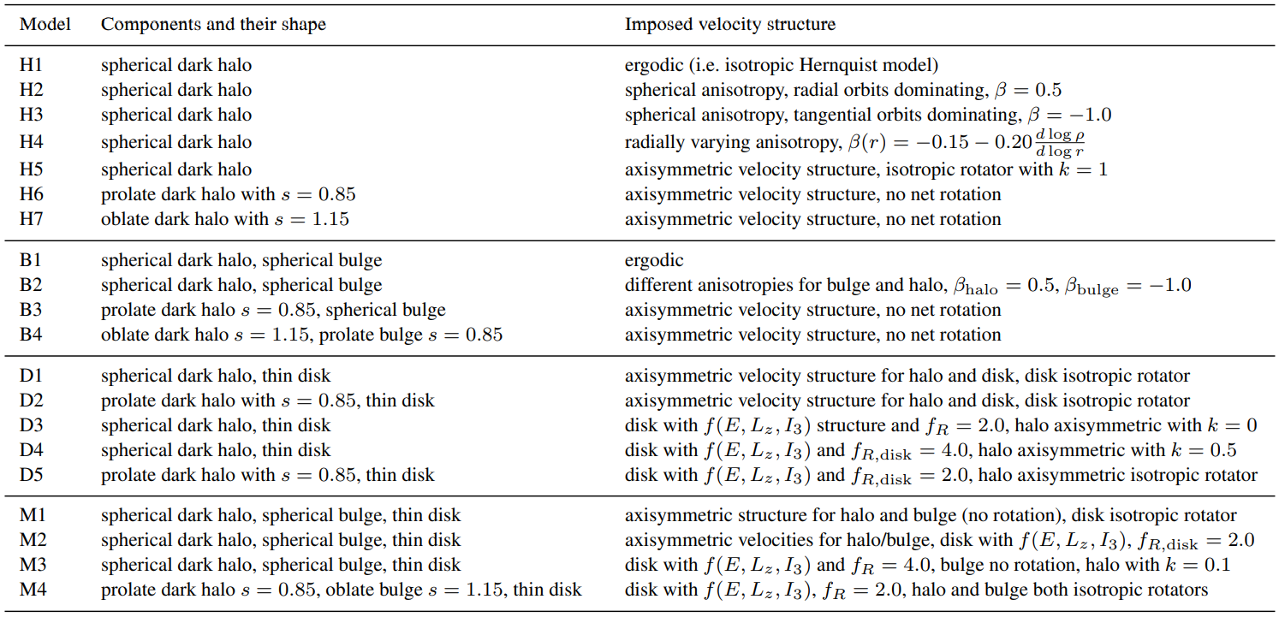
$$β=1−\frac{σ_{θ}^{2}+σ_{φ}^{2}}{2σ_{r}^{2}}$$

Slide 3
GalIC only uses Hernquist model, not NFW.
$$ρ_{H}\left(r\right)=\frac{ρ_{0}^{H}}{\frac{r}{a}{\left(1+\frac{r}{a}\right)}^{3}}$$
$$M_{tot}=\int_{0}^{∞}{dr4πr^{2}ρ\left(r\right)}=2πρ_{0}a^{3}\left(Converge\right)$$
$$r_{1/2}=\left(\sqrt{2}+1\right)a$$
$$ρ_{NFW}\left(r\right)=\frac{ρ_{0}^{NFW}}{\frac{r}{R_{s}}{\left(1+\frac{r}{R_{s}}\right)}^{2}}$$
$$M_{tot}=\int_{0}^{Λ}{dr4πr^{2}ρ\left(r\right)}=4πρ_{0}R_{s}^{3}\left\{\ln\left(1+\frac{Λ}{R_{s}}\right)−\frac{Λ/R_{s}}{1+Λ/R_{s}}\right\}\left(Needs Cutoff\right)$$
$$r_{1/2}≅1.51R_{s}$$
But… GalIC assumes that the halo mass($M_{halo}=2π×{10}^{8}M_{⊙}$, $r_{1/2}=0.53kpc$ for our simulation) is the total mass enclosed within the virial radius:$M_{halo}=M_{200}$ of an equivalent NFW halo.
$$ρ_{0}^{H}a=ρ_{0}^{NFW}R_{s}$$

Slide 4
This code requires the input file for “basic structural parameters of model” as below:
$c$ : Halo Concentration of a corresponding NFW halo of mass $M_{200}=M_{dm}$
$$a=\frac{r_{200}}{c}\sqrt{2\left\{\ln\left(1+c\right)−\frac{c}{1+c}\right\}}$$
$v_{200}$ : The Circular Velocity at $r_{200}$
$$v_{200}=\sqrt{\frac{GM_{200}}{r_{200}}}$$
$$ρ\left(r_{200}\right)=200ρ_{c}, M_{200}=4π\int_{0}^{r_{200}}{r^{2}ρ\left(r\right)dr}$$
From numerical calculation, I got $\left\{\begin{aligned}c=94.1857 \\ v_{200}=18.6828\left[km/s\right]\end{aligned}\right.$.
$$147.8992\left[M_{⊙}⋅{kpc}^{−3}\right] \left(h=0.73\right)$$

Slide 5
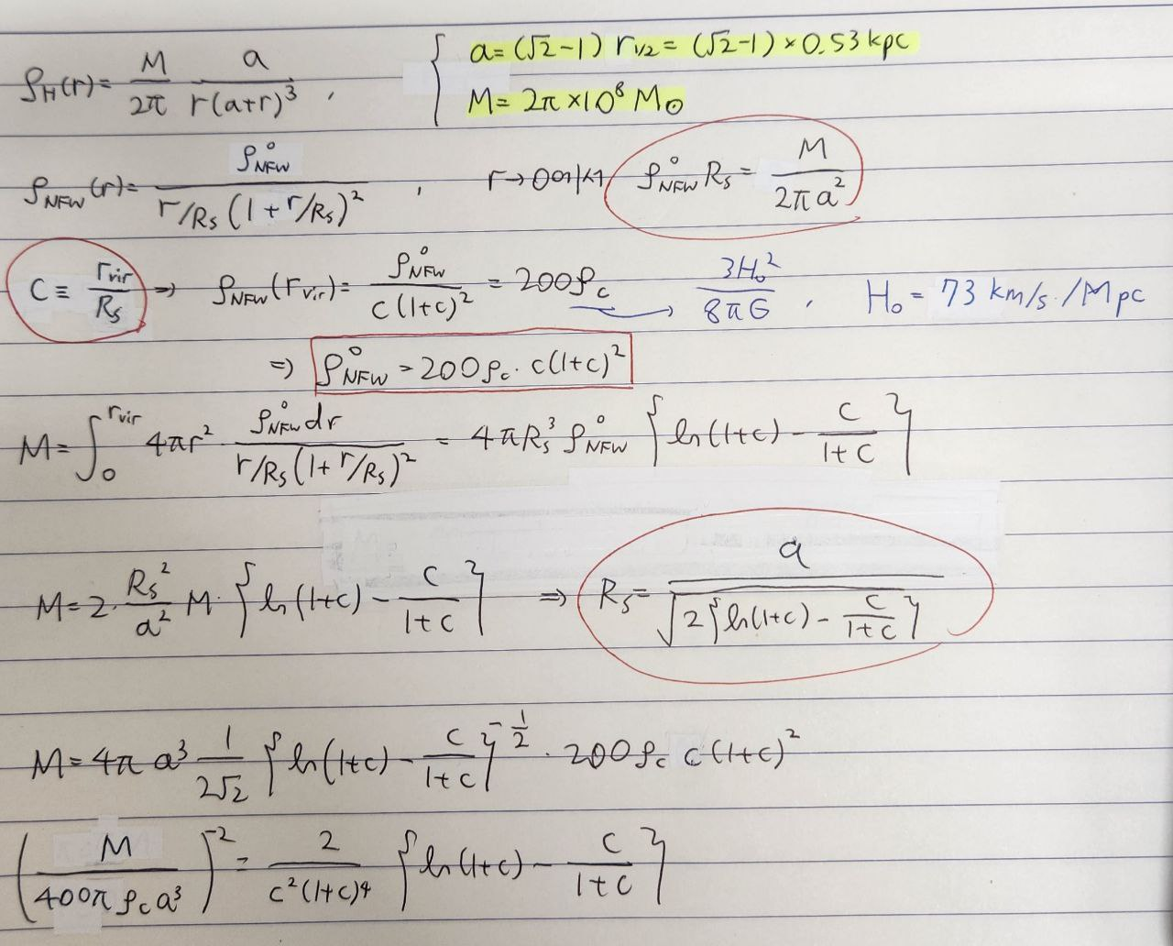

Slide 6
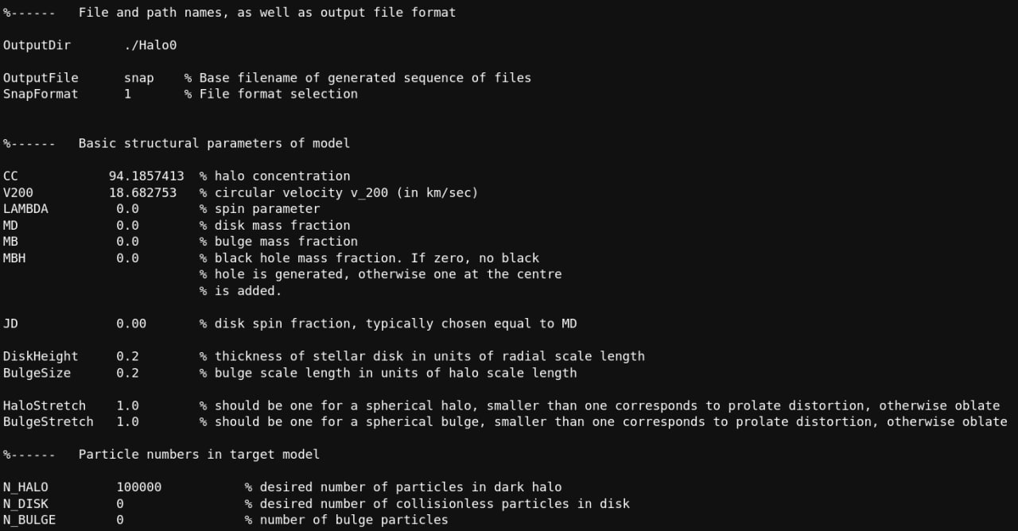

Slide 7
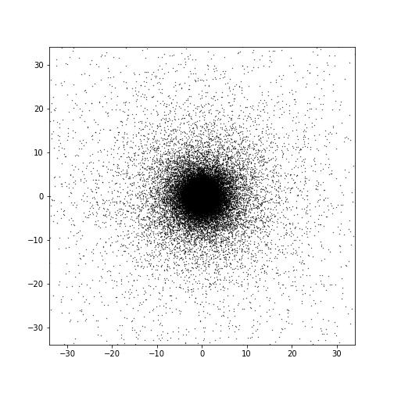
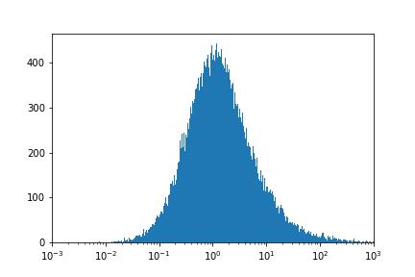
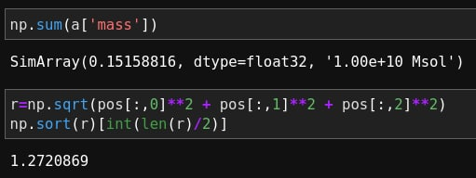
?!?!?!?!?!?!?!

Slide 8
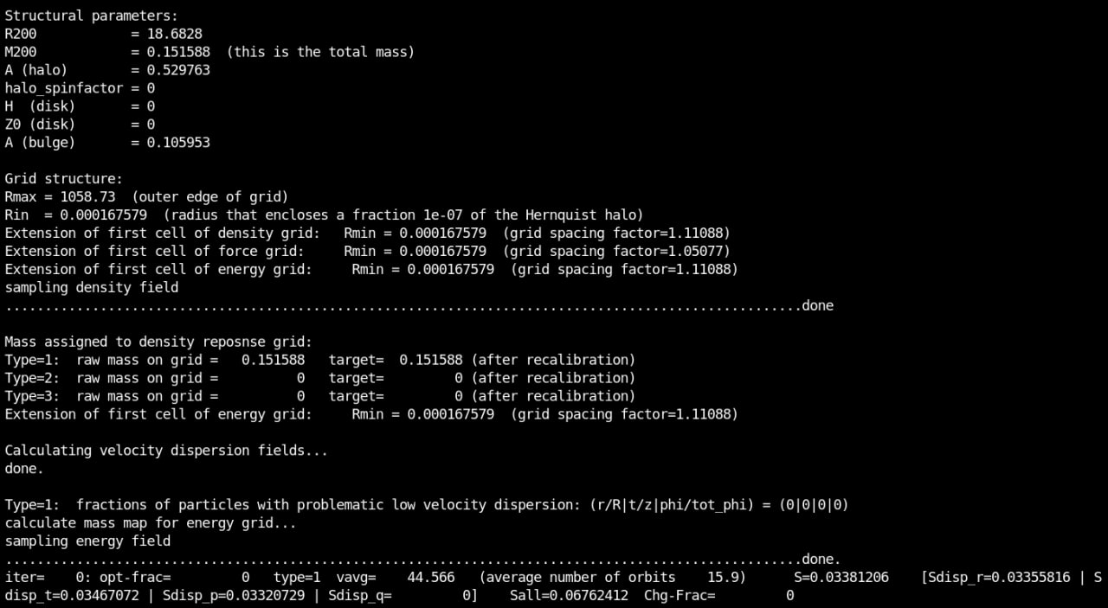

Slide 10
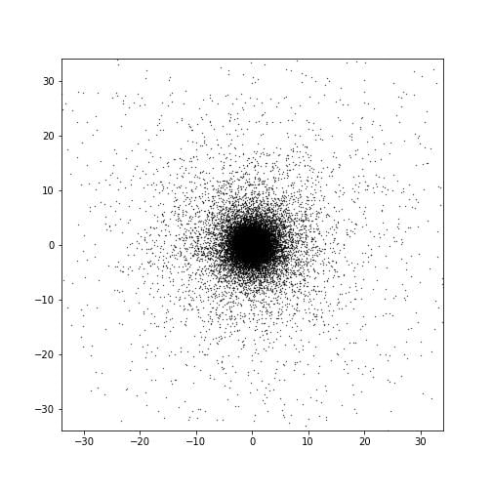
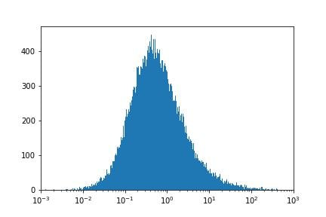
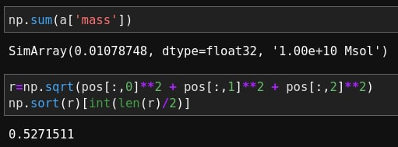
Just nearly matched $r_{1/2}$…
Need to Survey More.

Slide 11
I hope that we can put only stars inside FDM halo, using AxioNyx in the long run.

Slide 12
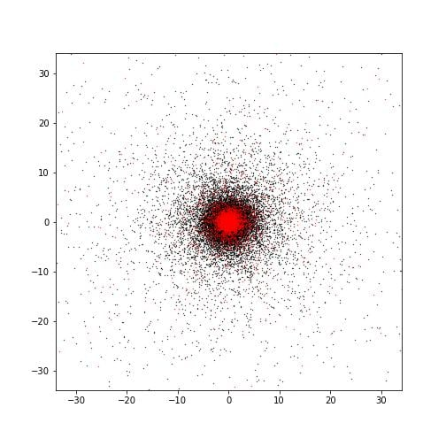
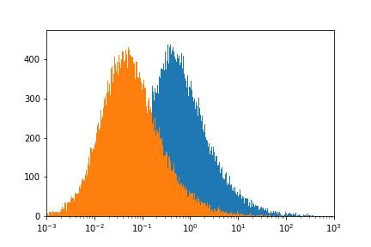
DM Particle + Bulge

