Slide 1
Advanced Si Sensors, What Has Been Done and Can Be Done By Korea
…
Y. Kwon
Dept. of Physics
2022년 가을, 고에너지 물리학회

Slide 2
Advanced Si Sensors
Contents
PHENIX MPC-Ex & PIN-structured Si sensor
ALICE ITS2 upgrade & ALPIDE from the CIS technology
Prospect & Korean Potential

Slide 3
PHENIX MPC-Ex & PIN-structured Si sensor
Advanced Si Sensors

Slide 4
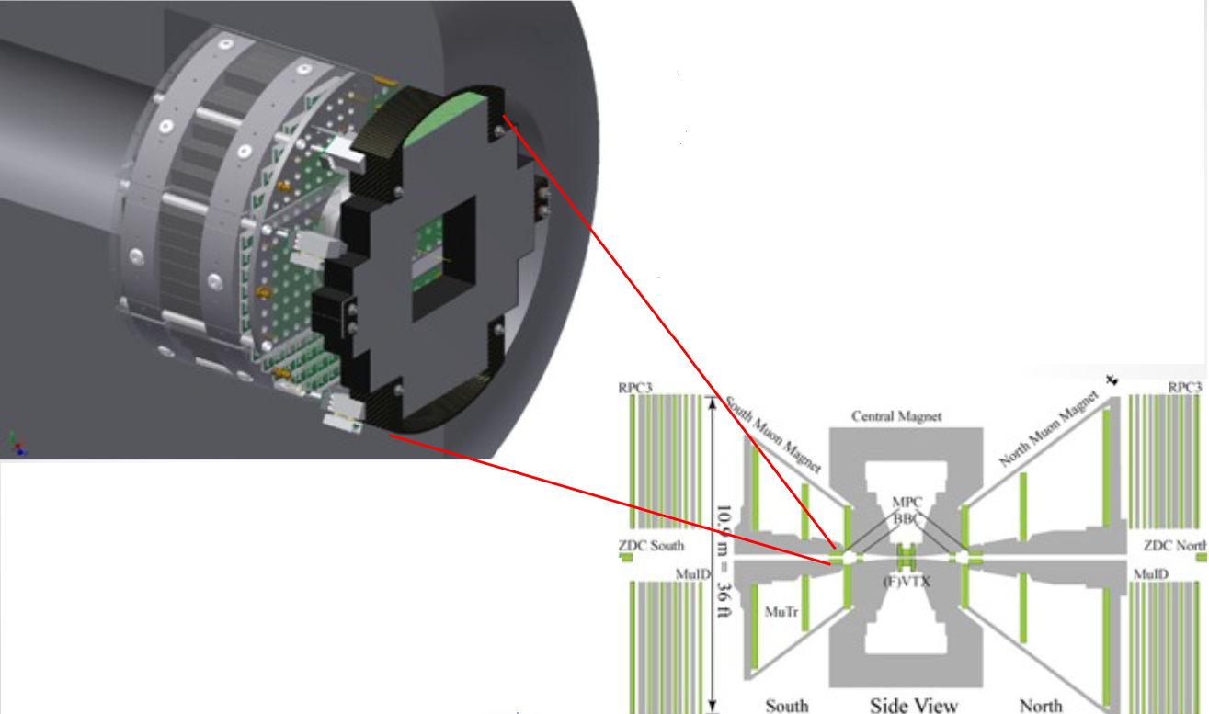
PHENIX MPC-Ex & PIN-structured Si sensor
PHENIX MPC-Ex
$$3.1< \left|η\right|<3.8$$
Compact
Flexible segmentation
Pre-shower detector with W/Si sandwich geometry
Pattern segmentation optimized to separate γ’s
from the forward high energy $π^{0}$ up to 80 (GeV/c)
for a prompt γ measurement.
4

Slide 5
PHENIX MPC-Ex & PIN-structured Si sensor
PIN-structured Si sensor
Traditional sensor
Medium scale production (~ 400 $6 \left(cm\right) ×6 (cm)$ units)
Design/Fabrication process understood
Readout ASIC has to match the ever-developing back end. Involvement in HGCROC R&D (CMS, High Granularity Calorimeter Read Out Chip) under exploration.
N⁺
N⁺
N⁺
N⁺
P⁺
h⁺
e⁻
e⁻
h⁺
h⁺
e⁻
e⁻
h⁺
e⁻
h⁺
e⁻
h⁺
Intrinsic P⁻ Wafer
P⁺
Backside
Charged
particle
5

Slide 6
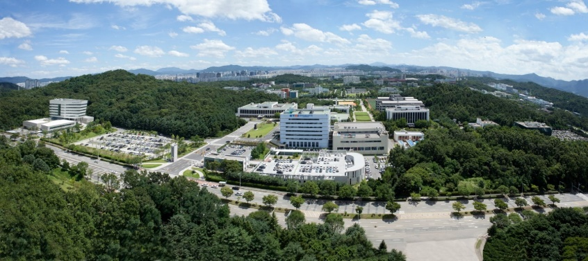
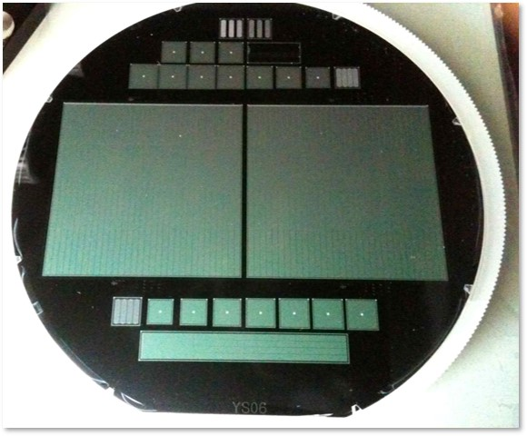
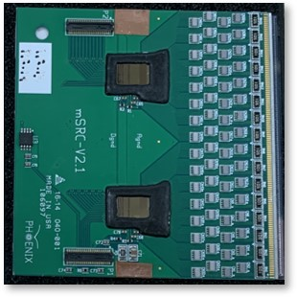
PHENIX MPC-Ex & PIN-structured Si sensor
PIN-structured Si sensor (Korean involvement)
Good products ~400 ea to PHENIX MPC-Ex
Test Sensor
Past(~ 10 years ago)
Ewha Womans Univ.,
Hanyang Univ.
Jeonbuk National Univ.,
Myongji Univ.,
SKKU,
Yonsei Univ.,
(Order in ABC)
Main Sensor
Sensor Packaging
Test Sensor
6

Slide 7
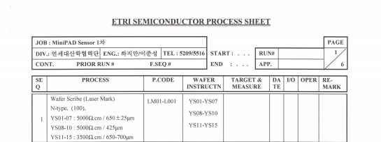
PHENIX MPC-Ex & PIN-structured Si sensor
PIN-structured Si sensor
7

Slide 8
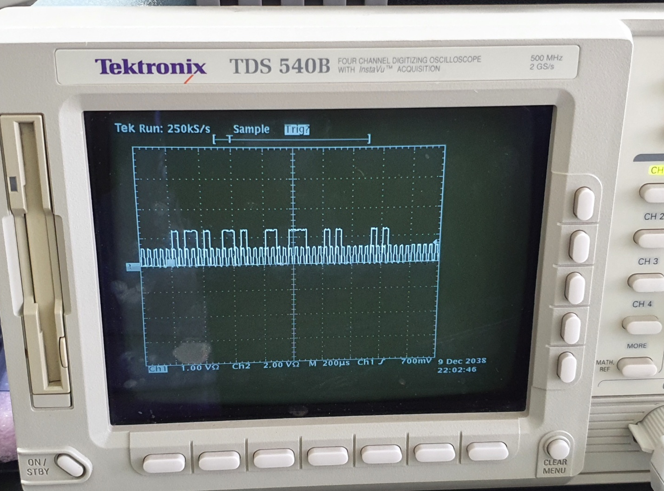
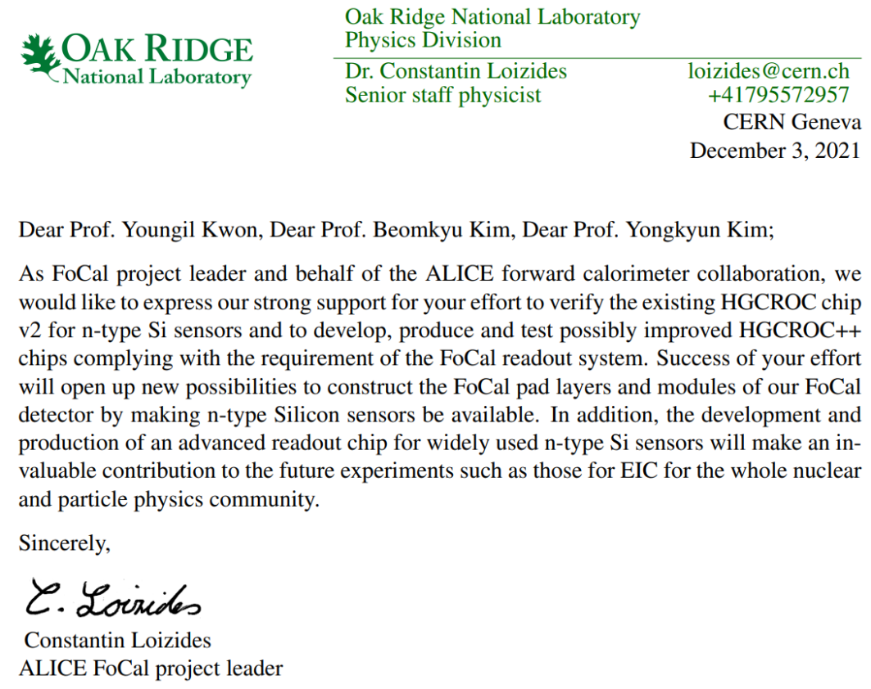
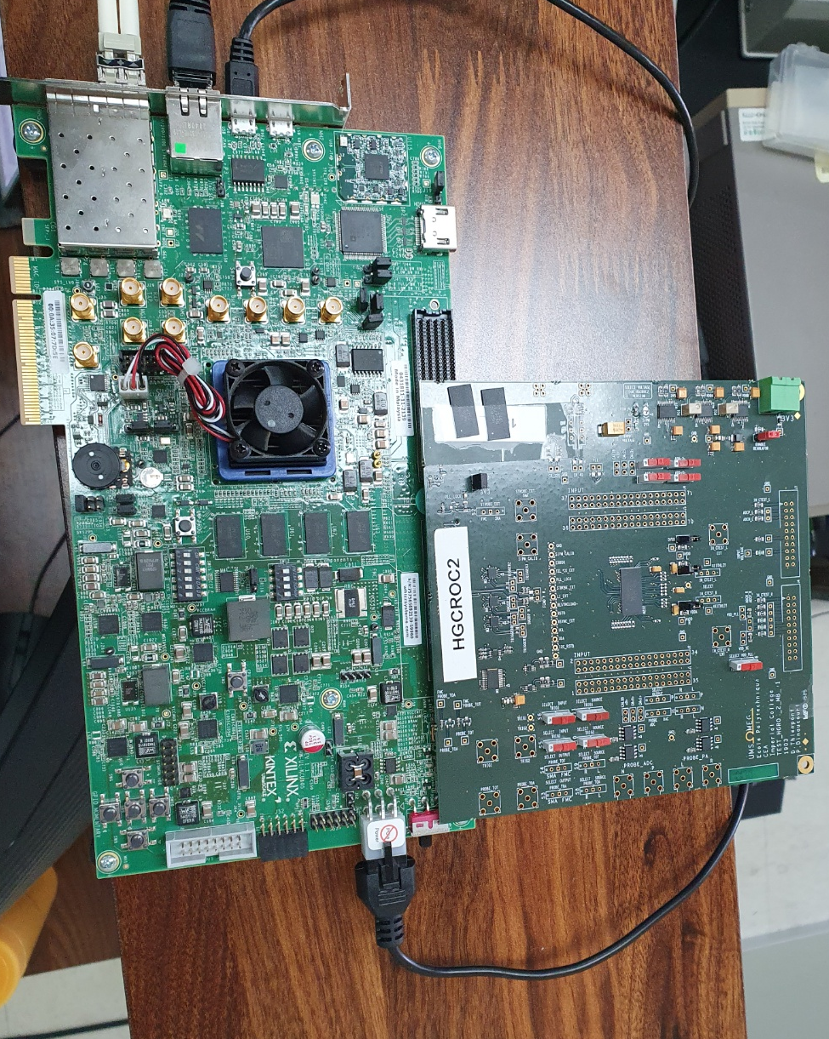
PHENIX MPC-Ex & PIN-structured Si sensor
Issues & Efforts
8

Slide 9
ALICE ITS2 upgrade & ALPIDE from the CIS technology
Advanced Si Sensors

Slide 10
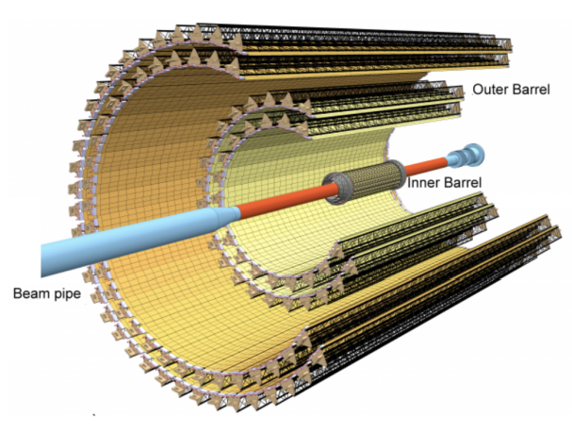
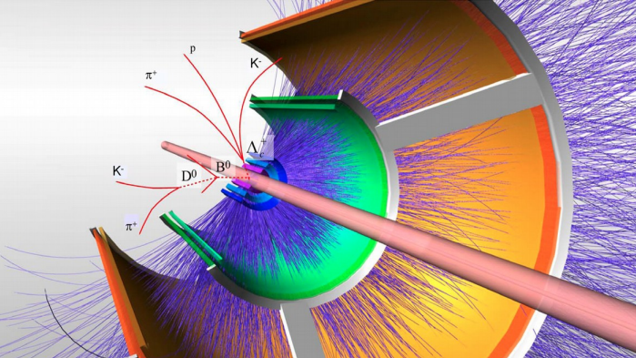
ALICE ITS2 upgrade & ALPIDE from the CIS technology
ALICE ITS2 upgrade
2022년 가을, 고에너지 물리학회

Slide 11
ALICE ITS2 upgrade & ALPIDE from the CIS technology
ALICE ITS2 upgrade
7 pixel layers
Total Area: 10 m²
Distance to IP: 21 mm
Material budget: 0.3% X₀ (Water Cooling!)
Tolerance to Radiation:
2.7 Mrad,
1.7 x 10¹³ 1 MeV n_{eq}/cm⁻²
Readout:
Pb+Pb at 100 kHz
2022년 가을, 고에너지 물리학회

Slide 12
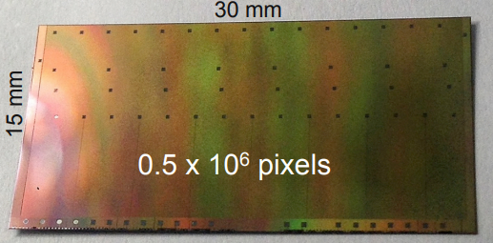
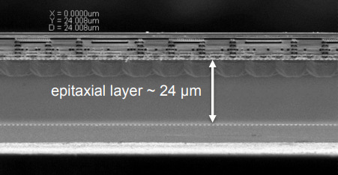
ALICE ITS2 upgrade & ALPIDE from the CIS technology
ALPIDE from the CIS technology
ALPIDE
0.18 μm CMOS technology, TowerJazz
Size: 1.5 x 3 cm², 50/100 μm thick
Pixel size: 29 x 27 (μm)²
Efficiency: > 99%
Fake hit rate: $≪{10}^{−5}$
Integration time: $10 μs$
Power density: $35 mW/cm^{2}$
Hit density: $18/cm^{2}$
2022년 가을, 고에너지 물리학회

Slide 13
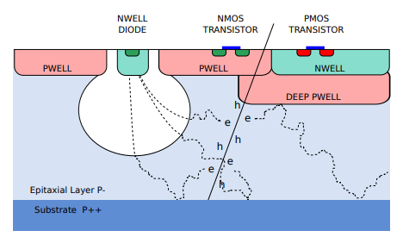
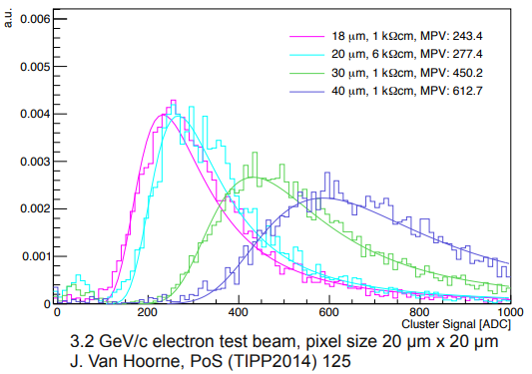
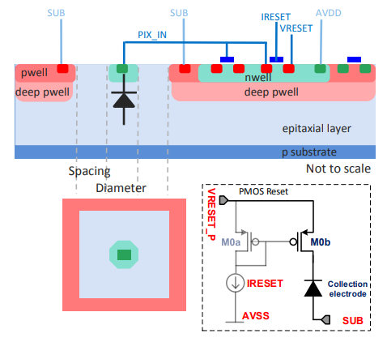
ALICE ITS2 upgrade & ALPIDE from the CIS technology
ALPIDE from the CIS technology
Pixel
2022년 가을, 고에너지 물리학회

Slide 14
ALICE ITS2 upgrade & ALPIDE from the CIS technology
ALPIDE from the CIS technology
Front end
2022년 가을, 고에너지 물리학회

Slide 15
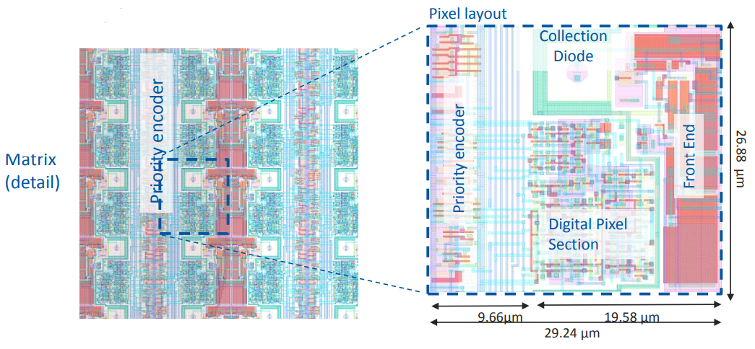
ALICE ITS2 upgrade & ALPIDE from the CIS technology
ALPIDE from the CIS technology
Real time zero suppression (priority encoder)
2022년 가을, 고에너지 물리학회

Slide 16
ALICE ITS2 upgrade & ALPIDE from the CIS technology
Korean involvement
Limited involvement in the circuit design (FEE & peripheral circuit of the chip)
Participation in the sensor characterization
Main involvement in post-processing
Thinning & Dicing (All sensors processed by the Korean company FUREX)
Mass production test (All key components produced by Korean companies)
Probe-card, NOTICE/EQENG
Automatic Test Equipment, C-On
Module Assembly
Wire-bonding by the Korean company Sejung
2022년 가을, 고에너지 물리학회

Slide 17
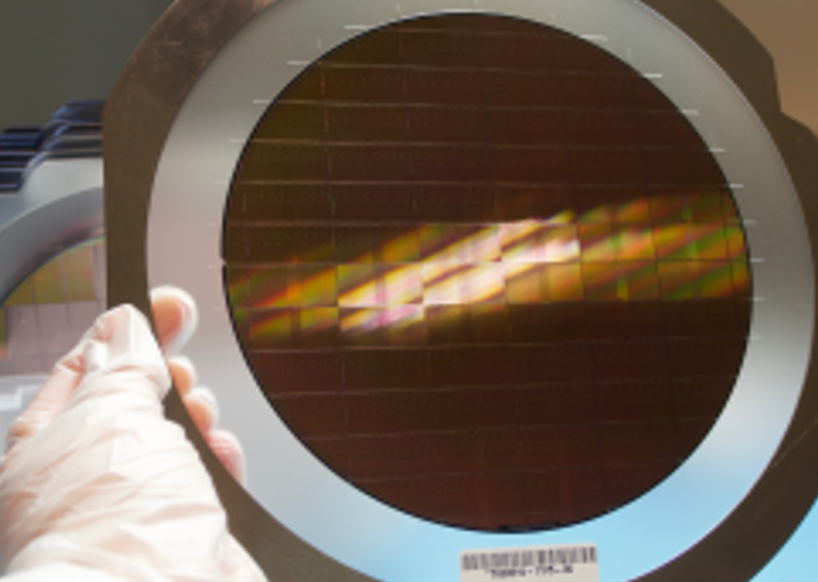
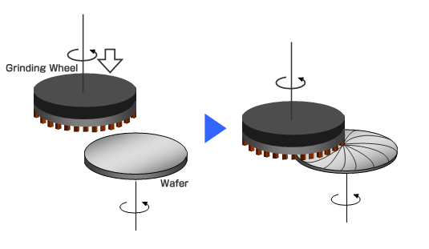
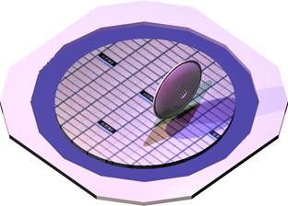
ALICE ITS2 upgrade & ALPIDE from the CIS technology
Korean involvement
2022년 가을, 고에너지 물리학회

Slide 18
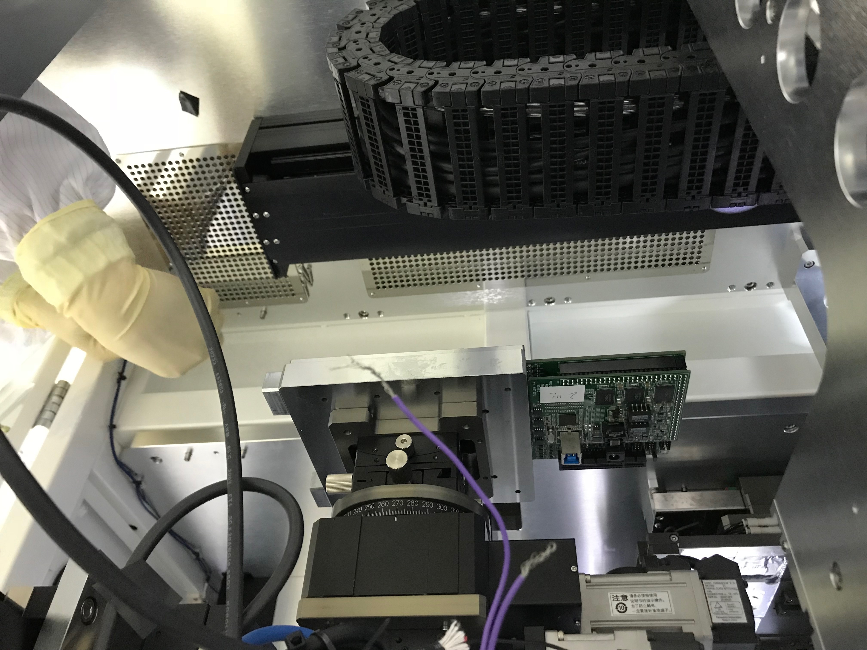
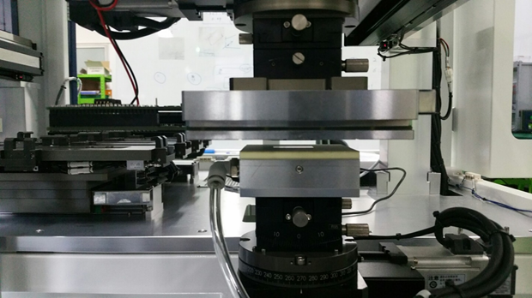
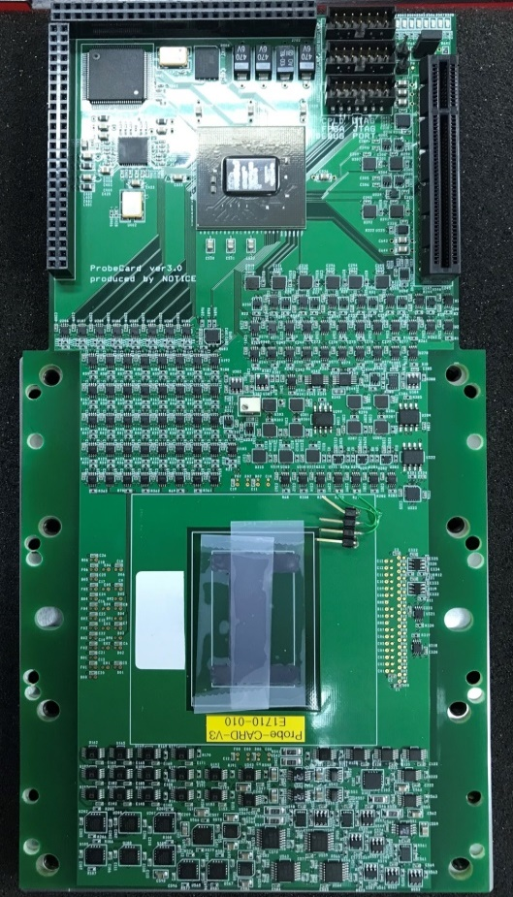
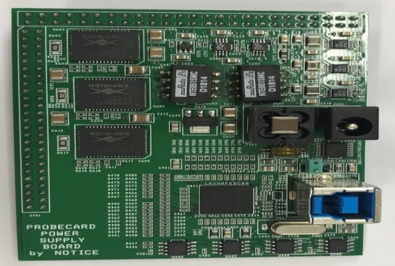
ALICE ITS2 upgrade & ALPIDE from the CIS technology
Korean involvement
Probe-card
Needle
Sensor
FPGA
전원
USB
Probe-card in ATE
Mother board
Daughter board
2022년 가을, 고에너지 물리학회

Slide 19
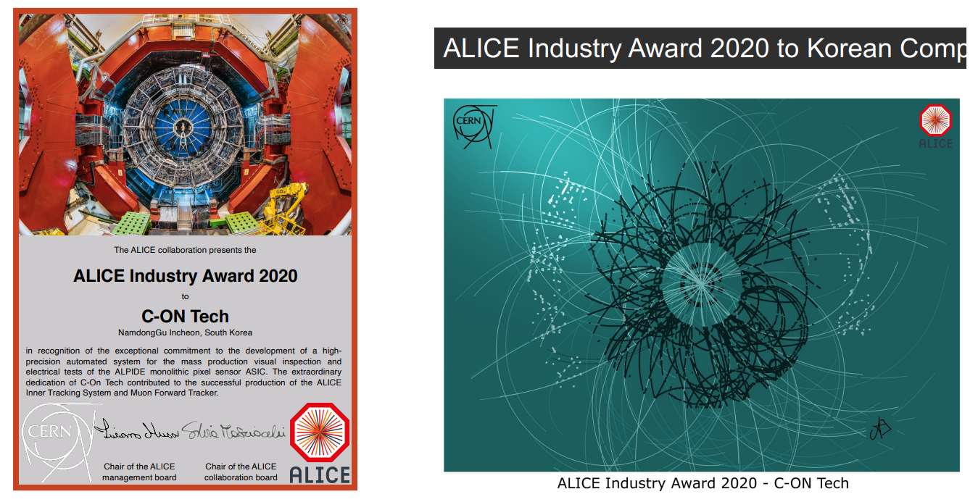
ALICE ITS2 upgrade & ALPIDE from the CIS technology
Korean involvement
2022년 가을, 고에너지 물리학회

Slide 20
Prospect & Korean Potential
Advanced Si Sensors

Slide 21
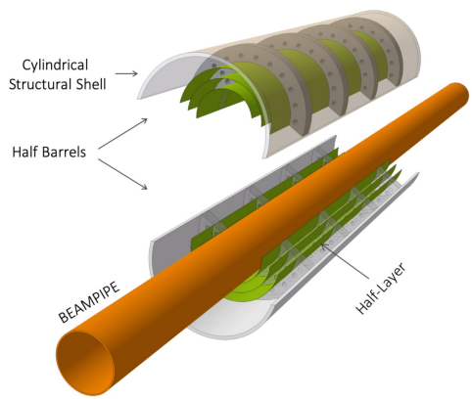
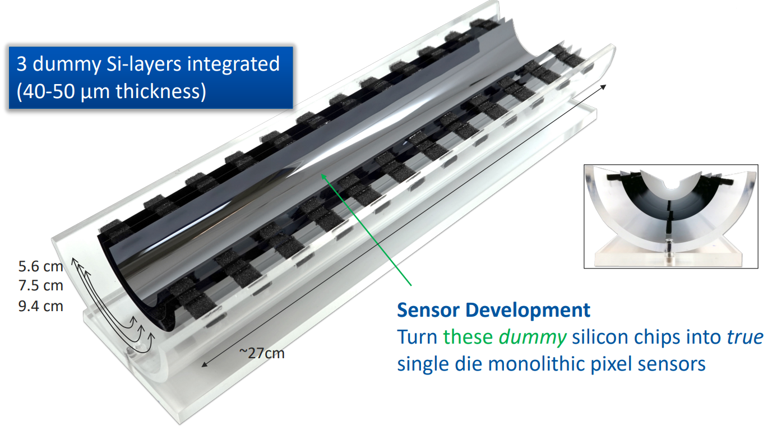
Prospect & Korean Potential
Prospect: Monolithic Stitched Sensor (ITS3)
2022년 가을, 고에너지 물리학회

Slide 22
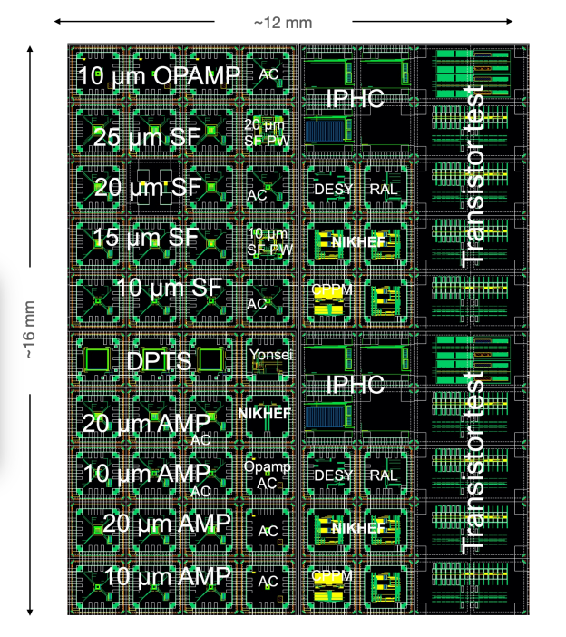
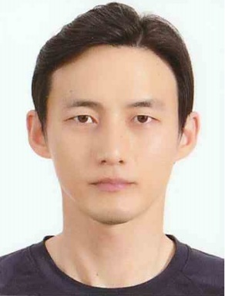
Prospect & Korean Potential
Prospect: Monolithic Stitched Sensor (ITS3)
A Ph.D in E.E. is participating in the
design team.
Post-processing technology for ITS3 is
not main stream industry, and
there’s limited involvements.
2022년 가을, 고에너지 물리학회

Slide 23
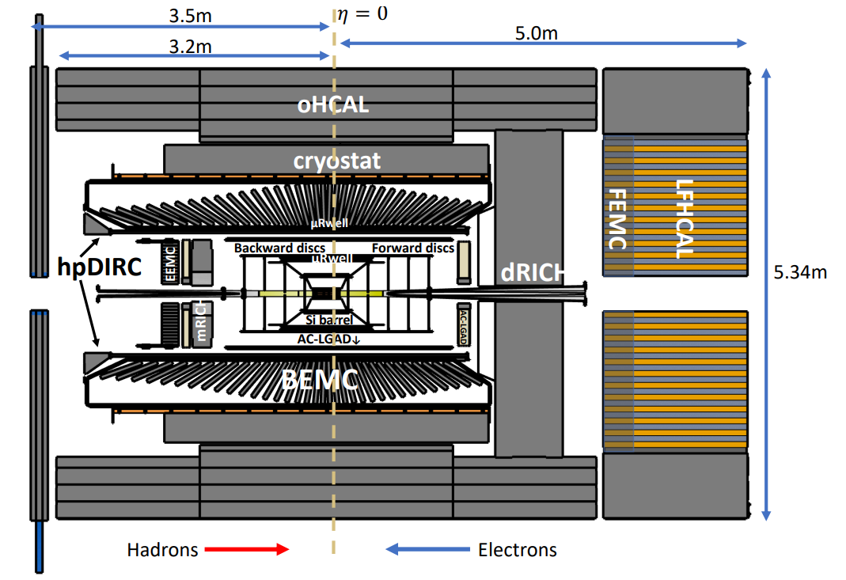
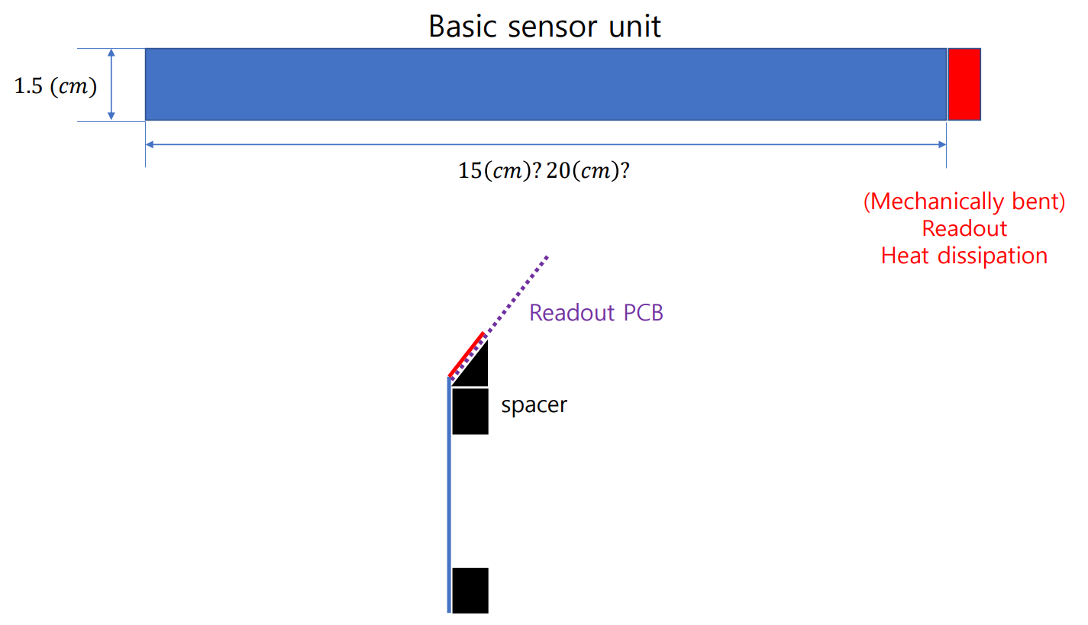
Prospect & Korean Potential
An interesting start related to EIC
2022년 가을, 고에너지 물리학회

Slide 24
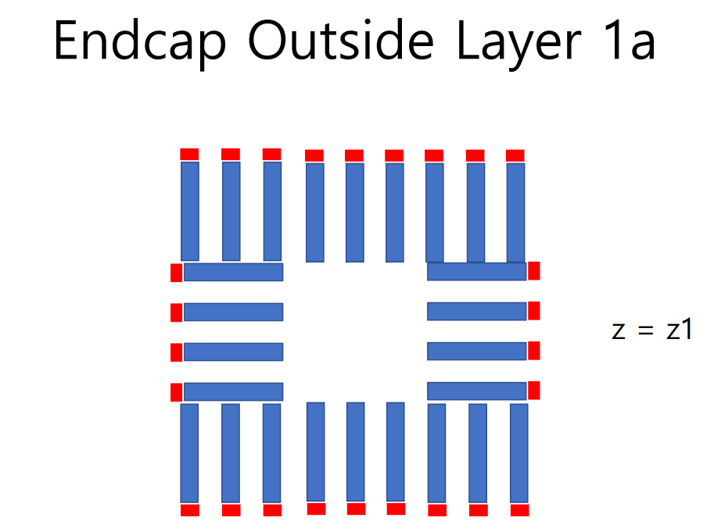
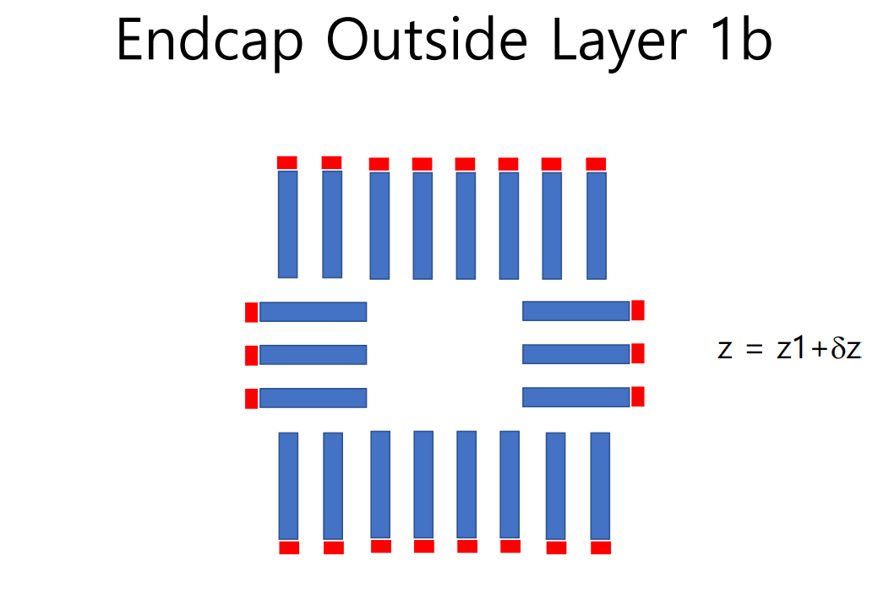
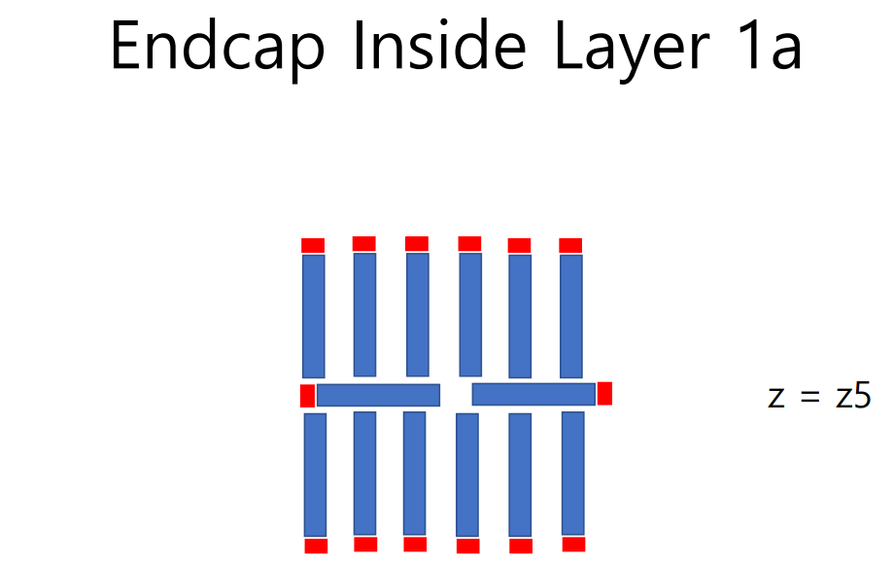
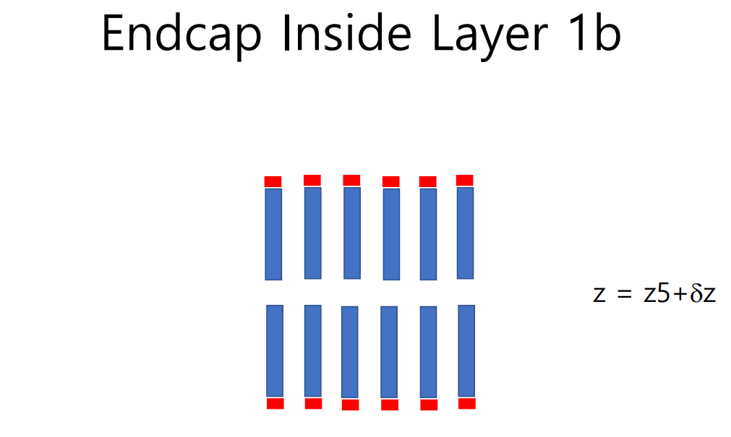
Prospect & Korean Potential
An interesting start related to EIC
2022년 가을, 고에너지 물리학회

Slide 25
Advanced Si Sensors
Summary
There’s a strong background in Korea for the Si sensors.
We have also seen the Korean strength in the post-processing of the Si sensors.
Involvement in the stitched sensor R&D, the ITS3 upgrade of the ALICE experiment.
2022년 가을, 고에너지 물리학회

