Slide 1
비저항검출기 (Resistive Plate Chamber) 관련 연구 동향과 전망
입자물리학 실험 (Particle Physics)
천체물리학 실험 (Astrophysics)
핵물리학 실험 (Nuclear Physics)
핵공학 (Nuclear Sciences)
입자선 치료 (Particle Therapy)
이경세
고려대학교 CENuM

Slide 2
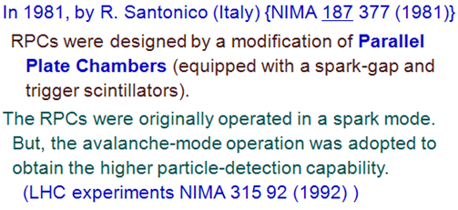
1. Resistive Plate Chambers (particle trigger/trackers and TOF)
비저항 검출기(RPC)란? 원래 입자물리 및 핵물리 실험에서 고에너지 입자를 측정하는데 이용되는 기체검출기
측정 대상이 되는 방사선
100 MeV 이상의 양성자 및 중성자
1 GeV 이상의 중이온
10 MeV 이상의 전자/양전자
500 keV 이상의 감마선 (기체검출기 중 유일하게 고에너지 photon에 민감)
특성
시간 반응이 가장 빠르고 시간 분해능이 높다(25 ps ~ 1 ns).
검출 효율이 95 ~ 99% 수준으로 높다.
위치 분해능은 수 mm 수준.
입자계수능력(particle rate capability)은 낮으나 noise도 적다. → 그래서 trigger 검출기로 사용.
기능
고에너지 대전입자를 빠른 시간 내에 등록하고 선별(plastic scintillator와 기능이 유사)
→ 단위 검출기 제작 단가가 비교적 낮아 대형 입자물리 실험에 적합.
최근 기능이 향상된 RPC의 경우 ~ 100 ps 시간 분해능과 ~ 2 mm 위치 분해능으로 개발되어 4차원 tracker로서 활용.
대형 입자물리 실험(특히 암흑 물질, Long lived Particles 탐색에 tracker/veto counter로 활용)
Muon radiography의 유일한 대안

Slide 3
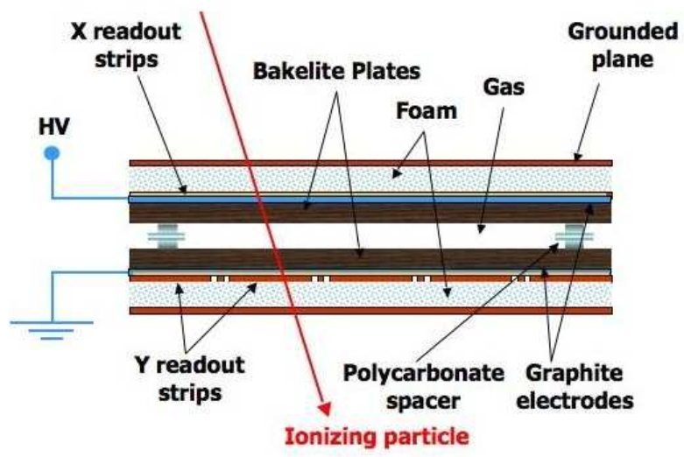
RPC 검출기의 기본 구조
검출기를 평면으로 제작하여 그 내부에 균일한 강한 전기장을 형성하도록 electrode 재료를 선택.
Electrode 재료
전류가 흐를 수 있는 정도의 불완전한 부도체 (dielectrics)
기체검출기 내에서 발생하는 낮은 에너지 X선에 의한 방전이 발생하지 않을 정도의 높은 chemical potential을 갖는 재료
베이클라이트, 유리, 세라믹 등
기체검출기 가동 방식
일반적으로 limited proportional mode (avalanche mode): 입자계수능력 ~ 0.5 kHz cm⁻² ~ 10 kHz cm⁻²
Geiger-Muller mode: 입자계수능력 < 100 Hz cm⁻²
검출기 가동 기체
1980년대 초기에는 50% Ar + 50% iC₄H₁₀
1990년 이후: R134a Freon (C₂H₂F₄, GWP = 1430) based gas mixture
2027년 이후: HFO1234ze (C₃H₂F₄, GWP ~ 6) based gas mixture
가동 기체 내의 다른 성분?
iC₄H₁₀, SF₆, CO₂

Slide 4
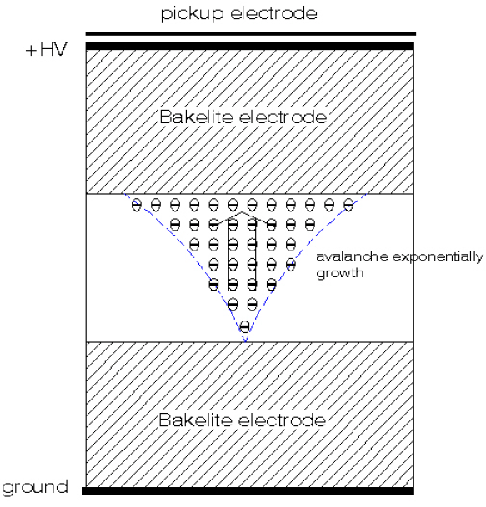
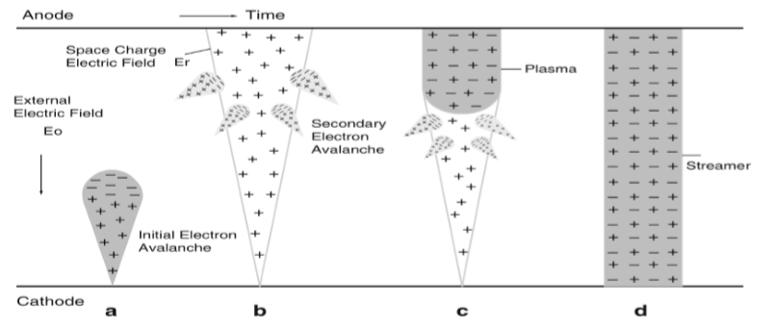
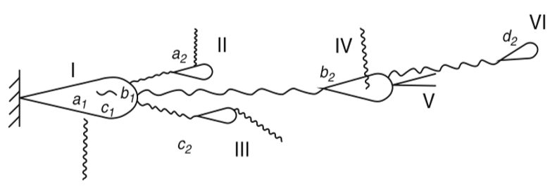
Operation modes (가동원리):
RPCs were originally designed for the Geiger-Muller mode operation (streamer mode). But a limited proportional mode operation has been accepted to enhance rate capability of particle detection. We called this operation mode the ‘avalanche mode’ (limited proportional mode).
RPC electrode는 기본적으로 leak current를 허용하는 parallel capacitor 구조.
Power supply는 강하고 균일한 전기장을 공급해주는 역할을 하며 방사선과 current leak으로 발생한 capacitor electrode 대전 charge를 보상해주는 charge breeder 역할

Slide 5
2. 입자물리, 천체물리학, 핵물리 실험

Slide 6
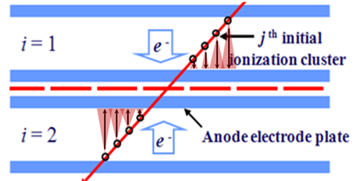
RPCs can be used for many different purposes
1. Trigger RPCs
Fast data for high-energy particles (tracking provided by tracker like DTs, CSCs, etc..)
Time resolution ~ 1 ns
Position resolution ~ 1 cm
Efficiencies: 95 ~ 99%
In general, provide 1 dimensional data (now 2D triggers in many experiments)
ATLAS RPC system (single-gap 2D RPCs)
CMS RPC system (double-gap 1D RPCs)

Slide 7
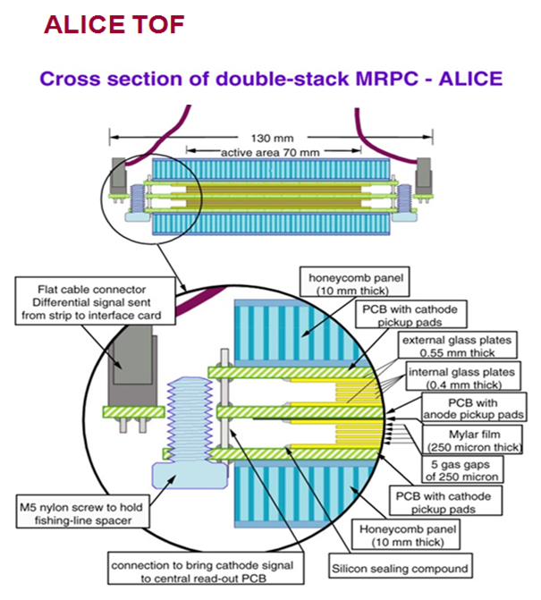
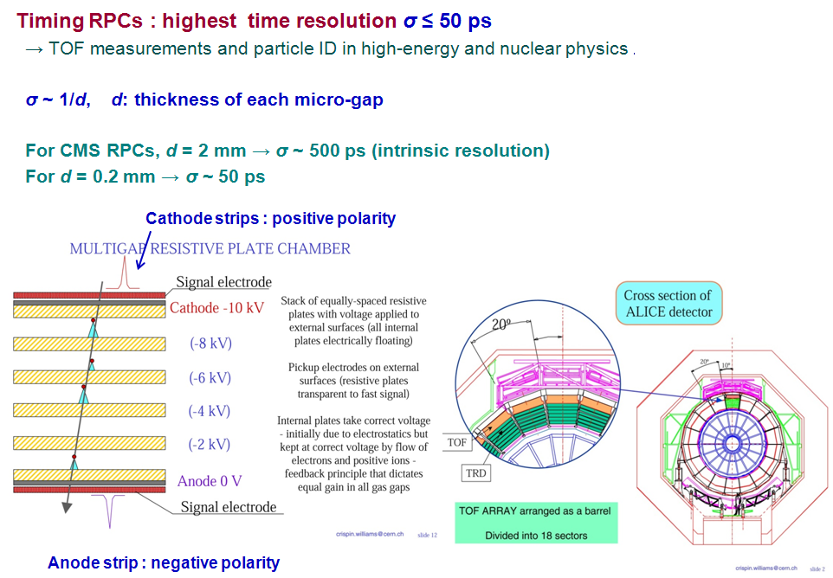
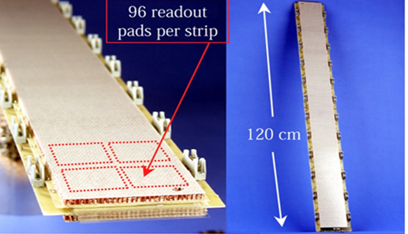
2. Timing RPCs for nuclear physics (for particle ID)

Slide 8
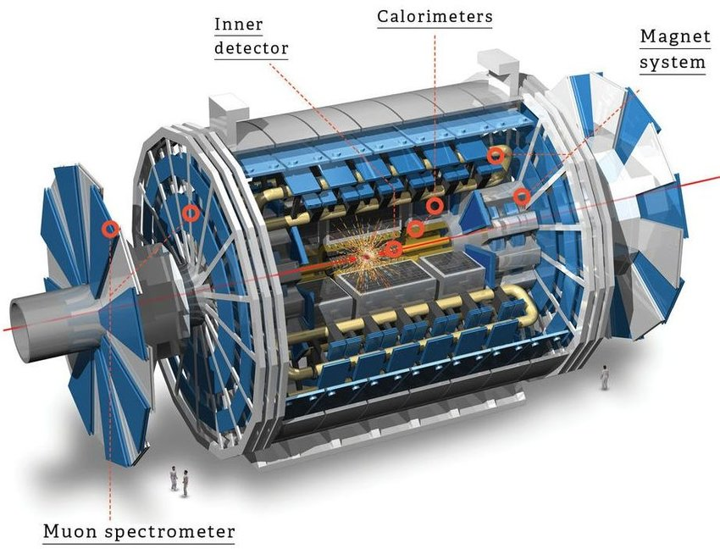
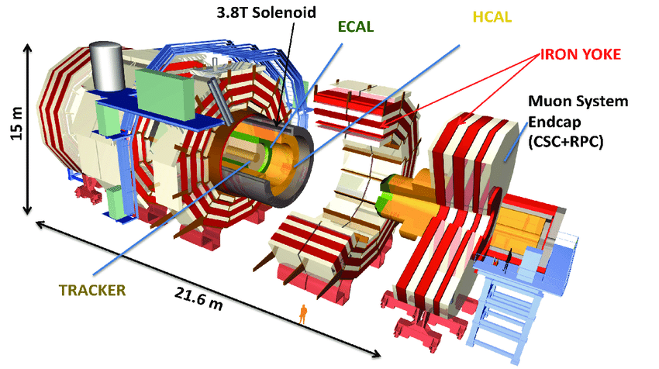
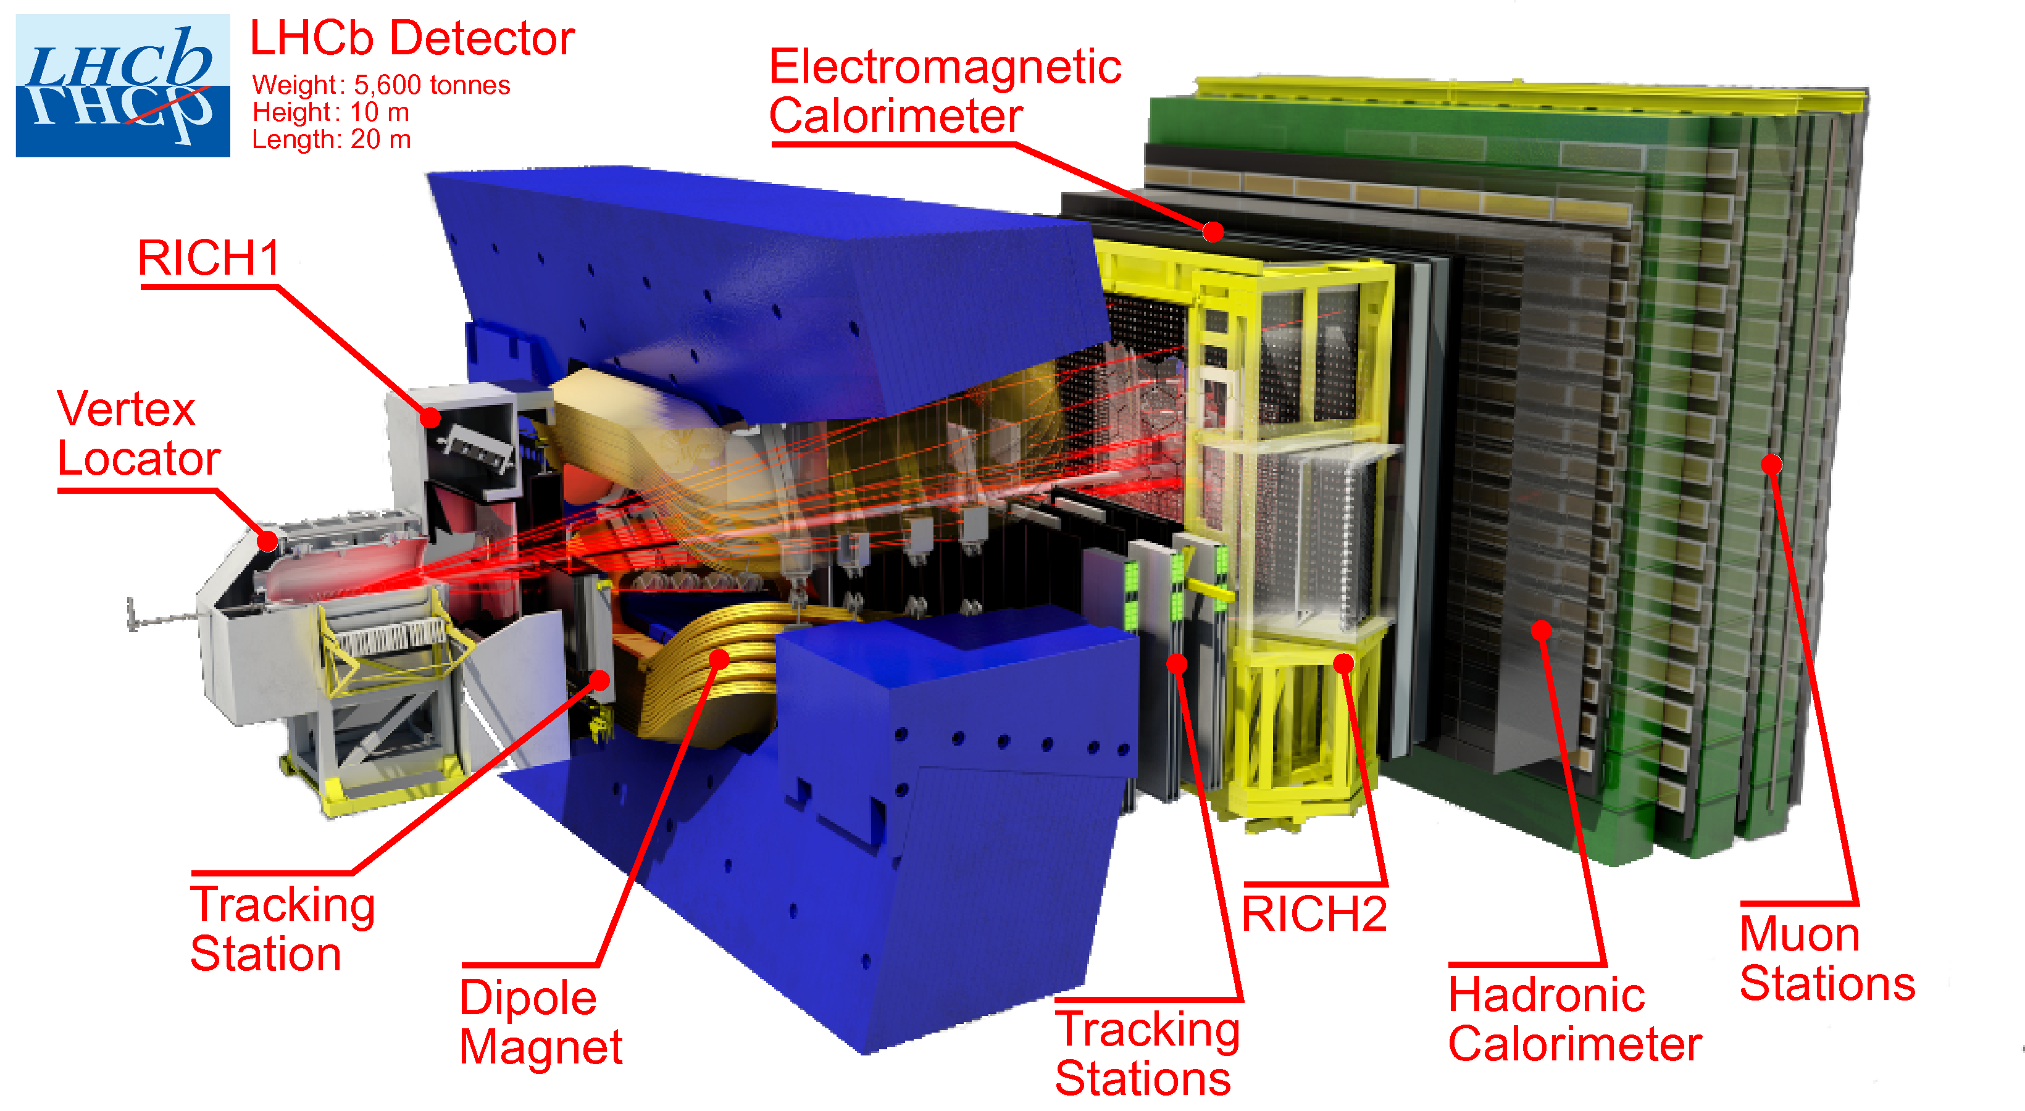
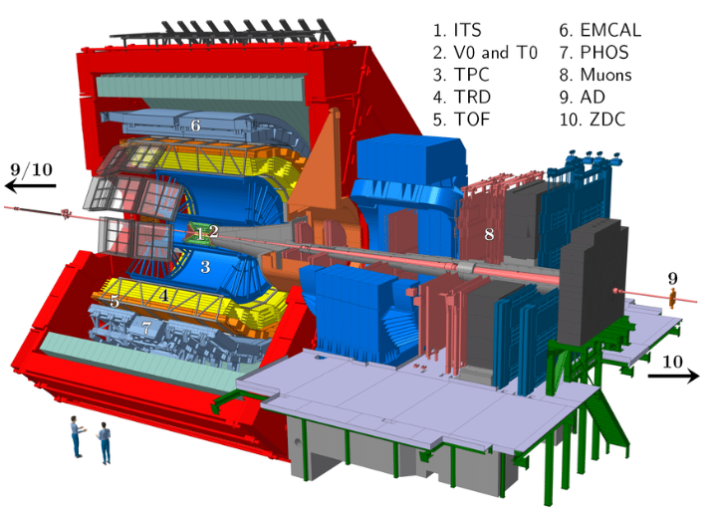
CMS (trigger only)
ATLAS (trigger only)
LHC-b(trigger only)
RPCs, the trigger detectors in LHC
ALICE (Time-OF-Flight)

Slide 9
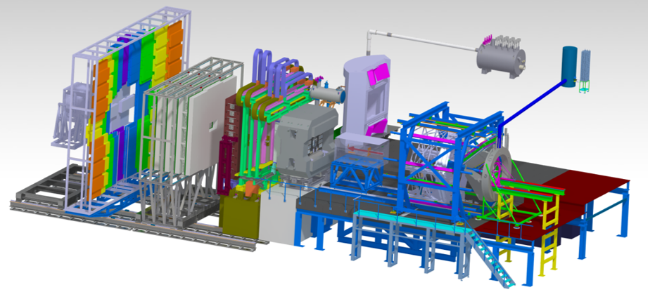
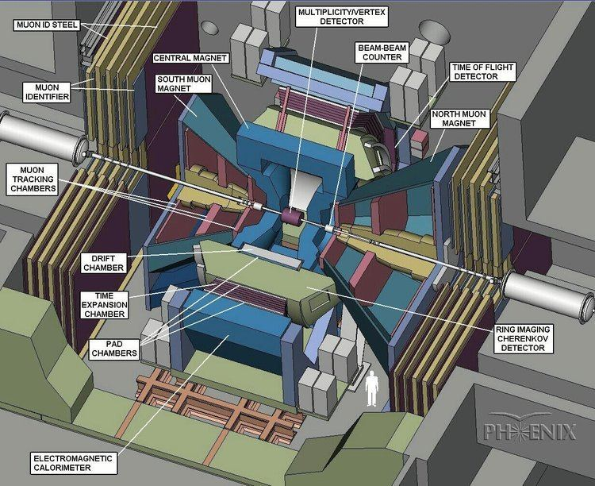
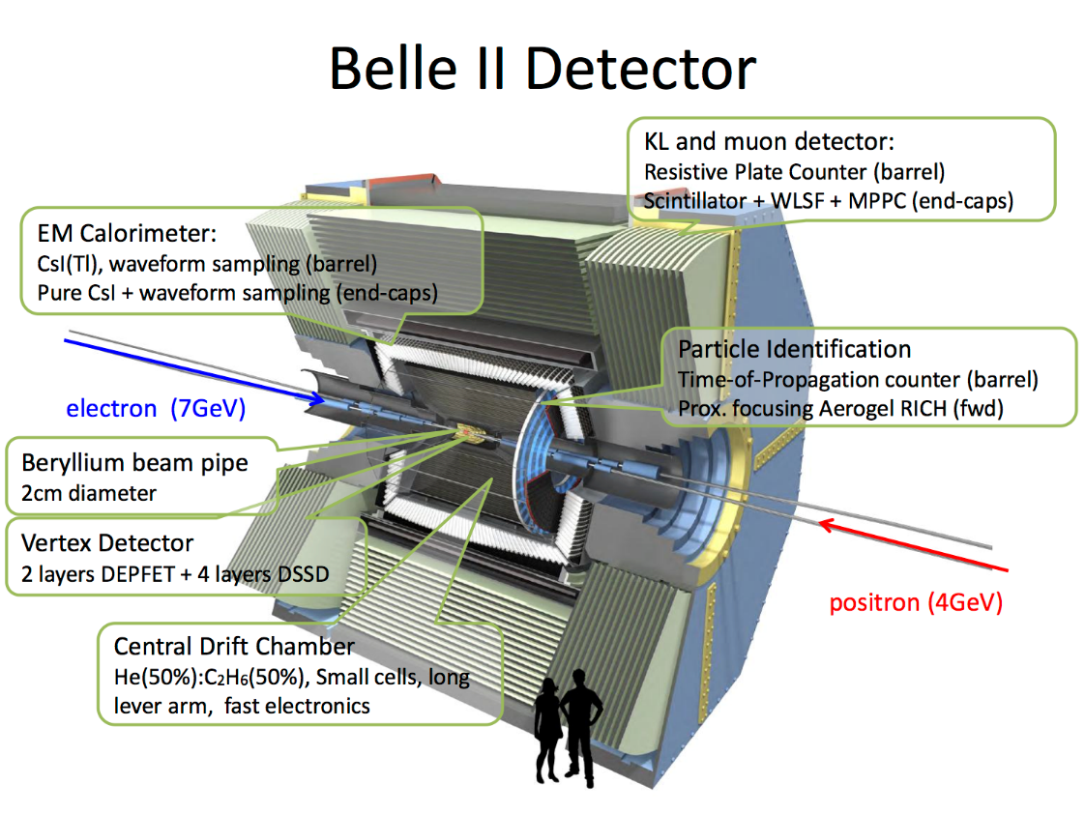
PHENIX/RHIC (trigger only)

Slide 10

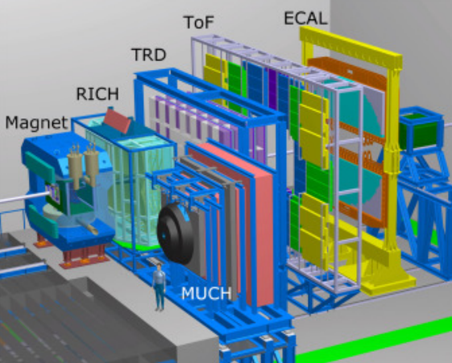
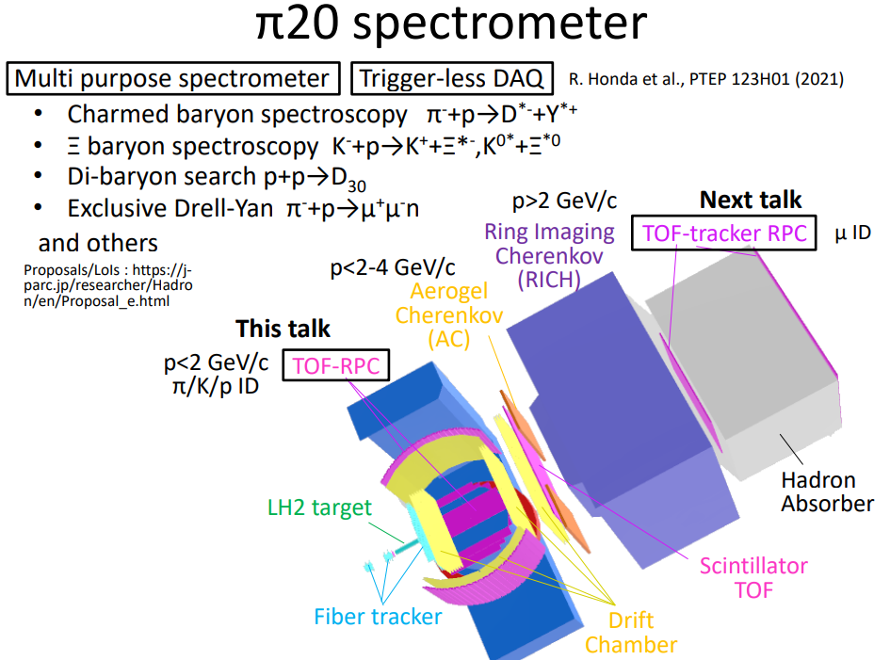
Time-OF-Flight detectors (time resolution ~50 ps)

Slide 11
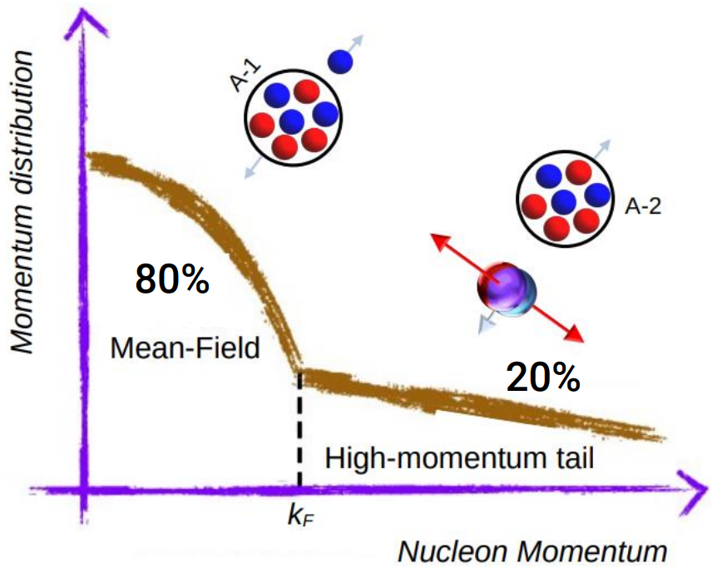


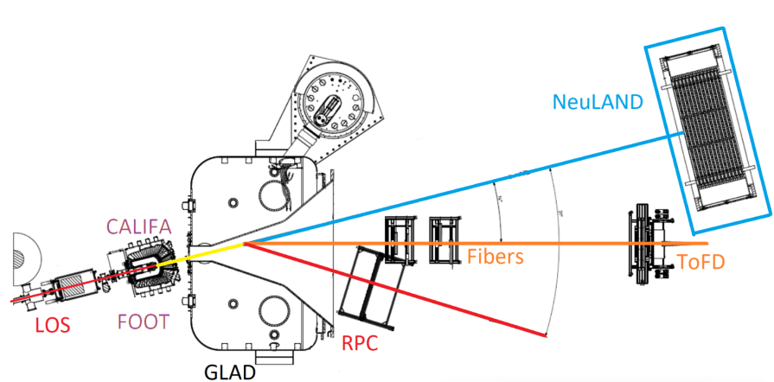
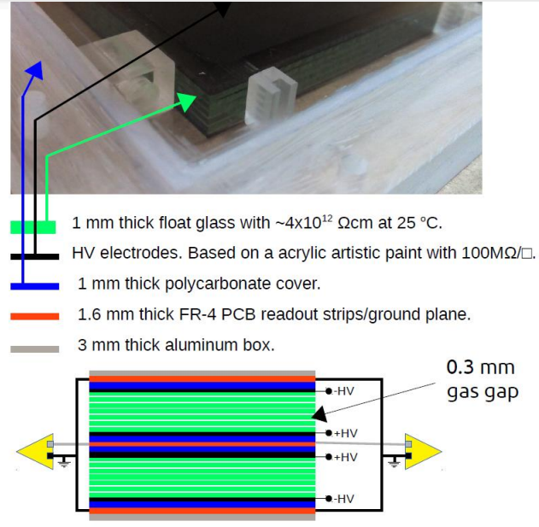
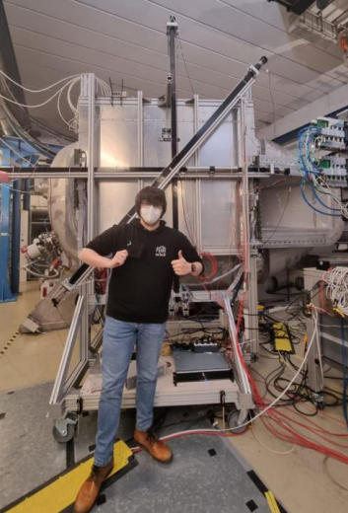
High relative momentum
Short Range Correlation of pair can be pp, pn and nn, where the pn are dominant
Fraction of high momentum nucleon in nuclei is about 20%
Time-OF-Flight detectors (time resolution ~50 ps)

Slide 12
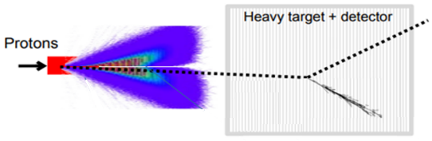
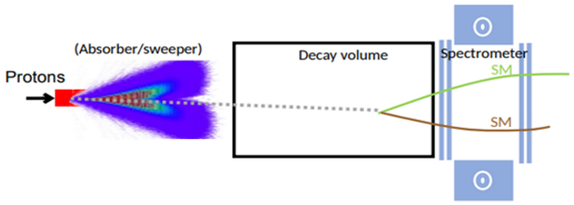
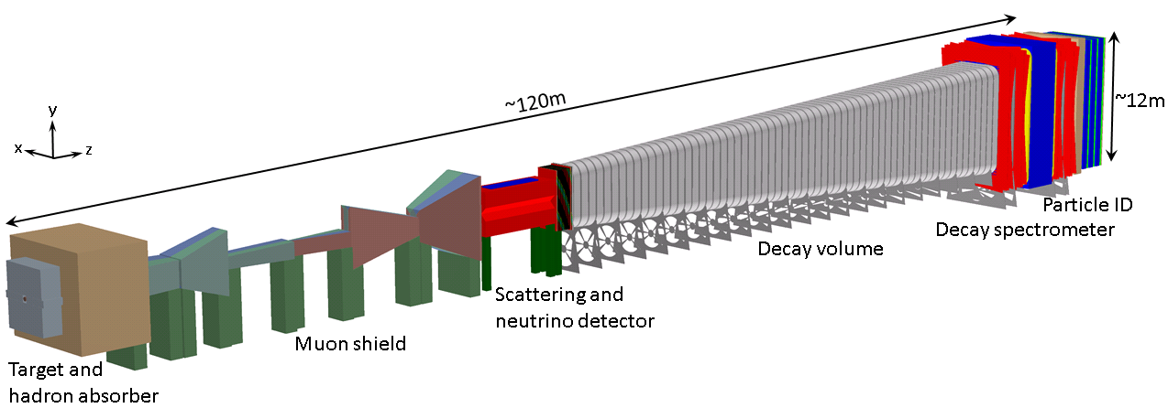
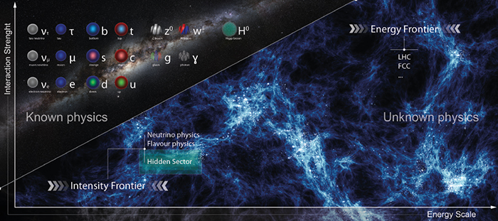
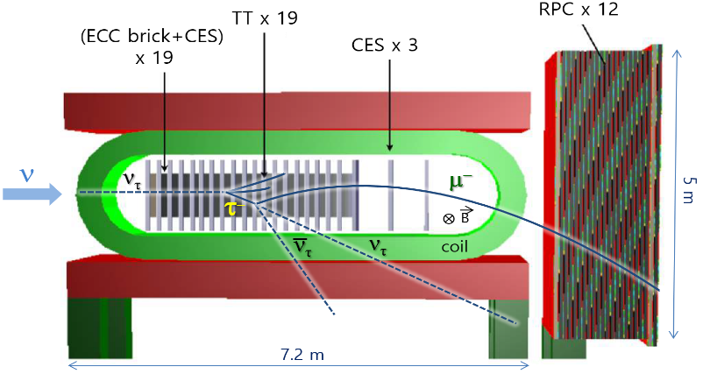
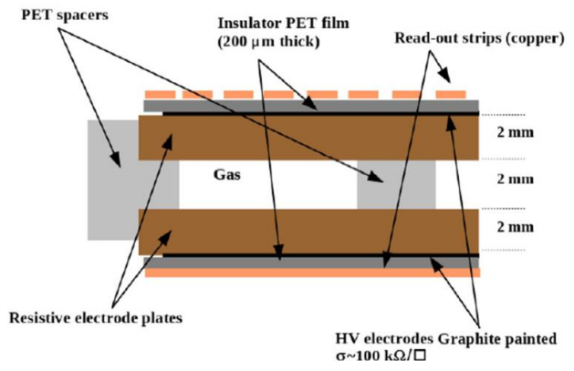
3. Trigger/Tracking RPCs (New experiment)
CERN SPS high intensity proton beam : 2 x 10²⁰ pot (400 GeV)
SHiP (Search for Hidden Particles)
Scattering of Tau neutrino/LDM
Decay of Hidden particles to SM particles
Hidden particles
Tau neutrinos
Heavy Neutral Leptons (HNL)
Dark Photons
Hidden Scalar
Axion Like Particles (ALP)
Light Dark matter (LDM)
Expect ~3500 ντ events
in 6 tons Emulsion target
ντ and Anti-ντ physics
(Cross section etc.)
SND (Emulsion + Drift Tube + RPC)
SND
The SHiP is a new experiment at the intensity frontier aimed at exploring the hidden sector.
SHiP RPC 기능:
- 타우 중성미자 충돌에서 발생하는 타우 렙톤의 붕괴 뮤온 궤적 확인 ( τ → μ ν ν )
- 뮤온 궤적의 곡률로 전하 측정 가능 → 반 타우 중성미자 반응 검출
- 새로운 입자 탐색 시 표준 모형 입자 Veto
Trigger RPC
for SHiP
We need cathode + anode strip RPCs
Proposal:
arXiv:1504.04956 (2015)
Two orthogonal strip readouts for 2D trigger measurements
(anode strips for x and cathode strips for y)
Expected position resolution of 3 ~ 4 mm in both directions

Slide 13
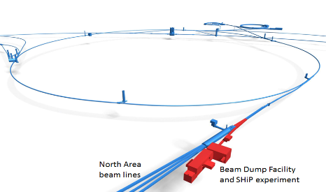
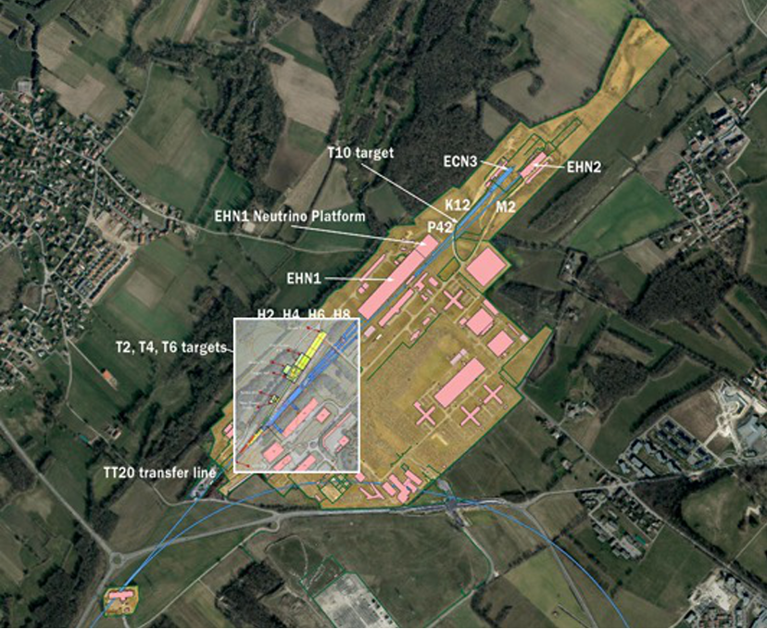

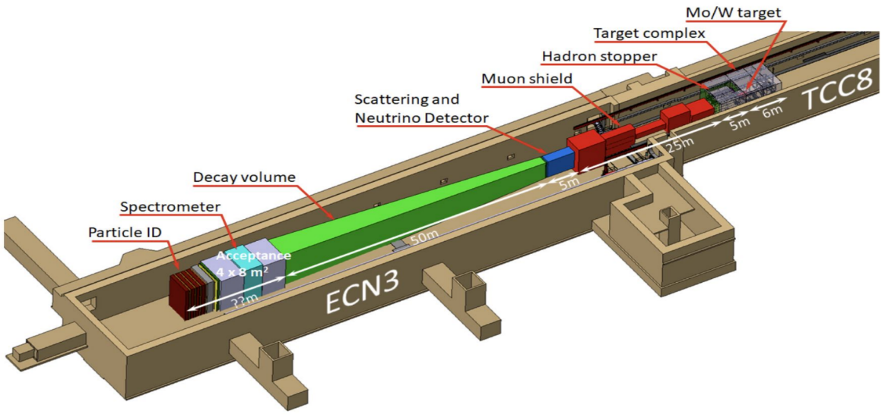
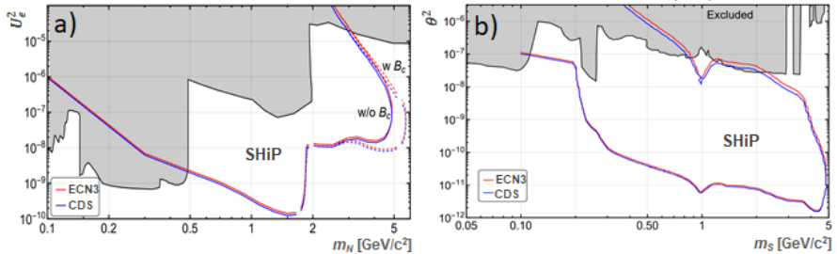
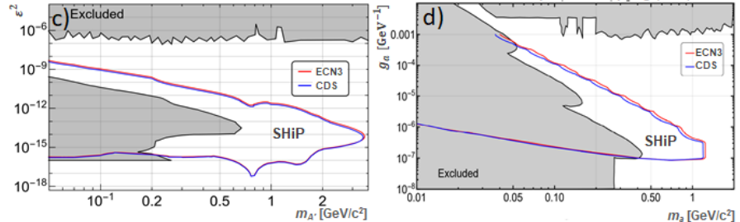
SPS
New location : ECN3 (existing facility NA62)
Most suitable and cost effective option
Submitted LoI (2022. 11)
SND
HSDS (Hidden sector Decay Search) spectrometer
original location
HNL
Dark scalar
New detector optimization
ECN3
CDS
Smaller ECN3 exp hall → Subdetectors re-optimization
Almost same sensitivities of Hidden particles
Dark photon
ALP
Original (CDS)
ECN3
SND
Muon shield
Decay volume
HSDS aperture
(ECC+ magnet), RPC
30 m
50 m
5 x 10 m²
ECC, (RPC+magnet)
25 m
Same
4 x 8 m²
(shorter distance
Beam dump & HSDS)
ESPPU (European Strategy of Particles Physics Update) 2020. 5
Among the proposals for larger-scale new facilities investigated
within the Physics Beyond Colliders study,
the Beam Dump Facility at the SPS emerged as one of the frontrunners.
However, such a project would be difficult to resource within the CERN budget,
considering the other recommendations of this Strategy
But SPS BDF R&D
was approved
by SPSC.
New experimental
site : ECN3
LoI : CERN-SPSC-2022-032 (2022)

Slide 14

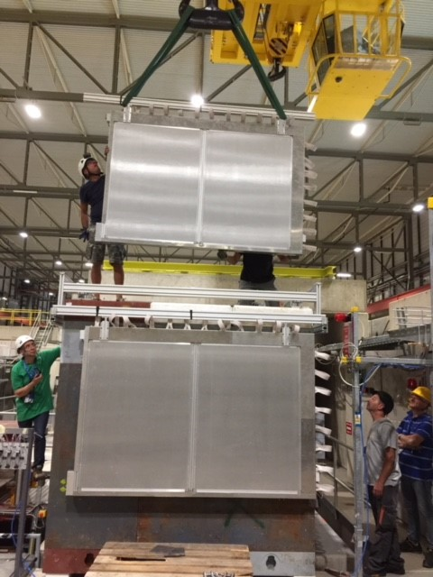
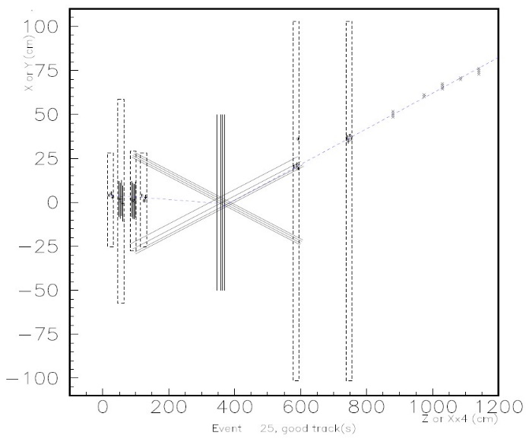
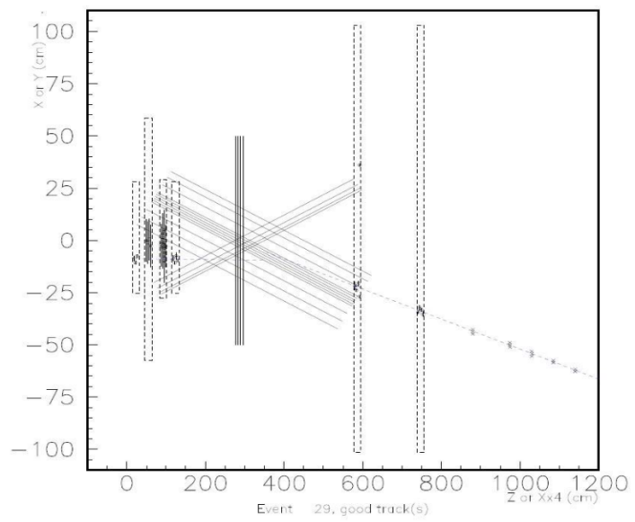
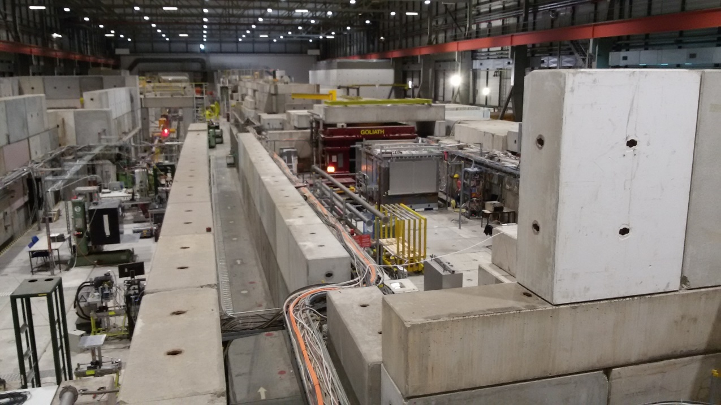
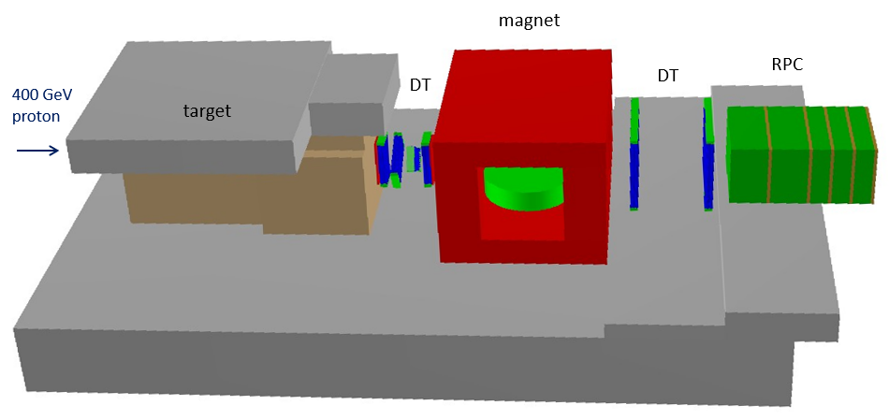
SPS Beam test of SHiP RPC (H4, 2018)
Installation of RPC fabricated by KODEL
for muon flux measurement & charm production study
5 RPC planes
Clear RPC hits

Slide 15
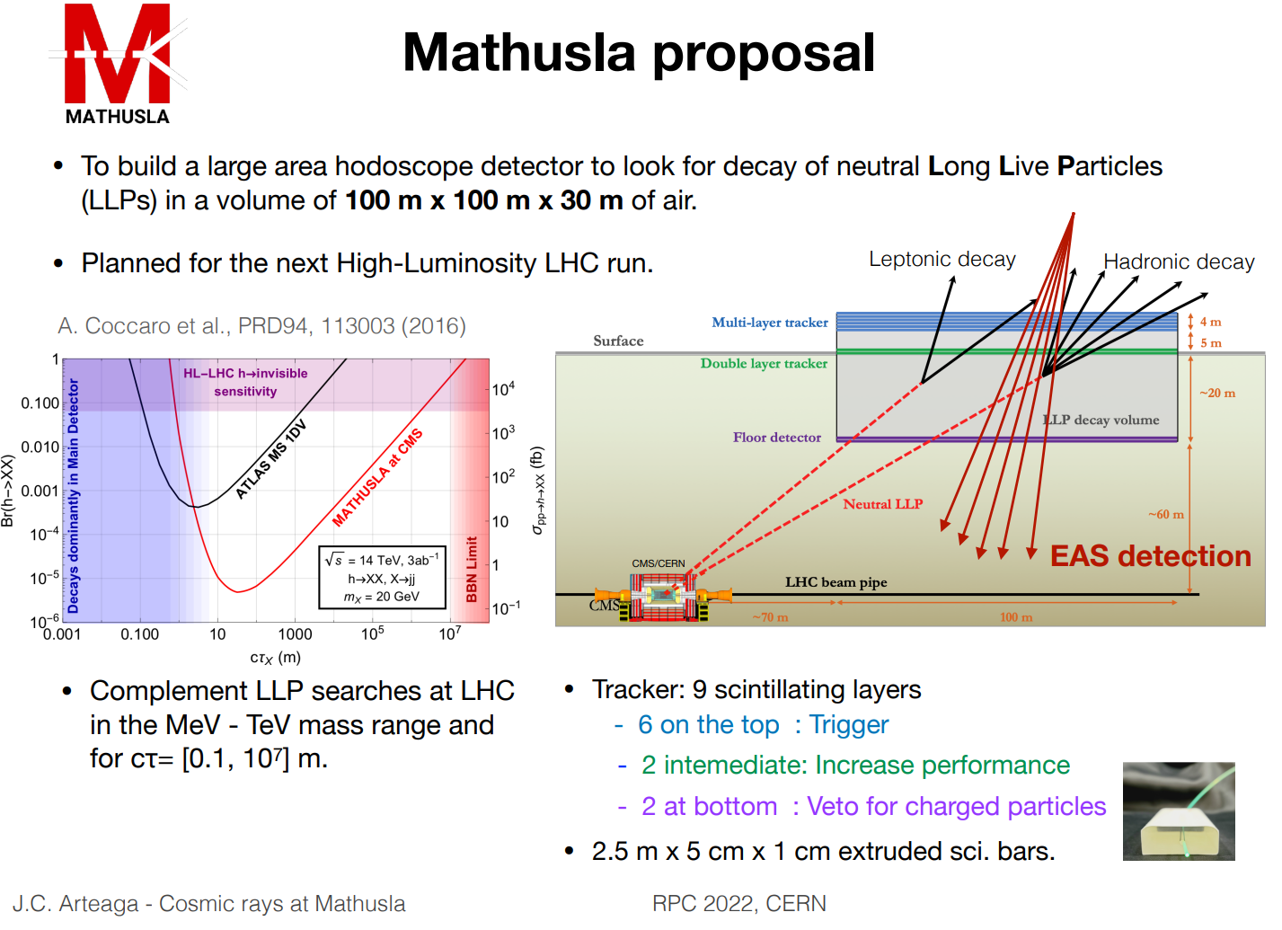
New experiment

Slide 16
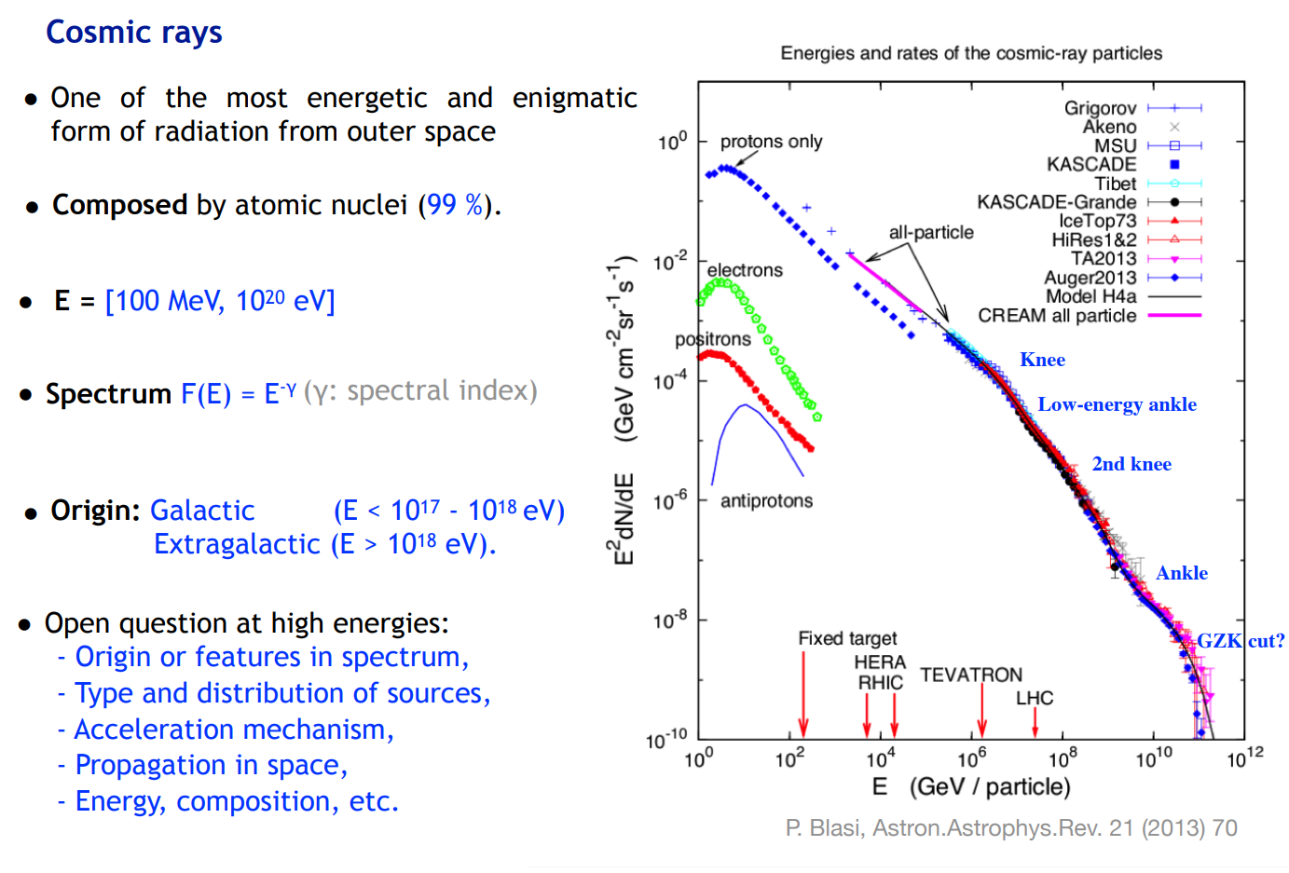

Slide 17
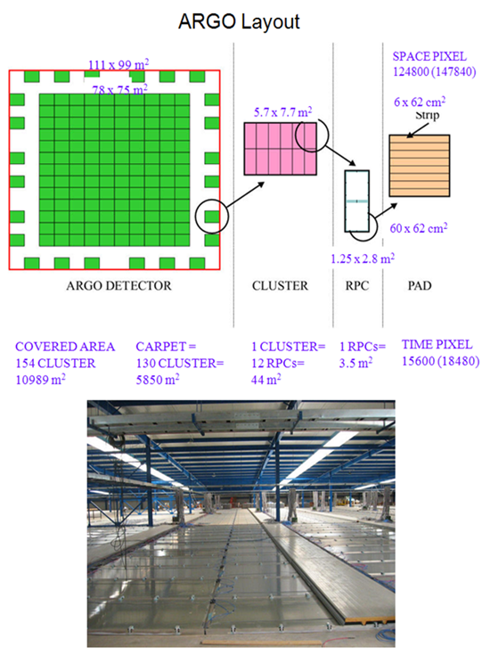
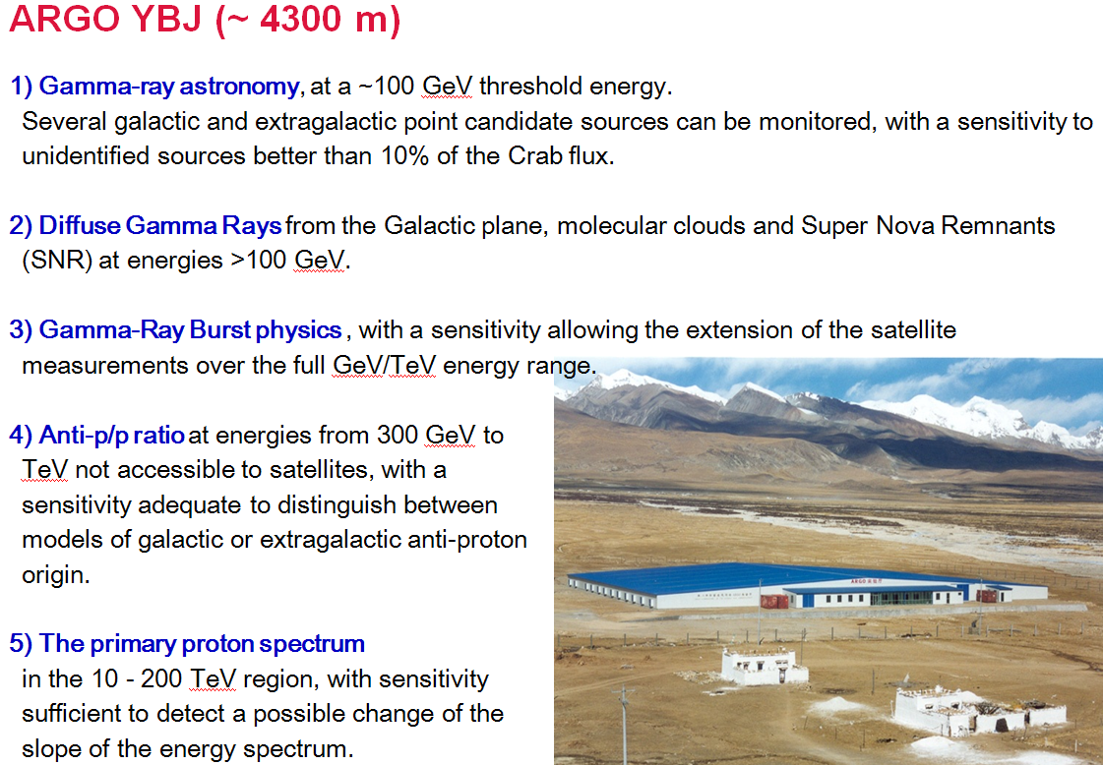
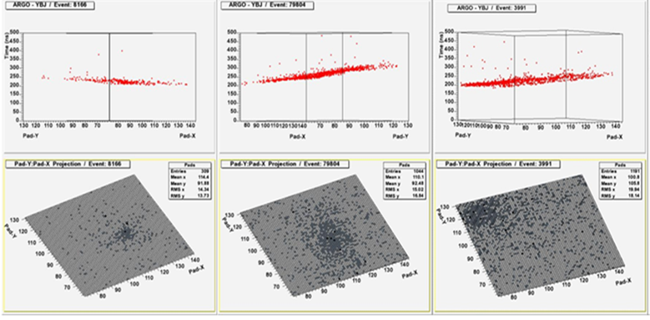
Cosmic ray experiments, ARGO YBJ China

Slide 18
3. Applications

Slide 19
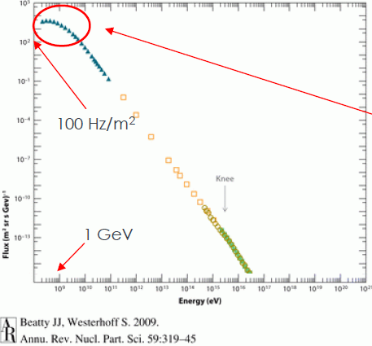
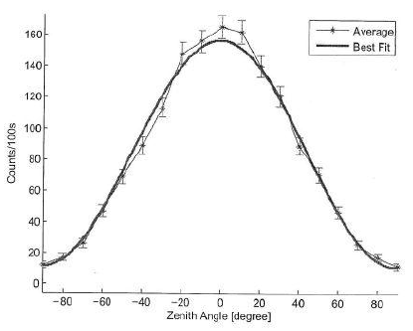
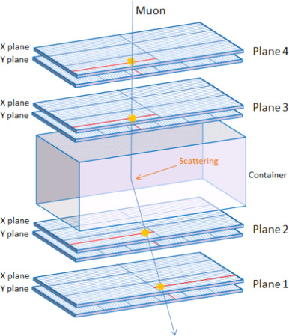
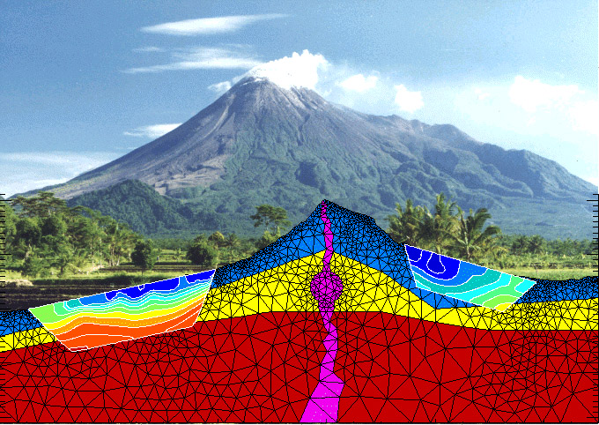
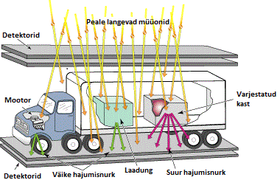
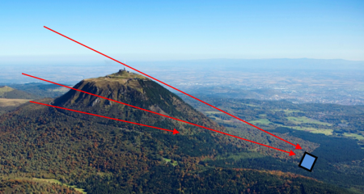
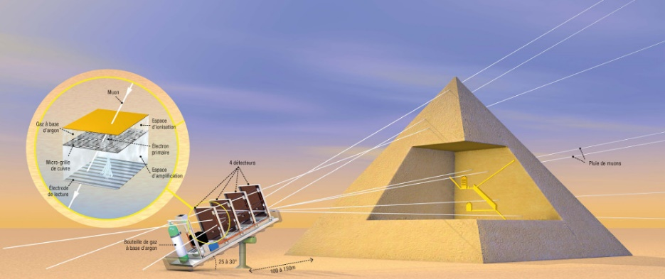
1. Muon radiography
POS(EPS-HEP2017) 609
Volcano inspection
Truck inspection
Inspection inside a pyramid(?)

Slide 20





Inspection of reactor cores
Annals of Nuclear Energy 78 166 (2015)
Used plastics scintillators.
The coincidence detector system should be relatively handy and movable.

Slide 21



Inspection of reactor cores using 2D RPCs
Tracking simulation
Prototype detector
총 tracking 검출기 수 = 8면
Electronics 채널 수 ~ 2000 channels
각 검출기 면에서의 이차원 위치분해능 < 3 mm
Tracking 각분해능 ~ 3 mrad
기능: 핵반응로 연로봉 상태 파악
Inspection time ~ a few days
Reconstruction 가능 뮤온 트랙 수 ~ 1M track 이상
2D detector data
2D detector data

Slide 22



Gamma-ray scan using a line-scan MRPC detector system
New idea: vertical mode line-scan type 6-gap MRPC detectors
Applications to Non destructive inspection using gamma rays (or high-energy bremsstrahlung X-rays)
Also potential applications to
1) SPECT technology + 1D line scans for particle therapy
2) In-beam PET for particle therapy
For narrow-area line-scan detections
Advantages of the vertical incidence of photons to the detector
Photons emerge in the detector from the side to perform the line scan
→ dramatically increase the effective area participating the gamma detections
Increase of the realistic detection efficiency by a factors of 5 ~ 20
Can mitigate the rate capability problem of the glass RPCs
고에너지 감마선에 대한 검출 효율을 50%이상이 되도록 설계 가능
Photons
e⁻
6-cm depth 6-gap MRPC
with 0.5 mm thick glass
Photons
Detector
Photons
Photons
Photons
Detector

Slide 23







1.5mm pixel resolution, color depth ~ 60
2.0mm pixel resolution, color depth ~ 100

Slide 24
Two pairs of 2.7-m-long line detectors
with a stereo angle
4 x 320 = 1280 channels
Detector depth ~ 20 cm
Strip pitch ~ 1 cm
Proposed real-sized gamma-scan system
Wish to use list-mode data for imaging
~ 6 m distance from source to detectors
Maximum measurable size cargos
Area = 180 cm x 300 cm
Depth ~ 150 cm
10 Ci ¹³⁷Cs or
~ 2 Ci ⁶⁰Co
Gamma images
Scan time ~ 60 seconds
Scan area ~ 250 cm x 400 cm
Pixel resolution ~ 3 mm
Color depth ~ 500
(~ 500 M γ/scan → fast FPGA process & memory for line image data )
Ethernet communication for slow control
Stereo-angle measurement for depth search

Slide 25


Application to on-line verification of beams in particle therapy.
→ Verification of therapy beams (protons and heavy ions) by measuring prompt gammas
In-beam PET (positron emission tomography)
Single-photon emission tomography using collimators
Compton camera (valid only for point-source searches)
Proton-beam Gantry at Samsung
Fixed carbon beam line at HIMAC
Detector

Slide 26



고에너지 감마선에 민감한 RPC 특성을 활용 암치료시 양성자 치료빔을 실시간으로 검증하는 검출기술에 적용. 양성자나 탄소빔과 같은 하드론 입자선을 암치료에 사용할 때 조사 대상의 치료부위에서 핵반응에 의해 양성자, 중성자, 다양한 중이온, 전자, 양전자, 감마선 등 많은 이차 입자가 발생.
환자를 빠져오는 감마선을 영상화.
GEANT4 simulations
4.74 GBq Cs-137 조사장치로 실험
What is the mission?: verifying distal edges of therapy beams

Slide 27
4. 지난 20여년간 CMS RPC 연구에 대한 한국 그룹의 역할

Slide 28





RPCs System for CMS and the upgrade plan
Barrel RPCs
- 6 stations (layers)
- Fully covering up to η = 0.8
- Partially covering up to η = ~ 1.2
Endcap RPCs
- 2 wings (RE+, RE-)
- 4 stations (RE1, RE2, RE3, RE4) in each wing
- Covering 0.92 < η <2.1
Low-η
Forward
RPCs
4-th Station
via PHASE I
upgrade
(2014)
RE3
RE2
RE1
RE4/3
RE3/3
RE2/3
Barrel RPCs
RE1/3
RE4/2
RE3/2
RE2/2
RE1/2
New RPCs for CMS (iRPCs)
Trigger double-gap RPCs but with 2D tracking capability
Efficiency > 95%
Time resolution < 1 ns
Position resolution in φ ~ 3 mm
Position resolution in r ~ 2 cm
RE4/1
RE3/1
RE2/1
High-η Forward
RPCs (Plan)
RE3/1
GE1/1
GE2/1

Slide 29

2003 – 2008
1st construction of trigger RPCs at CMS endcaps

Slide 30

2011 – 2014
1st extension of trigger RPCs at CMS endcaps
2013 – 2014

Slide 31



2022 - 2027
2nd extension of RPC triggers up to |η| = 2.1 with improved RPCs at RE3.1 and RE4.1 for the Phase-2 LHC
→ Enhancing muon trigger efficiencies over all |η| <2.4
Road map for iRPCs
In Phase-2 LHC (HL-LHC) runs,
The instantaneous luminosity → 5 × 10³⁴ cm⁻² s⁻¹
High background at the highest η ~ 700 Hz cm⁻²
Far higher trigger rates compared to Run 3
Accelerated aging effects on all RPCs
Complex event reconstruction for muons
Amrutha Samalan (RPC2022, Sept 26. 2022)

Slide 32

Improves RPCs for the Phase-2 CMS
Both CMS RPCs and new CMS iRPCs are double-gap (double-gas volume) RPCs
What are the difference of the iRPCs compared to the existing CMS RPCs?
민감도가 높은 기능이 향상된 improved RPC
Higher space-charge effect (toward a deeper limited proportional mode)
with an higher electric field in the gas volumes
Wider efficiency plateau to accommodate higher rate capability
Lower operational HV for electrical safety
Lower ionic charges to mitigate detector aging
Digitization threshold: 150 ~ 170 fC (RPCs) → 36 ~ 50 fC (iRPCs)
Mitigation of aging effects (by radiation current)
→ Ionic charge (avalanche) of a muon pulse: 70 pC (RPCs) → ~ 40 pC (iRPCs)
2D RPC trigger/tracking with better position resolutions in both r and φ directions
1D readout with 3 η divisions (RPCs) → 2D readout (iRPCs)
위치분해능: φ 방향 = 3 mm, R 방향 (strip 방향) = 1.5 cm

Slide 33
Infrastructure for iRPCs (international collaboration)
HPL (QC1, Puricelli)
HPL production
Quality control inspection
& resistivity data
RPC electrodes (QC2, KCMS)
Electrode production
Quality control test
Front end (QC1, Lyon)
FEBs with FPGA
Quality control test Radiation hardness
Back-end (IHEP)
Prototyping (Dec. 2022)
Production (March 2024)
Installation/commissioning (June 2026)
Link electronics (IPM) Prototyping (June 2022)
Production (August. 2023)
Installation/commissioning (June 2026)
RPC chambers
(QC2, QC3, Ghent, Iberoamericana)
Detector assembly
Quality control test
Added to iRPCs
Final integration of iRPCs (QC4, 904 @CERN)
Final quality control test
Added to iRPCs
Service installation (CERN)
Gas system, Cooling system
HV system, Low voltage system,
Cabling, Optical fibers
Chamber commissioning of RPC (+ iRPCs) system
(QC4, p5 @CERN)
Detector commissioning with run3 beams

Slide 34






Construction and installation of four Demonstrator iRPCs @P5 completed on January 2021.
Amrutha Samalan (RPC2022, Sept 26. 2022)
Recent commissioning of demonstrator chambers at CMS Cavern
Low noise (max 1 Hz/cm² ) with final CMS endcap disk grounding
Normal/stable operation temperature in CMS endcap closed mode and CMS endcap water cooling
Normal operation in 3.8T magnetic field

Slide 35
결론과 향후 전망
지난 30년간 RPC는 입자물리학, 핵물리학, 천체물리학에서 핵심 검출기 중 하나로 자리매김함.
입자물리학 실험 검출장치가 대형화 함에 따라 1 mm 이하의 위치 분해능을 요구하지 않는 범위에서 DT, MWPC, drift chamber 등 기존의 tracking 검출기를 대체하는 경향.
검출 시스템을 대형화 하기 용이하고 단가가 비교적 낮기 때문에 암흑물질, Beyond standard model LLP 탐색에 필수불가결한 검출기로 발전. 그 대신 검출기 민감도와 기능을 강화하여 4차원 tracking이 가능한 방향으로 발전함.
응용분야: 뮤온 래디오그래피 분야 유일한 대안. → 핵연료 검색
고에너지 감마선에 민감하게 검출기를 개발. → 감마선 투시검색과 입자선 치료빔 검증 등
RPC 2022 Workshop has been successfully held on the last Sept. 2022 at CERN.
The next conference site on fall 2024 will be Santiago, Spain.
The RPC conference organization committee strongly pushes the conference site of RPC 2026 to Seoul Korea.

Slide 36
Backups

Slide 37

Gluing gaps

Slide 38

Linseed oil varnishing

Slide 39



Recently, a new LOI for SHiP/BDF facility @ECN3 submitted
Nov. 7th – 9th, 2022
Physics Beyond Colliders Annual Workshop
https://indico.cern.ch/event/1137276/
https://indico.cern.ch/event/1166678/

