Slide 1
Ab initio study for electron-phonon coupling of Nb-doped SrTiO₃ with Jellium model
Minwoo Park and Suk Bum Chung
Department of Physics, University of Seoul

Slide 2
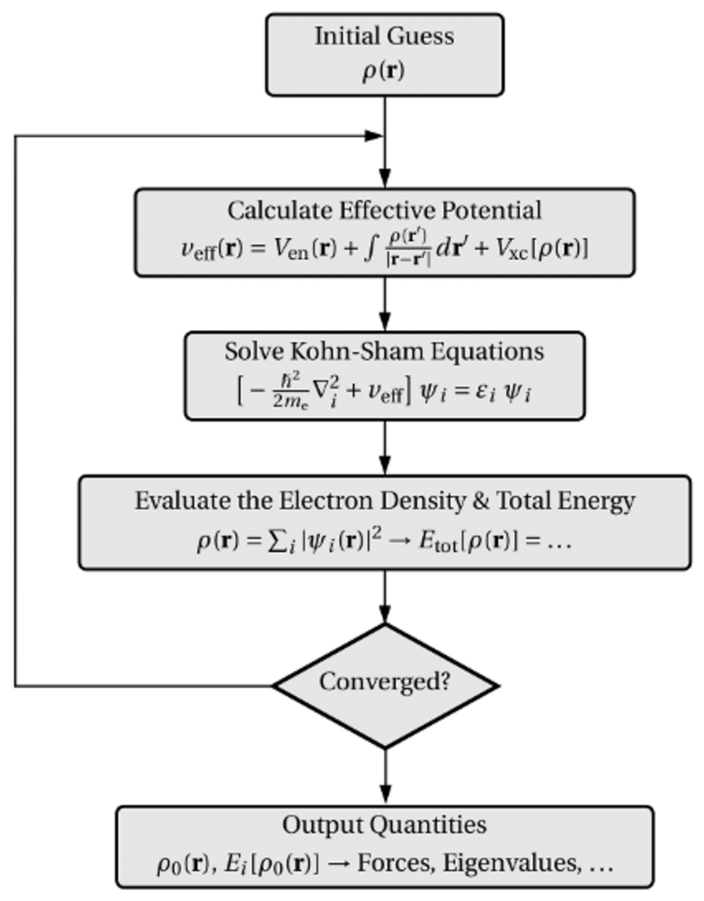
Density Functional Theory
Many-body
H : Hamiltonian, K : kinetic energy,
V : potential energy by charged nuclei,
U : the electron-electron interaction energy
: electrons density, : orbital
One-body
K : Sham kinetic energy, V_{en} : electron-nuclei potential,
V_{H} : Hartree (Coulomb) potential,
V_{XC} : exchange-correlation potential

Slide 3
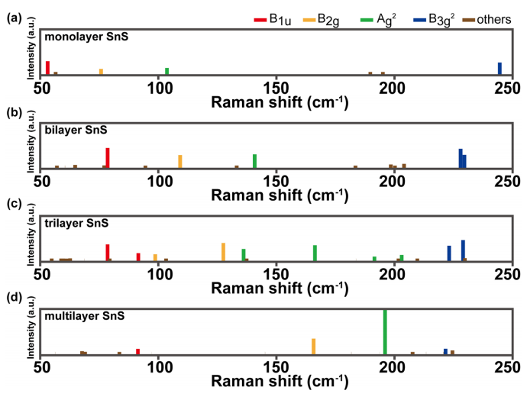
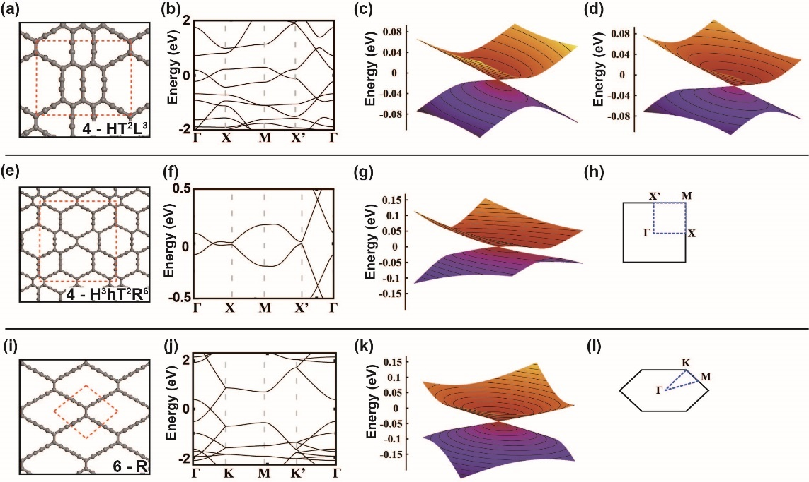
DFT examples
Z₂ in new 2D carbon systems
Raman shift of IV-VI 2D materials
Minwoo Park, el al., npj Computational Materials 4, 54 (2018)
Minwoo Park, et al. Scientific Reports 9, 19826 (2019)

Slide 4
Superconductivity with BCS pairing
Bardeen-Cooper-Schrieffer (BCS) solution
  Assumes weak electron-phonon coupling and ‘adiabatic condition’ E_{F}>>ħω_{D}
  No pseudo-gap,
  i.e. nonzero ∆(T) only below T_{c}
  BCS ratio 2∆(T=0)/k_{B}Tc = 3.53
  Infinitesimal interaction sufficient, i.e. ∆(T=0)=2ħω_{D}e^{-1/λ} (λ: interaction parameter)
Under ‘adiabatic condition’ E_{F}>>ħω_{D}, solution found for large λ, i.e. strong interaction (Migdal-Eliashberg)

Slide 5
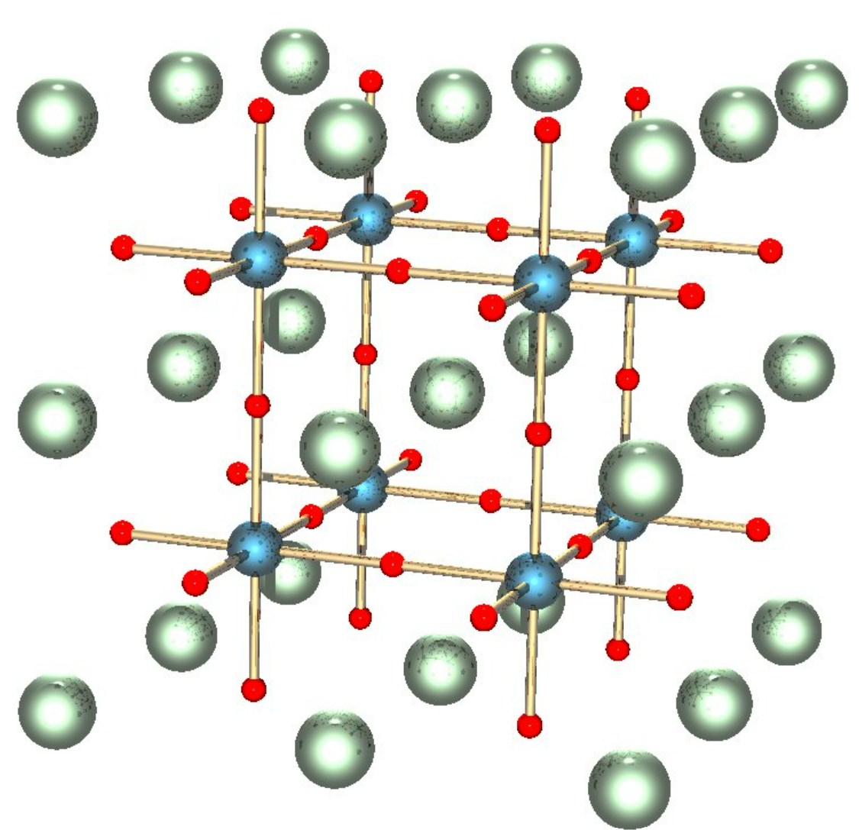
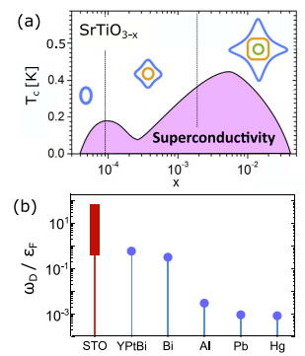
Introduction of SrTiO₃ (STO)
Cubic Perovskite
Wide indirect bandgap (3.25 eV)
Superconducting dome by doping
  n-type doping with T_{c} ≤ 0.3 K
Unconventional superconductor
  Not BCS – semiconductor, not metal
The origin of superconductivity is still open problem.
Structure of SrTiO₃. The red spheres are oxygens, blue are Ti⁴⁺ cations, and the green ones are Sr²⁺.
M.N. Gastiasoro et al., Ann. Phys. (2020)

Slide 6
Superconductivity in doped STO
● Superconducting dome over
finite range of doping discovered in
1960s!
(Schooley et al Phys Rev Lett 1964;
Koonce et al Phys Rev 1967)
● For half-a-century, the worst known
violation of E_{F}>>ħω_{D}
⇒ ┌ anything conventional left?
└ what about ∆(T=0)?

Slide 7
Varieties in n-type STO
● Various methods, i.e. ┌ Nb substituting Ti
├ O vacancy
└ La substituting Sr
● Effect on TO₁ mode may be dependent on dopant type
▶ Nearly identical hardening for Nb-doping and O-deficiency
→ higher dopant concentration means further from crystal quantum criticality
(Bäuerle et al 1980 Z Phys B
Van Mechelen et al 2008 Phys Rev Lett)
▶ No hardening confirmed for La-doping
● Experimental probe easiest for Nb-doped STO

Slide 8
Difference with O-reduced STO
● Superconducting dome at lower density
observed in O-reduced STO
● BCS ratio NOT confirmed for O-reduced STO
- resistant to tunneling spectroscopy
(X Lin, Behnia et al. 2014 Phys Rev Lett)

Slide 9
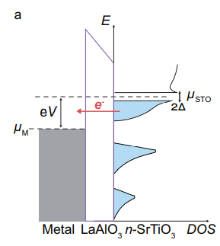
Tunneling spectroscopy on SrTi_{1-x}Nb_{x}O₃
(H Yoon, SB Chung, H Hwang et al. arXiv 2021)
X=0.005
● Cooper pair binding energy 2∆(T) measured by planar tunneling spectroscopy,
e.g. voltage difference between two di/dv peaks for very low T

Slide 10
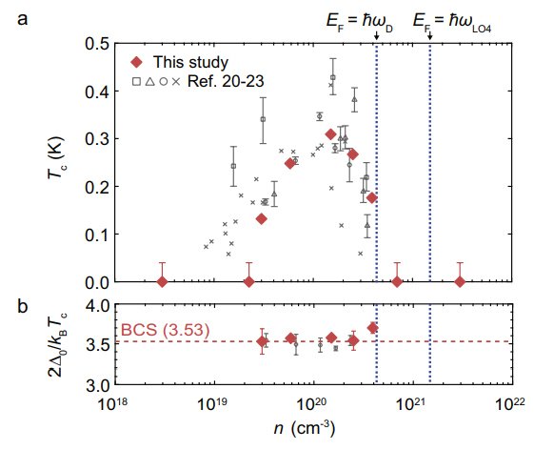
Measured gap to T_{c} ratio
(H Yoon, SB Chung, H Hwang et al. arXiv 2021)
● Combine ∆(T) from tunneling spectroscopy with T_{c} from resistivity measurement
▶ No pseudogap!
i.e. ∆(T)≠0
requires T<T_{c}
● BCS 2∆(T=0)/k_{B}T_{c}= 3.53 always holds!
⇒ conventional relation between the Cooper pair binding energy and T_{c} while E_{F}<ħω_{D}?

Slide 11
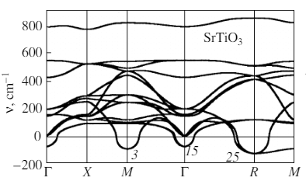
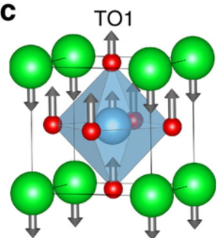
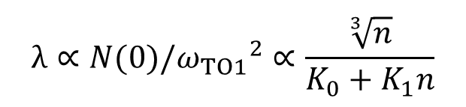
Possible to bring back adiabaticity
E_{F}
TO₁
A. I. Lebedev, Phys. Solid State (2009)
Only TO₁ mode remains slower than E_{F} over the entire superconducting dome
Adiabatic condition would hold for pairing mediated only by TO₁ mode
Explains the superconducting dome from
$$λ∝N(0)/{ω_{TO1}}^{2}∝\frac{\sqrt[3]{n}}{K_{0}+K_{1}n}$$
Underdoping – DOS too low
Overdoping – TO₁ mode too hard

Slide 12

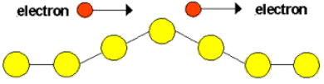
Different phonon mediated interaction
● Conventional phonons:
● TO₁ phonons:
→ couples to density
→ Rashba coupling to
spin current density
▶ TO₁ phonons can also mediate pairing interaction
(Kozii and Fu PRL 2015; Y Wang et al. PRB 2016;
M Lee, H J Lee, J H Lee, SBC PRM 2020)
▶ Superconducting dome reproduced
(Y Yu, H Hwang, S Raghu, SBC arXiv 2021)

Slide 13
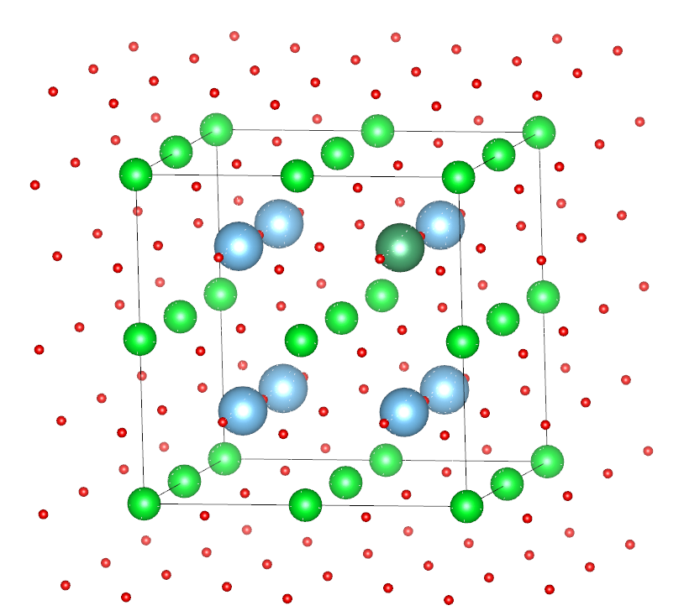
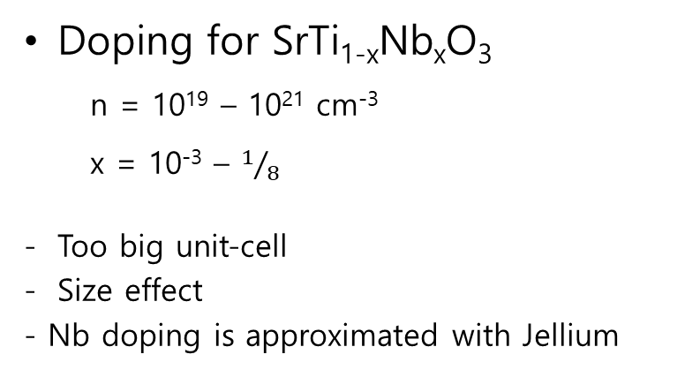
To describe doping effect
Doping for SrTi_{1-x}Nb_{x}O₃
  n = 10¹⁹ – 10²¹ cm⁻³
  x = 10⁻³ – $1/8$
Too big unit-cell
Size effect
- Nb doping is approximated with Jellium

Slide 14
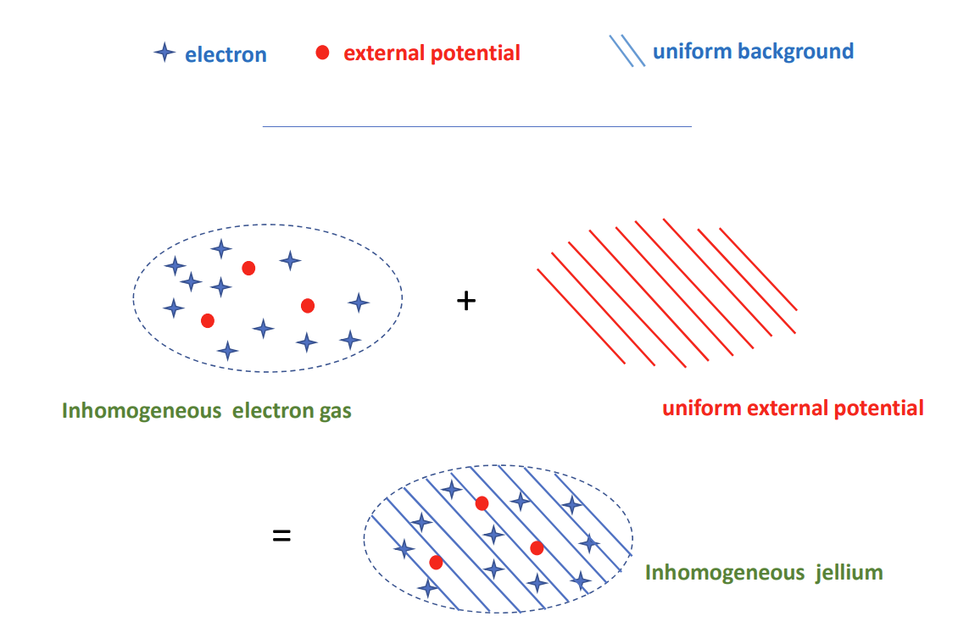
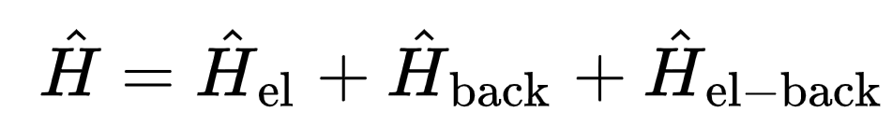
Introduction of Jellium model
Jellium
  - homogeneous background charge
  - uniformly distributed positive charges in space
H_{el} : kinetic and electron-electron repulsion
H_{back} : electrostatic interaction of the positive charge itself
H_{el-back} : electrostatic interaction of electron-background
Procedure
DFT band with
u_{TO1} & Jel.
TB parameters fitting
……
Phonon with Jel.
Get eigenvector (u_{TO1})

Slide 15
Phonon with Jellium for SrTi_{1-x}Nb_{x}O₃
SrTi_{1-x}Nb_{x}O₃ |  | Frequency |  | Phonon eigenvector
x | ~n(cm^-3) | freq(THz) | freq(meV) | Sr | Ti | O' | O | O
0 | 0.00E+00 | -2.0208 | -8.357231 | 0.2544 | 0.4547 | -0.4578 | -0.5094 | -0.5094
0.000156 | 2.55E+18 | -2.0101 | -8.313077 | 0.2547 | 0.4542 | -0.4576 | -0.5096 | -0.5096
0.001563 | 2.55E+19 | -1.8818 | -7.782295 | 0.2576 | 0.4466 | -0.4643 | -0.5093 | -0.5093
0.003125 | 5.10E+19 | -1.7299 | -7.154136 | 0.2597 | 0.4370 | -0.4693 | -0.5106 | -0.5106
0.007813 | 1.27E+20 | -1.1799 | -4.879746 | 0.2495 | 0.3928 | -0.4708 | -0.5300 | -0.5300
0.015625 | 2.55E+20 | -0.0993 | -0.410523 | 0.6592 | 0.4702 | -0.3363 | -0.3401 | -0.3401
0.03125 | 5.10E+20 | 2.2935 | 9.4853147 | 0.4320 | 0.2989 | -0.5157 | -0.4786 | -0.4786
0.125 | 2.04E+21 | 6.7076 | 27.740514 | -0.2461 | 0.8303 | -0.2066 | -0.322 | -0.322
(Negative frequency is imaginary value)
 | SrTi_{1-x}Nb_{x}O₃ |  |  |  | Phonon eigenvector
elect | x | ~n(cm^-3) | freq(THz) | freq(meV) | Sr | Ti | O' | O | O
0 | 0 | 0.00E+00 | -2.0208 | -8.357231 | 0.2544 | 0.4547 | -0.4578 | -0.5094 | -0.5094
0.01 | 0.000156 | 2.55E+18 | -2.0101 | -8.313077 | 0.2547 | 0.4542 | -0.4576 | -0.5096 | -0.5096
0.1 | 0.001563 | 2.55E+19 | -1.8818 | -7.782295 | 0.2576 | 0.4466 | -0.4643 | -0.5093 | -0.5093
0.2 | 0.003125 | 5.10E+19 | -1.7299 | -7.154136 | 0.2597 | 0.4370 | -0.4693 | -0.5106 | -0.5106
0.5 | 0.007813 | 1.27E+20 | -1.1799 | -4.879746 | 0.2495 | 0.3928 | -0.4708 | -0.5300 | -0.5300
1 | 0.015625 | 2.55E+20 | -0.0993 | -0.410523 | 0.6592 | 0.4702 | -0.3363 | -0.3401 | -0.3401
2 | 0.03125 | 5.10E+20 | 2.2935 | 9.4853147 | 0.4320 | 0.2989 | -0.5157 | -0.4786 | -0.4786
8 | 0.125 | 2.04E+21 | 6.7076 | 27.740514 | -0.2461 | 0.8303 | -0.2066 | -0.322 | -0.322

Slide 16
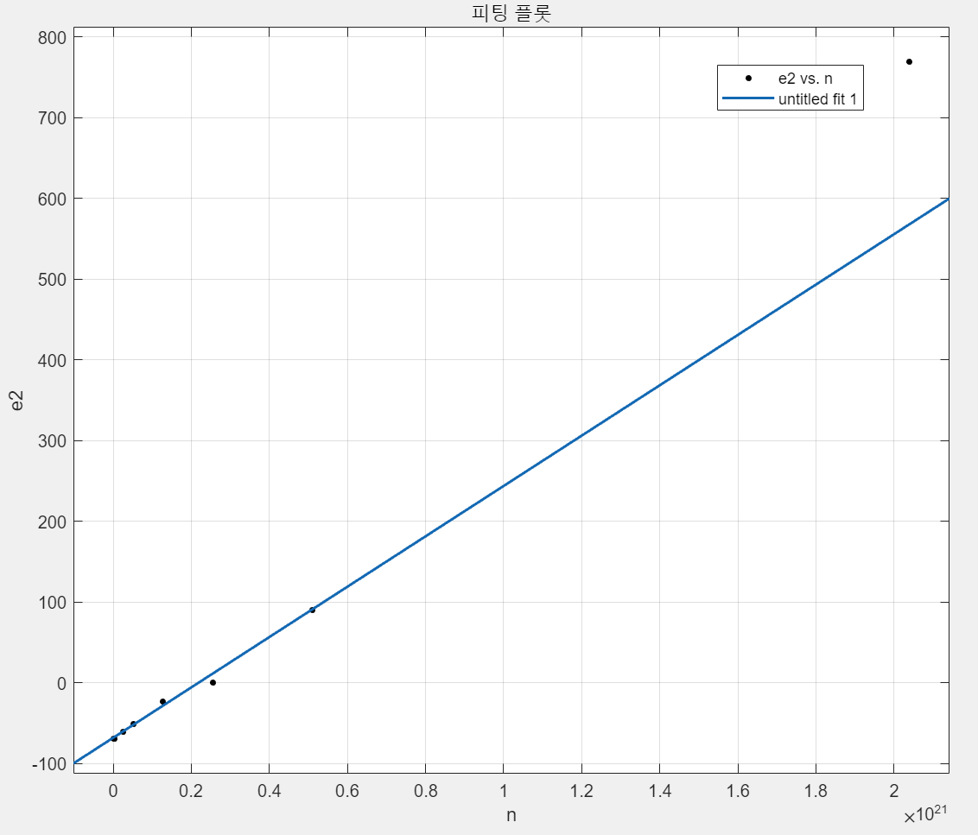
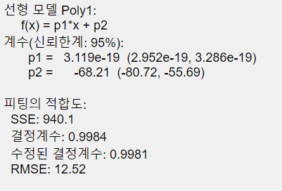
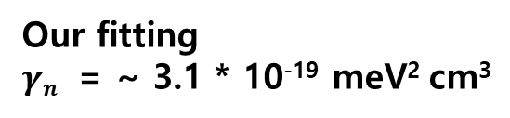
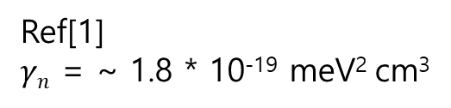
TO₁ mode with Jellium PBEsol
To confirm a relation between phonon frequency of TO₁ mode and the concentration
We adopt a phenomenological equation from ref[1]
x=1/8
(SrTi_{1-x}Nb_{x}O₃)
Our fitting
$γn$ = ~ 3.1 * 10⁻¹⁹ meV² cm³
ω²(meV²)
Ref[1]
$γn$ = ~ 1.8 * 10⁻¹⁹ meV² cm³
Jellium is good agreement for phonon
[1] Annals of Physics 417 168107 (2020)

Slide 17
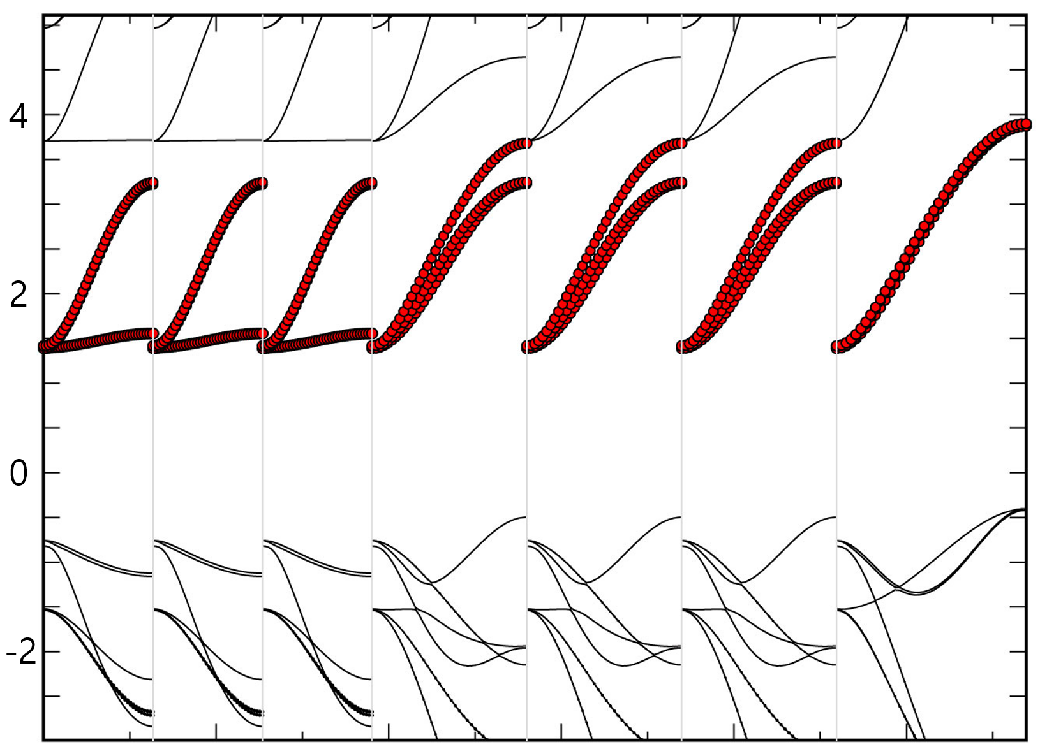
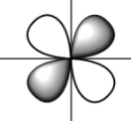
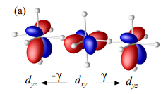
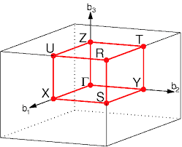
Tight Binding model for STO
Band structure of STO
= t_{2g} orbital of Ti
y
x
t₂
t₃
t₁
E - E_{fermi} (eV)
Only t_{2g} orbital considered for Tight Binding(TB)
t₁, t₂ and t₃ are hopping parameters
Γ X|Γ Y|Γ Z|Γ S|Γ T|Γ U|Γ R

Slide 18
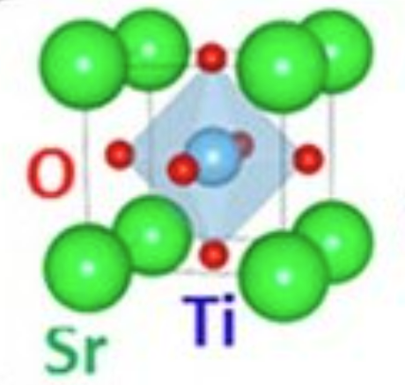
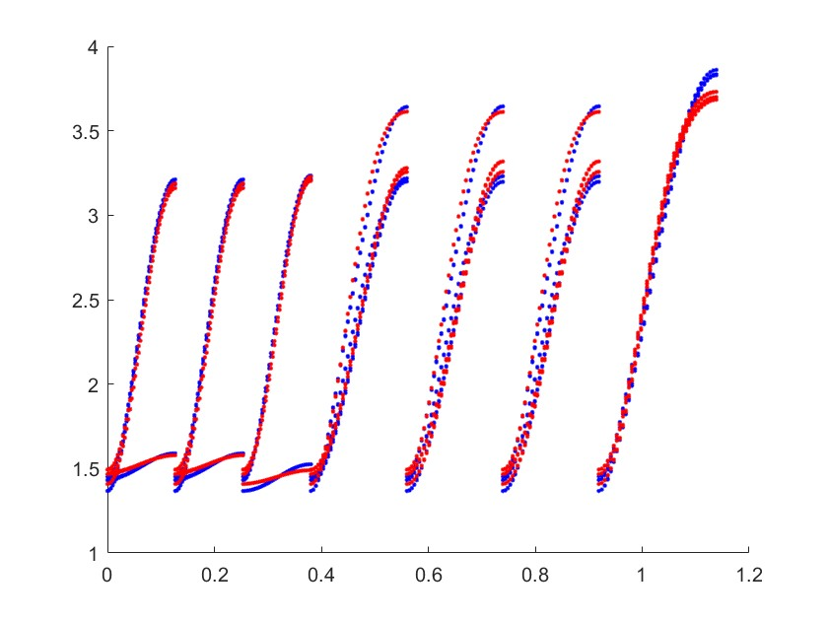
Tight binding model with phonon displacement
Distorted unit-cell by phonon mode
TB parameters for t_{2g} of Ti
Self energy : e₁ (for d_{xy}) e₂ (for d_{yz} , d_{xz})
+ d ∙ u_{TO1} =
xyz | hopping | d orbital | xyz | hopping | d orbital
R001 | t1' | xz | R011 | - | xz
 | t2 | xy |  | - | xy
 | t1' | yz |  | t3' | yz
R100 | t1'' | xz | R101 | t3' | xz
 | t1 | xy |  | - | xy
 | t2' | yz |  | - | yz
R010 | t2' | xz | R110 | - | xz
 | t1 | xy |  | t3 | xy
 | t1'' | yz |  | - | yz
u_{TO1} : eigenvector of TO₁ mode
d : displacement
Band structure of distorted STO
DFT
TB
Energy
y
x
t₂
t₃
t₁
Γ X|Γ Y|Γ Z|Γ S|Γ T|Γ U|Γ R

Slide 19
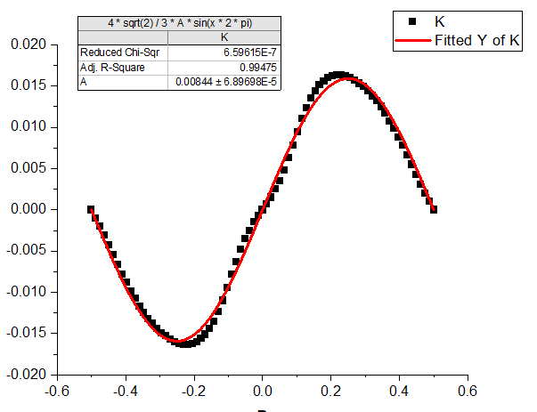
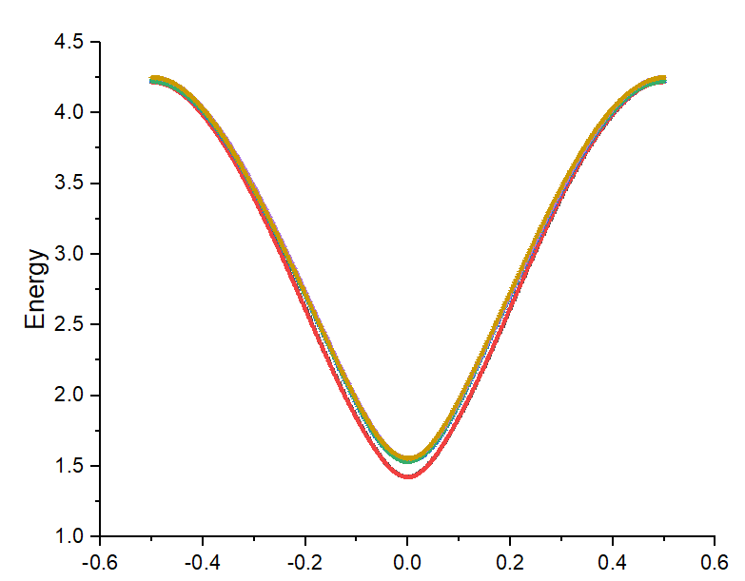
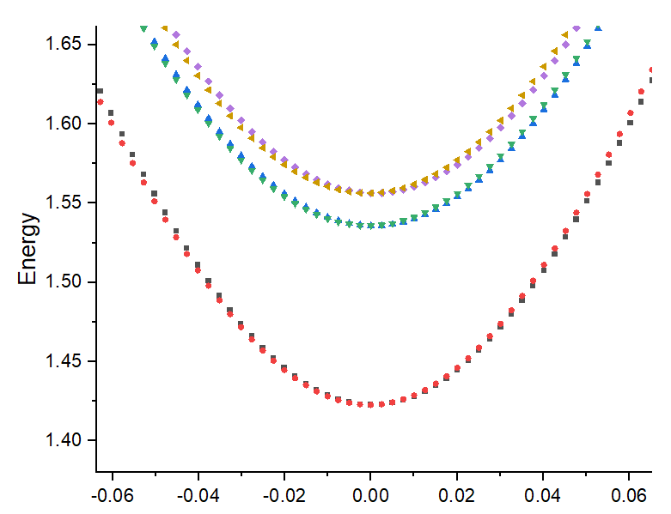
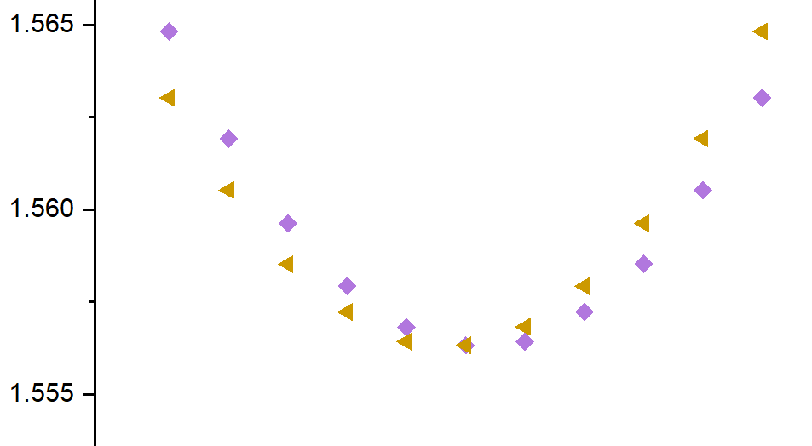

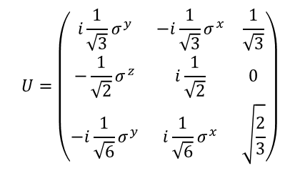
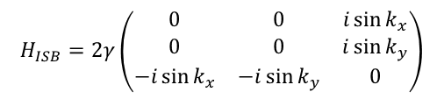

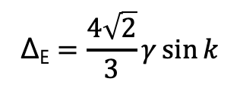
Energy splitting by symmetry breaking by TO₁ displacement
$$H_{ISB}=2γ\left(\begin{matrix}0 & 0 & i\sin{k_{x}} \\ 0 & 0 & i\sin{k_{y}} \\ −i\sin{k_{x}} & −i\sin{k_{y}} & 0\end{matrix}\right)$$
$$\left\langle J_{eff}=1/2 | UH_{ISB}U^{†} | J_{eff}=1/2\right\rangle =\frac{4}{3}γ(σ^{x}\sin{k_{y}}−σ^{y}\sin{k_{x}})$$
$$U=\left(\begin{matrix}i\frac{1}{\sqrt{3}}σ^{y} & −i\frac{1}{\sqrt{3}}σ^{x} & \frac{1}{\sqrt{3}} \\ −\frac{1}{\sqrt{2}}σ^{z} & i\frac{1}{\sqrt{2}} & 0 \\ −i\frac{1}{\sqrt{6}}σ^{y} & i\frac{1}{\sqrt{6}}σ^{x} & \sqrt{\frac{2}{3}}\end{matrix}\right)$$
$$\text{Δ}\text{E}=\frac{4\sqrt{2}}{3}γ\sin{k}$$
where k=k_{x}=k_{y}=k_{z}
Fit to get $γ$
Δ_{E}
Δ_{E}
Δ_{E}
-R
Γ
R
(0,0,0)
(0.5,0.5,0.5)
K-space

Slide 20
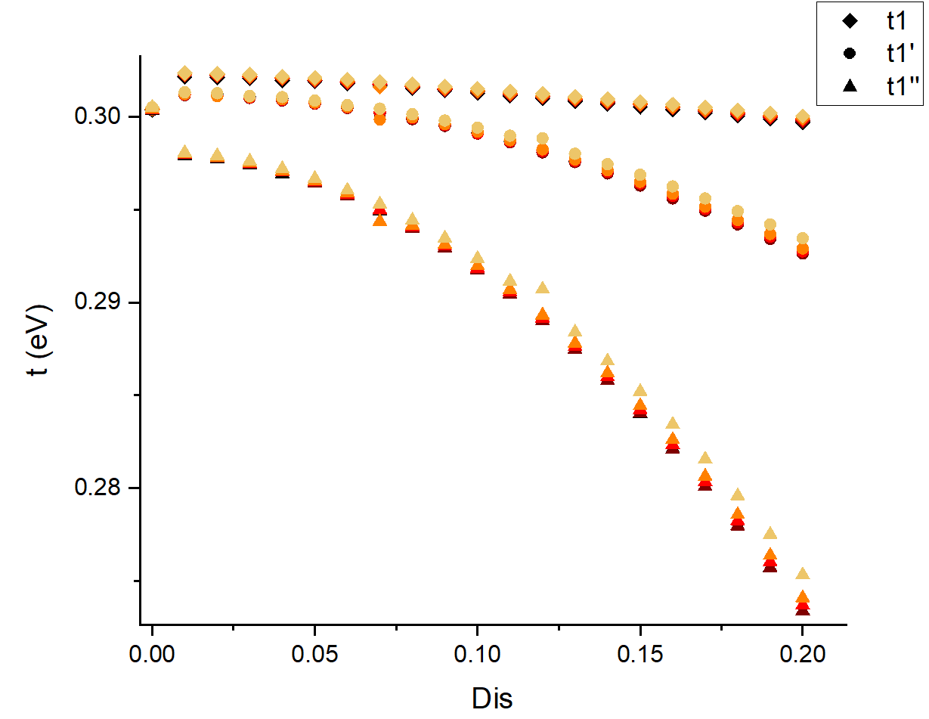
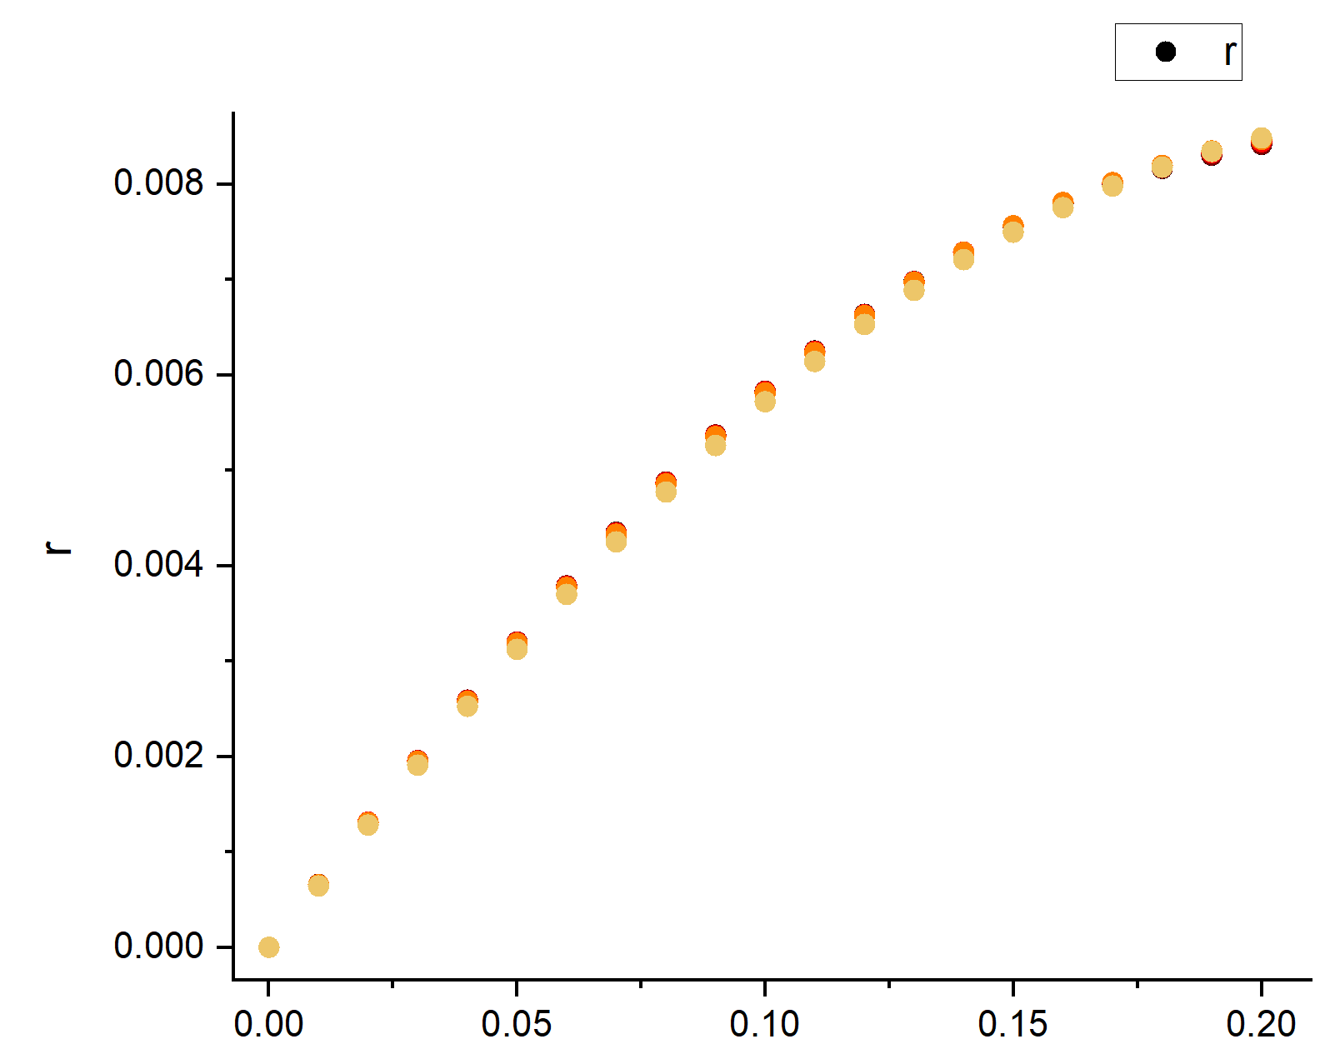

TB parameters with phonon displacement
x | n
0 | 0.000E+00 | 검
0.000156 | 2.644E+18 | 갈
0.001563 | 2.644E+19 | 빨
0.003125 | 5.288E+19 | 주
0.007813 | 1.322E+20 | 노
TB parameter
$$γ$$
d (Å)
d (Å)

Slide 21
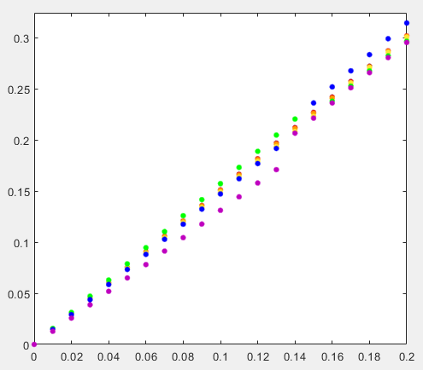
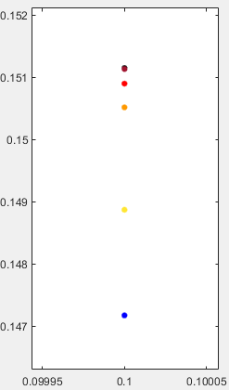
Dipole with doping effect
Set Ti [0,0,0]
Dipole = ∑ ( ∆chg * r)
x | n
0 | 0.00E+00 | 검
0.000156 | 2.55E+18 | 갈
0.001563 | 2.55E+19 | 빨
0.003125 | 5.10E+19 | 주
0.007813 | 1.27E+20 | 노
0.015625 | 2.55E+20 | 초
0.03125 | 5.10E+20 | 파
0.125 | 2.04E+21 | 보
dipole
- Dis : 0 – 0.13 & n : 0 – 1.27E+20
구간에서 도핑이 증가하면 dipole이 감소
- Dipole 감소하면 > 복원력 감소 > 진동수 감소
d (Å)

Slide 22
Conclusions
Using DFT, we calculate SrTiO₃ with jellium model to describe
Nb-doped SrTiO₃.
Phonon is well described with jellium model.
Electronic band structure has tiny change with jellium model.
Dipole results show good agreement with phonon frequency.
To do
nnn hopping? Ti – O interaction?
- quantitative analysis for dipole and phonon

Slide 23
Computational details
Vienna Ab-initio Simulation Package (VASP)
Exchange-correlation energy functional : PBEsol
The kinetic energy cutoff : 600 eV
Hellmann–Feynman force : 0.01 eV/Å.
Monkhorst–Pack scheme for k-point sampling
  6 × 6 × 6 for band structures, 3 × 3 × 3 for phonon calculation with 4 × 4 × 4 supercell
Full-relativistic SOC was considered using the noncollinear formalism as implemented in VASP

