Slide 1
CHOA
2022.02.07

Slide 2
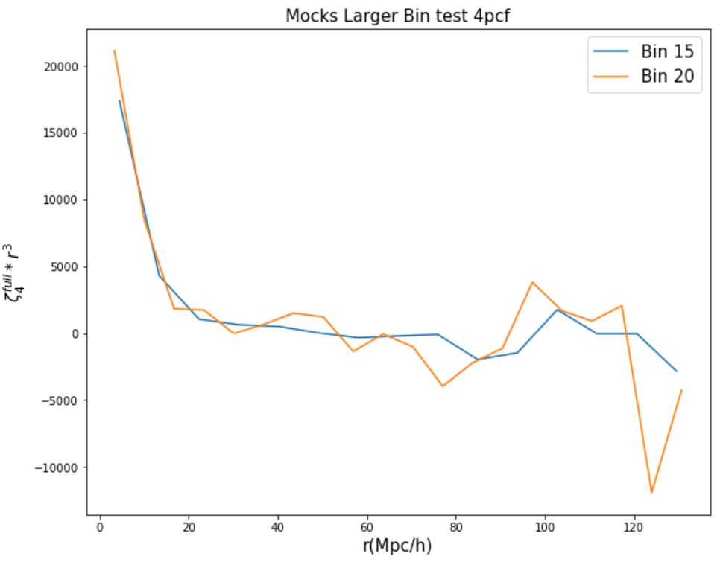
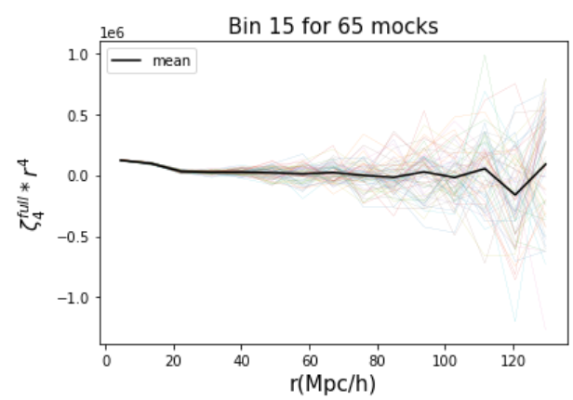
…From last presentation
Need to investigate more to see BAO
Notes:
From last time we

Slide 3
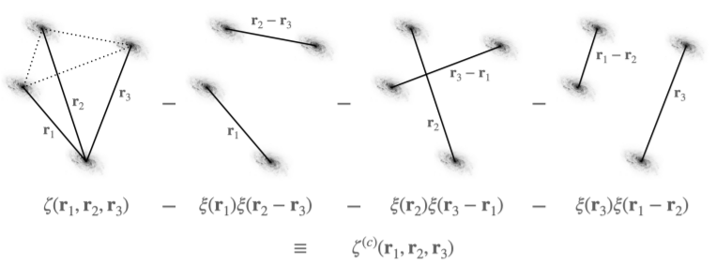
Test at the encore code
z
z
$$4pcf$$
$$3∗{2pcf}^{2}$$
Full
Disconnected
z
Connected
$$4pcf −3∗{2pcf}^{2}$$
4pcf (connected) 0%
2pcf 100%
Will connected be 0 ?
= Will encore remove disconnected part?
Fixed distance
X N
Disconnected part
$$3∗{2pcf}^{2}$$
Notes:
This week we had test at the encore code to compare it with our new code. In using encore it has a concept with full, disconnected, and connected. so we made a pair with fixed distance, randomly rotated and randomly spreaded data. It is only constructed with pairs, so there would be only 2pcf, which makes disconnected part. The question is will connected be 0? So will this encore code remove the disconnected part well?

Slide 4
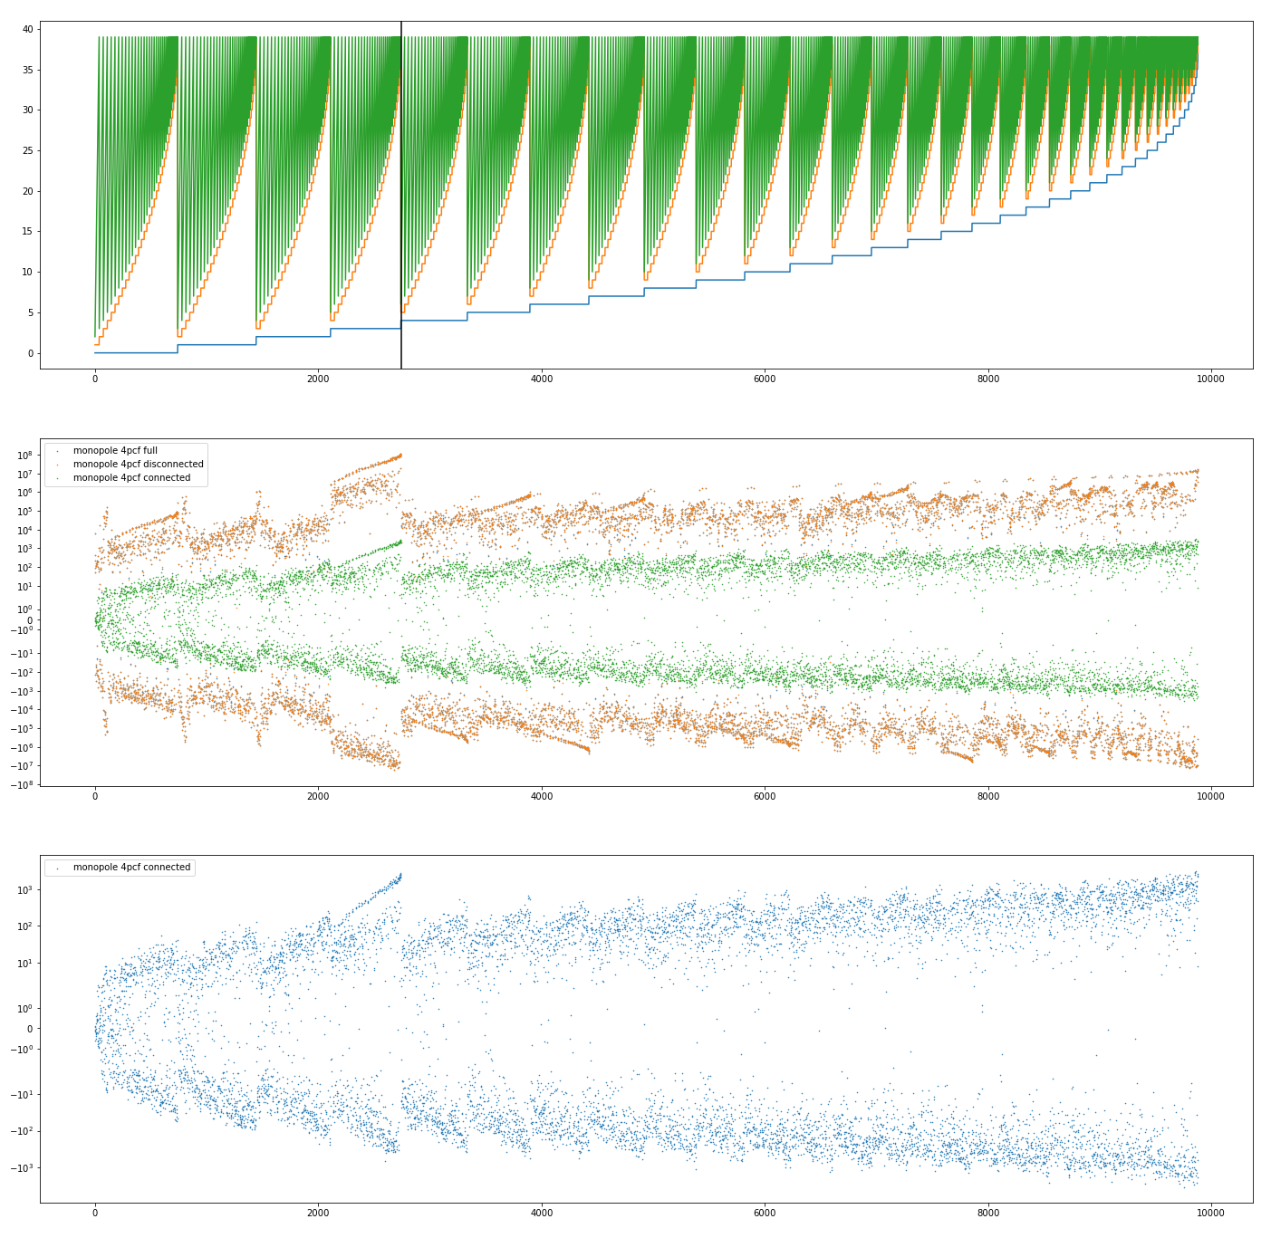
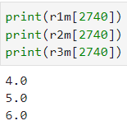
Test at the encore code
- Fixed distance 4
Bin 1, 2, 3
disconnected
connected
full
Can this connected
be a noise?
Notes:
So we did the calculation, with the fixed distance 4. The top plot is the bin 1,2,3, the middle plot shows the disconnected, connected, and the full part, and the bottom plot shows only connectred 4pcf. In the top panel the black line shows the middle panel’s peak, which prefers the fixed distance 4. It seems the disconnected part is much larger than the connected part, but it still has a value. And we wondered, can this existing connected part would be a noise.

Slide 5
Test at the encore code
- Fixed distance 4
Peak for distance 4
Seems decreasing after averaging multiple calculations,
so the connected value can be concluded as noise
Notes:
And we did the calculations, of 10, 100, 1000 averages from the bule to the red dots. Yes it seems decreasing after averaging multiple calculations and this value can be concluded as a noise, but there’s a peak for distance 4 not decreasing.

Slide 6
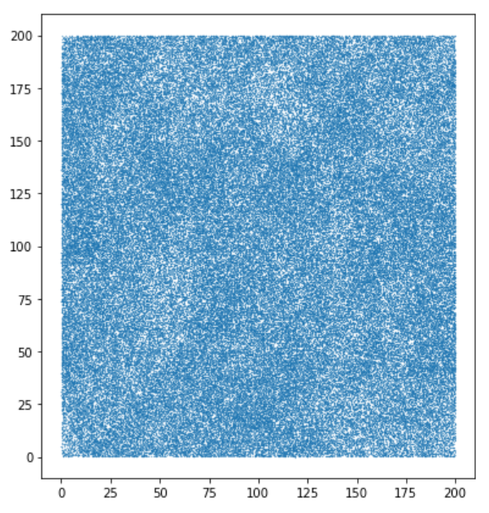
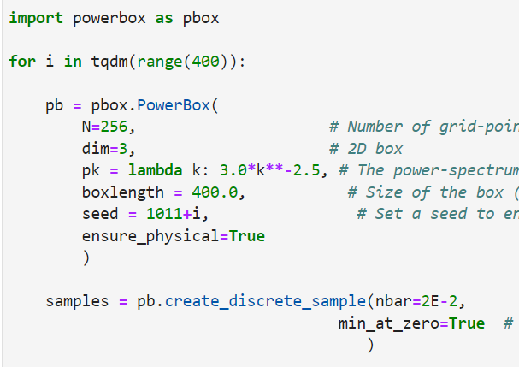
Test at the encore code 2
- Non – fixed distance
Given power spectrum
Calculates every available distance
Non -fixed distance
X N
powerbox
4pcf (connected) 0%
2pcf 100%
Will connected be 0 ?
= Will encore remove disconnected part?
Disconnected part
Notes:
So we did another test. In this time, we made a data of given power spectrum by using powerbox, that gives density grids. So it is not a data that has a fixed distance, because it calculates every available distance. And the question is same with before, will encore code remove the disconnected part well.

Slide 7
Test at the encore code 2
- Non – fixed distance
Given power spectrum
Calculates every available distance
Non -fixed distance
X N
powerbox
4pcf (connected) 0%
2pcf 100%
Will connected be 0 ?
= Will encore remove disconnected part?
Disconnected part
Notes:
So we did another test. In this time, we made a data of given power spectrum. So it is not a data that has a fixed distance, because it calculates every available distance. And the question is same with before, will encore code remove the disconnected part well.

Slide 8
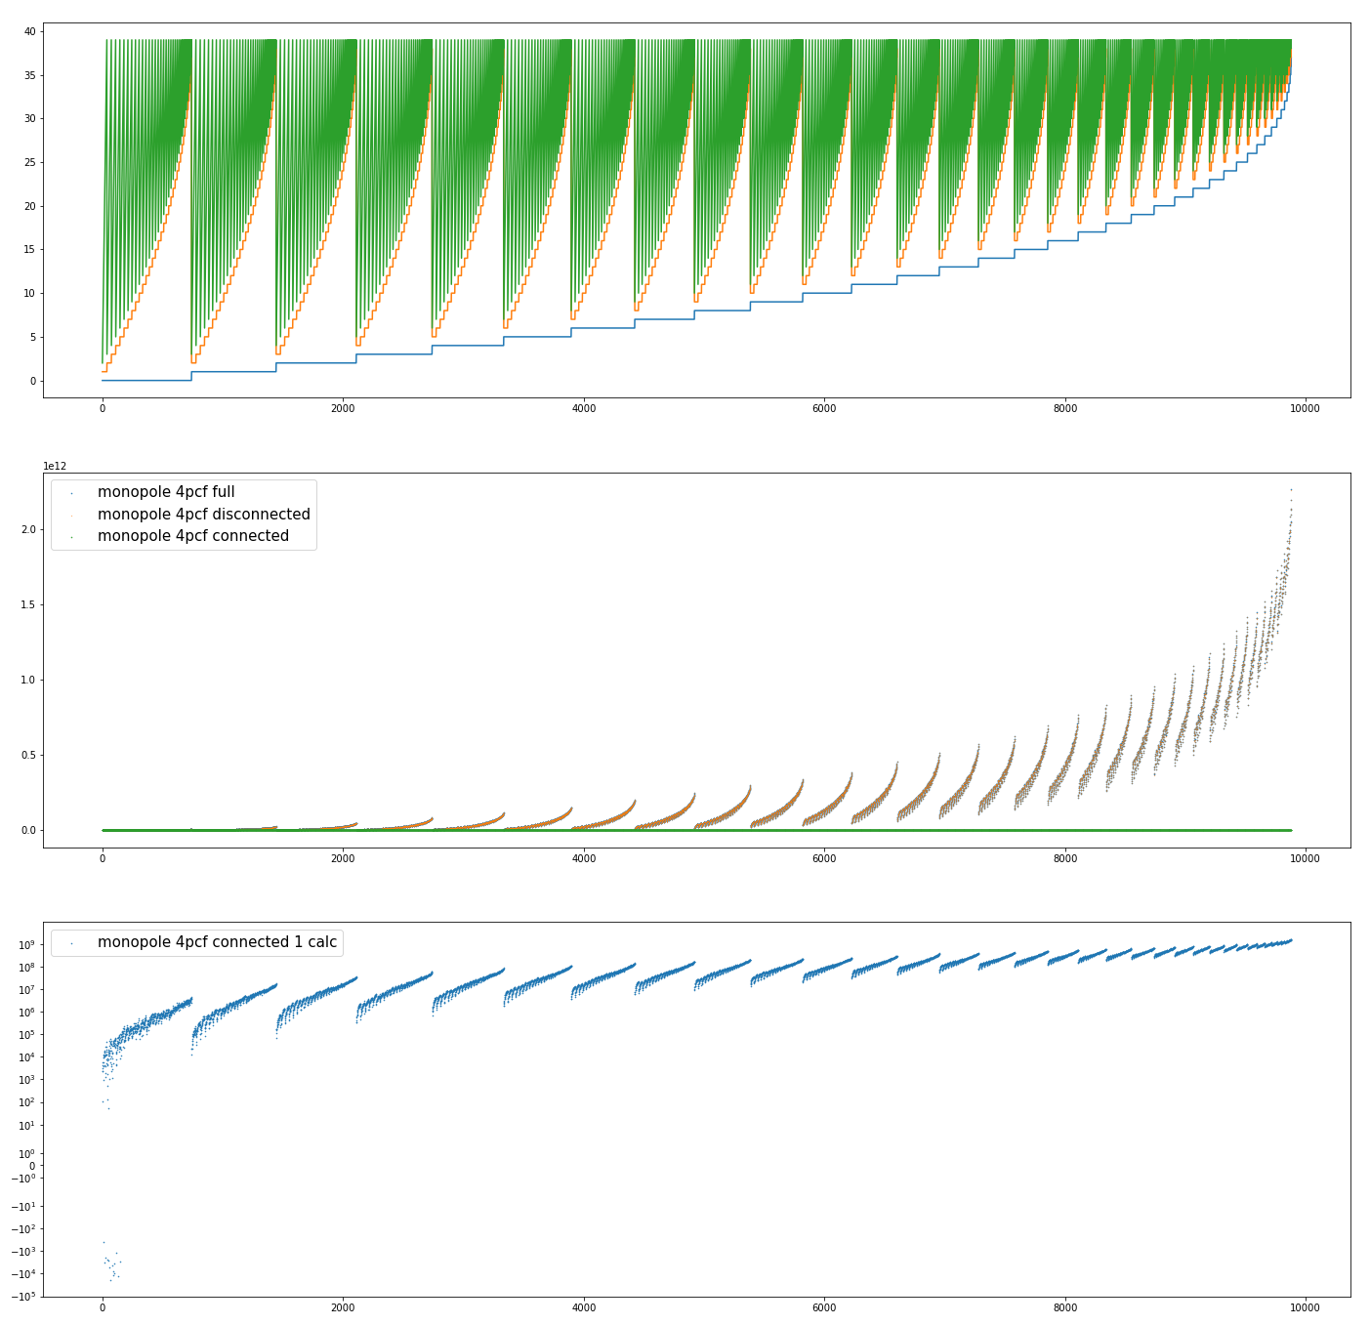
Test at the encore code 2
- Non – fixed distance
Bin 1, 2, 3
disconnected
connected
full
Can this connected
be a noise?
Notes:
In the middle plot disconnected and full part almost overlapped and connected part is down to 0, but it has the value looking at the bottom plot. We also thought it would be a noise in this time.

Slide 9
Test at the encore code 2
- Non – fixed distance
signal
noise
In multiple calculation, mean value is larger than standard deviation value, so encore code doesn’t remove the disconnected part well
Notes:
But in calculation the value didn’t seem to decrease. This plot shows the standard deviation and mean of 50 calculations. The bule is standard deviation and orange is the mean value. The mean value is larger than the standard deviation, so it is really a signal, so we concluded encore code doesn’t remove the disconnected part well.

Slide 10
For next…
Doing test and calculating mocks of our new code
Seeing other distance ranges
Doing some other tests … multipoles

Slide 11
Test at the encore code 2
- Problems?
multipole
monopole

