Slide 1
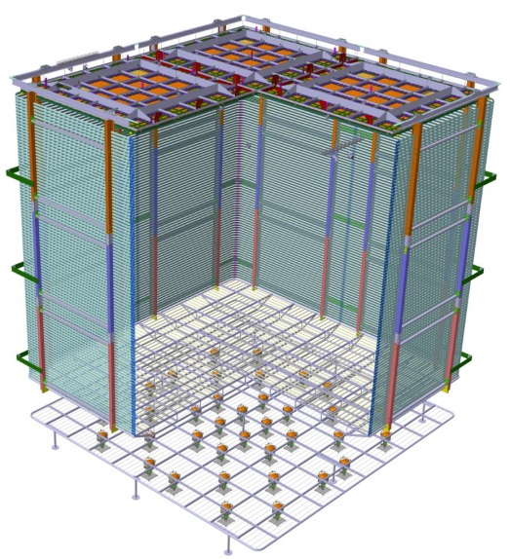
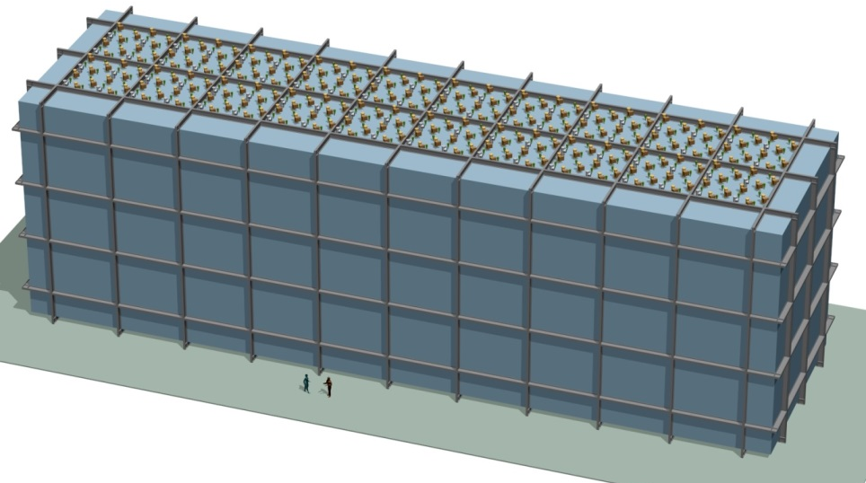
Time Projection Chambers;
Liquid Argon TPC
Jaehoon Yu
U. Of Texas at Arlington
Jan. 9 – 11, 2019
1st PDS4HEP2019

Slide 2

Contents
Physics Goals of the DUNE experiment
Requirements for the detector
What is a Time Projection Chamber?
TPC Principles
Liquid Argon TPC – Single Phase
Advancing LArTPC – Dual Phase TPC
Approach to Large Scale DP LArTPC & Prototyping
Conclusions

Slide 3
How do you design a HEP experiment?
Decide on physics goals to accomplish
Lay-down the capabilities and parameters for an experiment to meet the goals
Decide on the beam and the best detector technology to meet the parameters
Perform R&D for beam and detectors
Design and build prototype detectors and perform testing
Design and build the full scale experiment

Slide 4
Neutrino Oscillation Probability

Slide 5
What do we need to measure?
Need to measure the flux of each neutrino flavor before and after the oscillations and compare them
  Need to be able to see e or μ resulting from ν_{e} and ν_{μ} charged current interactions
    Need to be able to identify particles w/ high confidence
    Need to have a precision 3D tracking
    Need to be able to measure energy and momentum
Need to measure ν_{e} flux from Super-Nova burst
  Need to be able to measure flux as a function of time with superb timing resolution and low E threshold

Slide 6
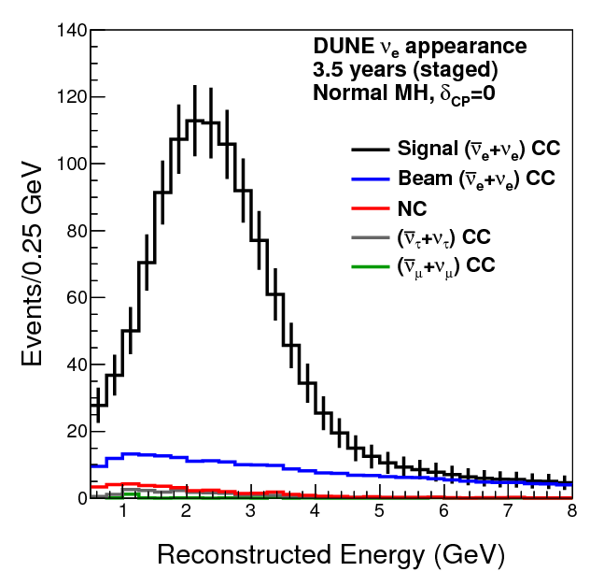
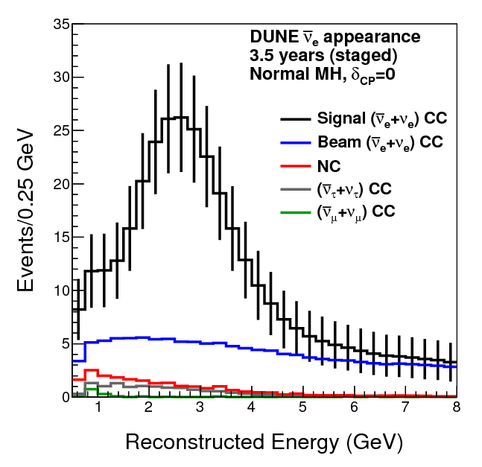
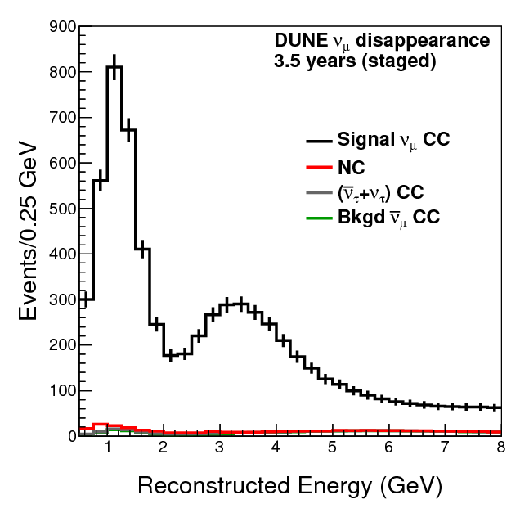
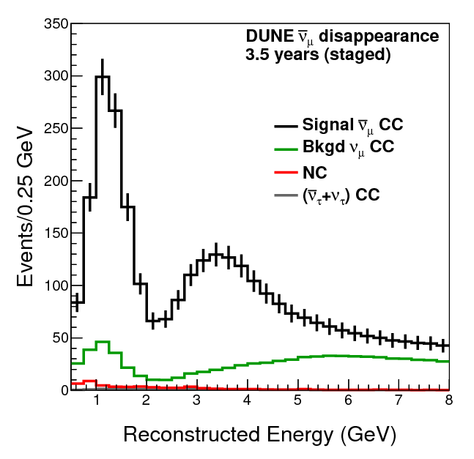
Neutrino Flux
ν_{e}
ν_{e}
ν_{μ}
ν_{μ}
DUNE Conceptual Design Report (CDR) arXiv:1512.06148

Slide 7
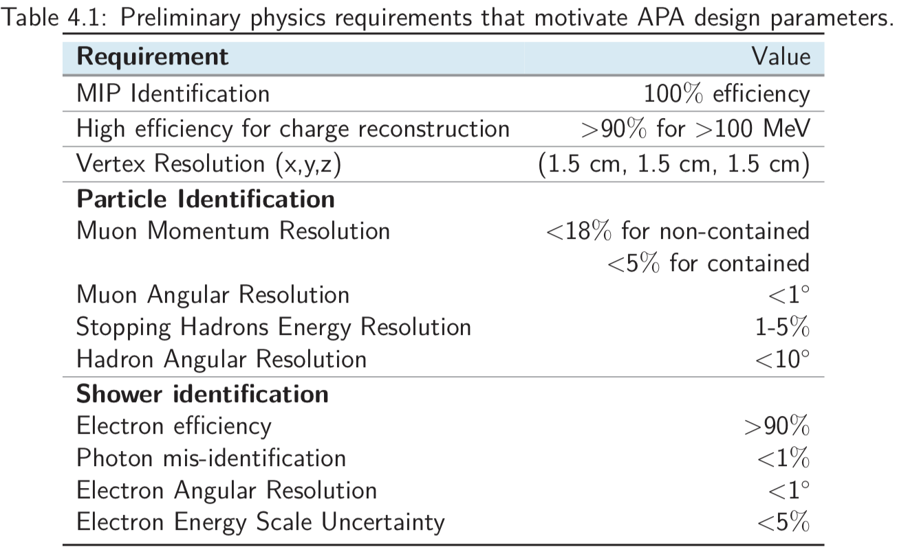
DUNE Physics Requirements

Slide 8
Neutrino Experiments
Neutrino cross sections are small ~10⁻³⁸ E_{ν}
To increase statistics
  Increase number of neutrinos
    Natural or reactor sources will not give you control of beam intensity
    Need man-made neutrino beams
  Increase neutrino energy ➔ Ain’t gonna work
  Increase thickness of material to interact with neutrinos ➔ Detectors with dense material ➔ Ain’t gonna work!
Beam can be made so that it is enriched with a specific flavors of neutrinos in optimal energy range

Slide 9
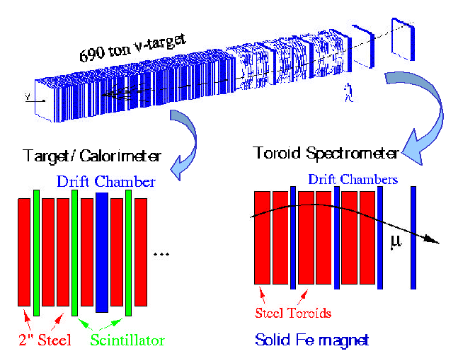
A Typical Past Neutrino Detector
Purposed to probe the structure of nucleons
Large amount of material in the path of neutrinos
Insufficient capabilities for precision n oscillation measurements ➔ Some other technology needed

Slide 10
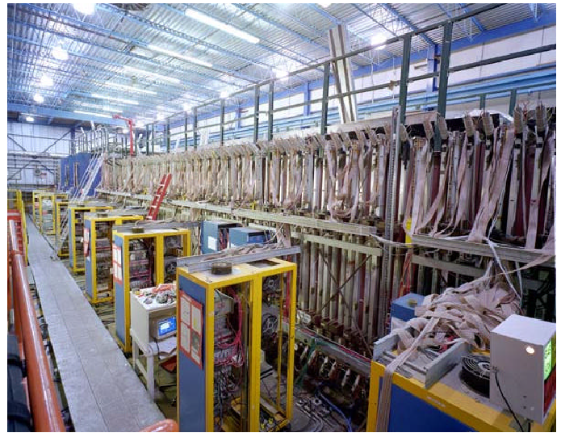
The NuTeV Detector
A picture from 1998. The detector has been dismantled to make room for other experiments, such as DØ

Slide 11
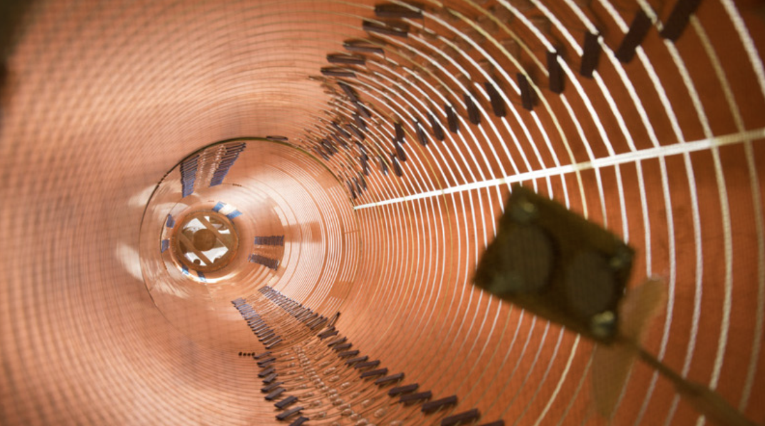
What is a Time Projection Chamber?
A precise particle tracking detector with 3D imaging capability and an energy measurement capability
Initially developed in mid-1970’s at SLAC for a tracking detector in a e⁺e⁻ collider experiments with gas mixture
Field Shaping Ring

Slide 12
Time Projection Chamber History
Invented in 1974 by David Nygren at LBNL (now at UT Arlington) to replace wire chambers
  David Nygren: https://en.wikipedia.org/wiki/David_R._Nygren

Slide 13
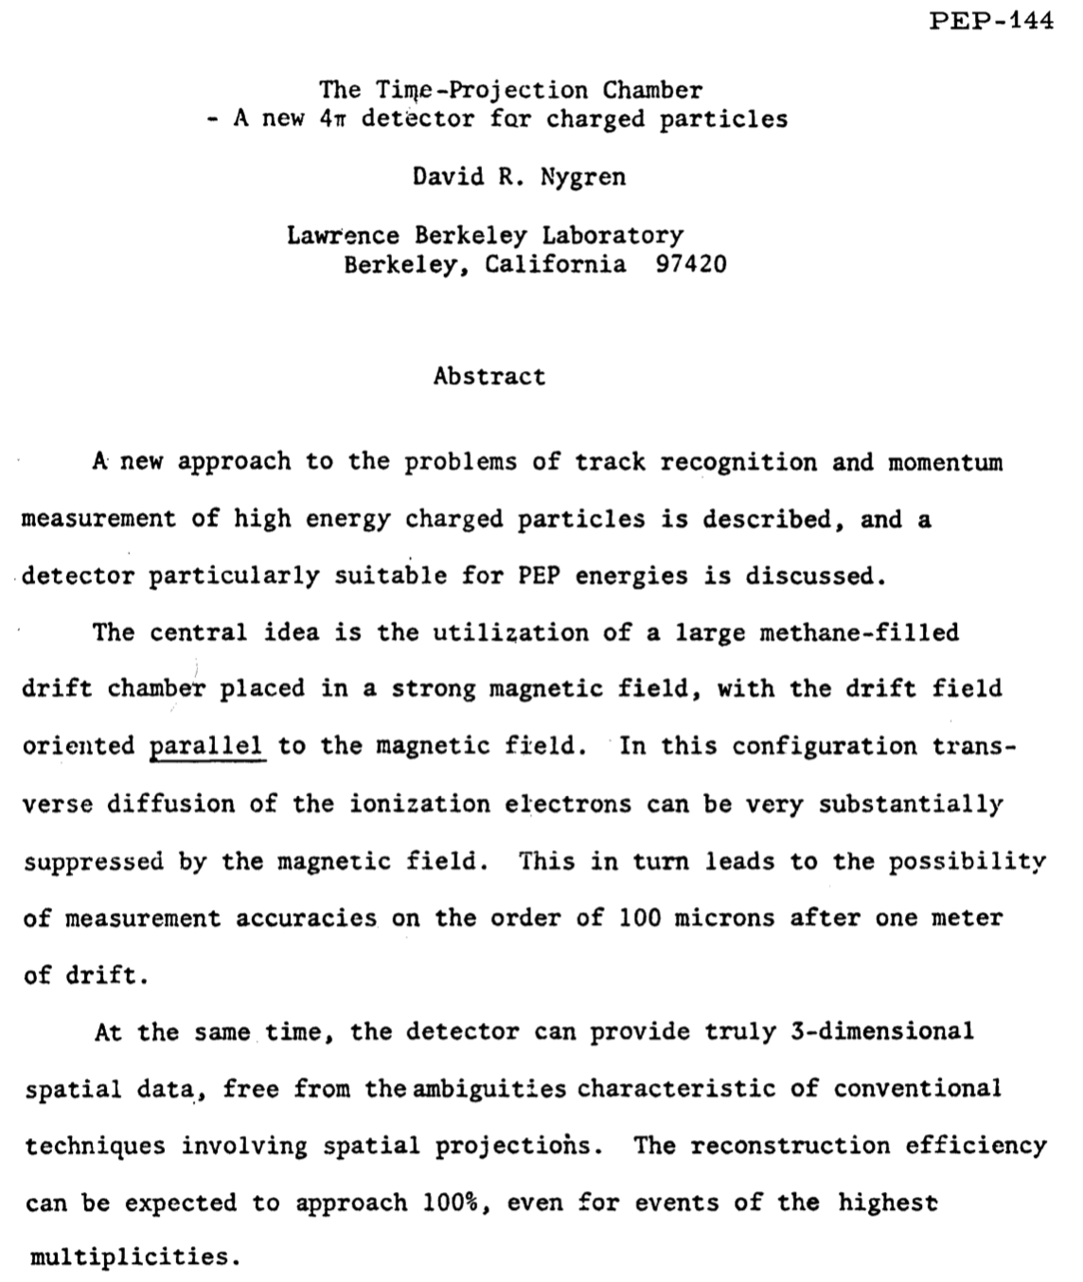

Slide 14
Time Projection Chamber History
Invented in 1974 by David Nygren at LBNL (now at UT Arlington) to replace wire chambers
  David Nygren: https://en.wikipedia.org/wiki/David_R._Nygren
Provides precise 3D image of particle interactions
First one built in 1981 for an experiment at SLAC with gas medium
ALICE and T2K use gas TPC’s

Slide 15
Time Projection Chamber History
Large number of underground DM exp. Use high pressure gas TPC’s, such as NEXT
Liquid Argon medium proposed in 1977 by C. Rubbia for neutrino experiment (ICARUS) and built the first LArTPC in 2001 and took data in 2010
It was followed up with several small scale LArTPC’s
  ArGoNEUT
  MicroBooNE
  ProtoDUNE SP and DP

Slide 16
Why the TPC?
High spatial resolution 50 ~ 200μm in a large volume in 3D
Close to 100% pattern recognition with good multiple track separation
Over 99.5% reconstruction efficiency of 4π
Good timing resolution
Fast recovery after triggering
Compatibility with high magnetic field
Reliability in operation

Slide 17
TPC Detector Schematics
Shared the cathode in the middle for active volumes
Ionization electrons from charged particle passage drifts toward the anode planes
A uniform electric field provided by the field cage surrounding the active volume
Charge arrival time provides the position in the third dimension
E
E

Slide 18
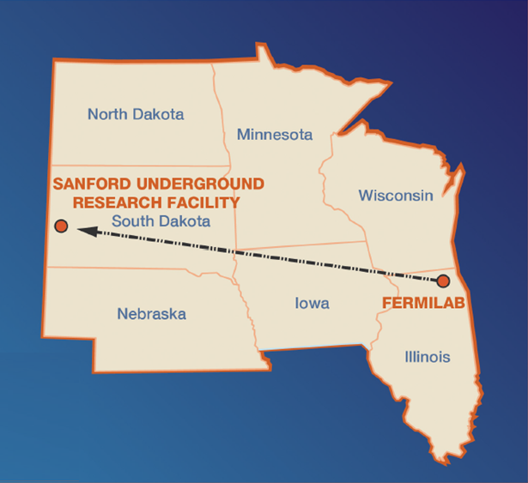
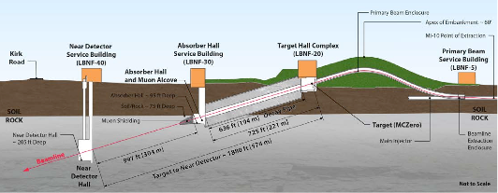
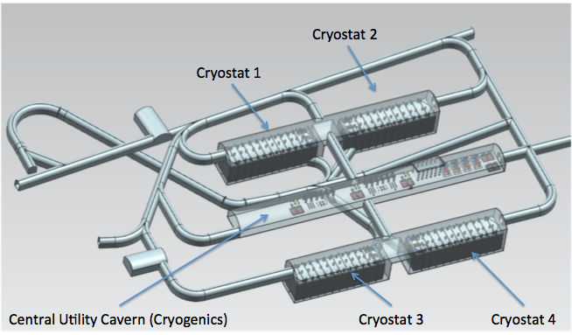
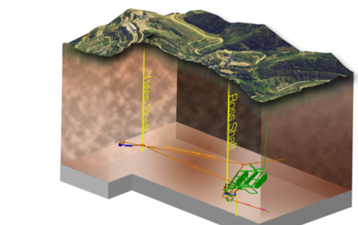
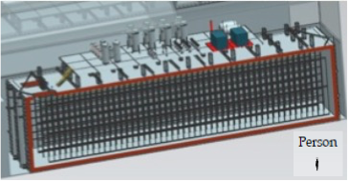
DUNE Experiment
Broadband ν beam from Fermilab
LBNF ν Beam
P_{Beam} :1.2MW →2.4MW
1300km (800 miles)
Long Baseline
4 caverns w/ active V~10kt LAr each
~30xICARUS
LBNF Far Detector Site, SURF
1500m underground
15m
15m
66m

Slide 19
DUNE Single Phase LAr TPC
L_{D}=3.6m

Slide 20
Detector Requirements
High density medium for large number of neutrinos to interact ➔ LAr

Slide 21
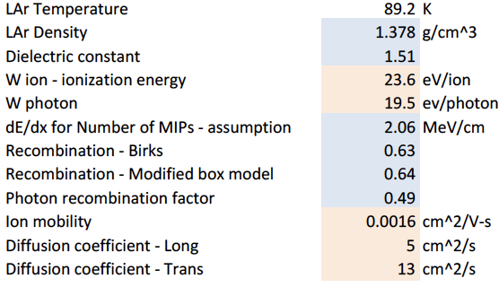
LAr Property

Slide 22
Detector Requirements
High density medium for large number of neutrinos to interact ➔ LAr
Strong and uniform electric field for ionization electron drift

Slide 23
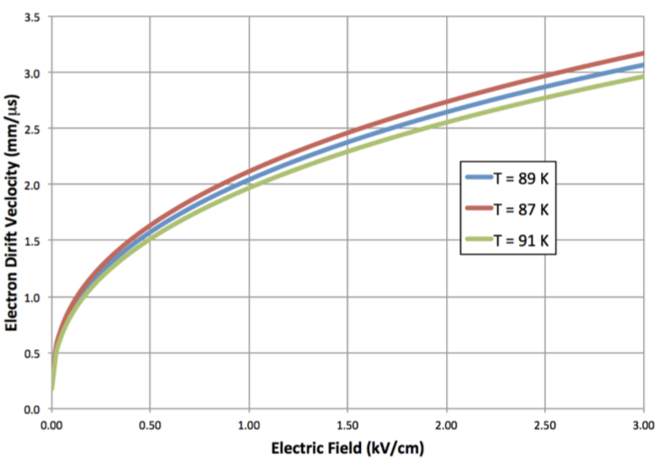
Ionization Electron Drift speed vs E
v_{D}~1.5mm/μs
DUNE operational field

Slide 24
Detector Requirements
High density medium for large number of neutrinos to interact ➔ LAr
Strong and uniform electric field for ionization electron drift
Low electron diffusion for x-y plane resolution

Slide 25
Electron Diffusion
Diffusion is the spread of the ionization electrons as they drift toward the anode

Slide 26
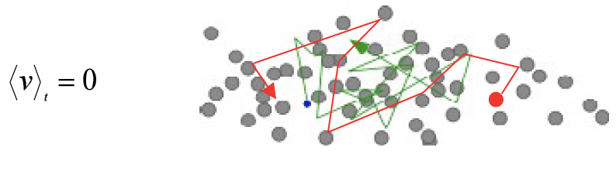
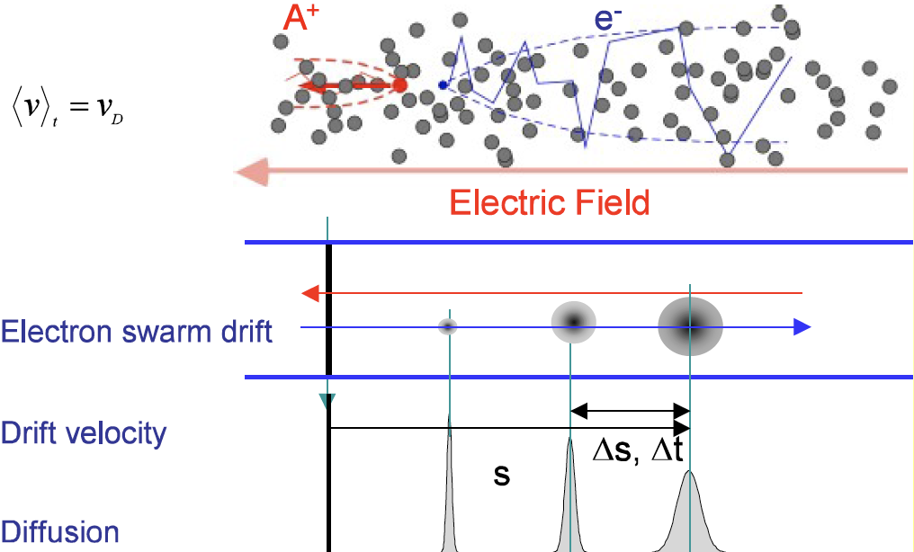
Electron Diffusion Effect
E=0: Thermal diffusion
E>0: Transport and diffusion

Slide 27
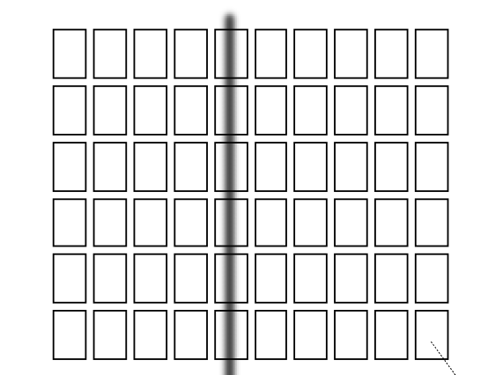
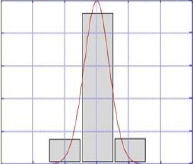
Electron Diffusion
Diffusion is the spread of the ionization electrons as they drift toward the anode
  Depends strongly on the medium

Slide 28
LAr Property

Slide 29
Electron Diffusion
Diffusion is the spread of the ionization electrons as they drift toward the anode
  Depends strongly on the medium
  And drift length and the drift electric field
Diffusion impacts the position resolution in all axes
Electron transverse diffusion in LAr is small in general
  For DUNE SP’s 3.6m drift length t=2.4ms drift time
    trans diff:13*2.4x10⁻³=31x10⁻³cm²~1.8mmx1.8mm
    long diff:5*2.4x10⁻³=12x10⁻³cm²~1.1mmx1.1mm

Slide 30
Detector Requirements
High density medium for large number of neutrinos to interact ➔ LAr
Strong electric field (and parallel B field) for ionization electron drift ➔ provided by field cage
Low electron diffusion for x-y plane resolution
Strong and uniform electric field for uniform electron drift speed
  z position resolution for ionization electron arrival time measurement
  Good timing resolution

Slide 31
Single Phase LAr TPC
Both ν interaction & secondary detection in LAr
Use wire planes with multiple layers for 3D info
Cryogenic Electronics for fast amplifications
Shorter drift distance ~3.6m and lower e-lifetime requirements
LAr
e⁻
Anode
E ~ 500 V/cm

Slide 32
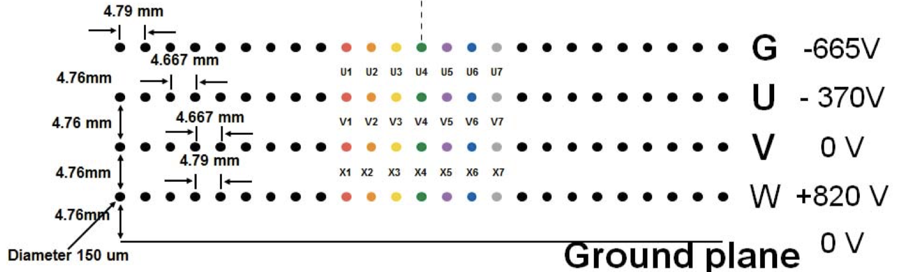
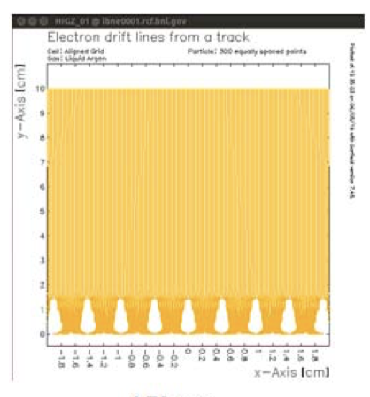
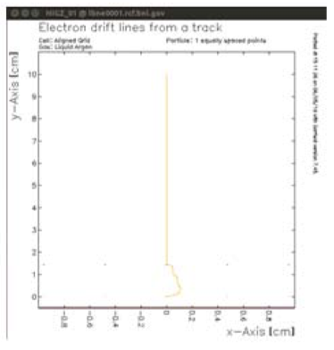
DUNE Single Phase Anode Plane

Slide 33
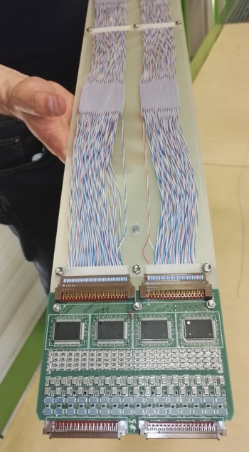
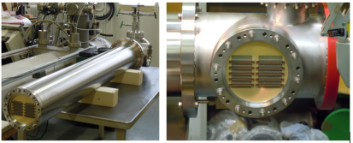
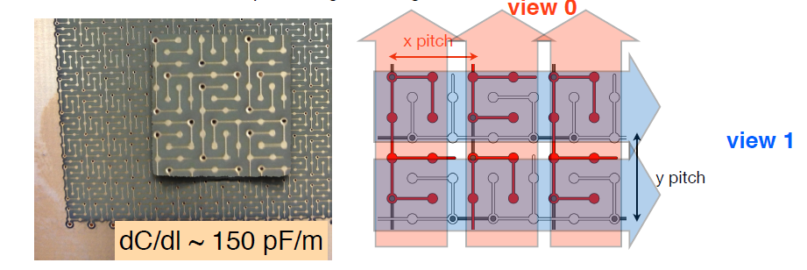
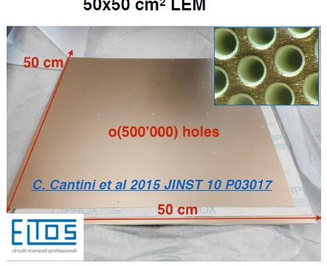
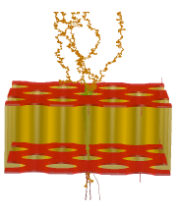
DUNE Dual Phase LAr TPC
Interaction occurs in LAr and charge readout in GAr
Anode with 2 collection (X, Y) views (no induction views), no ambiguities
Strip pitch 3.125 mm, covers 3 m length per unit charge readout plane (CRP)
Tunable gain in gas phase (20-100) w/ high S/N ratio for MIP > 100
Long drift projective geometry ➔ reduced number of readout channels
No materials in the active volume ➔ Better full containment
Accessible and replaceable cryogenic FE electronics
e⁻
LAr
Anode 0V
2 mm
Collection field 5 kV/cm
LEM (1mm)
25-35 kV/cm
GAr
Extraction field 2 kV/cm
1 cm
LAr
500 um holes
800 um pitch
Extraction Grid
Drift field 0.5-1 kV/cm

Slide 34
Effect of Tunable LEM Gain
Effect of tunable LEM gain (20-100) on S/N at 6m and 12m distance and for different purity levels
Drift field 0.5 kV/cm, 1300 e- ENC, minimal purity requirement 3 ms (same as for Ref. Design)
 | LEM gain 25 |  | LEM gain 50 |  | LEM gain 100
Distance (m) | S/N | Thresh. (keV) | S/N | Thresh. (keV) | S/N | Thresh. (keV)
6 | 51 | 38 | 103 | 19 | 207 | 9
12 | 15 | 133 | 30 | 66 | 59 | 33
3 ms →
 | LEM gain 25 |  | LEM gain 50 |  | LEM gain 100
Distance (m) | S/N | Thresh. (keV) | S/N | Thresh. (keV) | S/N | Thresh. (keV)
6 | 85 | 23 | 170 | 12 | 340 | 6
12 | 40 | 49 | 80 | 24 | 161 | 12
5 ms →
 | LEM gain 25 |  | LEM gain 50 |  | LEM gain 100
Distance (m) | S/N | Thresh. (keV) | S/N | Thresh. (keV) | S/N | Thresh. (keV)
6 | 132 | 15 | 264 | 7 | 528 | 4
12 | 96 | 20 | 193 | 10 | 386 | 5
12 ms →

Slide 35
Dual Phase Pilot Effective Gain
Preliminary
Preliminary
Preliminary

Slide 36
Dual Phase Pilot Charge Sharing
Charge deposit in View 0 (red, 3m strip) and View 1 (blue, 1m strip) ~share 50% each
Preliminary

Slide 37
Dual Phase Pilot Purity Measurement
Preliminary
Obtained using cosmic tracks that cross the full active volume
Two views show a factor 3 difference ➔ Investigating the cause

Slide 38
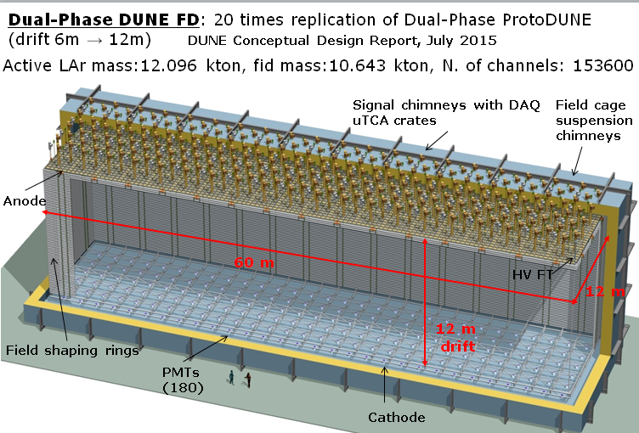
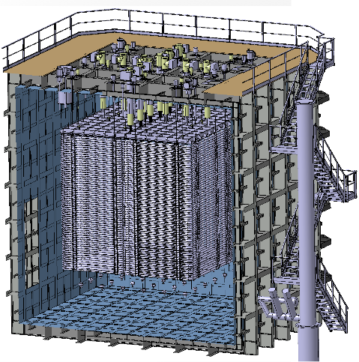

Strategy for Scale Up
3x1x1m³ 42t active volume Pilot detector
6x6x6m³ 600t protoDUNE Dual Phase
10kt DUNE Dual Phase LArTPC
3x1x1m³ Pilot
protoDUNE DP 6x6x6m³
10kt DUNE Dual Phase
3mx1m CRP units
50 field shaping rings
4 signal FT chimneys
4 suspension chimneys
12 PMTs
1280 readout channels
4 3mx3m CRP units
98 field shaping rings
12 signal FT chimneys
12 suspension chimneys
36 PMTs
7680 readout channels
80 3mx3m CRP units
200 field shaping rings
240 signal FT chimneys
240 suspension chimneys
180 PMTs
153600 readout channels

Slide 39
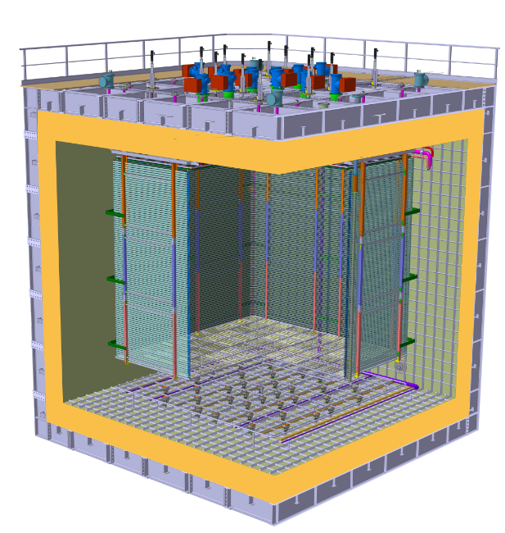
protoDUNE DP Detector–Cryostat Integration
Charge Readout Planes
6 m
Field Cage (common structural elements with SP)
Cathode
6 m

Slide 40
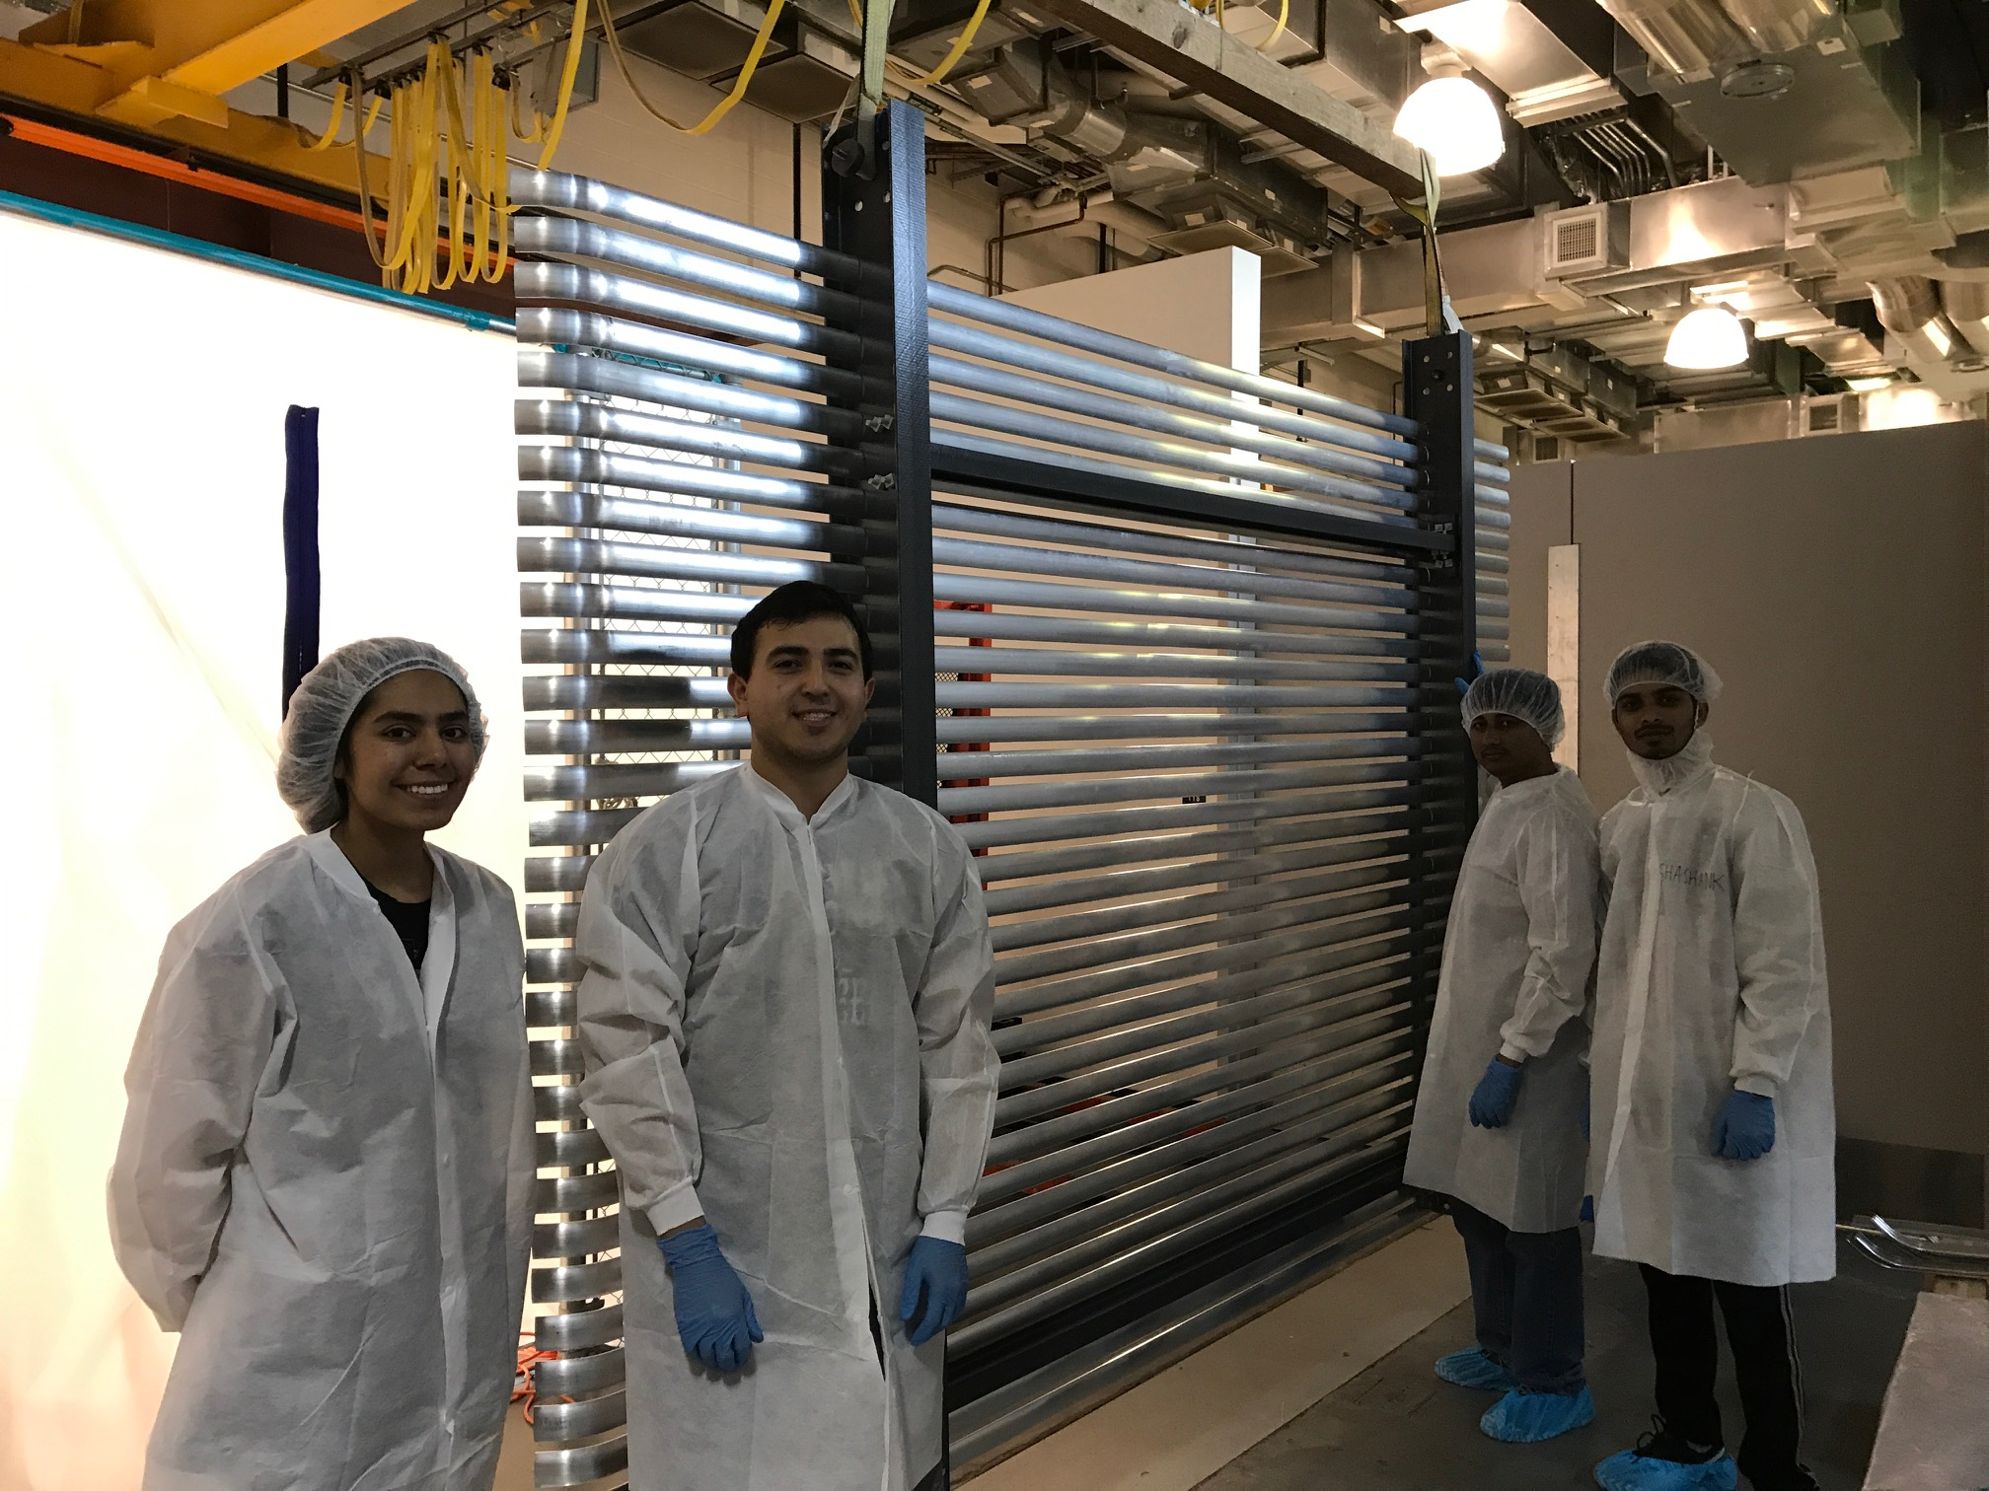
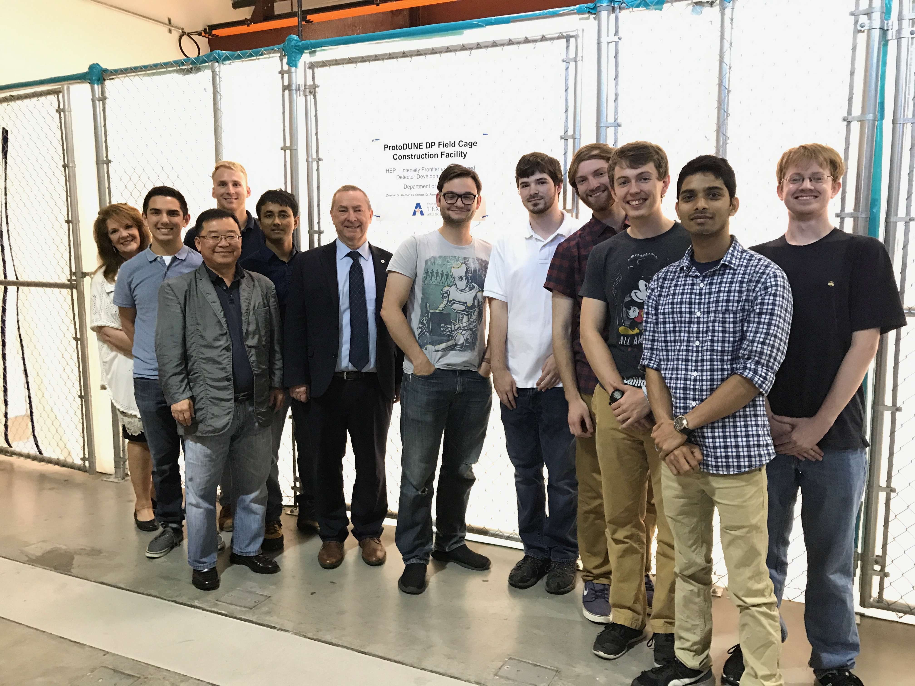
The UTA Field Cage Team

Slide 41
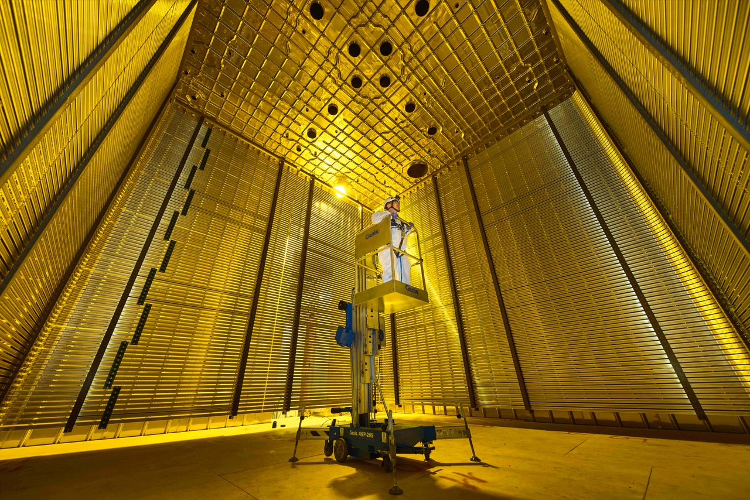
Image of ProtoDUNE Dual Phase
6m
6m
HV divider
Field Shaping Ring

Slide 42
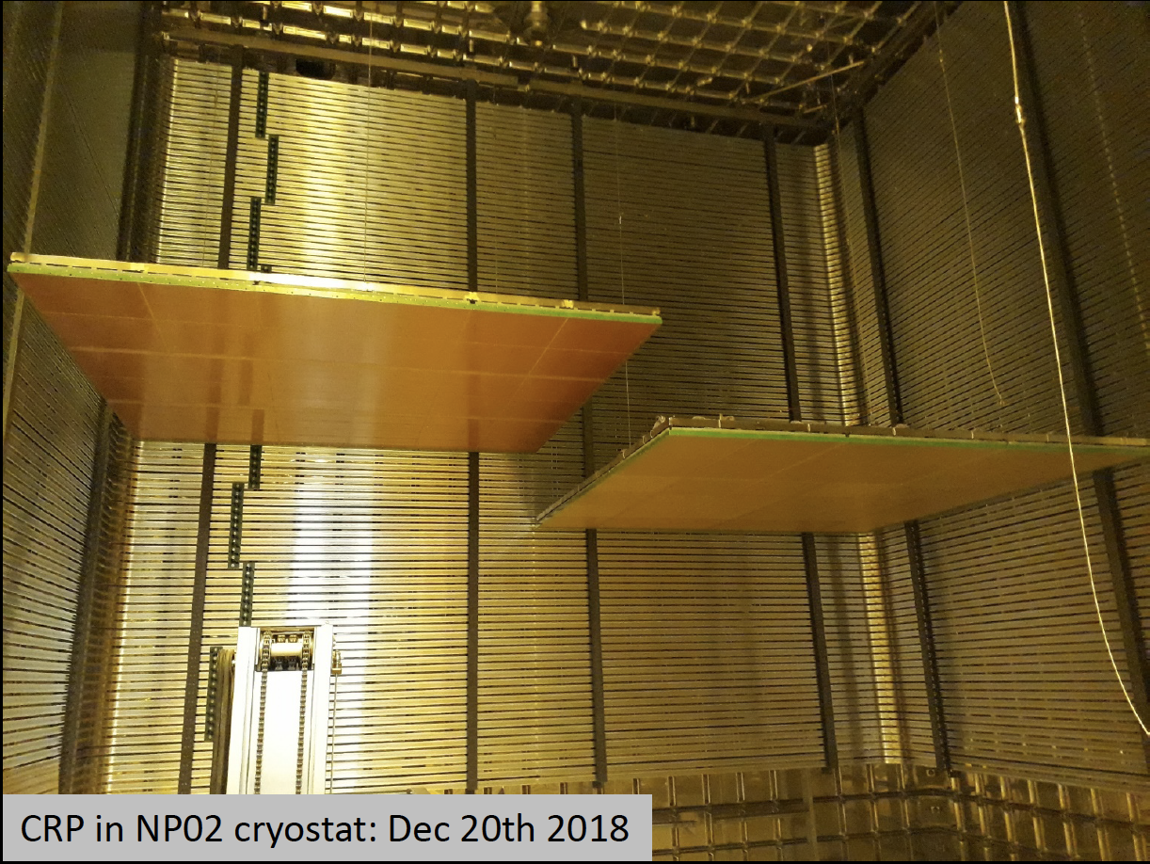
Status of ProtoDUNE Dual Phase
Field cage completed and tested at 150kV in air & the charge readout plane (CRP) assembly and installation in progress (3 ready, 2 installed)
  Complete the installation of the 3mx3m CRP’s, cathode and PDS and close the cryostat Spring 2019
  Complete purge and fill by July 2019
  Ready for cosmic data summer 2019
CRP

Slide 43
Dual Phase Challenges
Long Drift (12m for DUNE)
  Requires high purity LAr for good ionization electron survival
  Control ionization electron diffusion (~3.3mm at 0.5kV/cm)
Extremely high voltage
  For 0.5kV/cm operational field, an HVPS w/ > 600kV with very little ripple needed ➔ no such HVPS exists
  HVFT and the degraders to handle VHV
Stable operation with low LEM spark probability
  LEM’s spark at the edges at the rate of 1/few hours

Slide 44
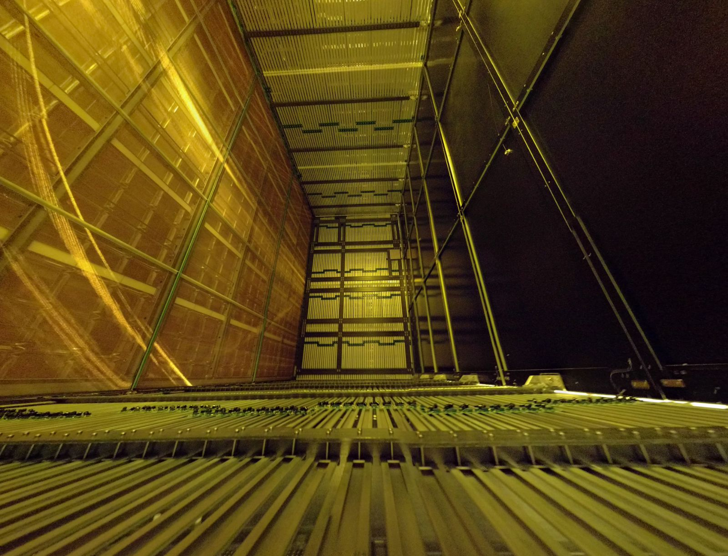
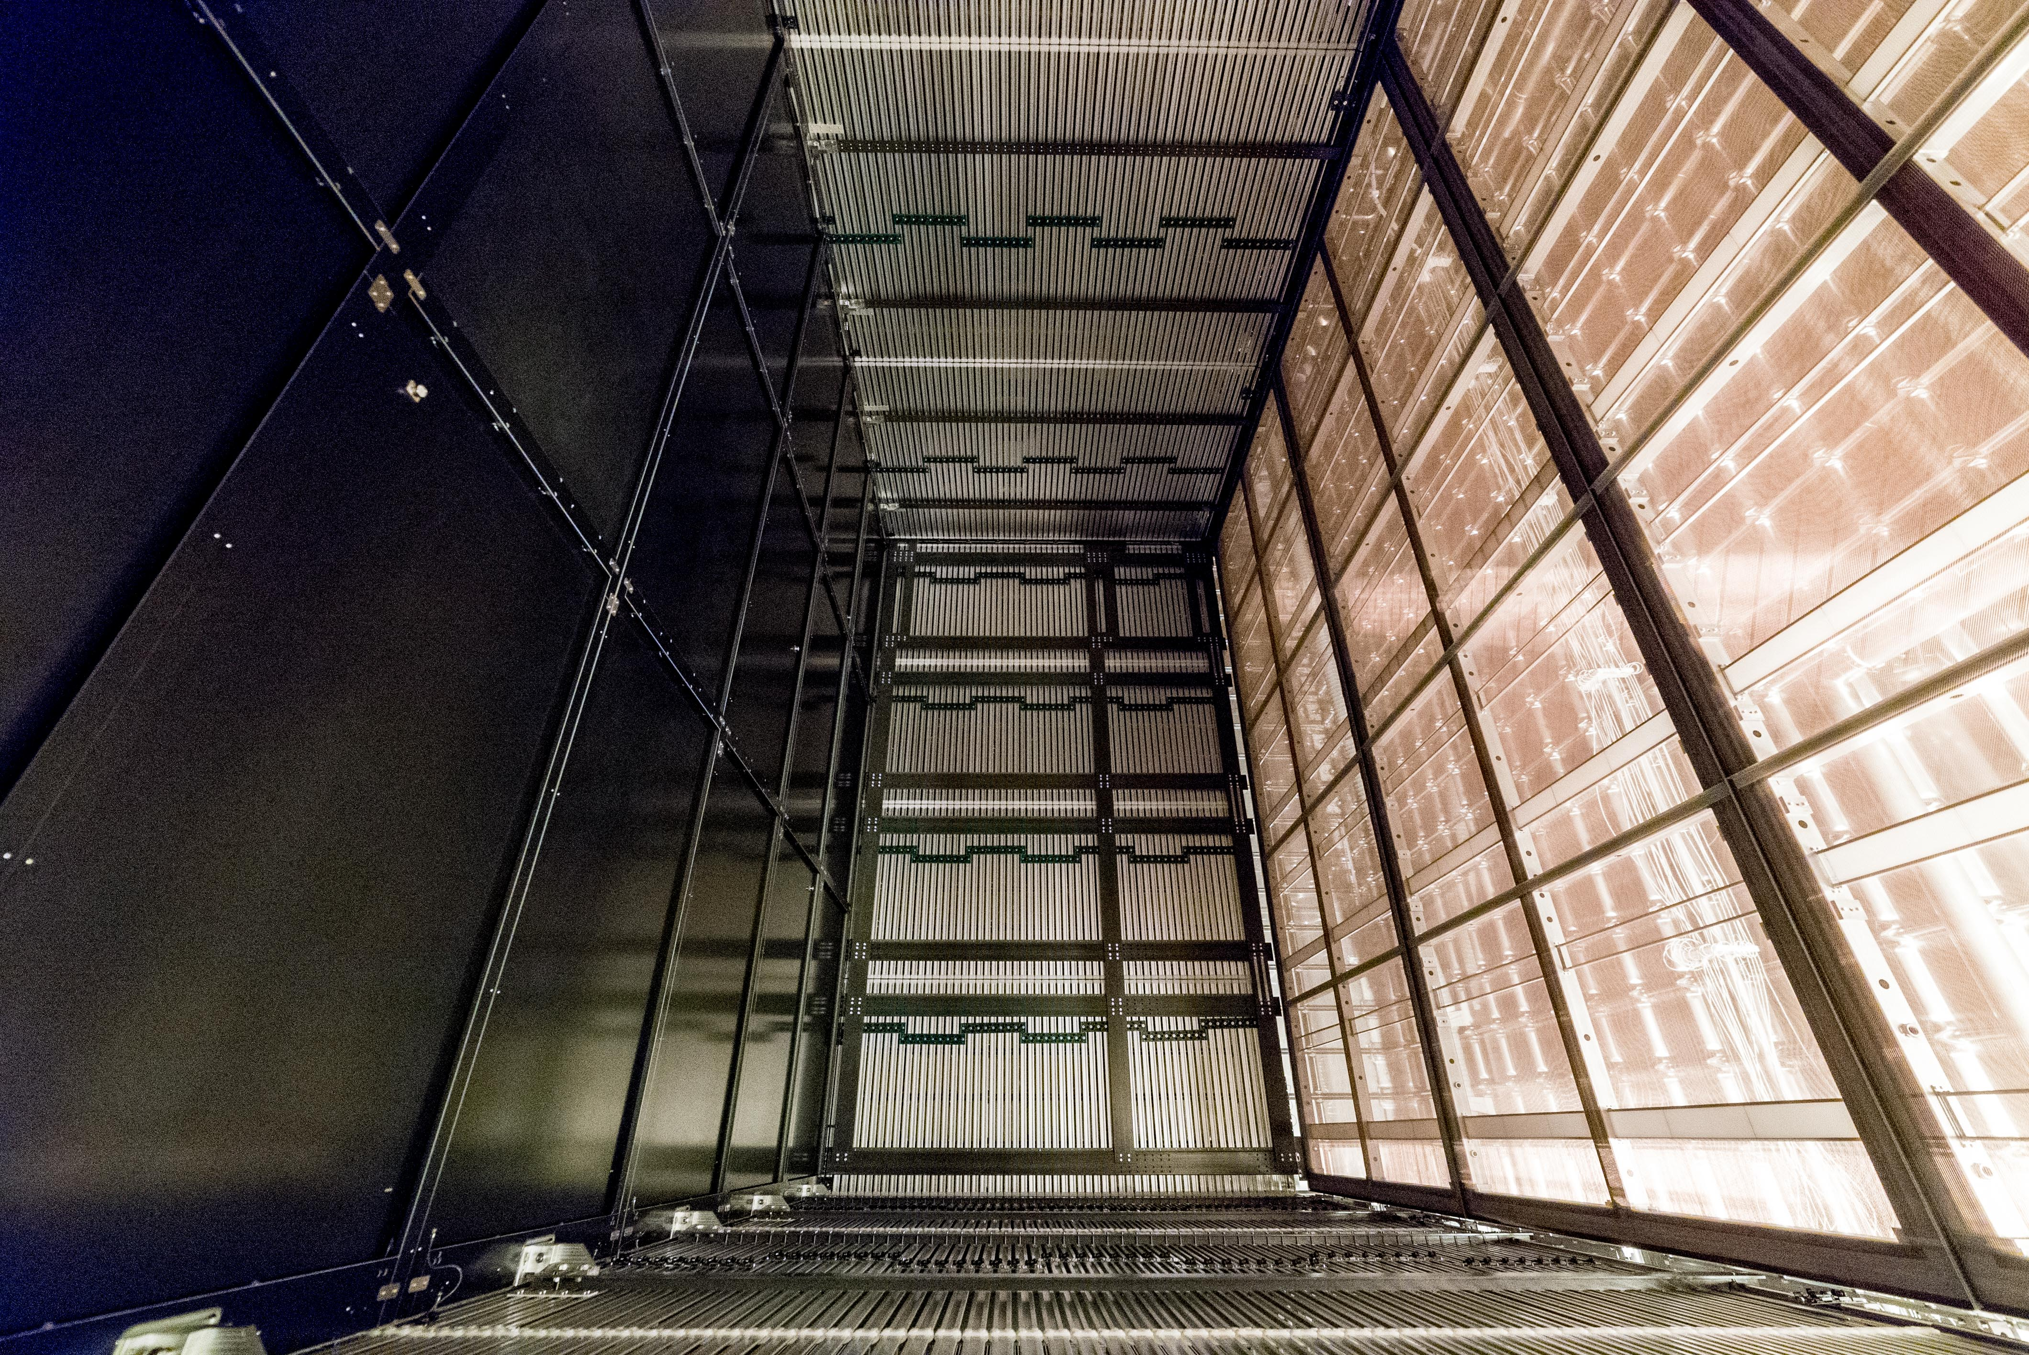
Status of ProtoDUNE Single Phase
Detector completed and the cryostat shut end of June
  Observed cosmic tracks as soon as the TPC turned on close to the operational HV
  LAr purity is ~6ms, 99.7% of the channels alive!, gain uniform within 5%
  Cosmic data taking continues throughout the 2 year CERN beam shutdown
Shared Cathode Plane
Field Shaping Ring
HV divider
6m
3.6m Drift
3.6m Drift

Slide 45
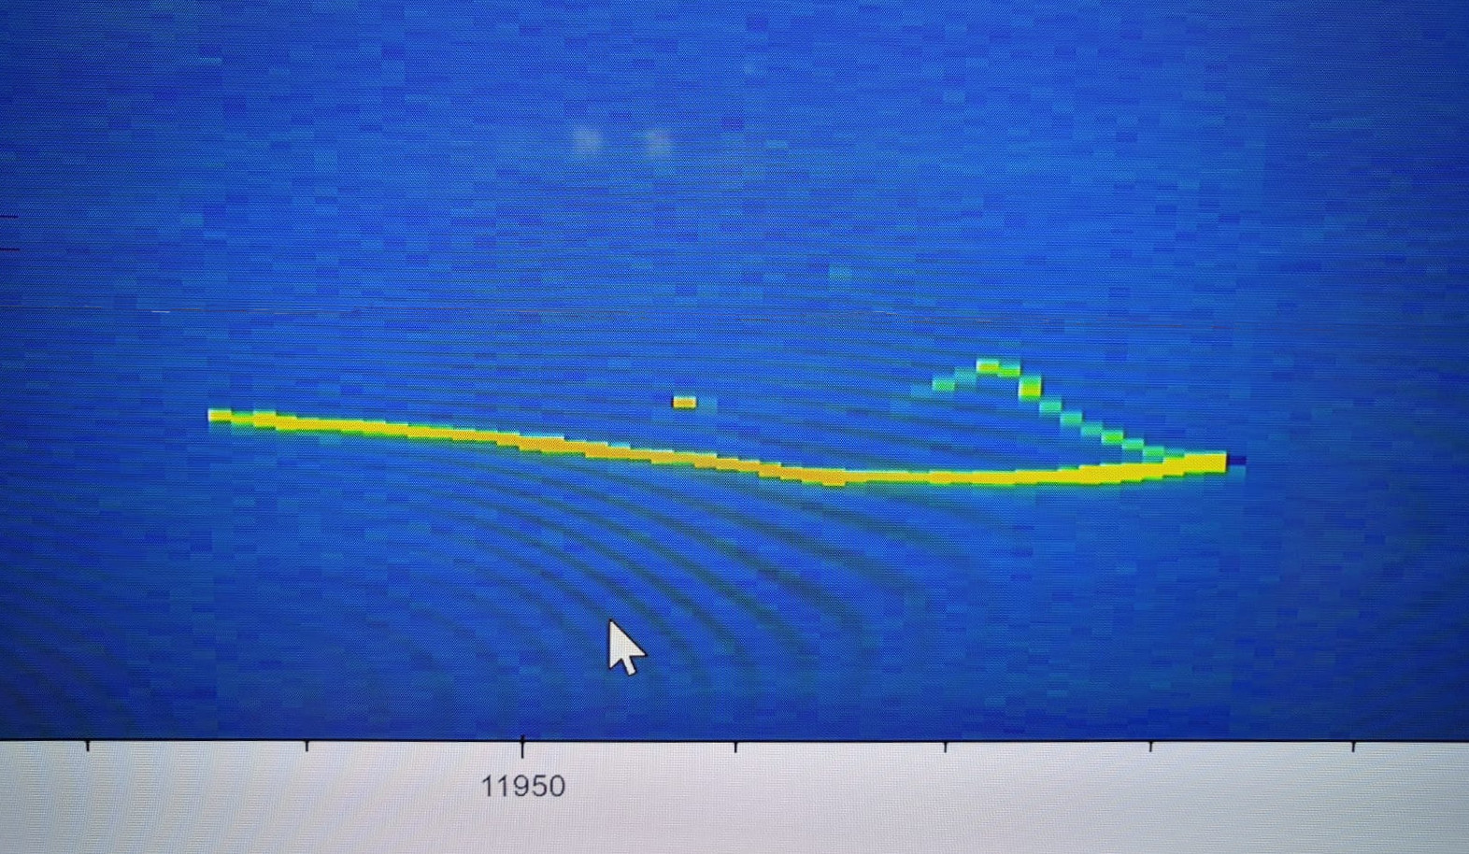
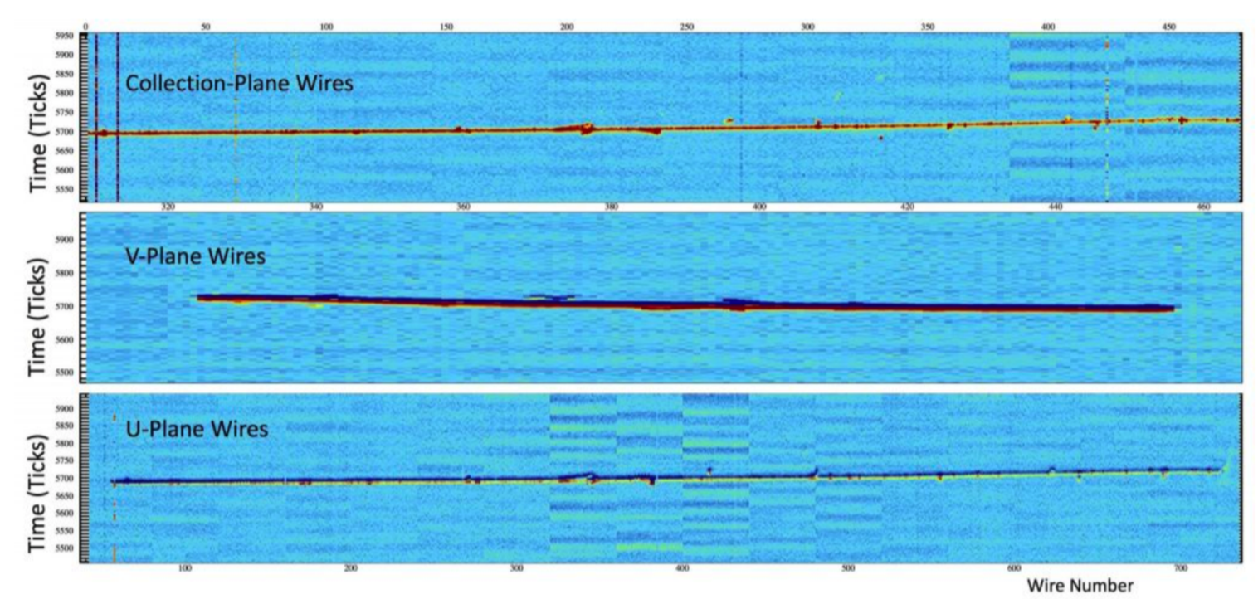
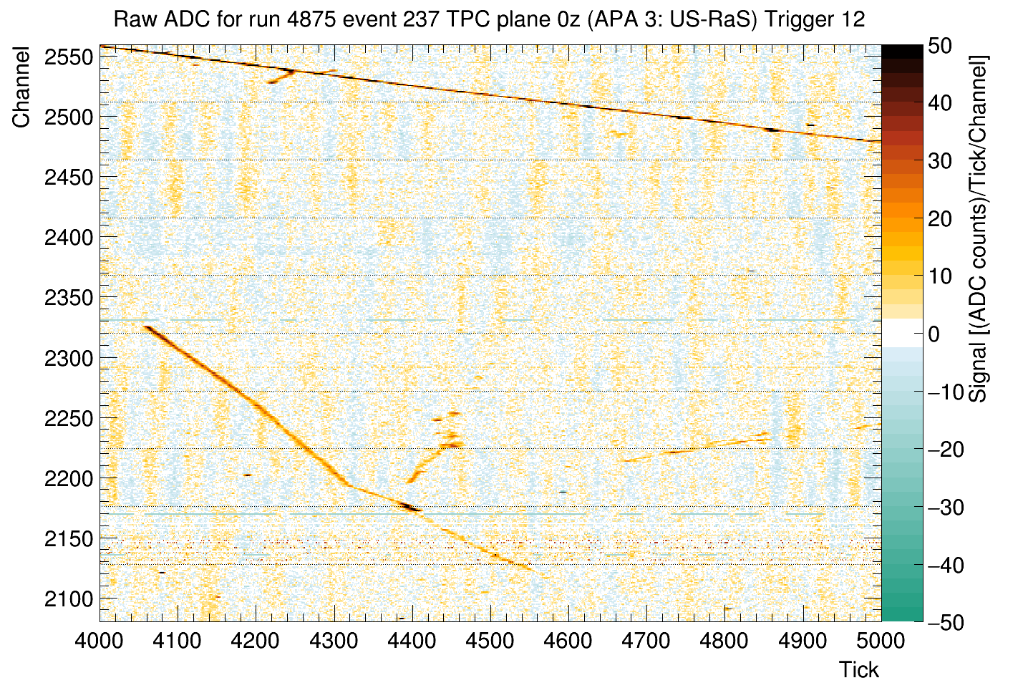
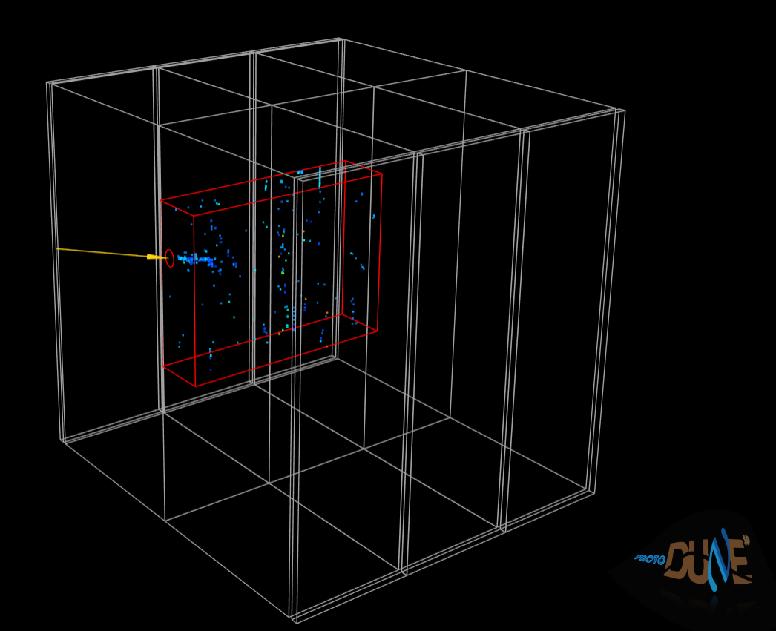
ProtoDUNE SP First Events
9/21/2018: First track seen at nominal E Field!
Off-line Event Display
On-line Event Display
10/2/2018: First event seen from beam!
(1 GeV electron)
10/2/18 1st e
3D “near”-line Event Display
10/2/2018: First pion interaction from beam!
(1 GeV pion)

Slide 46
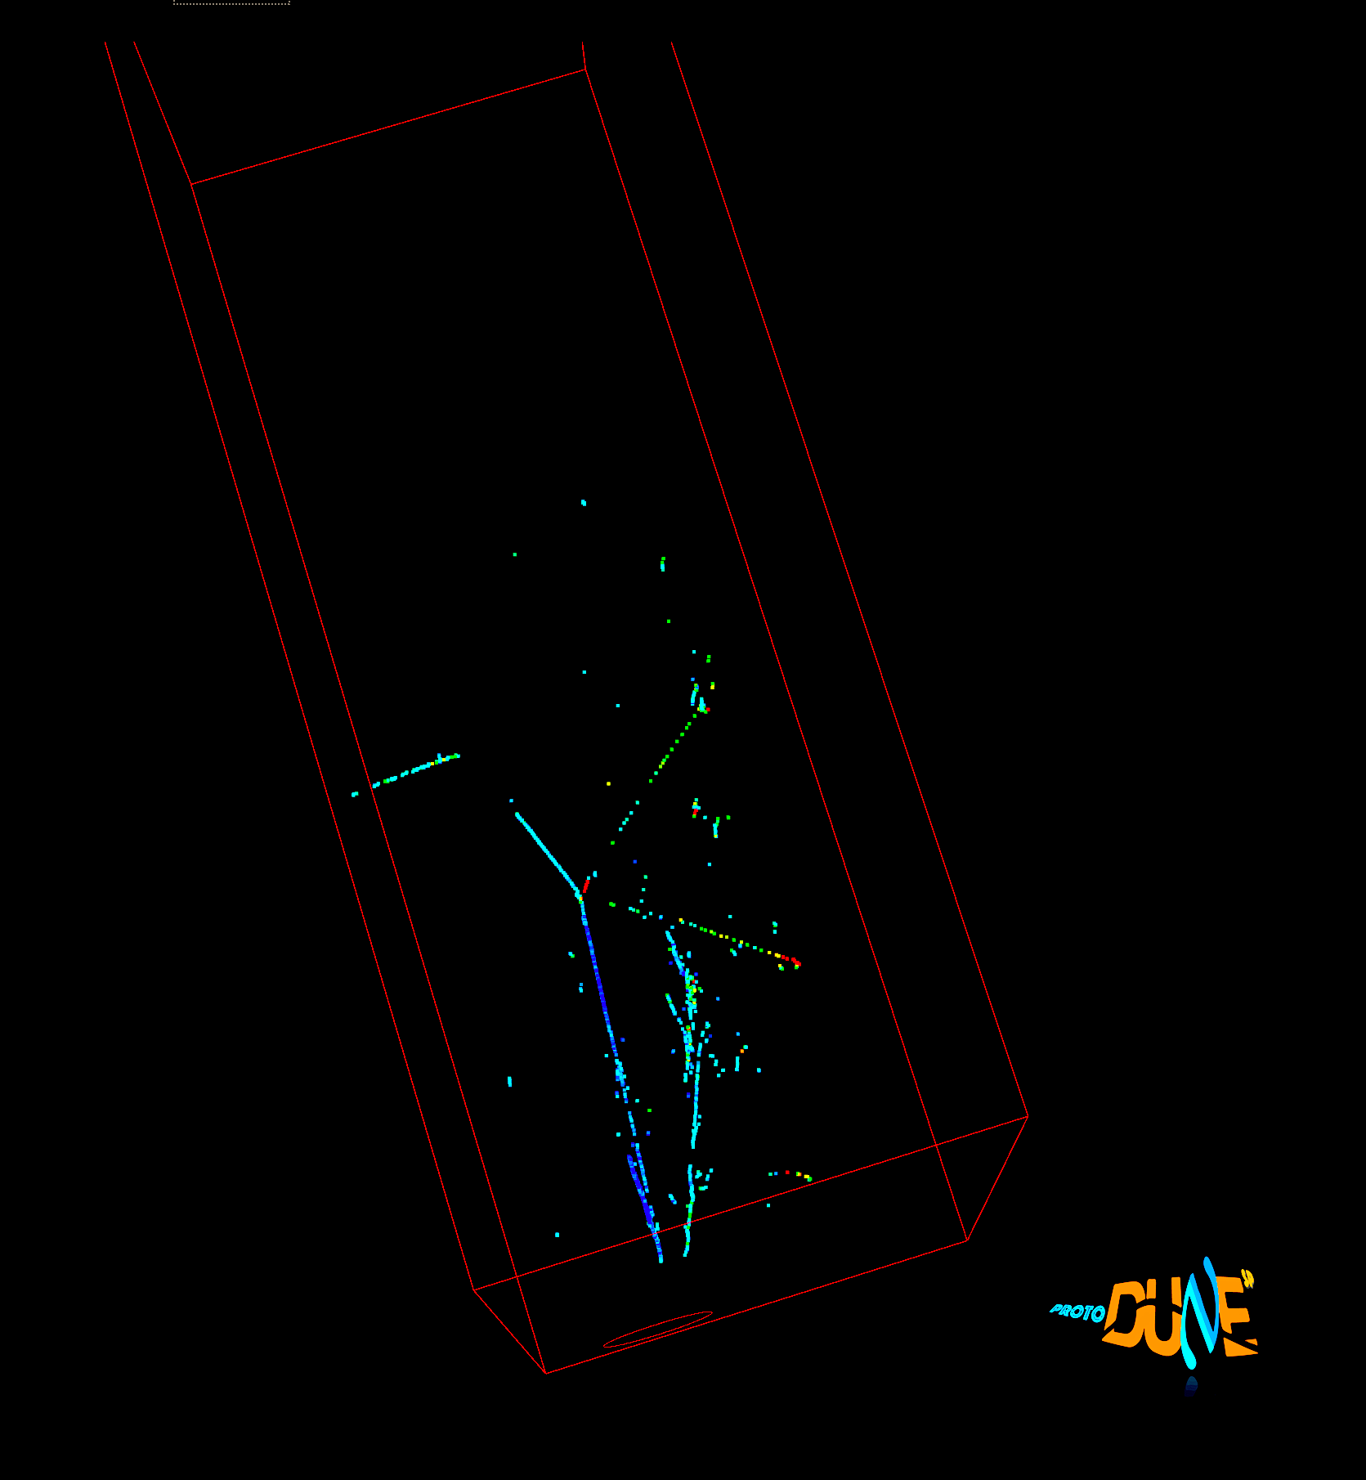

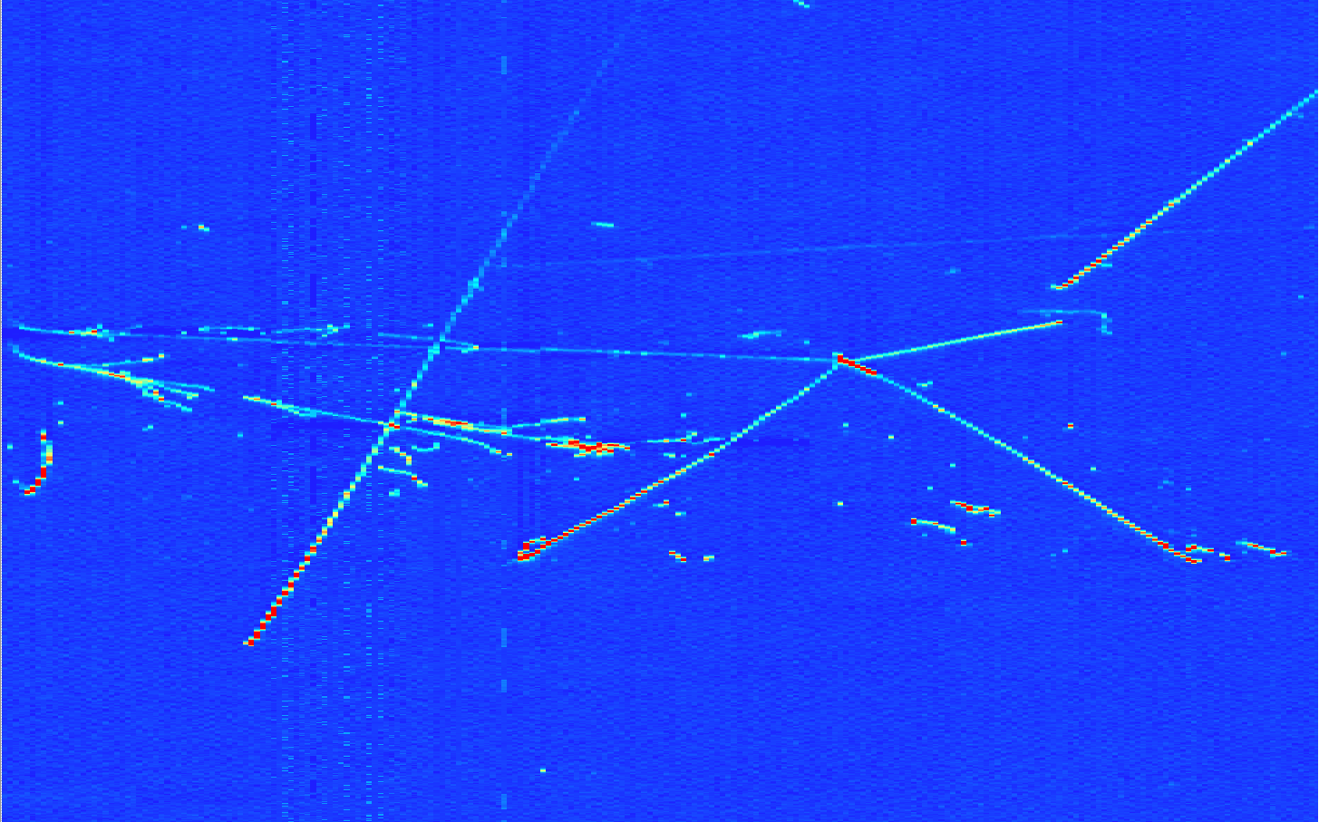
ProtoDUNE SP Beam Pile-up
Collection plane view
Run 4696, Ev 103:
2 EM showers and a pion interaction with 4 outcoming particles
3D view

Slide 47
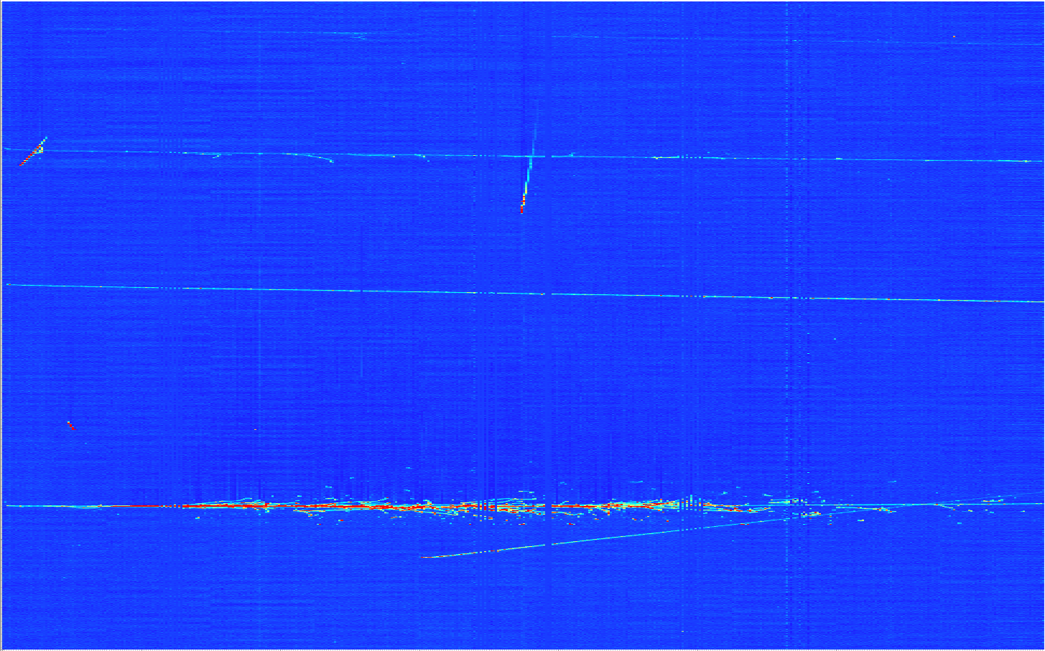
ProtoDUNE SP First Event
Beam halo (high energy) muon with bremsstrahlung initiated E.M. shower
Collection plane view

Slide 48
Summary
Time Projection Chambers provide precise 3D imaging & energy measurements
Developed initially for use in a collider
Now many neutrino detectors use LAr medium
Several single Phase LArTPC’s built and operate
  MicroBooNE took data and ICARUS T600 at Fermilab to take data
  SBND to be built in the next two years
DUNE large scale prototype SP is running
Next generation LArTPC w/ amplification using GAr to be turned on shortly
2x10kt DUNE LArTPC to take data in 2026

Slide 49
Some Reference Links
David Nygren: https://en.wikipedia.org/wiki/David_R._Nygren, UTA Physics faculty
Nygren original TPC proposal: http://lss.fnal.gov/conf/C740805/p58.pdf
  Follow up studies: http://slac.stanford.edu/pubs/slacreports/reports04/slac-r-190.pdf
LAr TPC: https://arxiv.org/pdf/1703.04024.pdf
Working Principles of TPC: https://www.lctpc.org/e8/e57671

