Slide 1
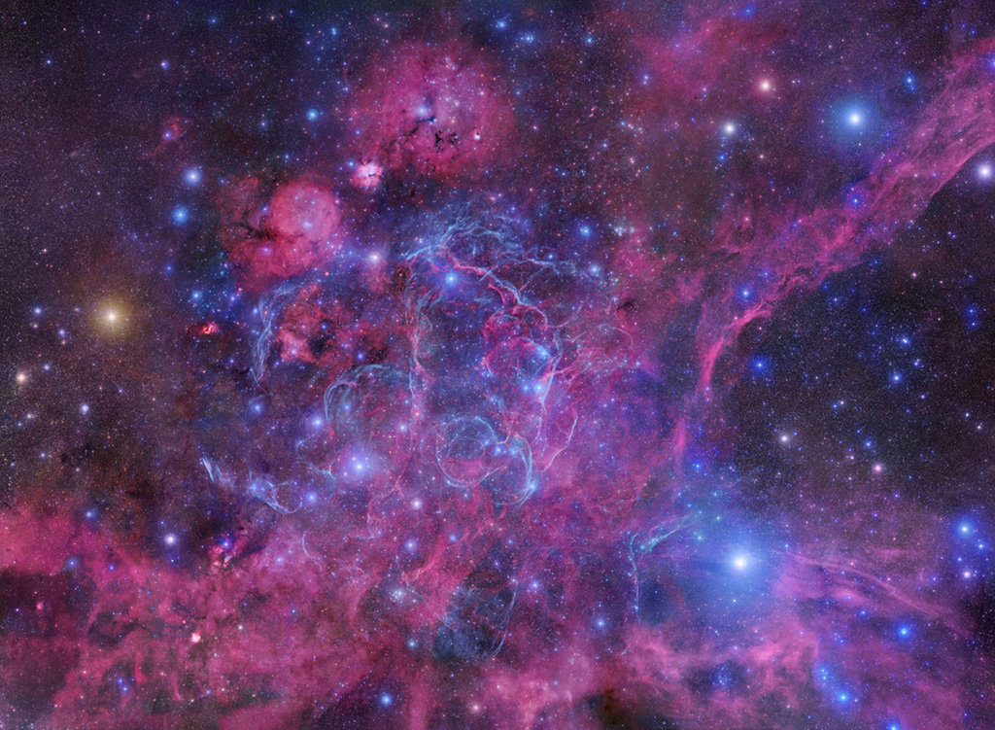
Astroparticle Physics
Secondary
Cosmic Rays
Sumi Kim
orcinus27@uos.ac.kr

Slide 2
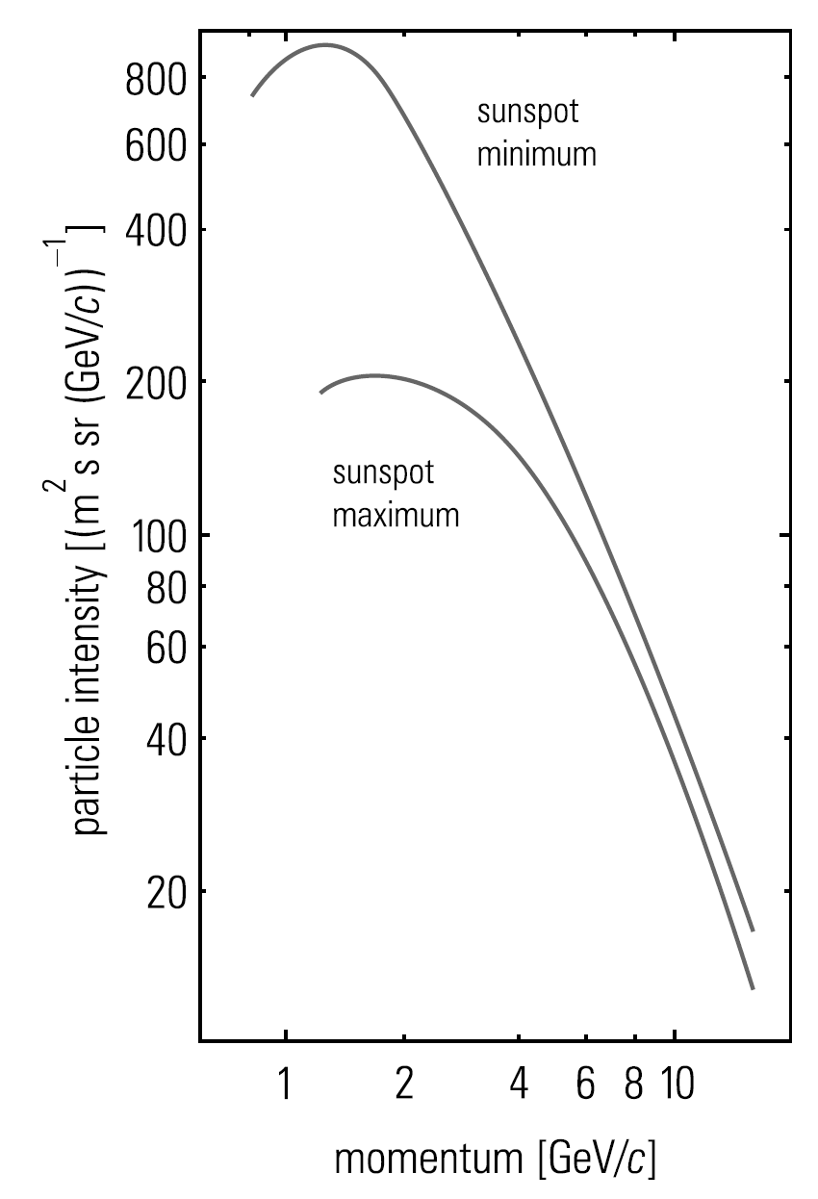
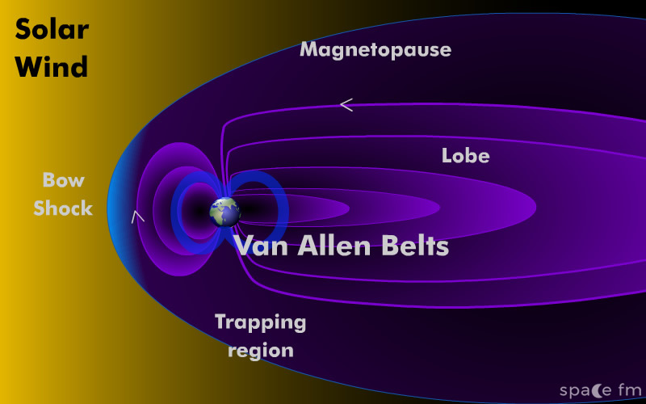

Slide 3
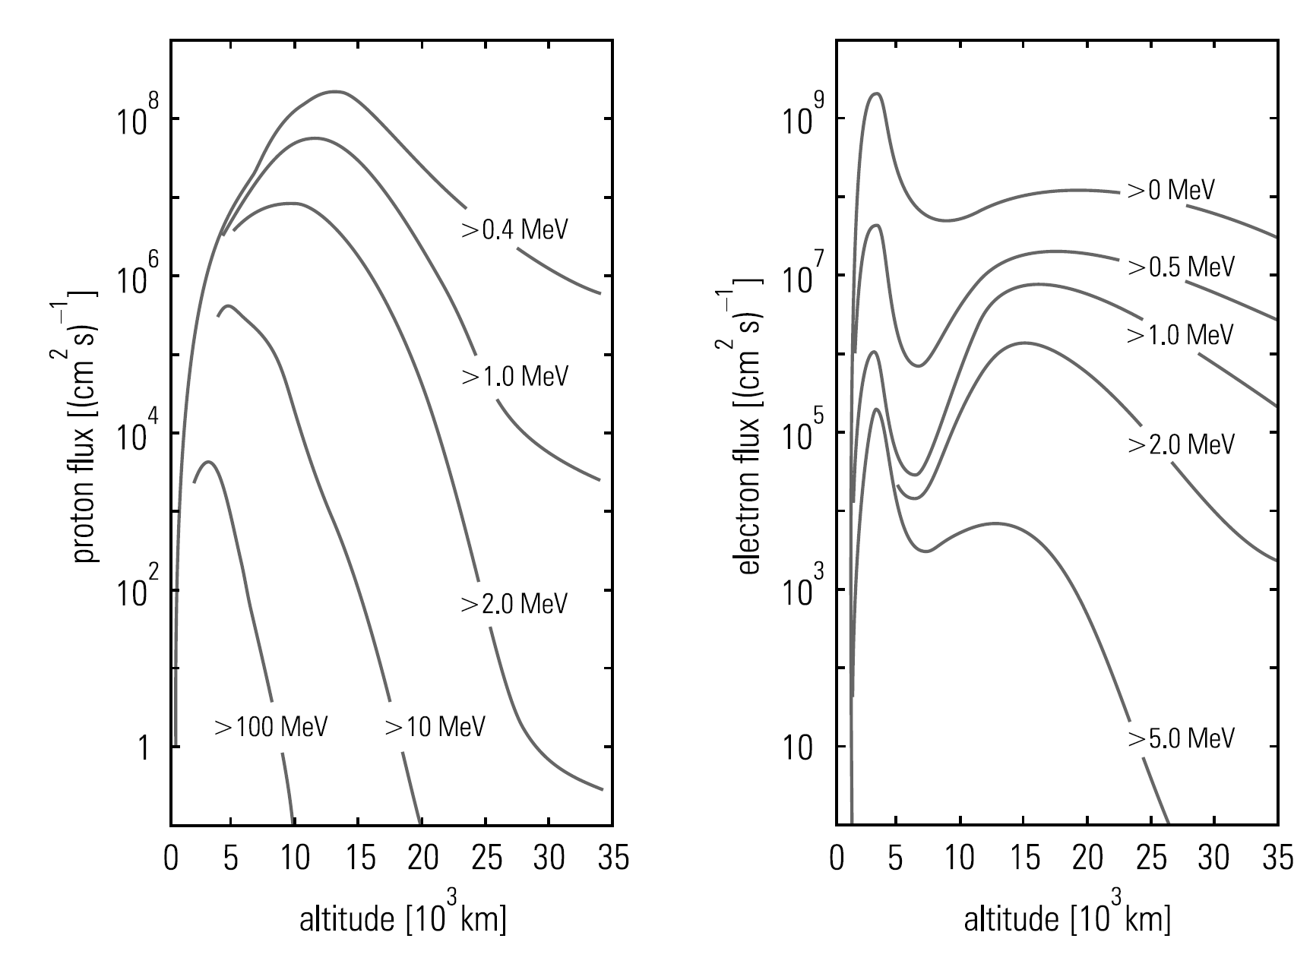
Inner part
Outer part

Slide 4
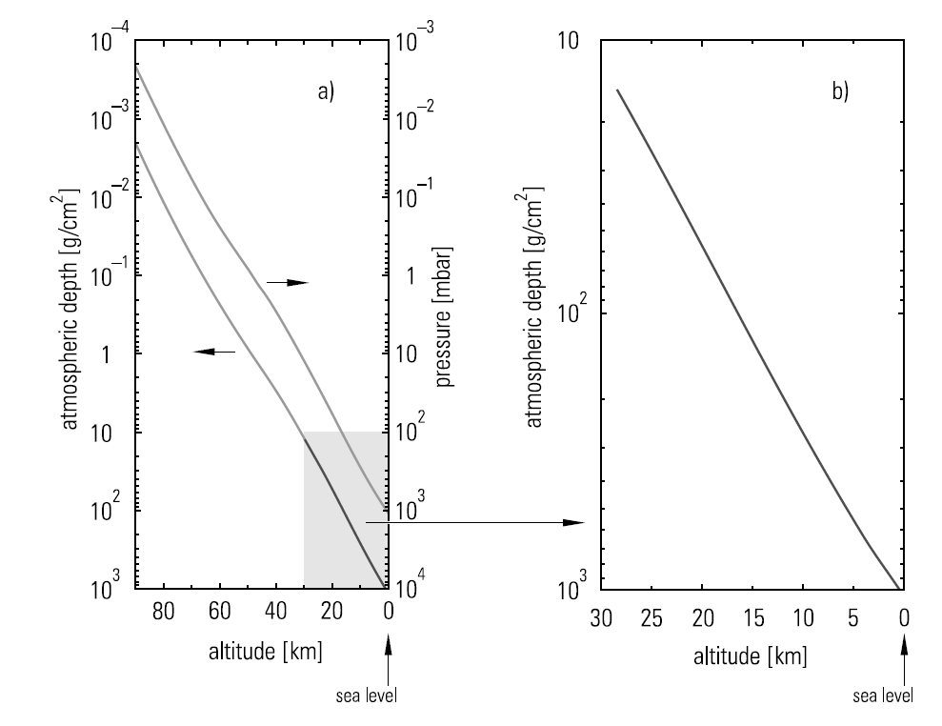
7.1 Propagation in
the Atmosphere
7.2 Cosmic Rays at
Sea Level
7.3 Cosmic Rays
Underground
7.4 Extensive Air
Showers
7.5 Nature and Origin
of the
Highest – Energy
Cosmic Rays
Atmospheric Depth
Primary cosmic rays
Atomic
nuclei
$$1000 g/{cm}^{2}$$

Slide 5
7.1 Propagation in
the Atmosphere
7.2 Cosmic Rays at
Sea Level
7.3 Cosmic Rays
Underground
7.4 Extensive Air
Showers
7.5 Nature and Origin
of the
Highest – Energy
Cosmic Rays
Radiation/Interaction Length
$$1000 g/{cm}^{2}$$
Photon, electron
Radiation length
hadron
Interaction length
$$X_{0}=36.66 g/{cm}^{2}$$
$$λ=90.0 g/{cm}^{2}$$
$$27 radiation length$$
$$11 interaction length$$
Original primary cosmic rays does not reach at sea level

Slide 6
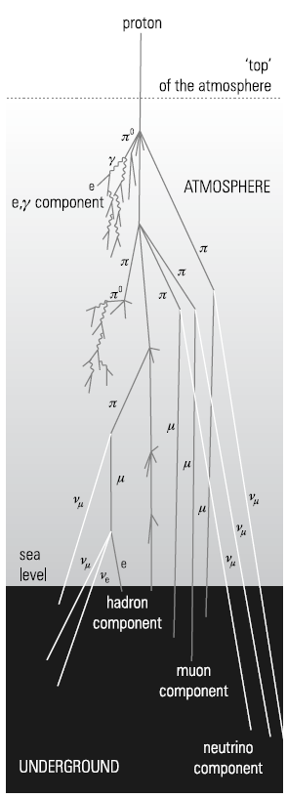
7.1 Propagation in
the Atmosphere
7.2 Cosmic Rays at
Sea Level
7.3 Cosmic Rays
Underground
7.4 Extensive Air
Showers
7.5 Nature and Origin
of the
Highest – Energy
Cosmic Rays
85% of primary cosmic rays
Hadron cascade at 100mbar layer (16154m)
Mostly pions (10% Kaons)
$$π^{+}→μ^{+}+ν_{μ}$$
$$K^{+}→μ^{+}+ν_{μ}$$
$$π^{−}→μ^{−}+{\overline{ν}}_{μ}$$
$$K^{−}→μ^{−}+{\overline{ν}}_{μ}$$
$$μ^{+}→e^{+}+ν_{e}+{\overline{ν}}_{μ}$$
$$μ^{−}→e^{−}+{\overline{ν}}_{e}+ν_{μ}$$

Slide 7
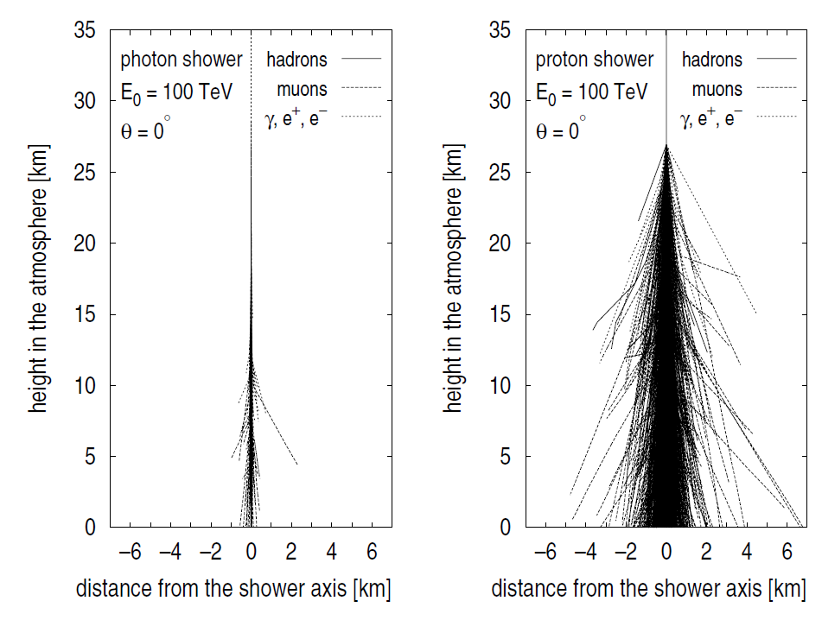
7.1 Propagation in
the Atmosphere
7.2 Cosmic Rays at
Sea Level
7.3 Cosmic Rays
Underground
7.4 Extensive Air
Showers
7.5 Nature and Origin
of the
Highest – Energy
Cosmic Rays
Electromagnetic/Hadronic Cascade
multiple scattering
transverse momenta

Slide 8
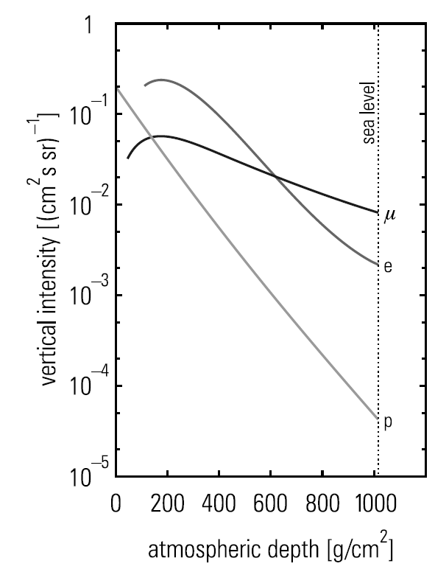
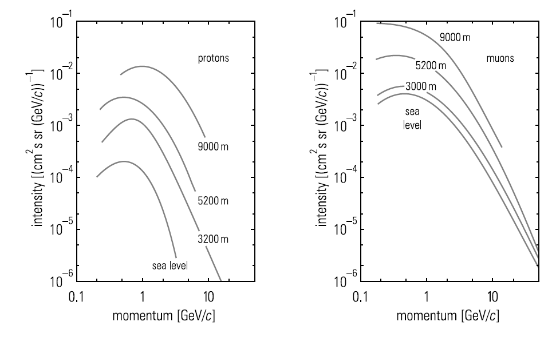
7.1 Propagation in
the Atmosphere
7.2 Cosmic Rays at
Sea Level
7.3 Cosmic Rays
Underground
7.4 Extensive Air
Showers
7.5 Nature and Origin
of the
Highest – Energy
Cosmic Rays
Muons and Protons
Low energy particles
(mostly secondary origin)
Protons ~ exponential
Electrons absorbed quickly
Muons absorbed slowly
Muons dominate over protons

Slide 9
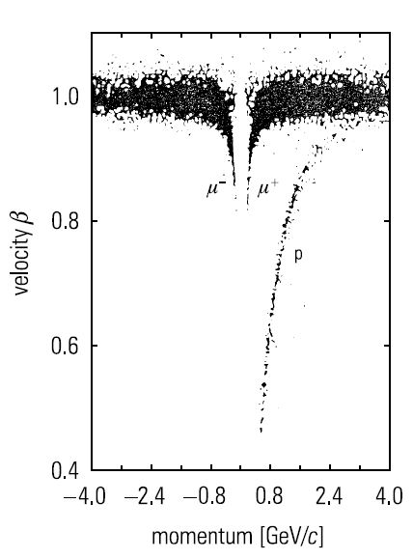
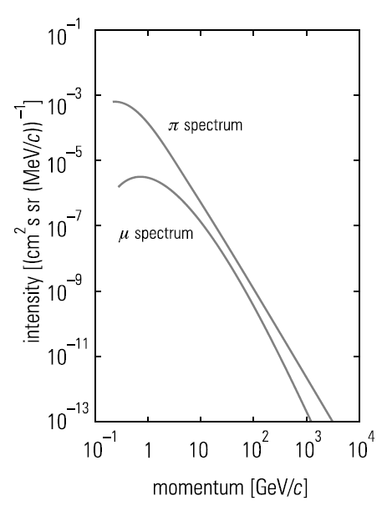
7.1 Propagation in
the Atmosphere
7.2 Cosmic Rays at
Sea Level
7.3 Cosmic Rays
Underground
7.4 Extensive Air
Showers
7.5 Nature and Origin
of the
Highest – Energy
Cosmic Rays
dominant muons
Pion decay
Hadron cascade
muon decay probability ↑
$$s_{μ}≈γτ_{μ}c=6.2km$$
$$s_{π}≈γτ_{π}c=78m$$
absorbed in the atmosphere
Providing muons lower energy

Slide 10
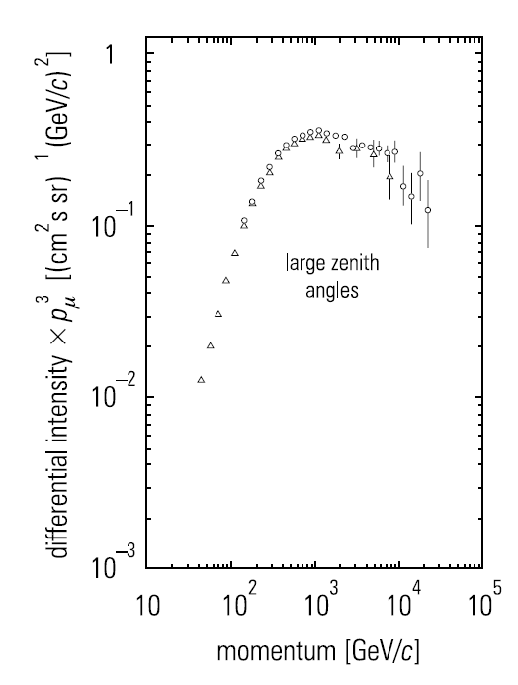
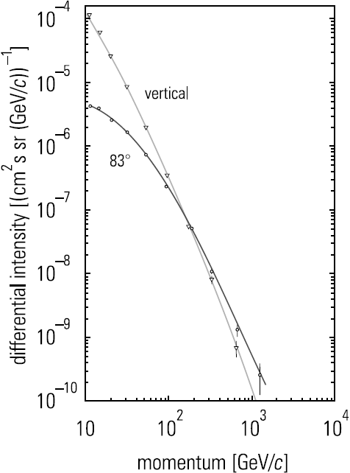
7.1 Propagation in
the Atmosphere
7.2 Cosmic Rays at
Sea Level
7.3 Cosmic Rays
Underground
7.4 Extensive Air
Showers
7.5 Nature and Origin
of the
Highest – Energy
Cosmic Rays
Long
distance
$$θ$$
Decay probability
Interaction probability
High energy muons
Low energy particles
(mostly secondary origin)
$$I_{μ}\left(θ\right)=I_{μ}\left(θ=0\right)\cos^{n}θ$$

Slide 11
7.1 Propagation in
the Atmosphere
7.2 Cosmic Rays at
Sea Level
7.3 Cosmic Rays
Underground
7.4 Extensive Air
Showers
7.5 Nature and Origin
of the
Highest – Energy
Cosmic Rays
primary cosmic rays
$$μ$$
$$\frac{N(μ^{+})}{N(μ^{−})}$$
$$R=\frac{N(π^{+})}{N(π^{−})}=1+\frac{1}{2k}$$
Charge exchange
$$D^{0}→K^{−}μ^{+}ν_{μ}$$
Rightaway decay
charmed
mesons
$$D^{+}→{\overline{K}}^{0}μ^{+}ν_{μ}$$
Source of high energy muons
$$D^{−}→K^{0}μ^{−}{\overline{ν}}_{μ}$$

Slide 12
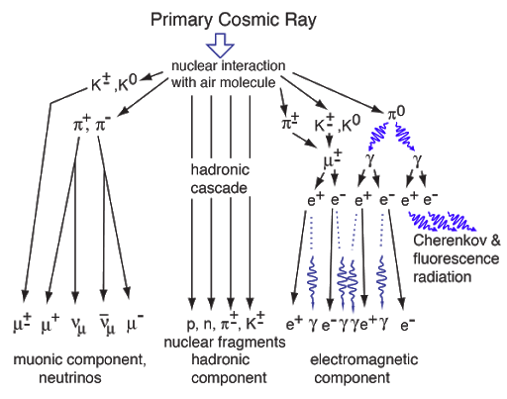
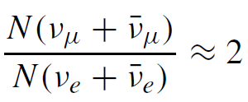
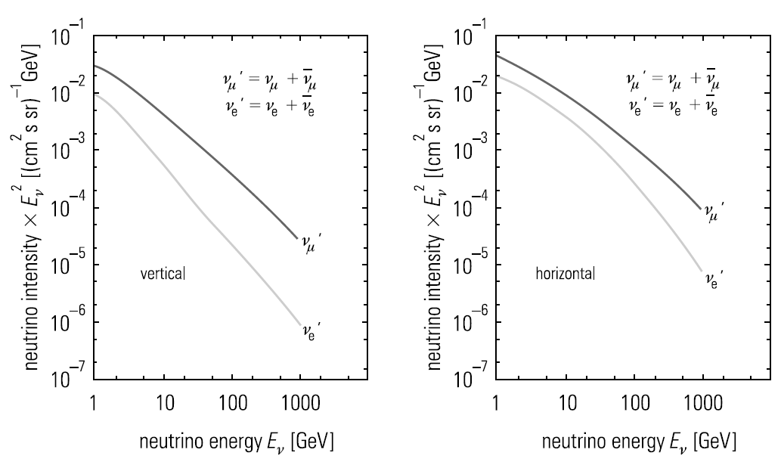
7.1 Propagation in
the Atmosphere
7.2 Cosmic Rays at
Sea Level
7.3 Cosmic Rays
Underground
7.4 Extensive Air
Showers
7.5 Nature and Origin
of the
Highest – Energy
Cosmic Rays

Slide 13
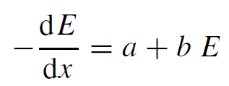
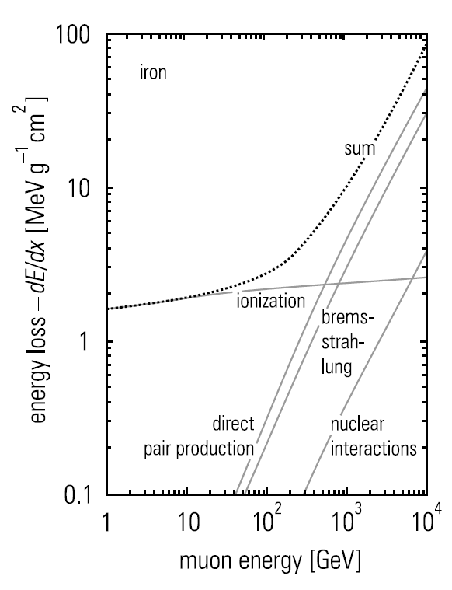
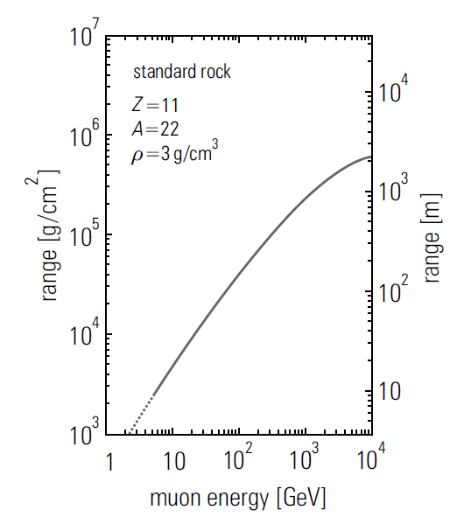
7.1 Propagation in
the Atmosphere
7.2 Cosmic Rays at
Sea Level
7.3 Cosmic Rays
Underground
7.4 Extensive Air
Showers
7.5 Nature and Origin
of the
Highest – Energy
Cosmic Rays
E < 100GeV
100 GeV
$$40000 g/{cm}^{2}$$
160m
400m water equivalent

Slide 14
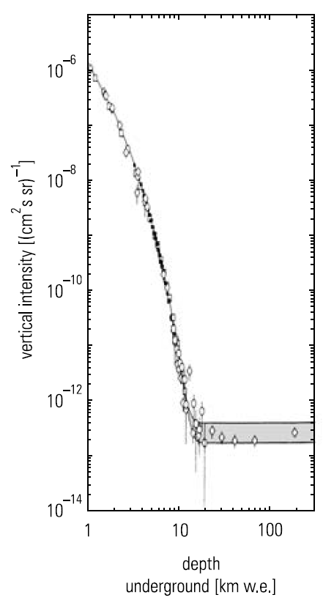
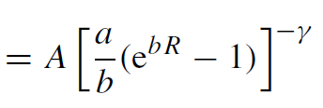
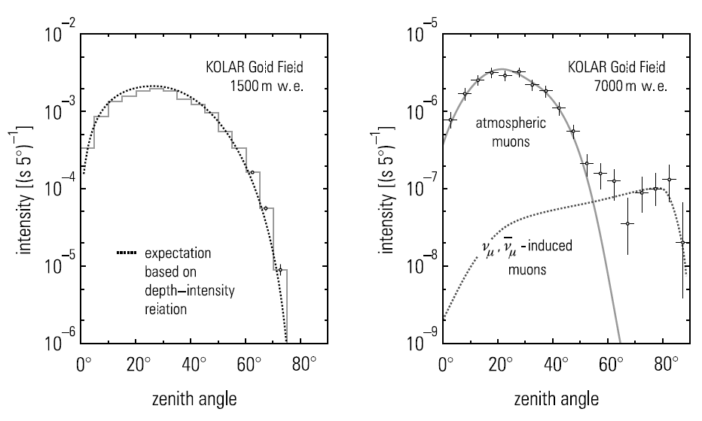
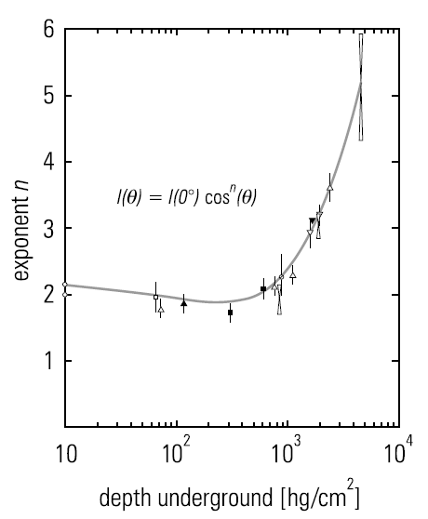
7.1 Propagation in
the Atmosphere
7.2 Cosmic Rays at
Sea Level
7.3 Cosmic Rays
Underground
7.4 Extensive Air
Showers
7.5 Nature and Origin
of the
Highest – Energy
Cosmic Rays
High
energy
inclined
directions
>2GeV
Neutrino
Induced
muons
shallower
depths

Slide 15
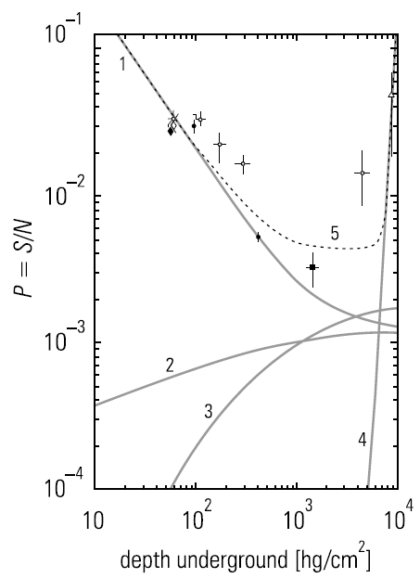
7.1 Propagation in
the Atmosphere
7.2 Cosmic Rays at
Sea Level
7.3 Cosmic Rays
Underground
7.4 Extensive Air
Showers
7.5 Nature and Origin
of the
Highest – Energy
Cosmic Rays
Reduce intensity
at low energy
100GeV
mrad
Produced by
Low-energy pions
electrons
positrons
Neutrino interactions
(5000m w.e. depths)
50~100m
photons
(1) Stopping atmospheric muons
(2) Stopping muons from nuclear interactions
(3) Stopping muons locally produced by photons
(4) Neutrino-induced stopping muons
(5) Sum of all contributions
hadrons
muons
neutrinos

Slide 16
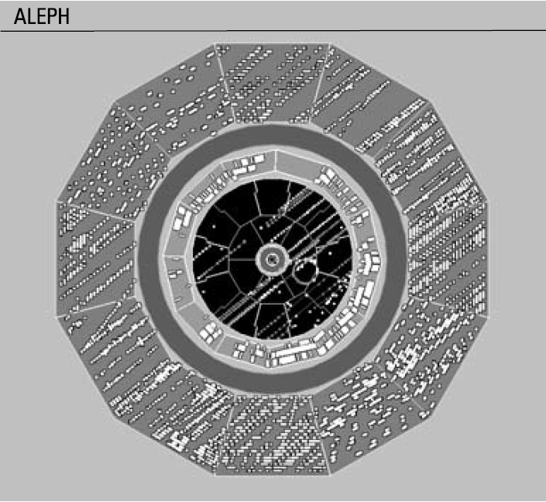
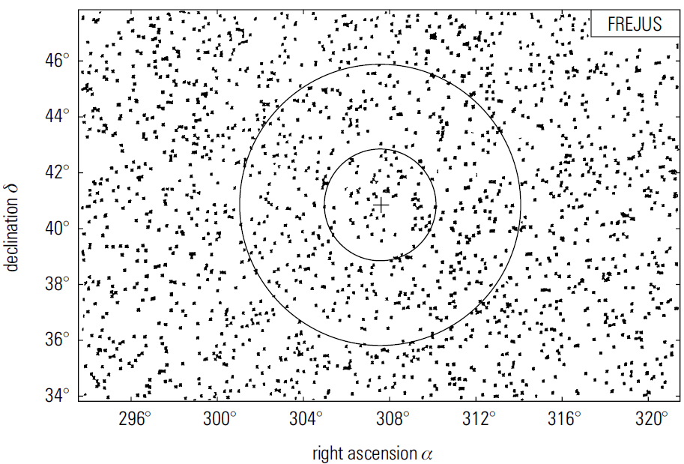
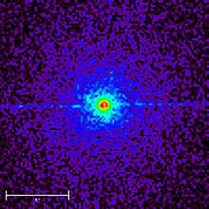
7.1 Propagation in
the Atmosphere
7.2 Cosmic Rays at
Sea Level
7.3 Cosmic Rays
Underground
7.4 Extensive Air
Showers
7.5 Nature and Origin
of the
Highest – Energy
Cosmic Rays
Bundles of parallel muons
Small distances between particles
Decay of pions and kaons
Mostly generated from top part of the shower
Cygnus X3
Candidate for a primary cosmic rays?

Slide 17
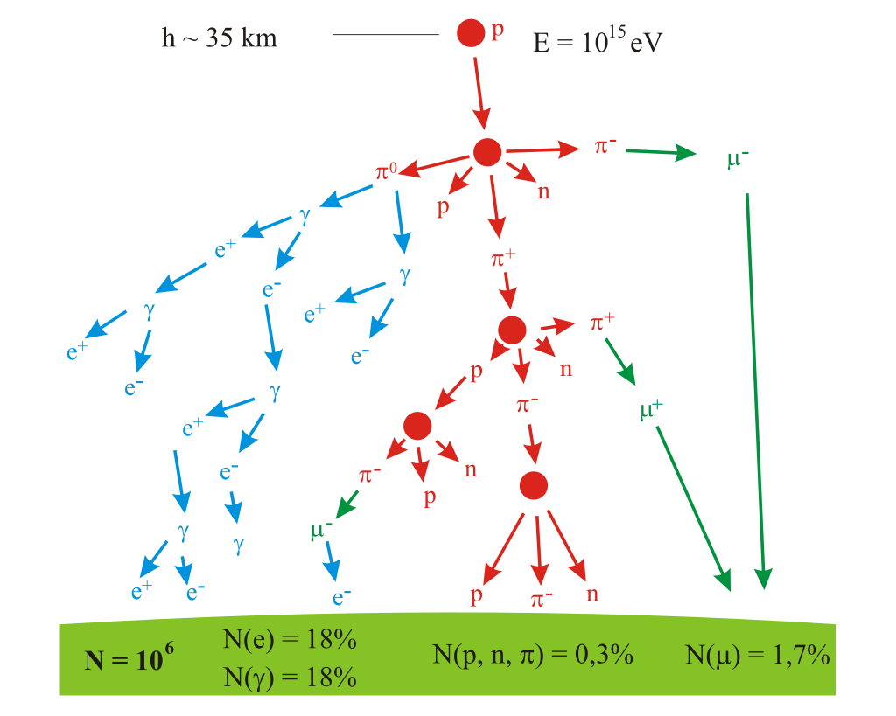
7.1 Propagation in
the Atmosphere
7.2 Cosmic Rays at
Sea Level
7.3 Cosmic Rays
Underground
7.4 Extensive Air
Showers
7.5 Nature and Origin
of the
Highest – Energy
Cosmic Rays
Inelasticity
50% energy transferred
to secondary particles
$$\frac{1}{3}$$
goes to electromagnetic component
Most primary energy
→ elctromagnetic
main component
of the shower

Slide 18
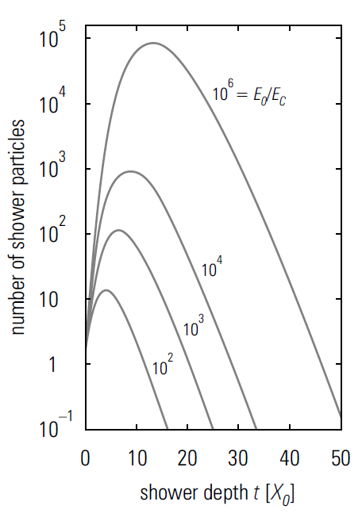
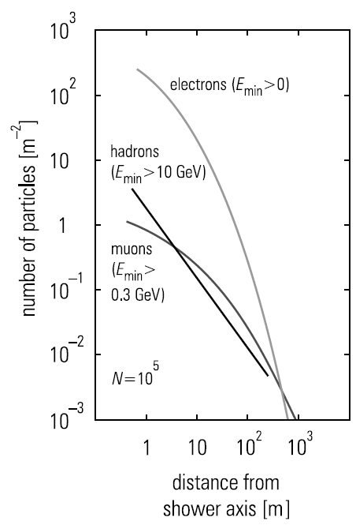
7.1 Propagation in
the Atmosphere
7.2 Cosmic Rays at
Sea Level
7.3 Cosmic Rays
Underground
7.4 Extensive Air
Showers
7.5 Nature and Origin
of the
Highest – Energy
Cosmic Rays
$$X_{0}=36.66 g/{cm}^{2}$$
atmosphere
$$27 radiation length$$
$$11 interaction length$$
→ 100TeV
transverse momenta
neurtinos follow muons

Slide 19
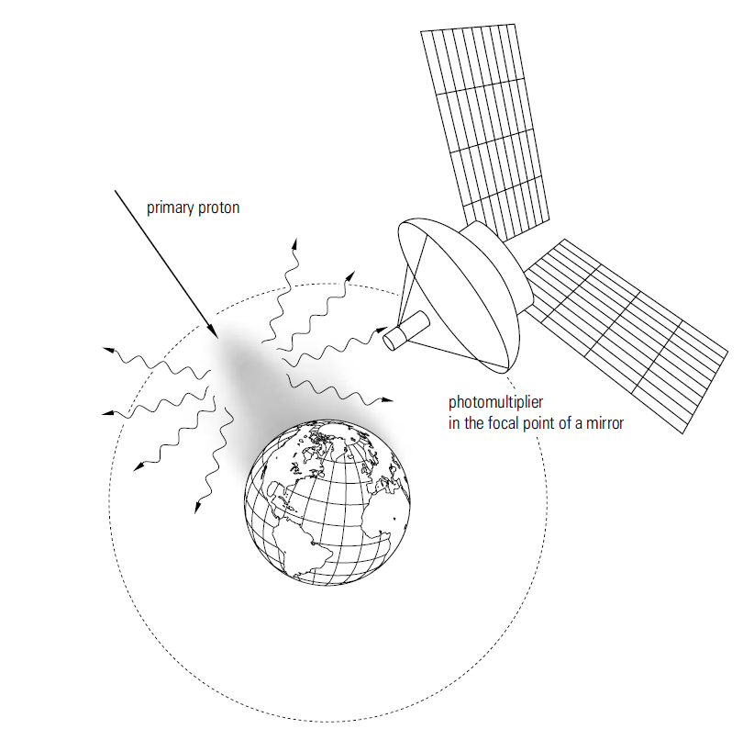
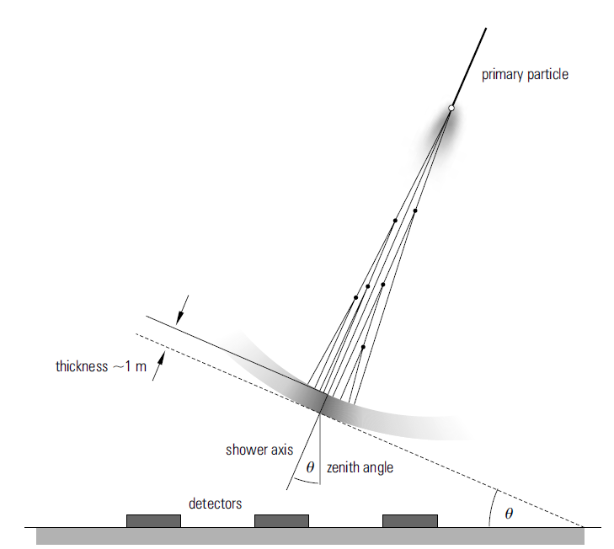
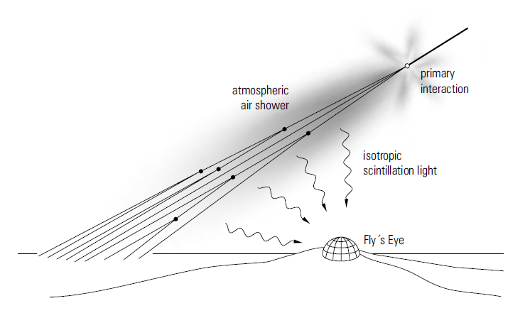
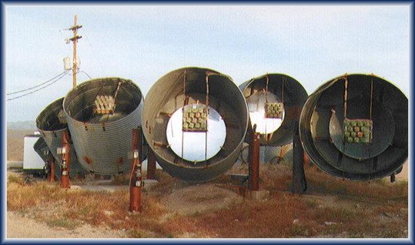
7.1 Propagation in
the Atmosphere
7.2 Cosmic Rays at
Sea Level
7.3 Cosmic Rays
Underground
7.4 Extensive Air
Showers
7.5 Nature and Origin
of the
Highest – Energy
Cosmic Rays
Cherenkov
light

Slide 20
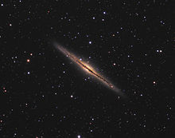
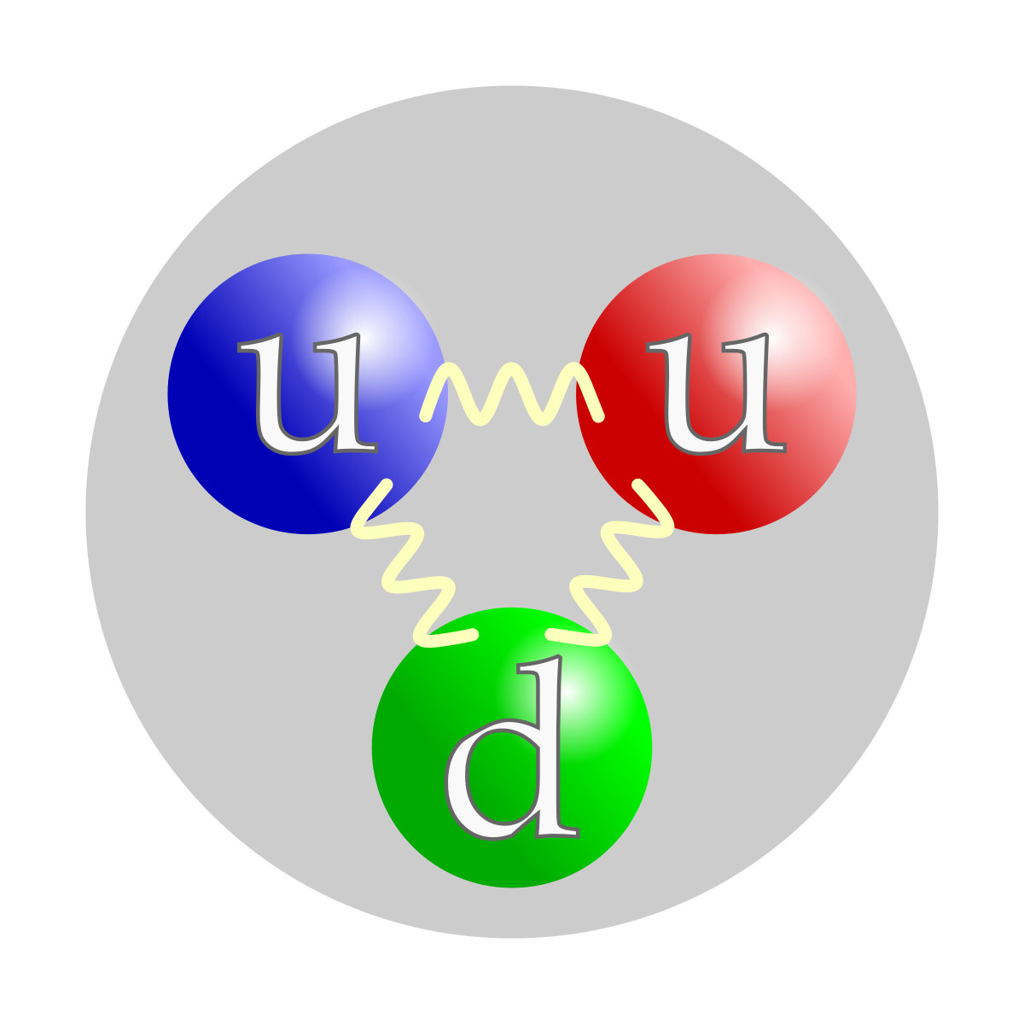
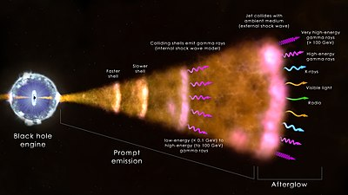
7.1 Propagation in
the Atmosphere
7.2 Cosmic Rays at
Sea Level
7.3 Cosmic Rays
Underground
7.4 Extensive Air
Showers
7.5 Nature and Origin
of the
Highest – Energy
Cosmic Rays
→ extragalactic
protons
→ months
$$<{10}^{20}eV$$
50 Mpc
→ years

Slide 21
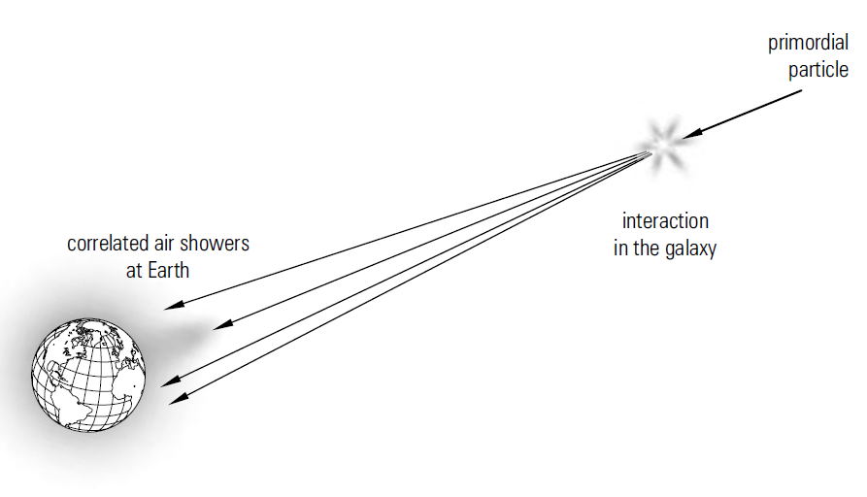
7.1 Propagation in
the Atmosphere
7.2 Cosmic Rays at
Sea Level
7.3 Cosmic Rays
Underground
7.4 Extensive Air
Showers
7.5 Nature and Origin
of the
Highest – Energy
Cosmic Rays
100km
0.3
100km
0.5

Slide 22
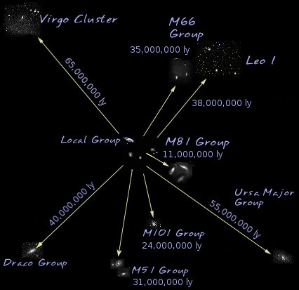
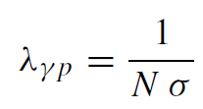
7.1 Propagation in
the Atmosphere
7.2 Cosmic Rays at
Sea Level
7.3 Cosmic Rays
Underground
7.4 Extensive Air
Showers
7.5 Nature and Origin
of the
Highest – Energy
Cosmic Rays
$$>{10}^{20}eV$$
Gyroradii
Size of the source
→ extragalactic
protons

Slide 23
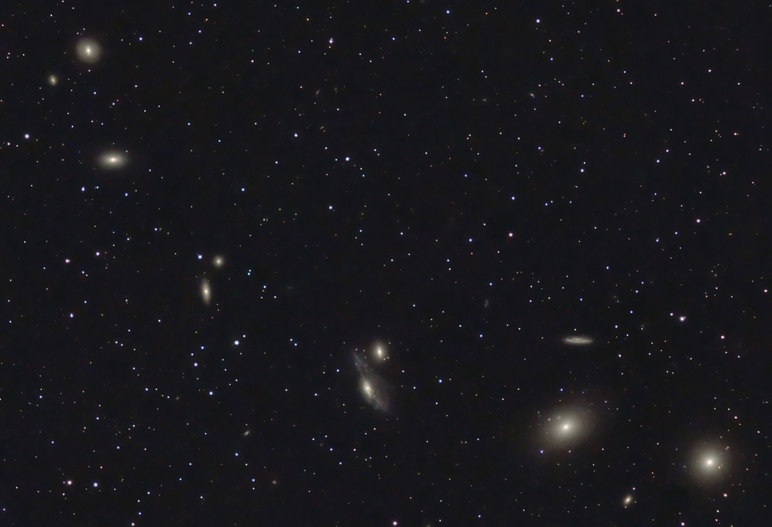
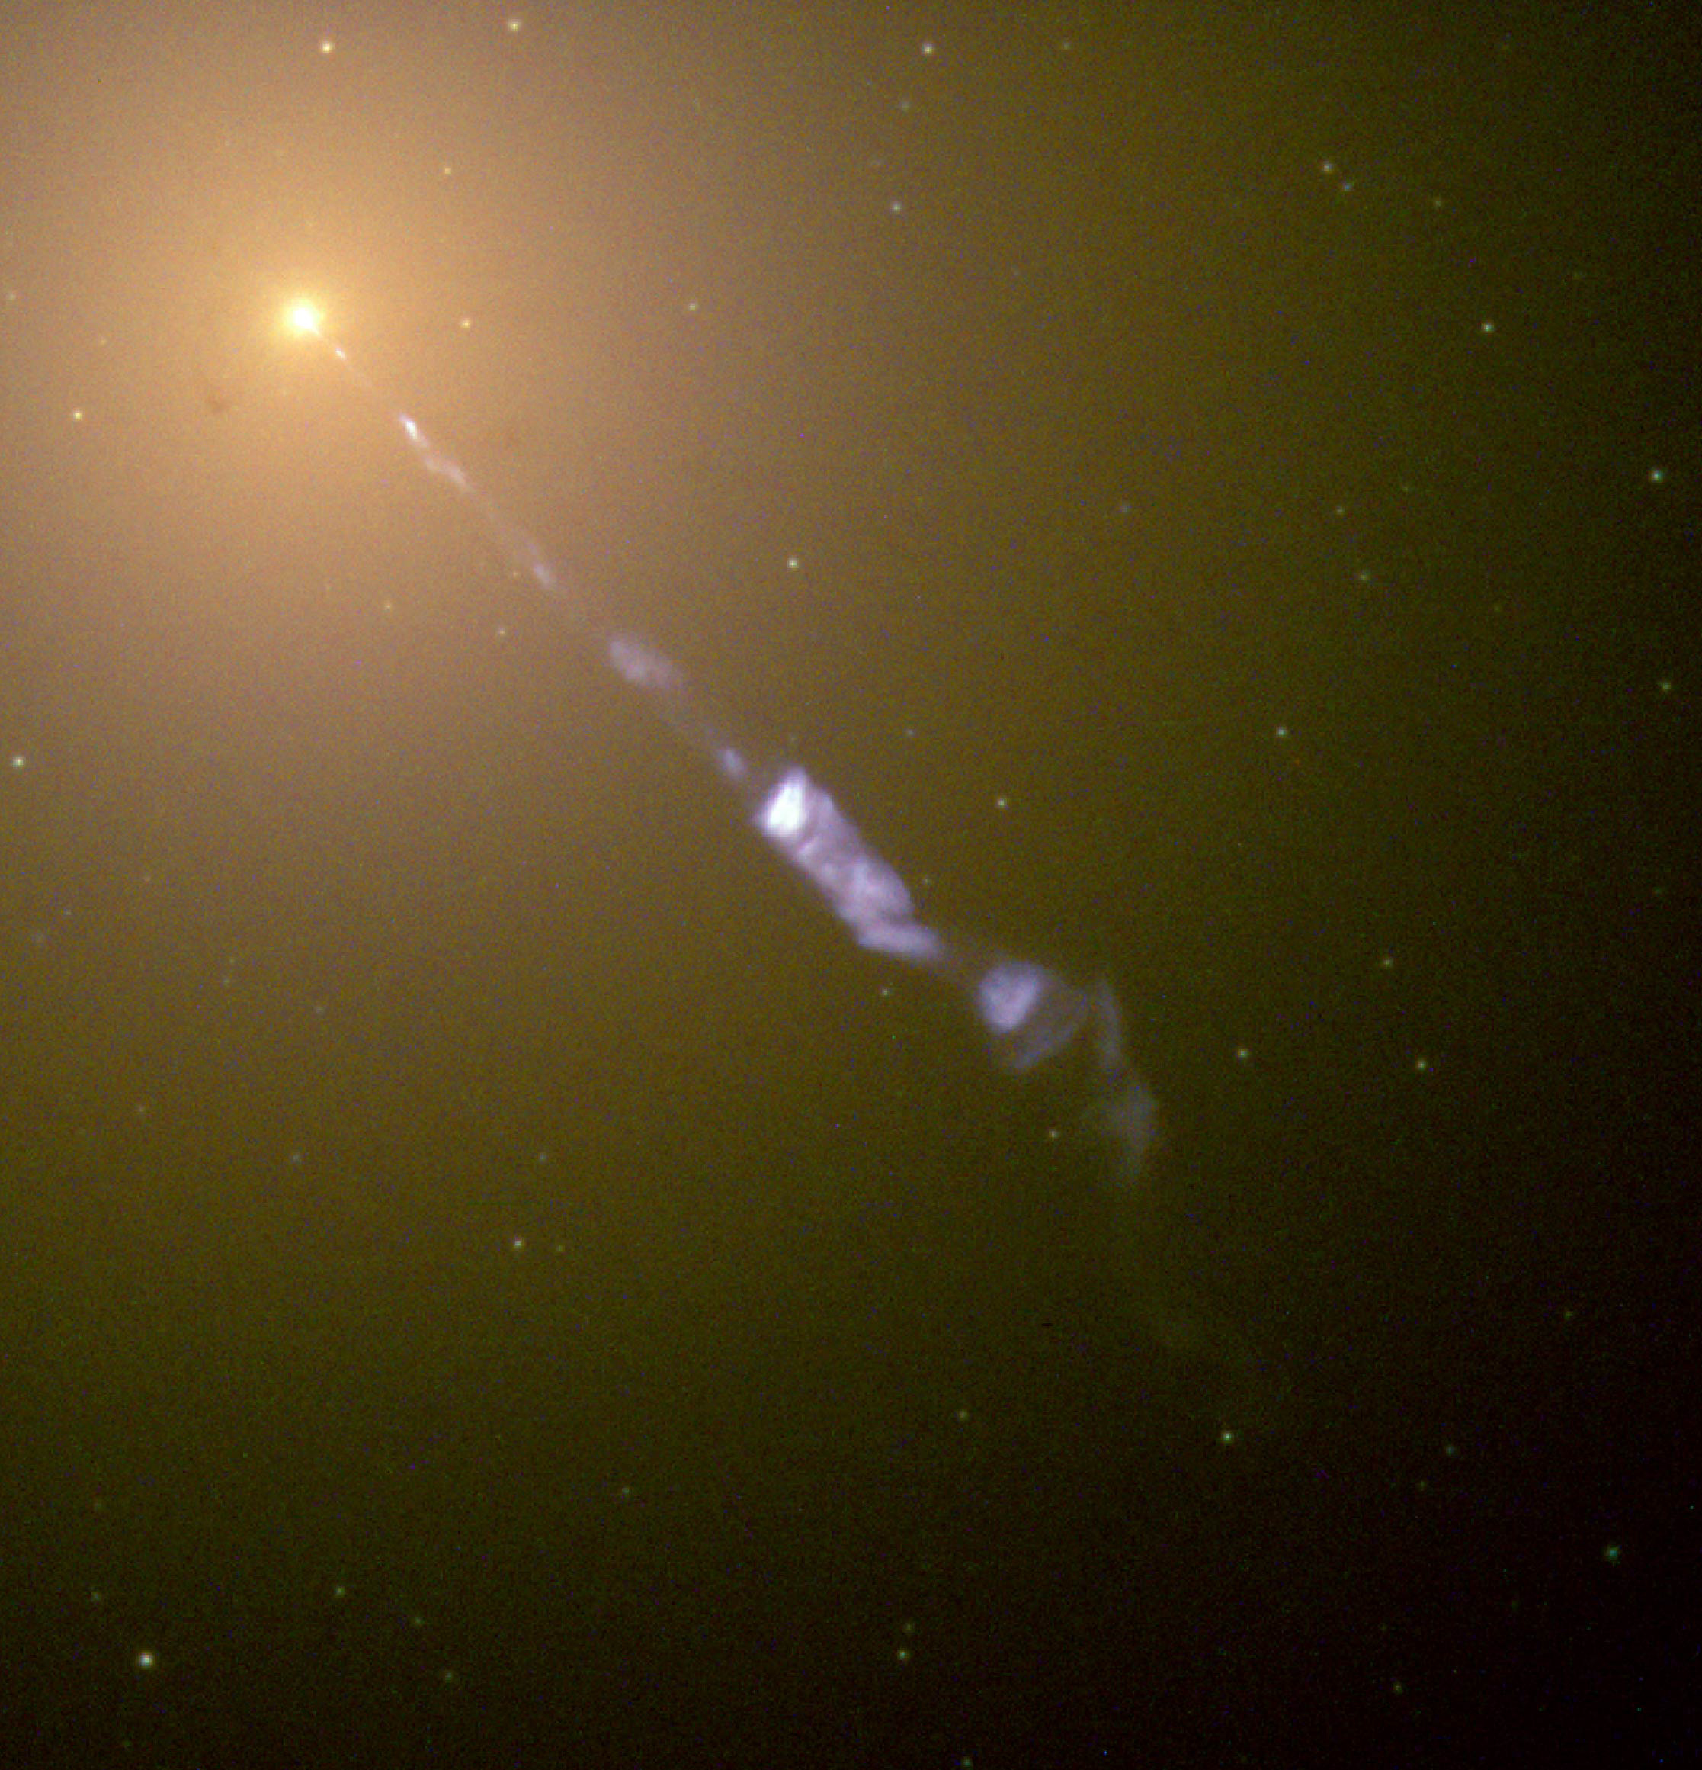
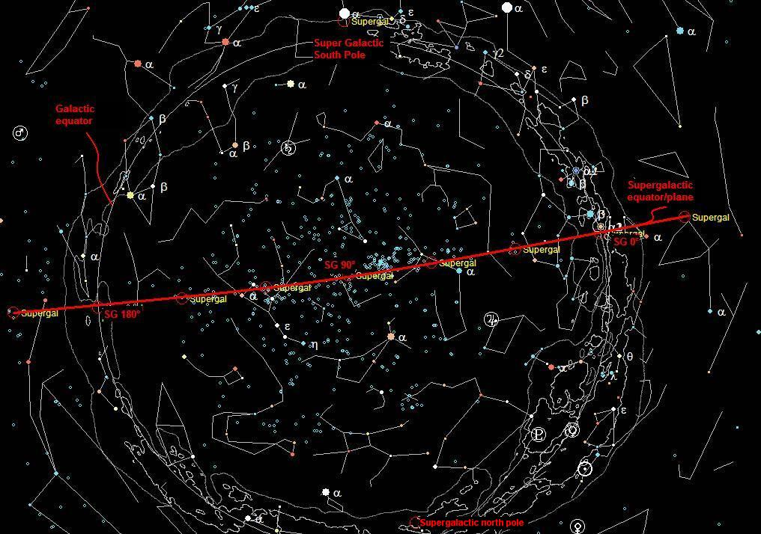
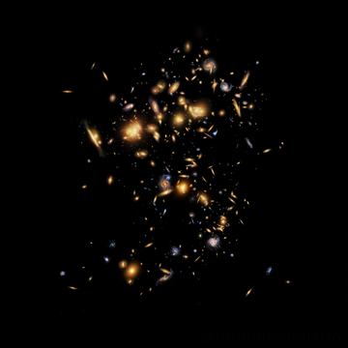
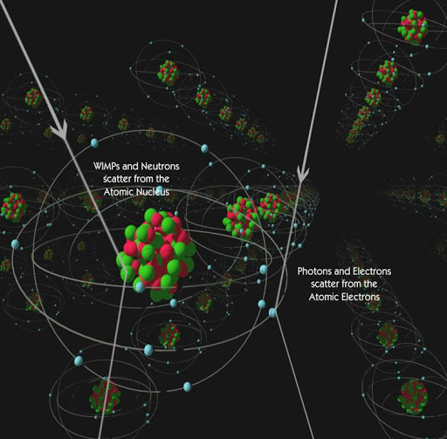
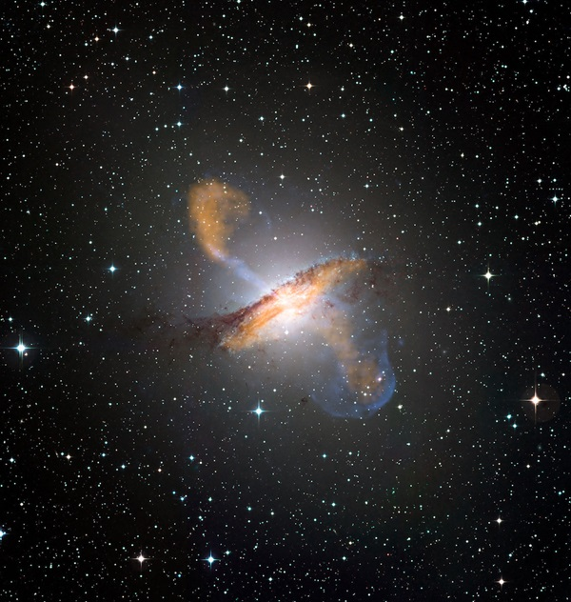
7.1 Propagation in
the Atmosphere
7.2 Cosmic Rays at
Sea Level
7.3 Cosmic Rays
Underground
7.4 Extensive Air
Showers
7.5 Nature and Origin
of the
Highest – Energy
Cosmic Rays
Markarian Galaxies
M87
Blazars

Slide 24
감사합니다.

