Slide 1
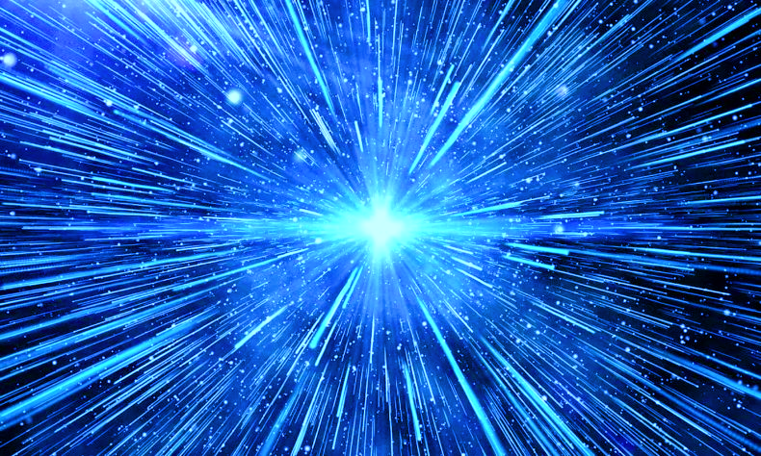
12. Inflation
Hyeonmo Koo

Slide 2
Contents
12.1. How Inflation Works
12.2. The Flatness Problem and Solution
12.3. The Horizon Problem and Solution
12.4. The Monopole Problem and Solution
12.5. Mechanisms for Inflation
12.6. Inflation and the Growth of Structure
12.7. Inflation and Gravitational Wave

Slide 3
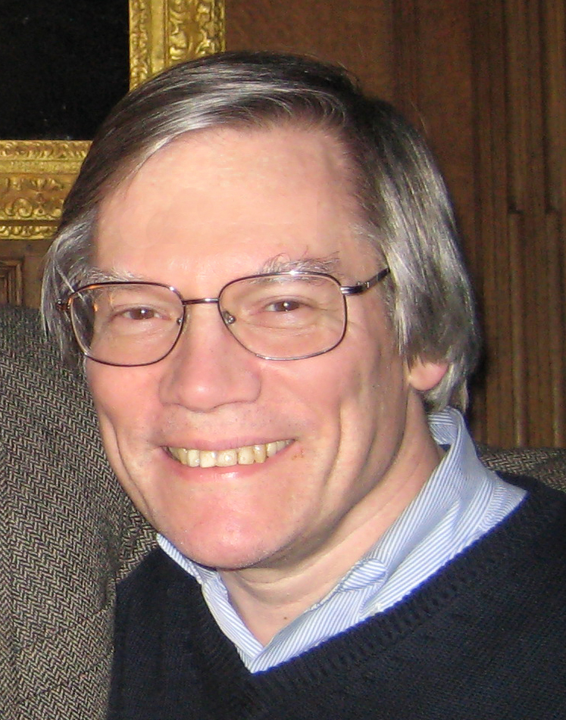
12.1. How Inflation Works
12.2. The Flatness Problem and Solution
12.3. The Horizon Problem and Solution
$$a\left(t\right)∝e^{Ht}$$
Alan Guth(1947~)
${\left(\frac{\dot{a}}{a}\right)}^{2}=\frac{8}{3}πGρ$ This model has a constant density.($k≅0$)
$\frac{\ddot{a}}{a}=−\frac{4}{3}πG\left(ρ+3P\right)>0$ This satisfies $ρ+3P=ρ\left(1+3w\right)<0$
$\dot{ρ}+3H\left(1+w\right)ρ=0$ This says $P=−ρ$(Same as Dark Energy)

Slide 4
12.1. How Inflation Works
12.2. The Flatness Problem and Solution
12.3. The Horizon Problem and Solution
$$\left|Ω−1\right|∝\frac{1}{{\left(a^{2}ρ_{c}\right)}^{2}}$$
$$\frac{Ω\left(t_{mr}\right)−1}{Ω\left(t_{0}\right)−1}={\left(\frac{t_{mr}}{t_{0}}\right)}^{2/3}≅2×{10}^{−4}$$
$$\frac{Ω\left(t_{Pl}\right)−1}{Ω\left(t_{0}\right)−1}=\frac{t_{Pl}}{t_{mr}}{\left(\frac{t_{mr}}{t_{0}}\right)}^{2/3}≅{10}^{−59}$$
$$Ω\left(t_{0}\right)=1.00±0.0002$$
$$\left|Ω−1\right|∝t^{2/3}$$
$$\left|Ω−1\right|∝t$$
In the past, our universe was too, too, too, too flat!!!
Is this decided by god…?
$$t_{Pl}$$
$$t_{mr}$$
$$t_{0}$$
$$t$$
Notes:
$$H^{2}+\frac{k}{a^{2}}=\frac{8}{3}πGρ$$
$$ρ_{c}=\frac{3H^{2}}{8πG}$$
$$\frac{k}{a^{2}}=\frac{8}{3}πGρ_{c}\left(Ω−1\right)$$
$$\left|Ω−1\right|∝\frac{1}{a^{2}ρ_{c}}$$
For $ρ∝a^{−3(1+w)}$ and $a\left(t\right)∝t^{\frac{2}{3\left(1+w\right)}}$, we know that $a^{2}ρ∝a^{−\left(1+3w\right)}=t^{−2+\frac{4}{3\left(1+w\right)}}$
A little bit strange… Too flat than expected.

Slide 5
12.1. How Inflation Works
12.2. The Flatness Problem and Solution
12.3. The Horizon Problem and Solution
$$\frac{Ω\left(t_{i}\right)−1}{Ω\left(t_{0}\right)−1}=\frac{e^{−2Ht_{i}}}{e^{−2Ht_{f}}}\frac{t_{f}}{t_{mr}}{\left(\frac{t_{mr}}{t_{0}}\right)}^{2/3}≡e^{2N}\frac{t_{f}}{t_{mr}}{\left(\frac{t_{mr}}{t_{0}}\right)}^{2/3}$$
$$N>\frac{1}{2}\ln\left\{\left|\frac{Ω\left(t_{i}\right)−1}{Ω\left(t_{0}\right)−1}\right|\frac{t_{mr}}{t_{f}}{\left(\frac{t_{0}}{t_{mr}}\right)}^{2/3}\right\}≅61$$
$$\left|Ω−1\right|∝\frac{1}{{\left(a^{2}ρ_{c}\right)}^{2}}$$
During the Inflation…
Universe expanded as: $e^{61}≅3×{10}^{26}$
$$\left|Ω−1\right|∝e^{−2Ht}$$
$$\left|Ω−1\right|∝t^{2/3}$$
$$\left|Ω−1\right|∝t$$
$$t_{i}$$
Inflation Era
$$t_{f}$$
$$t_{mr}$$
$$t_{0}$$
$$t$$

Slide 6
12.2. The Flatness Problem and Solution
12.3. The Horizon Problem and Solution
12.4. The Monopole Problem and Solution
$$d_{A}\left(z_{∗}\right)$$
$$d_{H}\left(z_{∗}\right)$$
$t=t_{∗}$(Last Scattering)
$$z_{∗}≅1100$$
$t=t_{0}$(Current)
$$d_{H}\left(z_{∗}\right)=a\left(t\right)\int_{0}^{t_{∗}}{\frac{dt}{a\left(t\right)}}$$
$$d_{A}\left(z_{∗}\right)=a\left(t\right)\int_{t_{∗}}^{t_{0}}{\frac{dt}{a\left(t\right)}}$$
$$θ_{LSS}≅\frac{d_{A}\left(z_{∗}\right)}{d_{H}\left(z_{∗}\right)}≅1.05° \left[No More Causal Contact\right]$$

Slide 7
12.2. The Flatness Problem and Solution
12.3. The Horizon Problem and Solution
12.4. The Monopole Problem and Solution
Conformal Time $η\left(t\right)=\int_{t_{i}}^{t}{\frac{dt^{′}}{a\left(t^{′}\right)}}$
Particle Horizon
$$χ_{PH}\left(t_{rec}\right)=ca_{rec}\int_{t_{i}}^{t_{rec}}{\frac{dt}{a\left(t\right)}}=c\left(η_{rec}−η_{i}\right)$$
Event Horizon
$$χ_{PH}\left(t_{rec}\right)=ca_{rec}\int_{t_{rec}}^{t_{0}}{\frac{dt}{a\left(t\right)}}=c\left(η_{0}−η_{rec}\right)$$
$$η_{i}=\frac{2H_{0}^{−1}}{1+3w}a_{i}^{\frac{1+3w}{2}}$$
$η_{0}$
P
Q
$η_{rec}$
$η_{i}$
For $1+3w>0$(Decelerating)…
$$\lim_{\begin{aligned}a_{i}→0 \\ w>−1/3\end{aligned}}{η_{i}}=\lim_{\begin{aligned}a_{i}→0 \\ w>−1/3\end{aligned}}{\frac{2H_{0}^{−1}}{1+3w}a_{i}^{\frac{1+3w}{2}}}=0$$
No causal contact! But $\frac{δT}{T}≅{10}^{−5}$…?

Slide 8
12.2. The Flatness Problem and Solution
12.3. The Horizon Problem and Solution
12.4. The Monopole Problem and Solution
For $1+3w<0$(Accelerating)…
$$\lim_{\begin{aligned}a_{i}→0 \\ w<−1/3\end{aligned}}{η_{i}}=\lim_{\begin{aligned}a_{i}→0 \\ w<−1/3\end{aligned}}{\frac{2H_{0}^{−1}}{1+3w}{\left(\frac{1}{a_{i}}\right)}^{−\frac{1+3w}{2}}}=−∞$$
Causal contact existed!
$η_{0}$
P
Q
$η_{rec}$
$η_{E}≅0$
Inflation
$η_{S}$
$η_{i}=−∞$

Slide 9
12.3. The Horizon Problem and Solution
12.4. The Monopole Problem and Solution
12.5. Mechanisms for Inflation
After GUT Phase Transition, X/Y Boson got mass!
Causally Disconnected
$$M_{X}≠0$$
$$M_{X}=0$$
Topological Defect

Slide 10
12.3. The Horizon Problem and Solution
12.4. The Monopole Problem and Solution
12.5. Mechanisms for Inflation
Then, magnetic monopole also got mass $m_{Mon}\sim {10}^{17}\left[GeV\right]$.
$$t=0$$
$$t=t_{GUT}={10}^{−39}s$$
Particle Horizon in $t={10}^{39}s$
$$χ_{PH}\left(t_{GUT}\right)=ca_{GUT}\int_{0}^{t_{GUT}}{\frac{dt}{a\left(t\right)}}=2ct_{GUT}$$
$$ρ_{mon}(t_{GUT})=\frac{m_{mon}}{{\left(2ct_{GUT}\right)}^{3}}≅2×{10}^{57}\left[{GeV}^{4}\right]$$
$$ρ_{γ}=\frac{π^{4}}{15{\left(ℏc\right)}^{3}}{\left(k_{B}T_{GUT}\right)}^{4}≅2×{10}^{63}\left[{GeV}^{4}\right]$$
Even if they decrease, $ρ_{mon}$ will overwhelm $ρ_{γ}$.
But where is magnetic monopole?

Slide 11
12.3. The Horizon Problem and Solution
12.4. The Monopole Problem and Solution
12.5. Mechanisms for Inflation
Inflation after GUT phase transition?
$$t=0$$
$$t=t_{GUT}={10}^{−39}s$$
$$t=t_{i}={10}^{−38}s$$
$$t=t_{f}={10}^{−36}s$$
$$n_{mon}=\frac{1}{{\left(2ct_{GUT}\right)}^{3}}{\left(\frac{t_{i}}{t_{GUT}}\right)}^{−\frac{3}{2}}{\left(\frac{e^{Ht_{f}}}{e^{Ht_{i}}}\right)}^{−3}{\left(\frac{t_{mr}}{t_{f}}\right)}^{−\frac{3}{2}}{\left(\frac{t_{0}}{t_{mr}}\right)}^{−2}≅3×{10}^{−38}\left[{Gpc}^{−3}\right]$$
Inflation Era
$$R∝e^{Ht}$$
Matter era
$$R∝t^{2/3}$$
Radiation Era
$$R∝t^{1/2}$$

Slide 12
12.3. The Horizon Problem and Solution
12.4. The Monopole Problem and Solution
12.5. Mechanisms for Inflation
Simply, Magnetic Monopole problem solved as…
Before Inflation…
After Inflation…
I can’t find magnetic monopole!
I guess it would be harder than whatever you think.

Slide 13
12.4. The Monopole Problem and Solution
12.5. Mechanisms for Inflation
12.6. Inflation and the Growth of Structure
Inflaton : The trigger of Inflation, and Scalar Field
Need to understand the scalar field theory simply…
Classical Mechanics
Lagrangian
$$L\left(x_{i},\dot{x_{i}}\right)=\frac{1}{2}m{\dot{\vec{x}}}^{2}−V\left(\vec{x}\right)$$
2. Hamiltonian(Energy if Conservative)
$$H\left(x_{i},p_{i}\right)=\sum_{i}{p_{i}}\dot{x_{i}}−L\left(x_{i},\dot{x_{i}}\right)$$
Scalar Field Theory
1. Lagrangian Density
$$ℒ=\frac{1}{2}g^{μν}\left(∂_{μ}φ\right)\left(∂_{ν}φ\right)−V\left(φ\right)=\frac{1}{2}\left\{{\dot{φ}}^{2}−{\left(∇φ\right)}^{2}\right\}−V\left(φ\right)$$
2. Energy-Momentum Tensor
$$T_{μ}^{ν}=\frac{∂ℒ}{∂\left(∂_{ν}φ\right)}∂_{μ}φ−ℒδ_{μ}^{ν}$$
$$T_{0}^{0}=\frac{∂ℒ}{∂\dot{φ}}\dot{φ}−ℒ={\dot{φ}}^{2}−\left[\frac{1}{2}\left\{{\dot{φ}}^{2}−{\left(∇φ\right)}^{2}\right\}−V\left(φ\right)\right]≅\frac{1}{2}{\dot{φ}}^{2}+V\left(φ\right)$$
$$T_{i}^{i}=\frac{∂ℒ}{∂\left(∇_{i}φ\right)}\left(∇_{i}φ\right)−ℒ={\left(∇_{i}φ\right)}^{2}−\left[\frac{1}{2}\left\{{\dot{φ}}^{2}−{\left(∇φ\right)}^{2}\right\}−V\left(φ\right)\right]≅−\frac{1}{2}{\dot{φ}}^{2}+V\left(φ\right)$$

Slide 14
12.4. The Monopole Problem and Solution
12.5. Mechanisms for Inflation
12.6. Inflation and the Growth of Structure
$$ρ=\frac{1}{2}{\dot{φ}}^{2}+V\left(φ\right)$$
$$P=\frac{1}{2}{\dot{φ}}^{2}−V\left(φ\right)$$
From General Relativity, we know that $T_{μ}^{ν}=diag\left(ρ,−P,−P,−P\right)$
Putting all of them into Friedmann equation and acceleration equation!
Time scale $H^{−1}$ varies rapidly in Inflation!
$$H^{2}=\frac{8}{3}πG\left\{\frac{1}{2}{\dot{φ}}^{2}+V\left(φ\right)\right\}$$
$$\dot{H}+H^{2}+\frac{8}{3}πG\left\{{\dot{φ}}^{2}−V\left(φ\right)\right\}=0$$
$$\dot{ρ}+3H\left(ρ+P\right)=0$$
$$\dot{H}=−4πG{\dot{φ}}^{2}$$
$$\ddot{φ}+3H\dot{φ}+V^{′}\left(φ\right)=0$$
$$\left|\frac{d}{dt}\frac{1}{H}\right|=\frac{\dot{H}}{H^{2}}≪1$$

Slide 15
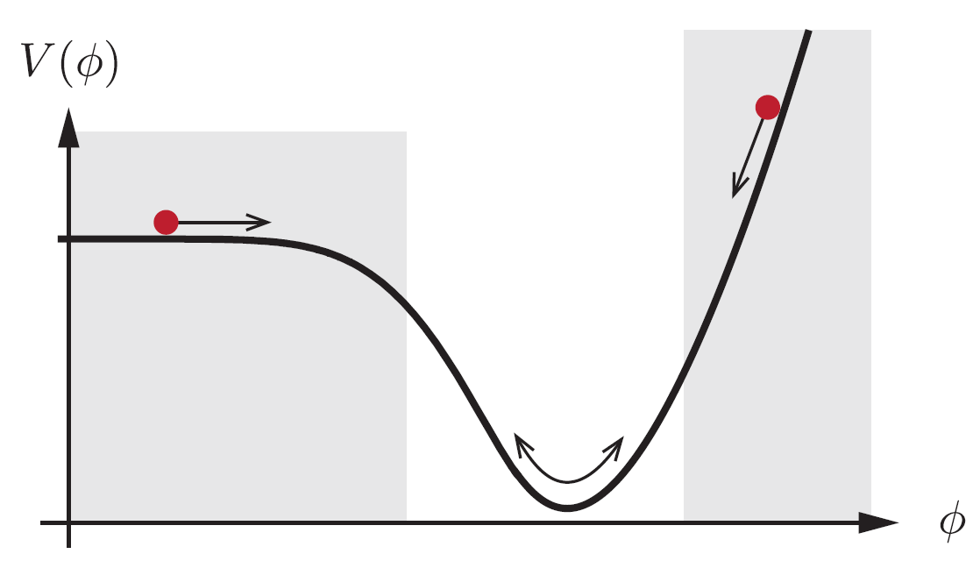
12.4. The Monopole Problem and Solution
12.5. Mechanisms for Inflation
12.6. Inflation and the Growth of Structure
1. $ρ≅−P≅V\left(φ\right)$
Inflaton Model represents “Exponential Inflation”.
2. Slowly-varying inflaton drives Inflation. [Slow-Roll Inflation]
$${\dot{φ}}^{2}≪V\left(φ\right)$$

Slide 16
12.4. The Monopole Problem and Solution
12.5. Mechanisms for Inflation
12.6. Inflation and the Growth of Structure
At the end of the Inflation, Inflaton would decay.
$$\dot{ρ_{φ}}+3Hρ_{φ}\left(1+w_{φ}\right)=−Γρ_{φ}$$
[Reheating]
Inflaton oscillation is damping with the rate $Γ$.
Frictional heating can be regarded as the growing of radiation energy.
Inflaton decays with the rate $Γ\left(const.\right)$
$$\dot{ρ_{r}}+3Hρ_{r}\left(1+w_{r}\right)=+Γρ_{φ}$$
Radiation era would begin with its growing.

Slide 17
12.5. Mechanisms for Inflation
12.6. Inflation and the Growth of Structure
12.7. Inflation and Gravitational Wave
The Primordial Quantum Fluctuation
Spread out by Inflation
And makes density perturbation.
$$δ\left(\vec{x}\right)=\frac{ρ\left(\vec{x}\right)−\left\langle ρ\right\rangle }{\left\langle ρ\right\rangle }=\int{\tilde{δ}\left(\vec{k}\right)e^{i\vec{k}∙\vec{x}}d^{3}\vec{k}}$$

Slide 18
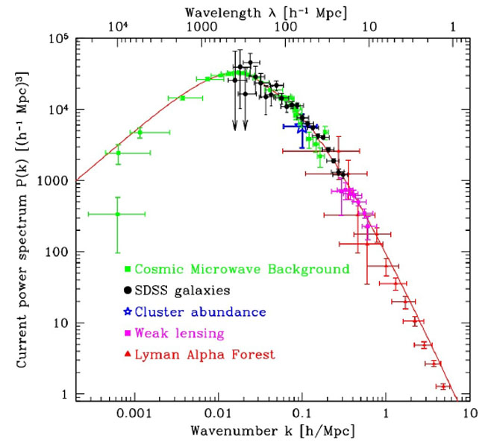
12.5. Mechanisms for Inflation
12.6. Inflation and the Growth of Structure
12.7. Inflation and Gravitational Wave
$$δ\left(\vec{x}\right)=\frac{ρ\left(\vec{x}\right)−\left\langle ρ\right\rangle }{\left\langle ρ\right\rangle }=\int{\tilde{δ}\left(\vec{k}\right)e^{i\vec{k}∙\vec{x}}d^{3}\vec{k}}$$
$$P\left(k\right)=\left\langle {\left|\tilde{δ}\left(\vec{k}\right)\right|}^{2}\right\rangle$$
$d≤100Mpc\left(k≥0.01h{Mpc}^{−1}\right)$ : SDSS data can be used to measure directly the galaxy density.
$d≥100Mpc\left(k≤0.01h{Mpc}^{−1}\right)$ : $\frac{δT}{T}$ from CMB provide the most accurate info.
From the cosmological perturbation theory:
$$P\left(k\right)=A_{S}{\left(\frac{k}{k_{0}}\right)}^{n}$$
$$P\left(k\right)∝k$$
$$P\left(k\right)∝k^{−3}$$

Slide 19
12.5. Mechanisms for Inflation
12.6. Inflation and the Growth of Structure
12.7. Inflation and Gravitational Wave
Gravitational Wave produced during Inflation.

Slide 20
12.5. Mechanisms for Inflation
12.6. Inflation and the Growth of Structure
12.7. Inflation and Gravitational Wave
Tensor Perturbation of metric
Put above into Einstein’s eq $G_{μν}=8πGT_{μν}$
$$ds^{2}=a^{2}\left[\left(1+2Φ\right){dη}^{2}−\left\{\left(1−2Φ\right)δ_{ij}+h_{ij}\right\}dx^{i}dx^{j}\right]$$
$$h_{ij}=\left(\begin{matrix}h_{+} & h_{×} & 0 \\ h_{×} & −h_{+} & 0 \\ 0 & 0 & 0\end{matrix}\right)$$
$$\ddot{h_{α}}+3H\dot{h_{α}}−a^{−2}∇^{2}h_{α}=0\left[Wave eq.\right]$$
Tensor Perturbation produces the Gravitation Wave.

Slide 21
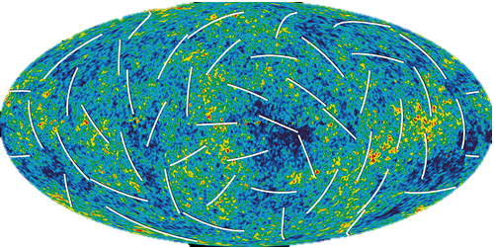
12.5. Mechanisms for Inflation
12.6. Inflation and the Growth of Structure
12.7. Inflation and Gravitational Wave
Tensor Perturbation produces the Gravitation Wave.
And it is forbidden in the CMB polarization.
E-mode
B-mode
The B-mode polarization could be a probe of Inflationary Era.

Slide 22
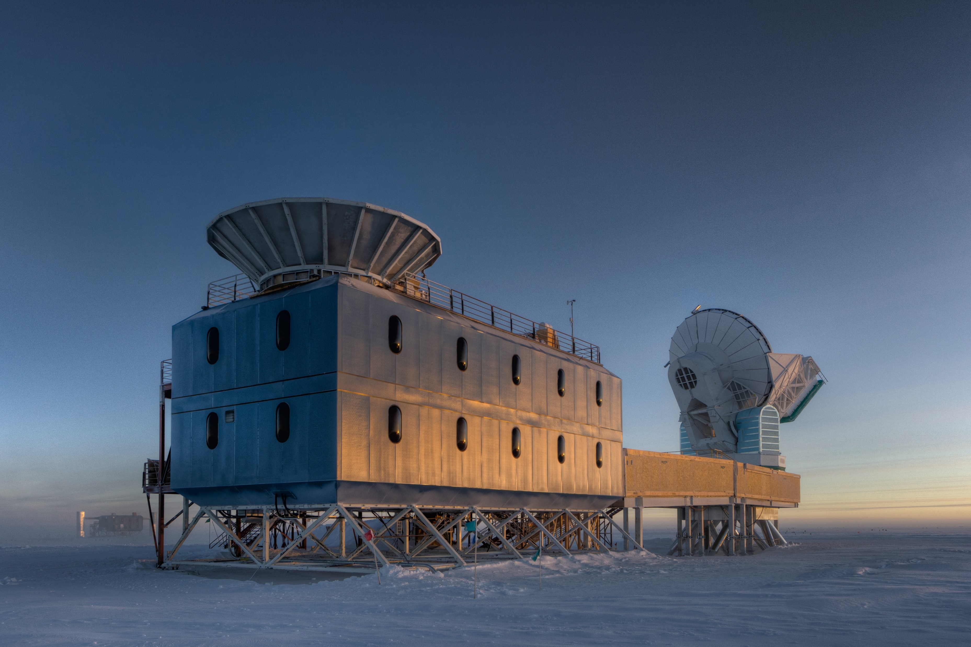
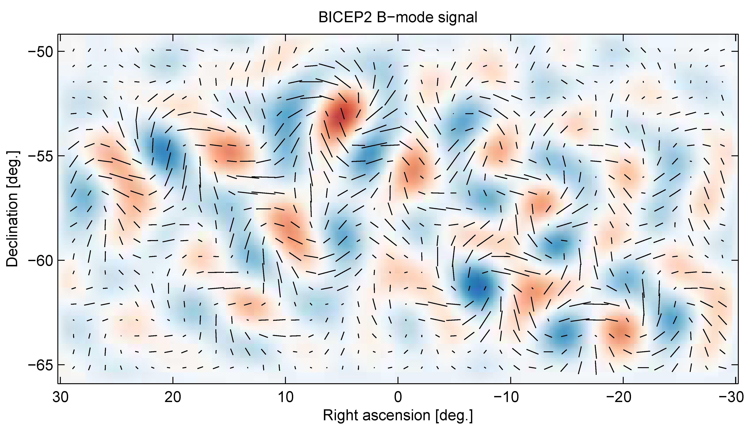
12.5. Mechanisms for Inflation
12.6. Inflation and the Growth of Structure
12.7. Inflation and Gravitational Wave
BICEP(Background Imaging of Cosmic Extragalactic Polarization)2
Maybe that result is not from CMB polarization, but from the scattering by interstellar gas in our galaxy!
David Spergel

