Slide 1
11. The Cosmic Microwave Background(CMB)
Hyeonmo Koo

Slide 2
Contents
11.1. Prelude : Transition to a Matter-Dominated Universe
11.2. Formation of the CMB
11.3. CMB Anisotropies
11.4. Determination of Cosmological Parameter

Slide 3
11.1. Transition to a Matter-Dominated Universe
11.2. Formation of the CMB
11.3. CMB Anisotropies
From the last presentations…
Friedmann eq. for flat spacetime
$$H^{2}=\frac{8}{3}πGρ$$
Physical Quantities derived from Friedmann eq.
$\frac{ρ_{m}}{ρ_{r}}∝a^{1}$
Component | Energy Density $ρ(a)$ | Scale Factor $a(t)∝T^{−1}$ | Hubble Const. $H(t)$
Radiation ($P=ρ/3$) | $$∝a^{−4}$$ | $$∝t^{1/2}$$ | $$\frac{1}{2t}$$
Matter ($P=0$) | $$∝a^{−3}$$ | $$∝t^{2/3}$$ | $$\frac{2}{3t}$$
Cosmological Constant ($P=−ρ$) | Const. | $$∝e^{\sqrt{Λ/3}t}$$ | $$\sqrt{\frac{Λ}{3}}$$

Slide 4
11.1. Transition to a Matter-Dominated Universe
11.2. Formation of the CMB
11.3. CMB Anisotropies
The time when matter-radiation equal
The critical density of our universe is $ρ_{c}=\frac{3H_{0}^{2}}{8πG}=8.63×{10}^{−30}[g/cm^{3}]$
$$Ω_{m}=ρ_{m}/ρ_{c}≅0.3, Ω_{r}=ρ_{r}/ρ_{c}≅8.47×{10}^{−5}$$
$$\frac{a_{eq}}{1}=\frac{a_{0}\left(=1\right)}{ρ_{m}/ρ_{r}}$$
$$a_{eq}≅\frac{1}{3600}$$
Matter-Radiation eq.
Now
$$H^{2}=\frac{8}{3}πGρ_{Tot}=\frac{8}{3}πGρ_{eq}\left\{{\left(\frac{a_{eq}}{a}\right)}^{3}+{\left(\frac{a_{eq}}{a}\right)}^{4}\right\}$$
$$H_{eq}^{2}=H^{2}\left(a=a_{eq}\right)=\frac{16}{3}πGρ_{eq}=\frac{16}{3}πGρ_{m}a_{eq}^{−3}$$
For Matter
For Radiation
$$t_{eq}=\frac{2\sqrt{2}}{3}\left(2−\sqrt{2}\right)H_{eq}^{−1}≅55000[yr]$$

Slide 5
11.1. Transition to a Matter-Dominated Universe
11.2. Formation of the CMB
11.3. CMB Anisotropies
Recombination : The process of $p^{+}+e^{−}→{}_{1}^{}H+γ$
Decoupling : The epoch when $γ$ stop to interact with $e^{−}$

Slide 6
11.1. Transition to a Matter-Dominated Universe
11.2. Formation of the CMB
11.3. CMB Anisotropies
$$e^{−}$$
$$p^{+}$$
Free?
$$e^{−}$$
$$p^{+}$$
Binding Energy of Hydrogen : 13.6eV
So, can we expect that the recombination temperature corresponds to $\frac{13.6\left[eV\right]}{k_{B}}≅157821\left[K\right]$?
$${}_{1}^{}H$$

Slide 7
11.1. Transition to a Matter-Dominated Universe
11.2. Formation of the CMB
11.3. CMB Anisotropies
$$p^{+}$$
$$p^{+}$$
$$e^{−}$$
$$e^{−}$$
$$p^{+}$$
$$e^{−}$$
$$p^{+}$$
$$e^{−}$$
$$e^{−}$$
$$e^{−}$$
No. According to baryon-photon ratio as given: $η=5×{10}^{−10}$, so the recombination temperature should be lower than $13.6\left[eV\right]/k_{B}$.
Precisely… $T_{rec}=0.3\left[eV\right]/k_{B}≅3500[K]$
$$e^{−}$$
$$p^{+}$$
$${}_{1}^{}H$$
And from $T\left(t\right)∝a^{−1}\left(t\right)∝t^{−2/3}$, $t_{rec}≅300000[yr]$

Slide 8
11.1. Transition to a Matter-Dominated Universe
11.2. Formation of the CMB
11.3. CMB Anisotropies
$$e^{−}$$
$$p^{+}$$
$$e^{−}$$
$$p^{+}$$
$$e^{−}$$
$$p^{+}$$
Free!
$$e^{−}$$
$$p^{+}$$
At the temperature $T_{dec}=3000\left[K\right]$, corresponds to $t_{dec}=380000\left[yr\right]$, the mean free path $λ_{mfp}$ of photon becomes longer than the horizon distance after “Last scattering”.
From this, photon is totally decoupled, and this makes the Cosmic Microwave Background.
$$e^{−}$$
$$p^{+}$$
$${}_{1}^{}H$$

Slide 9
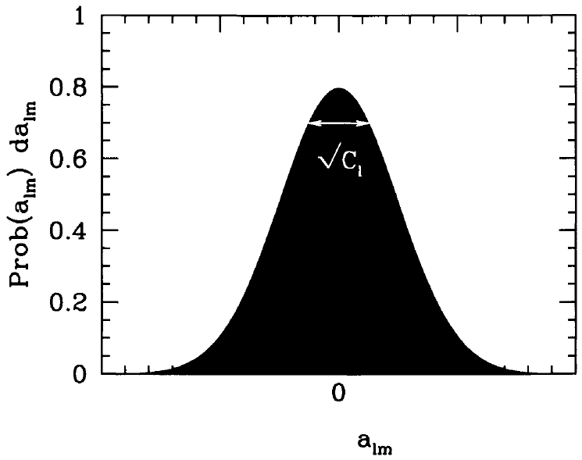
11.2. Formation of the CMB
11.3. CMB Anisotropies
11.4. Determination of Cosmological Parameters
$$\frac{δT}{T}\left(\hat{n}\right)=\sum_{l=0}^{∞}{\sum_{m=−l}^{+l}{a_{l}^{m}Y_{l}^{m}\left(θ,φ\right)}}$$
$$a_{l}^{m}=\int{dΩ}\frac{δT}{T}\left(\hat{n}\right){Y_{l}^{m}}^{∗}\left(\hat{n}\right)$$
$$δT\left(\hat{n}\right)$$
$$\hat{n}$$
$$\left\langle a_{l}^{m}\right\rangle =0$$
$$\left\langle a_{l}^{m}a_{l^{′}}^{m^{′}}\right\rangle =C_{l}δ_{l^{′}l}δ_{m^{′}m}$$

Slide 10
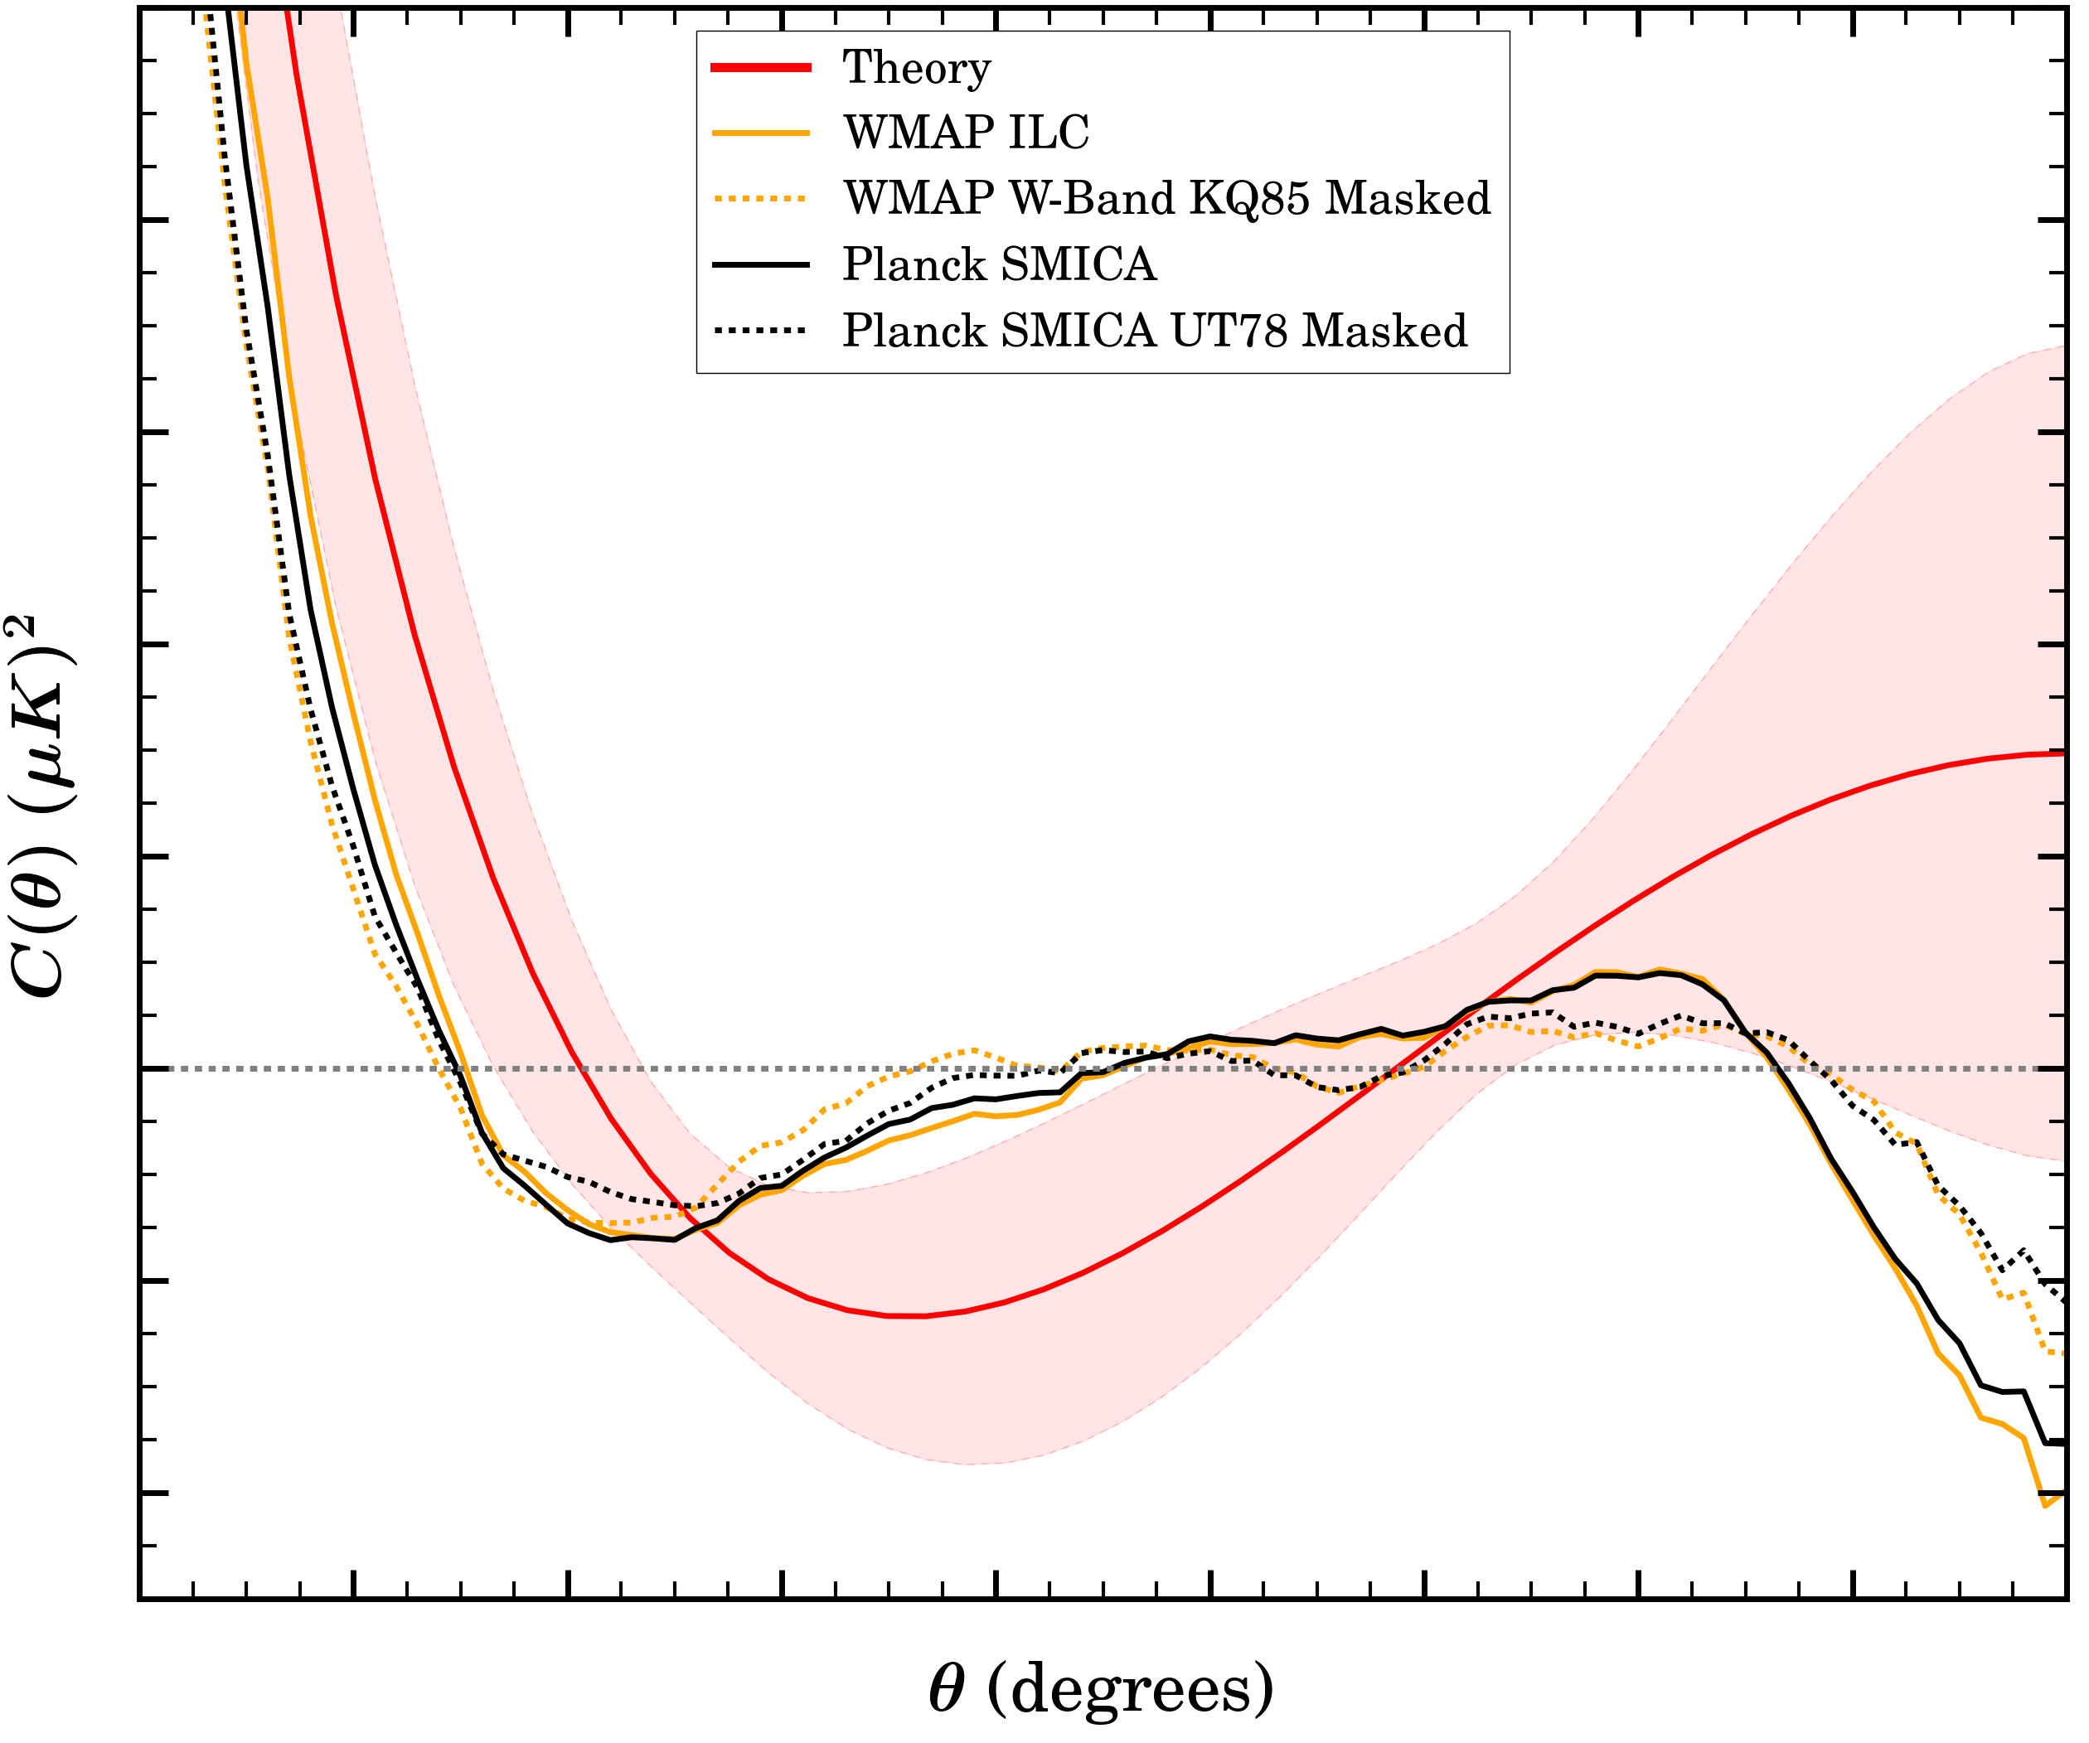
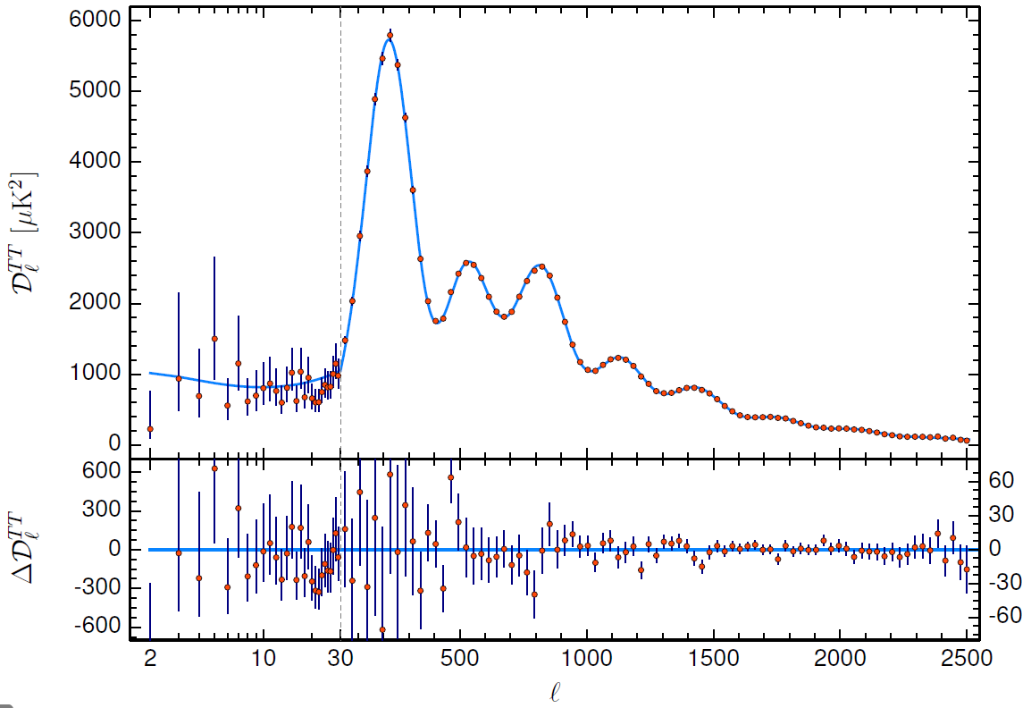
11.2. Formation of the CMB
11.3. CMB Anisotropies
11.4. Determination of Cosmological Parameters
$$δT\left(\hat{n^{′}}\right)$$
$$C\left(θ\right)=\left\langle \frac{δT}{T}\left(\hat{n}\right)\frac{δT}{T}\left(\hat{n^{′}}\right)\right\rangle =\sum_{l=0}^{∞}{\frac{2l+1}{4π}}C_{l}P_{l}\left(\cos{θ}\right)$$
$$\hat{n^{′}}$$
$$δT\left(\hat{n}\right)$$
$$θ$$
$$\hat{n}$$
$$Δθ≅\frac{180°}{l}$$

Slide 11
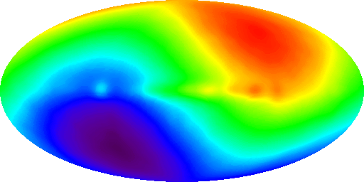
11.2. Formation of the CMB
11.3. CMB Anisotropies
11.4. Determination of Cosmological Parameters
Dipole Anisotropy : Doppler Shift
$$δT\left(\hat{n}\right)$$
Observed photon momentum $p_{0}∝T_{0}$
Emitting photon momentum $p∝T$
$$p_{0}\left(\hat{n}\right)=p\sqrt{\frac{1+\hat{n}∙\vec{v}/c}{1−\hat{n}∙\vec{v}/c}}≅p\left(1+\hat{n}∙\frac{\vec{v}}{c}\right)$$
$$\frac{δT}{T}\left(\hat{n}\right)=\frac{T_{0}\left(\hat{n}\right)−T}{T}=\hat{n}∙\frac{\vec{v}}{c}$$
From the WMAP experiment $\frac{δT}{T}≅1.23×{10}^{−3}$, the Earth is moving through with a speed of $v=371\left[km/s\right]$
$$γ$$
$$\hat{n}$$
$$\vec{v}$$
HOT
COLD

Slide 12
11.2. Formation of the CMB
11.3. CMB Anisotropies
11.4. Determination of Cosmological Parameters
What is the Origin of high-order anisotropy?
$$ds^{2}=−\left(1+2Φ\right){\left(cdt\right)}^{2}+a^{2}\left(1−2Φ\right)\left(dx^{2}+dy^{2}+dz^{2}\right)$$
$$f\left(\vec{x},\vec{p},t\right)=f_{0}\left(\vec{p},t\right)+δf\left(\vec{x},\vec{p},t\right)$$
Perturbation of metric & Distribution Function
Boltzmann equation : Dynamic Distribution function due to collision $C\left[f\right]$
Photon density perturbation would be defined as:
$$\frac{df}{dt}=\frac{∂f}{∂t}+∇_{x}f∙\vec{v}+\frac{∂f}{∂p}\frac{dp}{dt}=C\left[f\right]$$
Affected by $Φ\left(\vec{x},\vec{p},t\right)$
$$\int{\frac{p^{2}dp}{2π^{2}}pδf_{γ}}=4ρ_{γ}\left(t\right)Θ\left(\vec{x},\hat{p},t\right)$$

Slide 13
11.2. Formation of the CMB
11.3. CMB Anisotropies
11.4. Determination of Cosmological Parameters
What is the Origin of high-order anisotropy?
$$\frac{d}{dt}\left(Θ+Φ\right)=2\frac{∂Φ}{∂t}$$
[Sachs Wolfe Effect]
Temperature Anisotropy at recombination changes due to climbing the potential well(or hill).
[Integrated Sachs Wolfe Effect]
Time-varying gravitational potential less affects temperature anisotropy.
Early ISW : Small presence of radiation still at decoupling.
Late ISW : Due to Dark Energy.

Slide 14
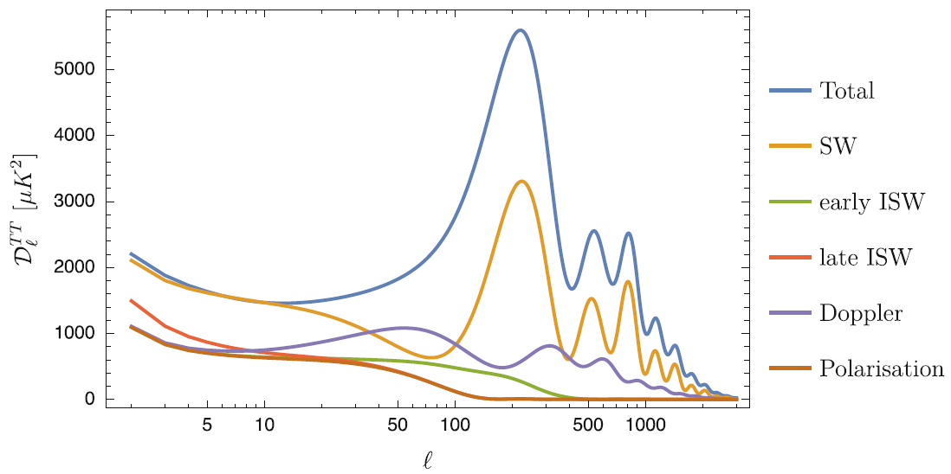
11.2. Formation of the CMB
11.3. CMB Anisotropies
11.4. Determination of Cosmological Parameters

Slide 15
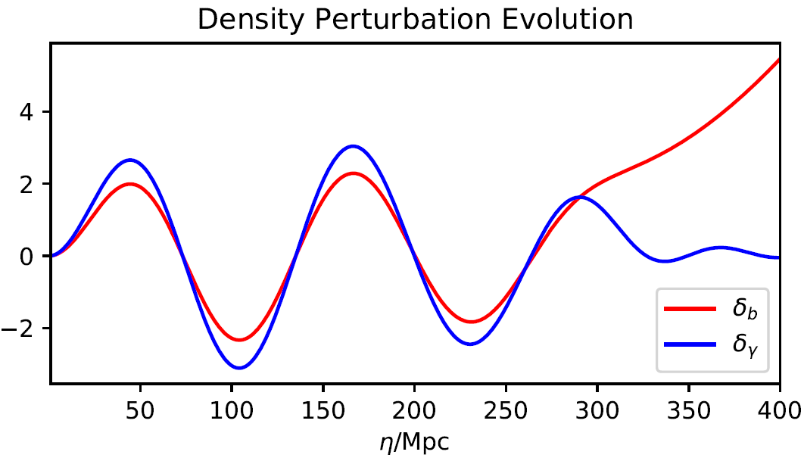
11.2. Formation of the CMB
11.3. CMB Anisotropies
11.4. Determination of Cosmological Parameters
What is the meaning of the peak of $D_{l}^{TT}$?
Temperature Decrease
Temperature Increase
Photon Decoupled
Baryonic Acoustic Oscillation (BAO)

Slide 16
11.2. Formation of the CMB
11.3. CMB Anisotropies
11.4. Determination of Cosmological Parameters
$$d_{A}\left(z_{∗}\right)$$
$$d_{H}\left(z_{∗}\right)$$
$t=t_{∗}$(Last Scattering)
$$z_{∗}≅1100$$
$t=t_{0}$(Current)

Slide 17
11.2. Formation of the CMB
11.3. CMB Anisotropies
11.4. Determination of Cosmological Parameters
Horizon Distance
$$d_{H}\left(z_{∗}\right)=a\left(t\right)\int_{0}^{t_{∗}}{\frac{dt}{a\left(t\right)}}=a\int_{0}^{a_{∗}}{\frac{da}{a^{2}H\left(a\right)}}$$
Angular Diameter Distance
$$d_{A}\left(z_{∗}\right)=a\left(t\right)\int_{t_{∗}}^{t_{0}}{\frac{dt}{a\left(t\right)}}=a\int_{a_{∗}}^{1}{\frac{da}{a^{2}H\left(a\right)}}$$
$$θ_{LSS}≅\frac{d_{A}\left(z_{∗}\right)}{d_{H}\left(z_{∗}\right)}≅1.05° \left[No More Causal Contact\right]$$
Notes:
$$\int{\frac{da}{a^{2}H\left(a\right)}}=\int{\frac{da}{a^{2}H_{0}\sqrt{Ω_{m0}a^{−3}+Ω_{r0}a^{−4}}}}\sim \sqrt{Ω_{m0}a+Ω_{r0}}$$

Slide 18
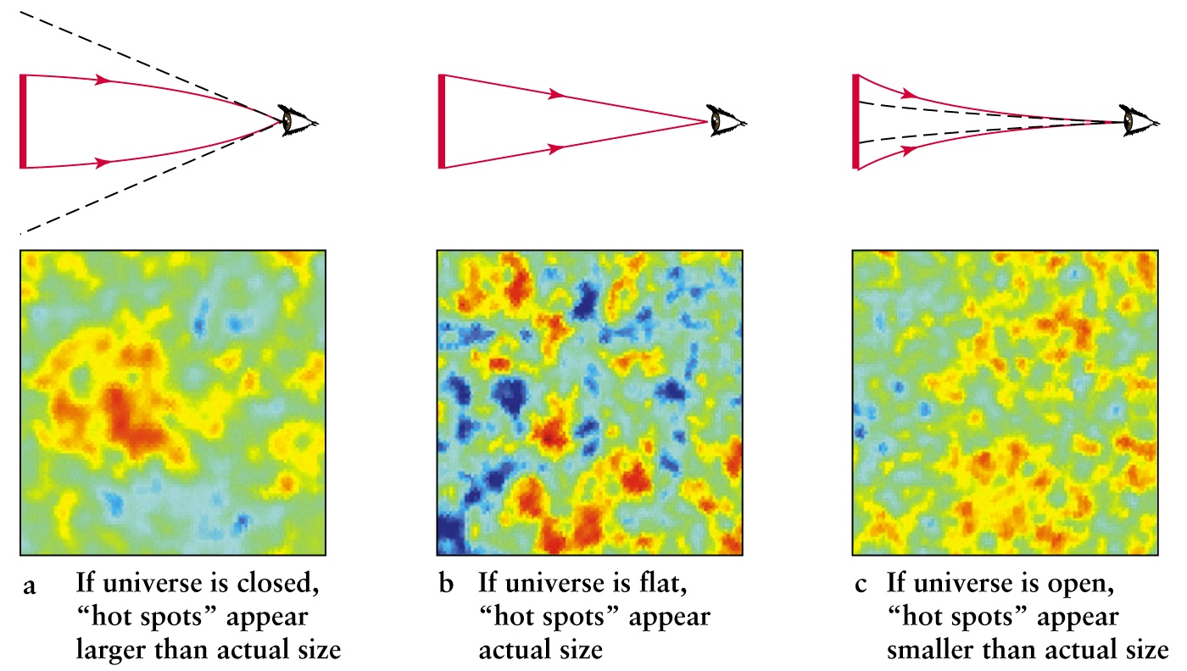
11.2. Formation of the CMB
11.3. CMB Anisotropies
11.4. Determination of Cosmological Parameters
$$Ω_{k}>0$$
$$Ω_{k}=0$$
$$Ω_{k}<0$$

Slide 19
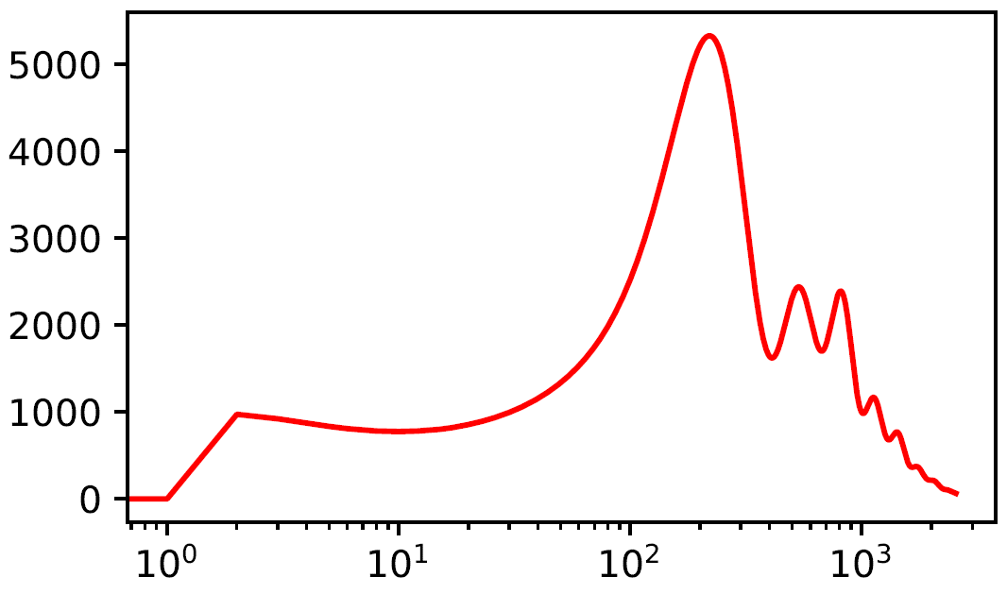
11.2. Formation of the CMB
11.3. CMB Anisotropies
11.4. Determination of Cosmological Parameters
In general, $l_{1st}≅\frac{200}{\sqrt{Ω_{0}}}$
From this, $Ω_{0}≅{1.099}_{−0.085}^{+0.100}$
So, our universe is opened!
$$Ω_{k}>0$$
$$Ω_{k}=0$$
$$l_{1st}$$

Slide 20
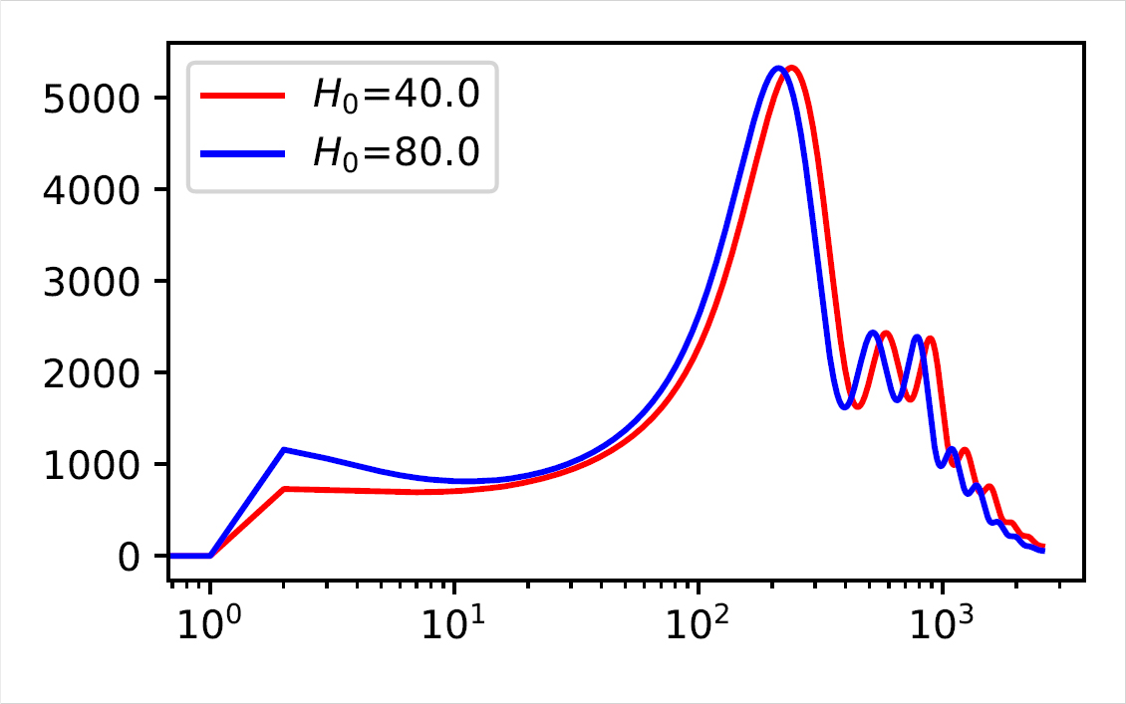
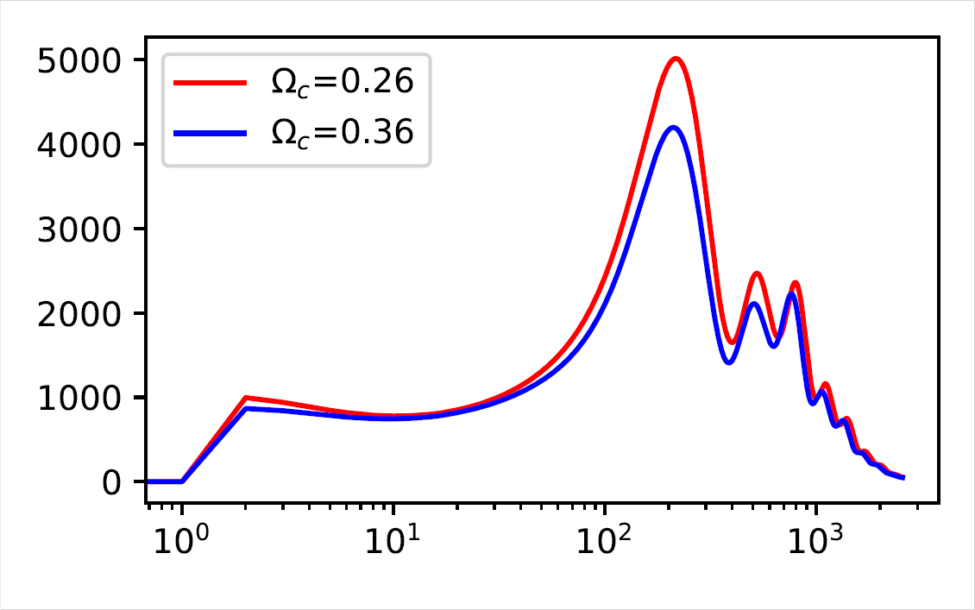
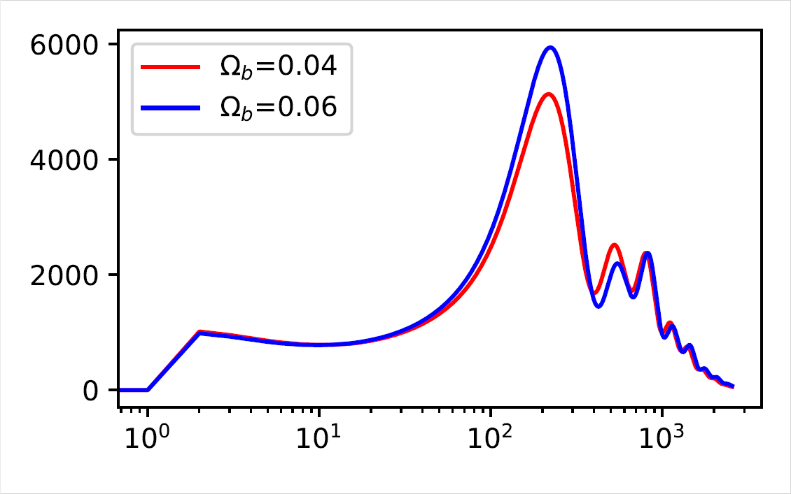
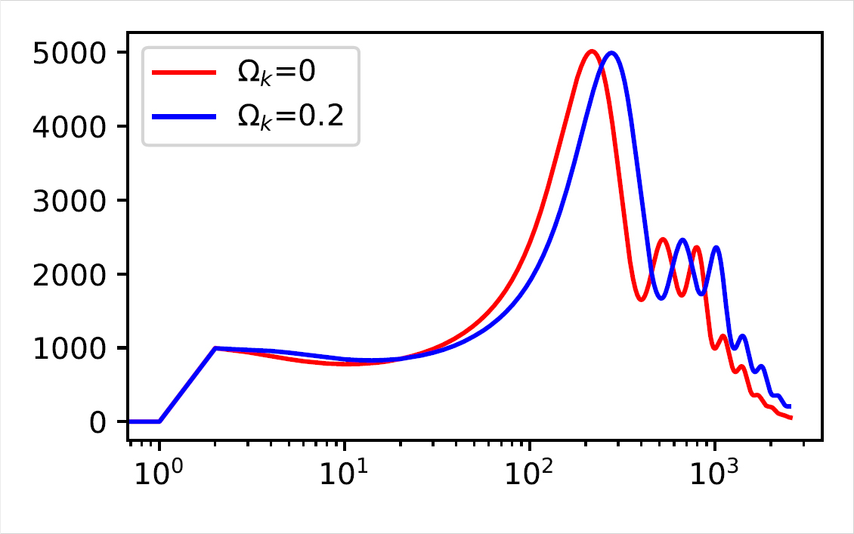
11.2. Formation of the CMB
11.3. CMB Anisotropies
11.4. Determination of Cosmological Parameters

Slide 21
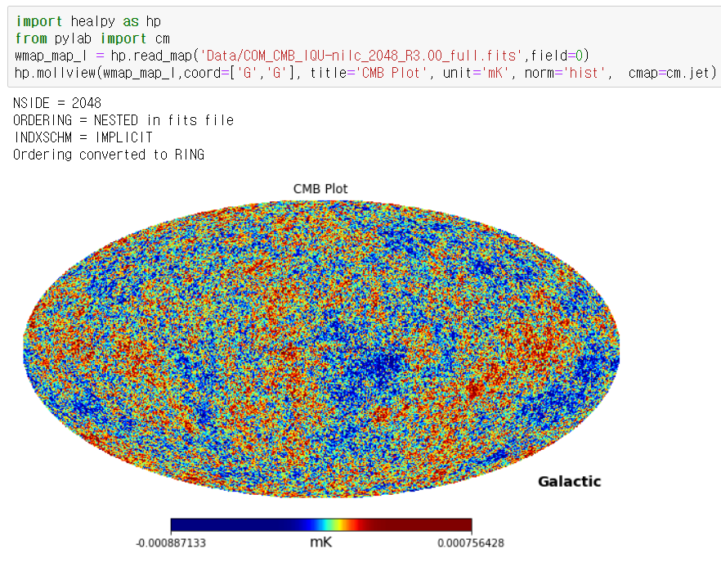
Healpy : Python Package to handle CMB Data

Slide 22
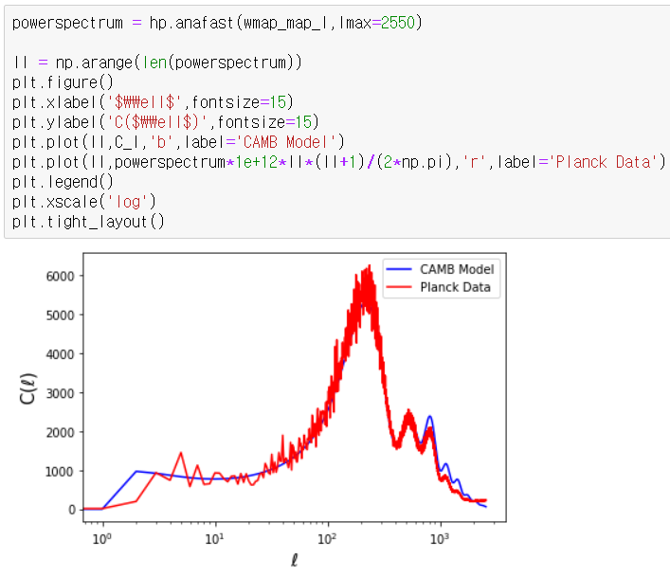
Healpy : Python Package to handle CMB Data

Slide 23
