Slide 1
9. The Early Universe
Hyeonmo Koo

Slide 2
Contents
9.1. The Planck Scale
9.2. Thermodynamics of the Early Universe
9.3. Solving the Friedmann Equation
9.4. Thermal History of the First ${10}^{−6}s$
9.5. The Baryon Asymmetry of the Universe

Slide 3
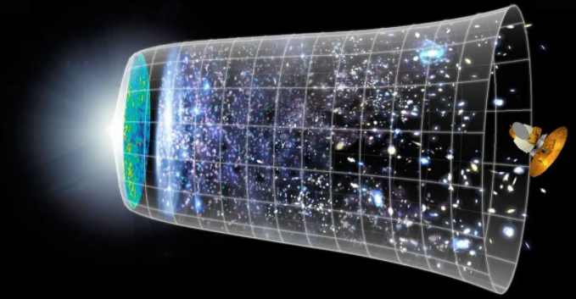
9.1. The Planck Scale
9.2. Thermodynamics of the Early Universe
9.3. Solving the Friedmann Equation
Planck Era
The age of the Universe around ${10}^{−43}s$ after Big Bang
Quantum Mechanical aspects of gravity are important.
Match the Schwartzschild radius($R_{s}=\frac{2GM}{c^{2}}$) and the Compton Wavelength($λ_{c}=\frac{h}{Mc}$)!
$$m_{Pl}=\sqrt{\frac{ℏc}{G}}≅2.2×{10}^{−5}\left[g\right]$$
$$E_{Pl}=m_{Pl}c^{2}≅1.22×{10}^{19}\left[GeV\right]$$
$$l_{Pl}=\frac{ℏ}{m_{Pl}c}≅1.6×{10}^{−35}\left[m\right]$$
$$t_{Pl}=\frac{l_{Pl}}{c}≅5.4×{10}^{−44}\left[s\right]$$
Physically, energy higher than $E_{Pl}$, length shorter than $l_{Pl}$, time shorter than $t_{Pl}$ are meaningless.

Slide 4
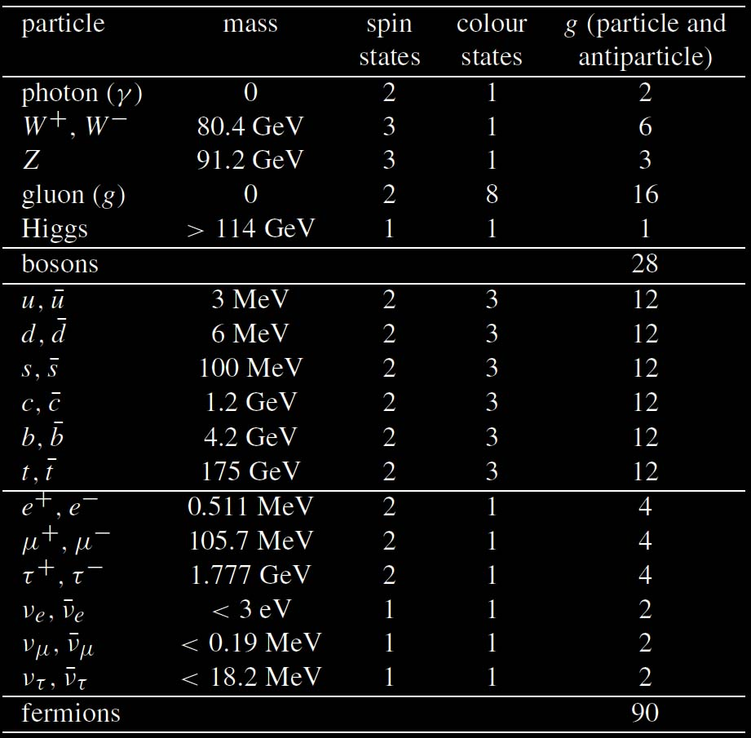
9.1. The Planck Scale
9.2. Thermodynamics of the Early Universe
9.3. Solving the Friedmann Equation
How to get the density of elements in the Universe?
$$p_{i}$$
Volume in Phase space
$$\frac{d^{3}\vec{x}d^{3}\vec{p}}{{\left(2πℏ\right)}^{3}}$$
Degree of freedom
$$g$$
Distribution function of particles system (Whether it is Fermion or Boson)
$$f\left(\vec{p}\right)=\frac{1}{e^{(E\left(\vec{p}\right)−μ)/k_{B}T}±1}$$
$$E\left(p\right)=\sqrt{m^{2}c^{4}+p^{2}c^{2}}=\left\{\begin{aligned}pc(Relativistic Particles) \\ mc^{2}+\frac{p^{2}}{2m}(Nonrelativistic Particles)\end{aligned}\right.$$
$${dp}_{i}$$
$${dx}_{i}$$
$$x_{i}$$
Number Density of one-particle Phase Space
$$\frac{d^{3}\vec{p}}{{\left(2πℏ\right)}^{3}}$$

Slide 5
9.1. The Planck Scale
9.2. Thermodynamics of the Early Universe
9.3. Solving the Friedmann Equation
 |  | Number density $$n=g\int{\frac{d^{3}\vec{p}}{{(2πℏ)}^{3}}f\left(\vec{p}\right)}$$ | Energy Density $$ρ=g\int{\frac{d^{3}\vec{p}}{{\left(2πℏ\right)}^{3}}E(p)f\left(\vec{p}\right)}$$
Relativistic Particles | Boson | $$n_{Boson}=\frac{ξ\left(3\right)}{π^{2}{\left(ℏc\right)}^{3}}g{\left(k_{B}T\right)}^{3}$$ | $$ρ_{Boson}=\frac{π^{2}}{30{\left(ℏc\right)}^{3}}g{\left(k_{B}T\right)}^{4}$$
 | Fermion | $$n_{Fermion}=\frac{3}{4}\frac{ξ\left(3\right)}{π^{2}{\left(ℏc\right)}^{3}}g{\left(k_{B}T\right)}^{3}$$ | $$ρ_{Fermion}=\frac{7}{8}\frac{π^{2}}{30{\left(ℏc\right)}^{3}}g{\left(k_{B}T\right)}^{4}$$
Nonrelativistic Particles |  | $$n_{Baryon}=g{\left(\frac{mk_{B}T}{2πℏ^{2}}\right)}^{3/2}e^{−mc^{2}/k_{B}T}$$ | $$ρ_{Baryon}=n_{Baryon}\left(mc^{2}+\frac{3}{2}k_{B}T\right)$$

Slide 6
9.1. The Planck Scale
9.2. Thermodynamics of the Early Universe
9.3. Solving the Friedmann Equation
 |  | Number density $$n=g\int{\frac{d^{3}\vec{p}}{{(2πℏ)}^{3}}f\left(\vec{p}\right)}$$ | Energy Density $$ρ=g\int{\frac{d^{3}\vec{p}}{{\left(2πℏ\right)}^{3}}E(p)f\left(\vec{p}\right)}$$
Relativistic Particles | Boson | $$n_{Boson}=\frac{ξ\left(3\right)}{π^{2}{\left(ℏc\right)}^{3}}g{\left(k_{B}T\right)}^{3}$$ | $$ρ_{Boson}=\frac{π^{2}}{30{\left(ℏc\right)}^{3}}g{\left(k_{B}T\right)}^{4}$$
 | Fermion | $$n_{Fermion}=\frac{3}{4}\frac{ξ\left(3\right)}{π^{2}{\left(ℏc\right)}^{3}}g{\left(k_{B}T\right)}^{3}$$ | $$ρ_{Fermion}=\frac{7}{8}\frac{π^{2}}{30{\left(ℏc\right)}^{3}}g{\left(k_{B}T\right)}^{4}$$
Nonrelativistic Particles |  | $$n_{Baryon}=g{\left(\frac{mk_{B}T}{2πℏ^{2}}\right)}^{3/2}e^{−mc^{2}/k_{B}T}$$ | $$ρ_{Baryon}=n_{Baryon}\left(mc^{2}+\frac{3}{2}k_{B}T\right)$$
For Fermion, the difference of integral with Boson can be written as:
$$\int_{0}^{∞}{\frac{x^{n}dx}{e^{x}+1}}=\sum_{k=1}^{∞}{{\left(−1\right)}^{k+1}\int_{0}^{∞}{x^{n}e^{−kx}dx}}=n!\left(\frac{1}{1^{n+1}}−\frac{1}{2^{n+1}}+\frac{1}{3^{n+1}}−\frac{1}{4^{n+1}}+…\right)=\left(1−\frac{1}{2^{n+1}}\right)n!\left(\frac{1}{1^{n+1}}+\frac{1}{2^{n+1}}+\frac{1}{3^{n+1}}+\frac{1}{4^{n+1}}+…\right)=\left(1−\frac{1}{2^{n+1}}\right)\int_{0}^{∞}{\frac{x^{n}dx}{e^{x}−1}}$$

Slide 7
9.1. The Planck Scale
9.2. Thermodynamics of the Early Universe
9.3. Solving the Friedmann Equation
In Early Times… ($t<{10}^{5}[yr]$)
Radiation Energy Dominated our Universe! [Radiation Era]
High $Γ$
Most of particles were all in thermal equilibrium.
$$ρ_{Tot}=\frac{π^{2}}{30{\left(ℏc\right)}^{3}}g_{∗}({k_{B}T)}^{4}=\sum_{boson}{\frac{π^{2}}{30{\left(ℏc\right)}^{3}}g_{b}({k_{B}T)}^{4}}+\frac{7}{8}\sum_{fermion}{\frac{π^{2}}{30{\left(ℏc\right)}^{3}}g_{f}({k_{B}T)}^{4}}$$
$$g_{∗}=\sum_{boson}{g_{b}}+\frac{7}{8}\sum_{fermion}{g_{f}}$$
Low $Γ$

Slide 8
9.1. The Planck Scale
9.2. Thermodynamics of the Early Universe
9.3. Solving the Friedmann Equation
In [Matter Era]… ($t>{10}^{5}[yr]$)
Some particles cannot interact with photon anymore.
$Γ>H$ : Particles can interact with photon during Hubble expansion.
$Γ<H$ : Particles cannot interact with photon during Hubble expansion.
The temperature of particles would be different with photon. [Decoupling]
$$ρ_{Tot}=\frac{π^{2}}{30{\left(ℏc\right)}^{3}}g_{∗}({k_{B}T)}^{4}=\sum_{boson}{\frac{π^{2}}{30{\left(ℏc\right)}^{3}}g_{b}({k_{B}T_{b})}^{4}}+\frac{7}{8}\sum_{fermion}{\frac{π^{2}}{30{\left(ℏc\right)}^{3}}g_{f}({k_{B}T_{f})}^{4}}$$
$$g_{∗}=\sum_{boson}{g_{b}{\left(\frac{T_{b}}{T}\right)}^{4}}+\frac{7}{8}\sum_{fermion}{g_{f}{\left(\frac{T_{f}}{T}\right)}^{4}}$$
High $Γ$
Low $Γ$

Slide 9
9.1. The Planck Scale
9.2. Thermodynamics of the Early Universe
9.3. Solving the Friedmann Equation
In [Matter Era]… ($t>{10}^{5}[yr]$)
Some particles cannot interact with photon anymore.
$Γ>H$ : Particles can interact with photon during Hubble expansion.
$Γ<H$ : Particles cannot interact with photon during Hubble expansion.
The temperature of particles would be different with photon. [Decoupling]
$$ρ_{Tot}=\frac{π^{2}}{30{\left(ℏc\right)}^{3}}g_{∗}({k_{B}T)}^{4}=\sum_{boson}{\frac{π^{2}}{30{\left(ℏc\right)}^{3}}g_{b}({k_{B}T_{b})}^{4}}+\frac{7}{8}\sum_{fermion}{\frac{π^{2}}{30{\left(ℏc\right)}^{3}}g_{f}({k_{B}T_{f})}^{4}}$$
$$g_{∗}=\sum_{boson}{g_{b}{\left(\frac{T_{b}}{T}\right)}^{4}}+\frac{7}{8}\sum_{fermion}{g_{f}{\left(\frac{T_{f}}{T}\right)}^{4}}$$
High $Γ$
Low $Γ$

Slide 10
9.1. The Planck Scale
9.2. Thermodynamics of the Early Universe
9.3. Solving the Friedmann Equation
In [Matter Era]… ($t>{10}^{5}[yr]$)
Some particles cannot interact with photon anymore.
For photon, $E=pc=\frac{hc}{λ}∝k_{B}T$
And Hubble expansion $H∝\frac{1}{λ}\frac{dλ}{dt}$
$$T∝R^{−1}$$
$$\frac{1}{T}\frac{dT}{dt}=H$$
The reaction rate $Γ=n\left\langle σv\right\rangle$ need to maintain equilibrium when $Γ≫|\dot{T}/T|$, and this is equivalent with $Γ≫H$.
High $Γ$
$$R$$
Low $Γ$

Slide 11
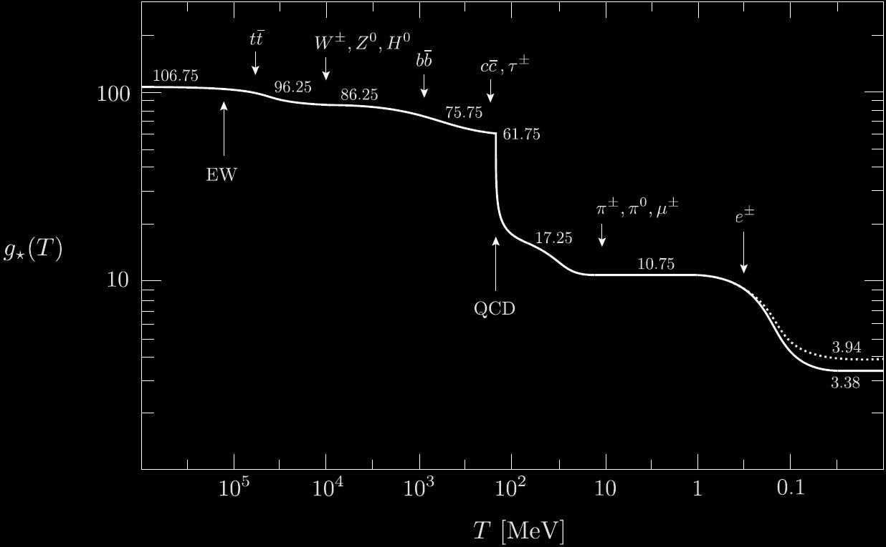
9.1. The Planck Scale
9.2. Thermodynamics of the Early Universe
9.3. Solving the Friedmann Equation
$$g_{∗}=\sum_{boson}{g_{b}}+\frac{7}{8}\sum_{fermion}{g_{f}}$$

Slide 12
9.1. The Planck Scale
9.2. Thermodynamics of the Early Universe
9.3. Solving the Friedmann Equation
Entropy Density $s=\frac{ρ+P}{k_{B}T}=\frac{2π^{2}}{45{\left(ℏc\right)}^{3}}g{\left(k_{B}T\right)}^{3}$

Slide 13
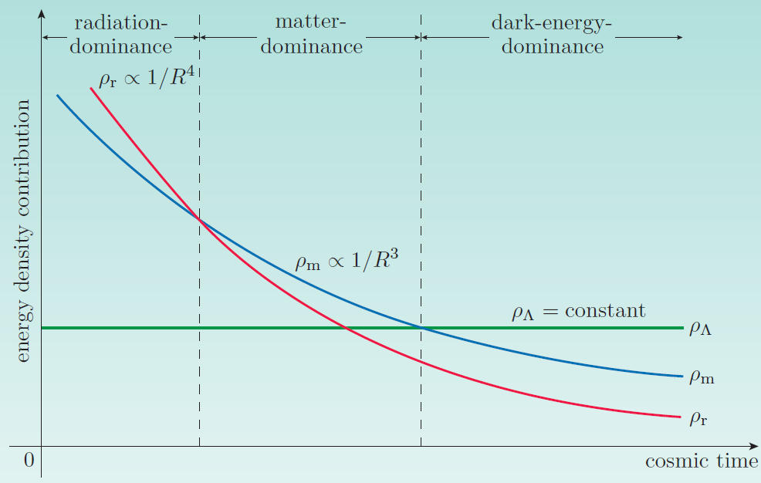
9.2. Thermodynamics of the Early Universe
9.3. Solving the Friedmann Equation
9.4. Thermal History of the First ${10}^{−6}s$
Cosmological Perfect Fluid satisfies: $P=wρ$
Putting into fluid eq. $\dot{ρ}+3H\left(ρ+P\right)=0$, we can get:
$$ρ\left(R\right)∝R^{−3\left(1+w\right)}$$
Putting into Friedmann eq. $H^{2}=\frac{8}{3}πGρ+\frac{Λ}{3}$, we can get:
$$R(t)∝t^{\frac{2}{3(1+w)}}$$
Component | Energy Density $ρ(R)$ | Scale Factor $R(t)∝T^{−1}$ | Hubble Const. $H(t)$
Radiation ($P=ρ/3$) | $$∝R^{−4}$$ | $$∝t^{1/2}$$ | $$\frac{1}{2t}$$
Matter ($P=0$) | $$∝R^{−3}$$ | $$∝t^{2/3}$$ | $$\frac{2}{3t}$$
Cosmological Constant ($P=−ρ$) | Const. | $$∝e^{\sqrt{Λ/3}t}$$ | $$\sqrt{\frac{Λ}{3}}$$

Slide 14
9.3. Solving the Friedmann Equation
9.4. Thermal History of the First ${10}^{−6}s$
9.5. The Baryon Asymmetry of the Universe
$$m_{Pl}=\sqrt{\frac{ℏc}{G}}≅2.2×{10}^{−5}\left[g\right]$$
$$E_{Pl}=m_{Pl}c^{2}≅1.22×{10}^{19}\left[GeV\right]$$
$$l_{Pl}=\frac{ℏ}{m_{Pl}c}≅1.6×{10}^{−35}\left[m\right]$$
$$t_{Pl}=\frac{l_{Pl}}{c}≅5.4×{10}^{−44}\left[s\right]$$
$$ρ(t)=\frac{3}{32πGt^{2}}$$
$$ρ\left(t_{Pl}\right)=\frac{3c^{5}}{32πℏG^{2}}=\frac{3{\left(m_{Pl}c^{2}\right)}^{4}}{32πℏ^{3}c^{5}}$$
If $ℏ=c=1$, $ρ\left(t_{Pl}\right)=6.63×{10}^{74}[GeV^{4}]$

Slide 15
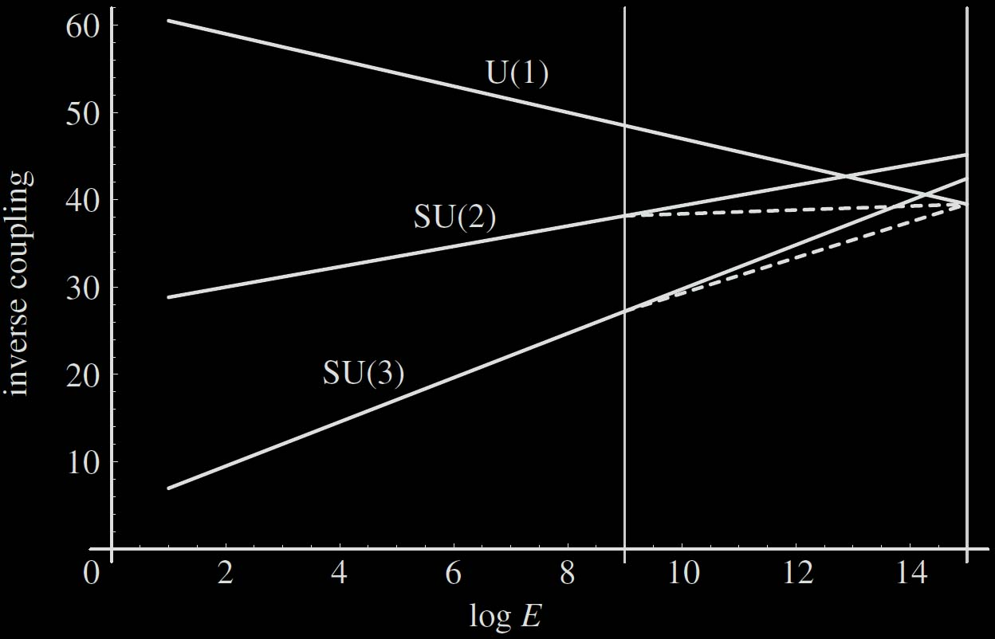
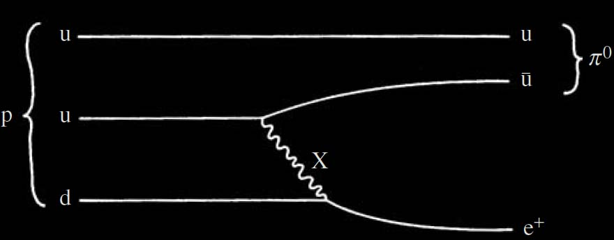
9.3. Solving the Friedmann Equation
9.4. Thermal History of the First ${10}^{−6}s$
9.5. The Baryon Asymmetry of the Universe
Gravity
Strong
Spontaneous Symmetry Breaking
$$G_{GUT}=SU\left(5\right)? SO\left(10\right)?$$
$$G_{S}=SU\left(3\right)×SU\left(2\right)×U(1)$$
Electromagnetic
Weak
Couplings were gathered!
Proton decay(mediated by massive GUT X boson : Baryon Number is not conserved)
X boson-interaction would be highly suppressed.

Slide 16
9.3. Solving the Friedmann Equation
9.4. Thermal History of the First ${10}^{−6}s$
9.5. The Baryon Asymmetry of the Universe
Gravity
Strong
Spontaneous Symmetry Breaking
$$U\left(1\right)[QED]$$
$$SU\left(2\right) [Weak]$$
$$SU\left(2\right)×U\left(1\right)[ElectroWeak]$$
Electromagnetic
Weak
Massive Gauge Bosons
$W^{+},W^{−}$ [Charged W-Boson]
$Z^{0}=−B^{0}\sin{θ_{W}}+W^{0}\cos{θ_{W}}$ [Z-Boson]
$γ=B^{0}\cos{θ_{W}}+W^{0}\sin{θ_{W}}$ [Photon]
Massless Gauge Bosons
$$B^{0}, W^{+}, W^{0}, W^{−}$$

Slide 17
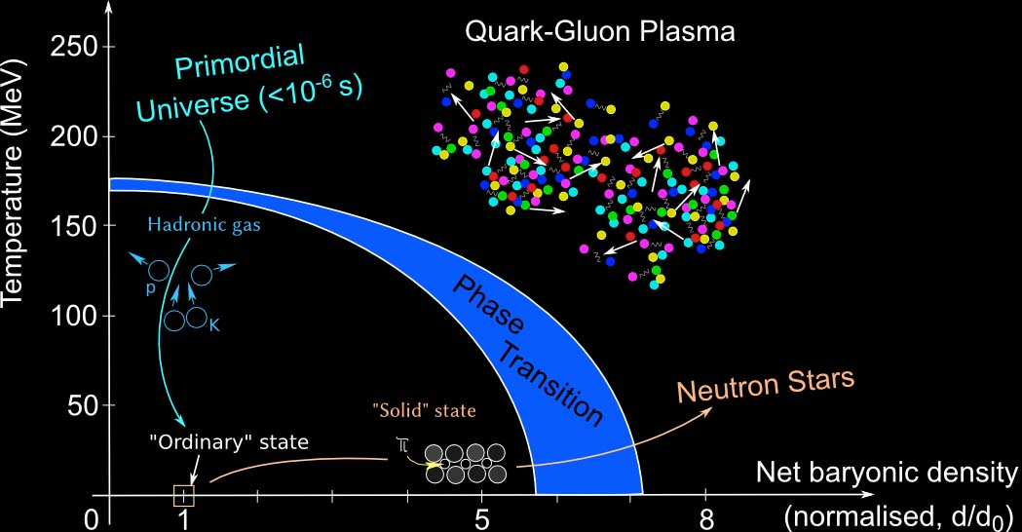
9.3. Solving the Friedmann Equation
9.4. Thermal History of the First ${10}^{−6}s$
9.5. The Baryon Asymmetry of the Universe
Gravity
Strong
Electromagnetic
Weak

Slide 18
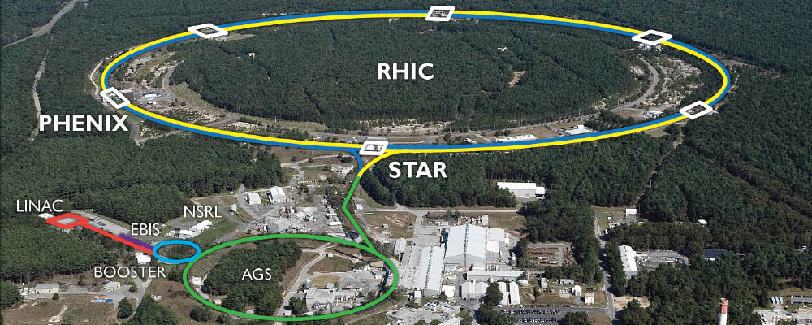
9.3. Solving the Friedmann Equation
9.4. Thermal History of the First ${10}^{−6}s$
9.5. The Baryon Asymmetry of the Universe

Slide 19
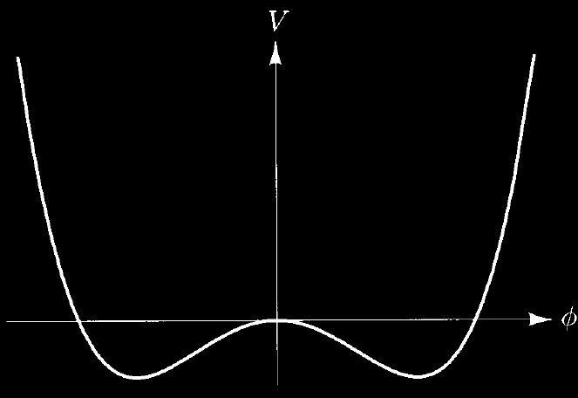
9.3. Solving the Friedmann Equation
9.4. Thermal History of the First ${10}^{−6}s$
9.5. The Baryon Asymmetry of the Universe
How can we intuitively understand the Symmetry Breaking?
$$V\left(φ\right)=−\frac{1}{2}μ^{2}φ^{2}+\frac{1}{4!}λφ^{4}$$
$$V\left(σ\right)=−\frac{1}{2}μ^{2}{\left(σ+φ_{0}\right)}^{2}+\frac{1}{4!}λ{\left(σ+φ_{0}\right)}^{4}=\frac{1}{2}\left(2μ^{2}\right)σ^{2}+\sqrt{\frac{λ}{6}}μσ^{3}+\frac{1}{4!}λσ^{4}+Const.$$
$$−φ_{0}=−\sqrt{\frac{6}{λ}}μ$$
$$φ_{0}=\sqrt{\frac{6}{λ}}μ$$
Symmetry $σ↔−σ$ is no longer apparent!
[Spontaneous Symmetry Broken]
$$σ(x)$$

Slide 20
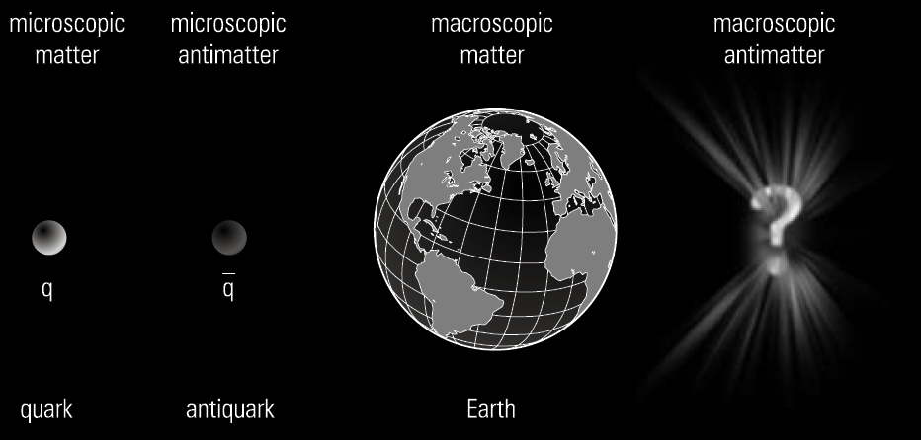
9.3. Solving the Friedmann Equation
9.4. Thermal History of the First ${10}^{−6}s$
9.5. The Baryon Asymmetry of the Universe

Slide 21
9.3. Solving the Friedmann Equation
9.4. Thermal History of the First ${10}^{−6}s$
9.5. The Baryon Asymmetry of the Universe
Why baryon asymmetry occurs?
[Sakharov Condition]
Baryon-Number Violating
CP Violation
Departure from Equilibrium
$$X^{+}→u+u$$
$$X^{+}→e^{+}+\overline{d}$$
$$G_{GUT}$$
$$SU\left(3\right)×SU(2)×U\left(1\right)$$
SSB
$X$ and $Y$ bosons become very massive!
$$Y^{+}→e^{+}+\overline{u}$$
$$Y^{+}→d+u$$
$$Y^{+}→\overline{d}+\overline{ν_{e}}$$
If CP symmetric, $X$ and $Y$ bosons are instantaneously created when annihilated. But it’s not..!

