Slide 1


Nodule Classification using
a Multi-Task Training
Shin So, Wonyong Cho, Jeongmin Kim, and Jeong-Rae Kim
Department of Mathematics, University of Seoul
LUNA25 Team : MClab
https://github.com/dobe0715/LUNA25_MClab
Notes:
로고 추가하기

Slide 2
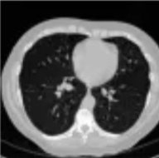
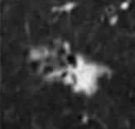
Data set
4069 patients
- Nodule ID
- Coordinates
- Malignant / Benign
6163 samples
64x64x64
162x512x512

Slide 3
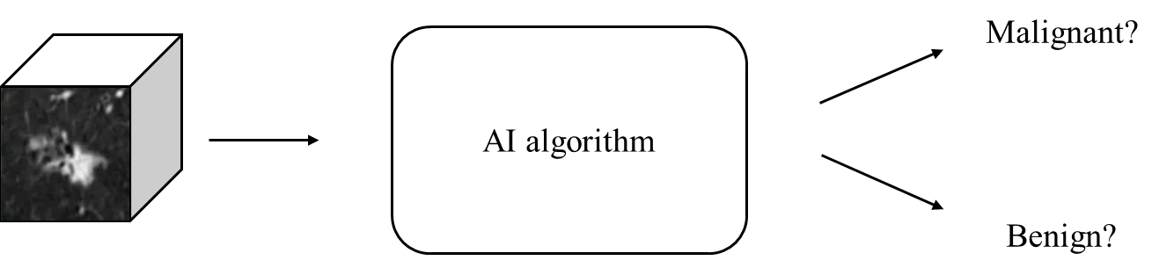
Problem definition and challenges
Problem
  Binary classification of malignant nodules in lung CT scans.
Challenges
  The complexity of 3D data
    3D datasets exhibit more complex spatial features than 2D images.
  Data imbalance
    The dataset exhibits significant class imbalance, with only 555 malignant cases out of 6,163 total images (approx. 9%).

Slide 4
Overview
Data Preprocessing
Model architecture
Inference strategy
How to evaluate Model

Slide 5
Data preprocessing

Slide 6
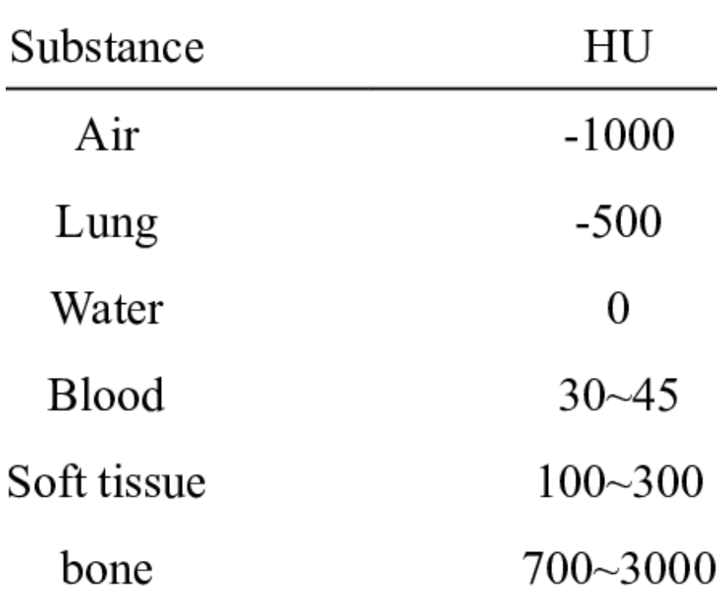
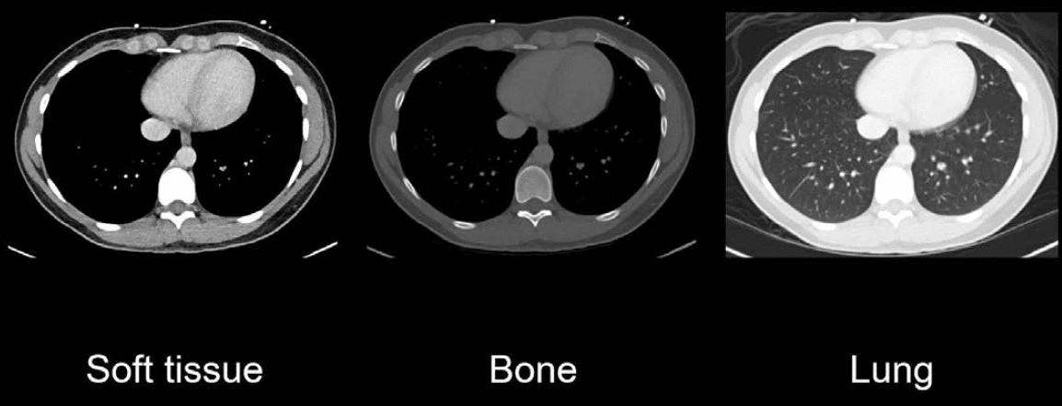
Hounsfield Unit (HU) value
https://litfl.com/abdominal-ct-windows-basics/
-1000 ~ 400 clipping!

Slide 7
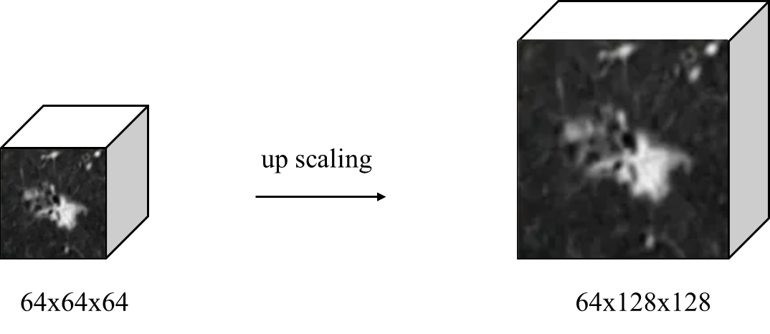
Data preprocessing
Our method
  Upscaling nodule patches from 64×64×64 to 64×128×128
    The I3D model reduces unnecessary down sampling in deeper layers and mitigates
    excessive loss of spatial detail.
    Although simple, the approach is effective and deliberately designed.
Notes:
아래 단락 좀 더 자세하게 작성하거나 이미지를 추가해서 만들기

Slide 8

Data preprocessing
z
y
x
Our method
1
2
2
1
4
3
3
4
  y- and z-axes flips and 90º rotation
    These augmentations aim to enhance
    model robustness.
    These augmentation choices are heuristic.
y-axis flip
5
6
6
5
8
7
7
8
1
2
5
1
4
3
8
4
6
90º rotate
2
5
5
8
7
7
3
P = 0.3
Notes:
아래 단락 좀 더 자세하게 작성하거나 이미지를 추가해서 만들기

Slide 9
Model architecture

Slide 10
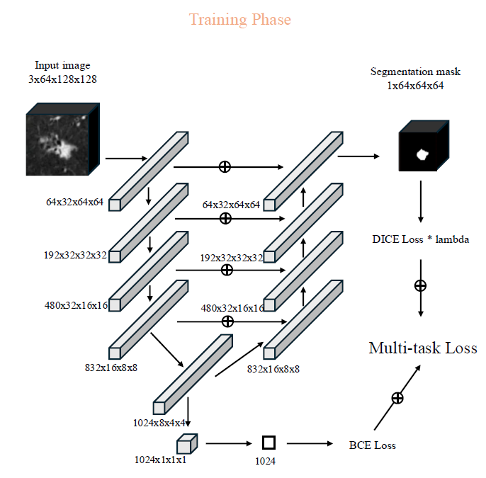
Model architecture : Multi-task learning
I3D model
Classification model (main task)
  An I3D model pre-trained on the Kinetics-400 dataset
  Final classification is performed using
  global average pooling and an MLP head.
Segmentation model (auxiliary task)
  To integrate I3D features,
  we use U-Net-like skip connections
The tasks are mutually complementary.
  nodule type ↔ shape
  (classification) (segmentation)

Slide 11
Inference strategy

Slide 12
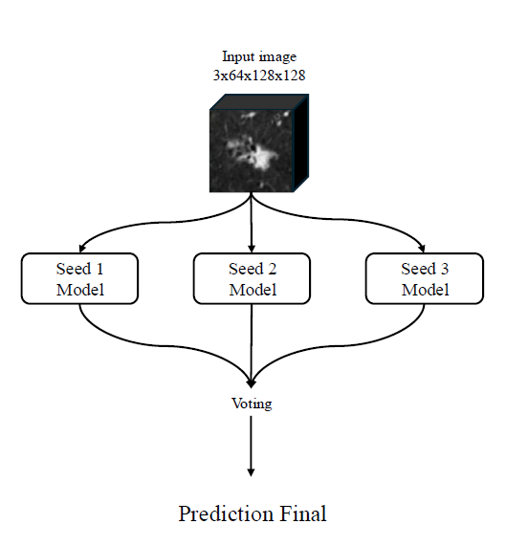
Inference strategy
Goal: Reduce model bias and maximize generalization performances.
Three identical models were trained independently,
each initialized with a random seed.
The final prediction was determined using soft voting.
(Soft voting: weighted sum of the predicted probabilities of each model)

Slide 13
Model evaluation

Slide 14
Experimental setup
Goal
To address severe data imbalance and ensure reliable validation
Dataset
6157 CT patches with 554 malignant from the LUNA25 challenges
(excluding 6 samples without masks)

Slide 15

Splitting method
Dataset B
Dataset A
The remaining benign samples
All 554 malignant samples
+ 554 benign samples
. . .
. . .
Training set (A-C)$⋃$ B
Validation set(C)
  The samples from
  the rest of A + the entire of B
Randomly sampled
almost 200 samples
from Dataset A
malignant sample
benign sample
. . .
. . .

Slide 16
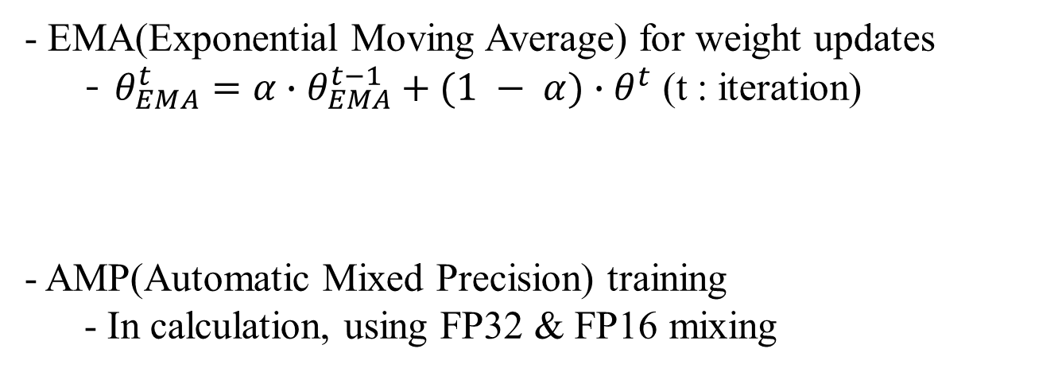
Additional training method
- EMA(Exponential Moving Average) for weight updates
  - $θ_{EMA}^{t}={α∙θ}_{EMA}^{t−1}+(1 − α)∙θ^{t}$ (t : iteration)
- AMP(Automatic Mixed Precision) training
  - In calculation, using FP32 & FP16 mixing

Slide 17
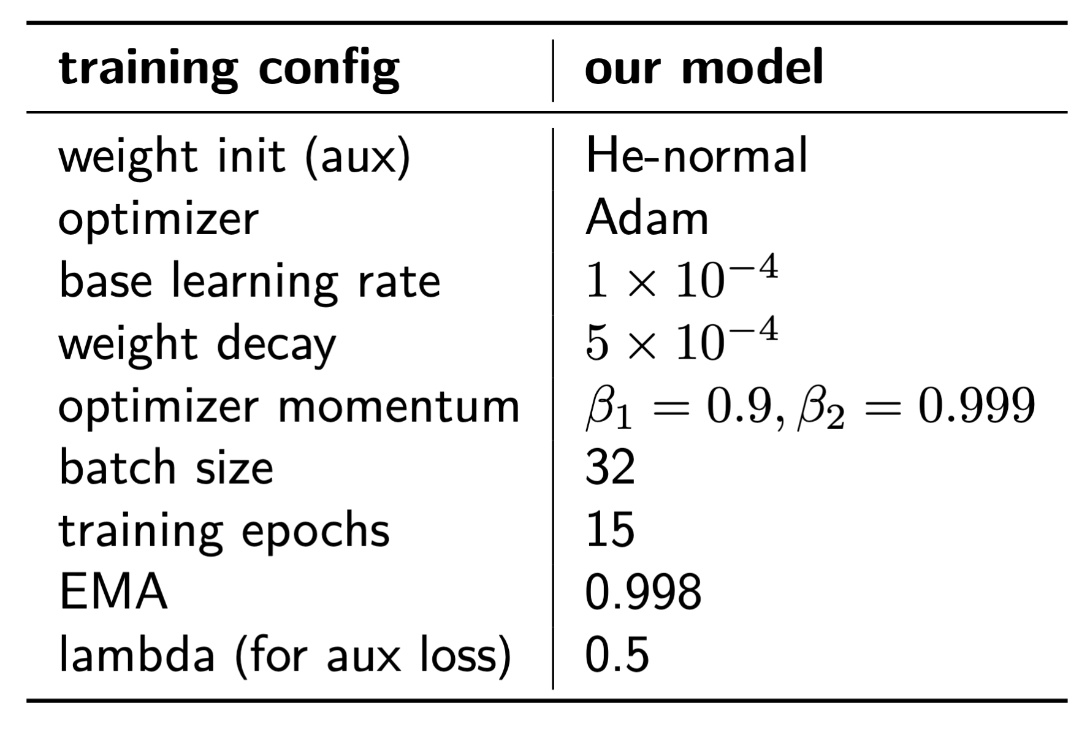
Hyperparameters

Slide 18
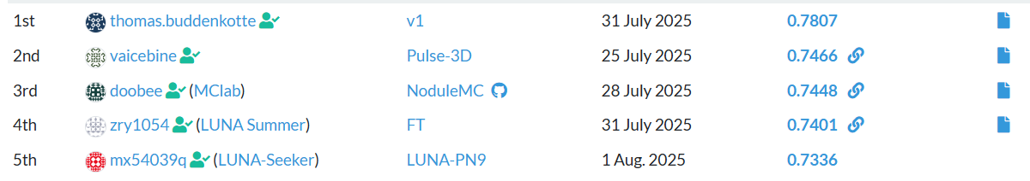
Rank

Slide 19
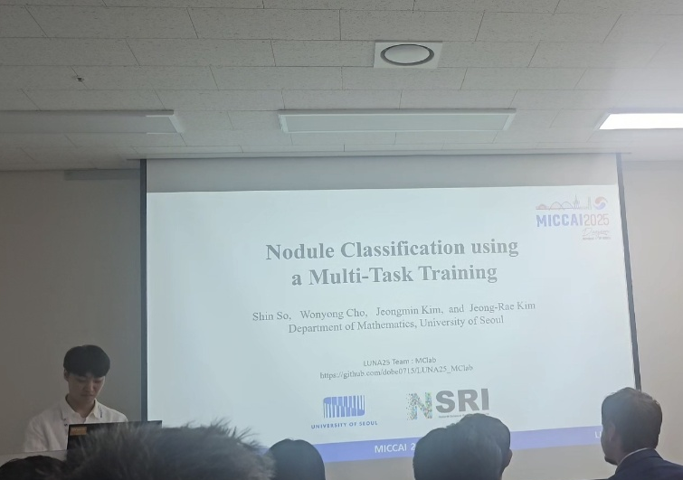
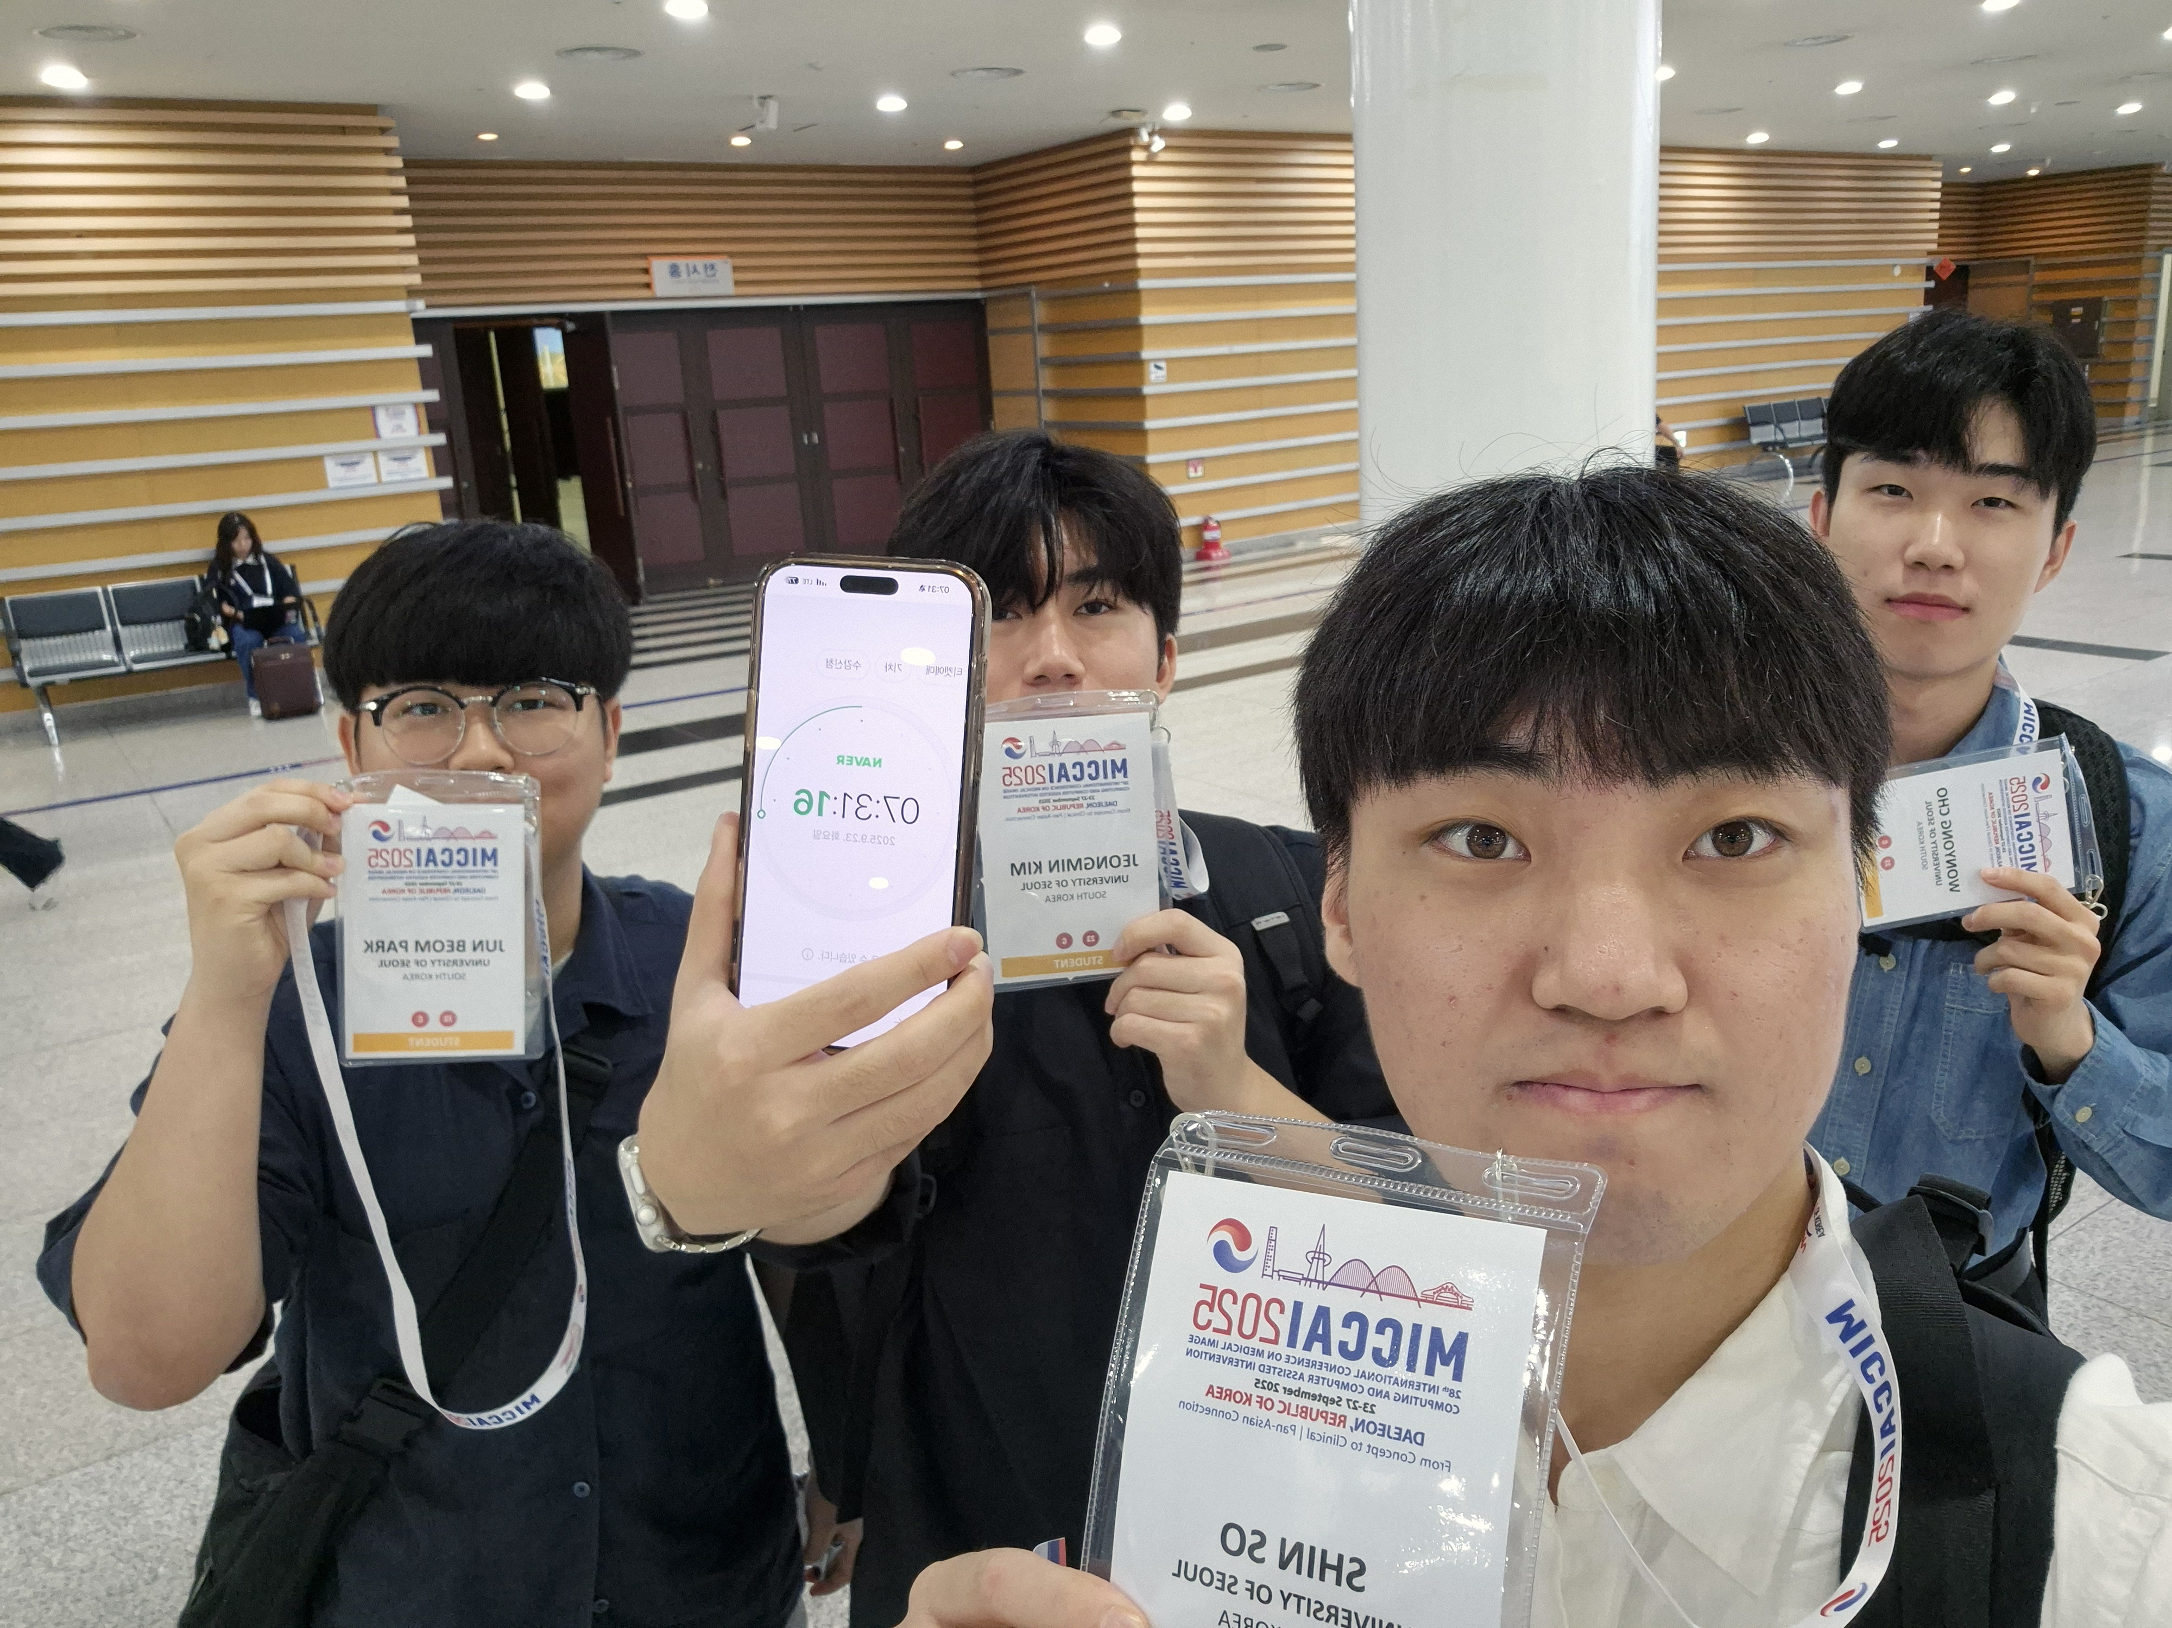
MICCAI Challenge

Slide 20
Q & A
Thank You ☺

