Slide 1
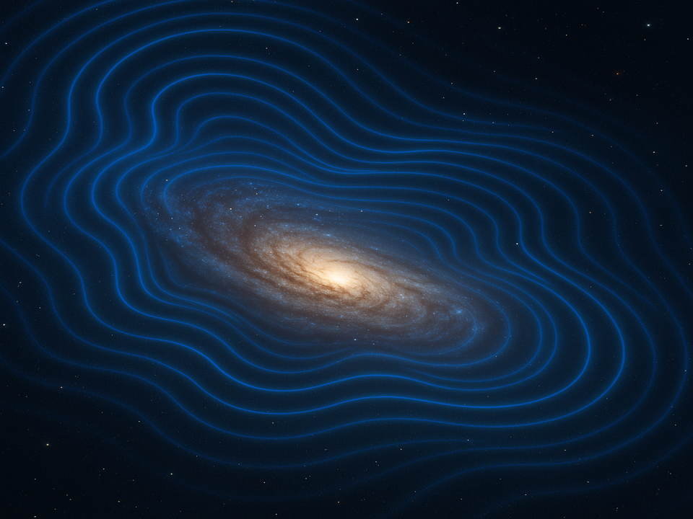
How to detect ULDM
Jae-Weon Lee (Jungwon University)

Slide 2
Outline
ULDM (Fuzzy DM)
2. Gravitational detection of FDM
3. non-gravitational detection and SIULDM

Slide 3
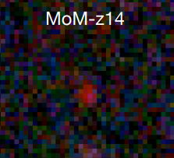

Challenges for ΛCDM
ΛCDM was very successful but is slowly becoming non-standard?
1. Small scale crisis (on galactic scale and below) :
predicts too many small structures not observed
2. Hubble tension ~ 5$σ$:
H₀ mismatch between CMB and SN
3. $S_{8}$ tension ~ 2-3$σ$: $S_{8}≡σ_{8}\sqrt{Ω_{m}/0.3}$ , z < 2, Mpc
matter density fluctuation amplitude mismatch
between CMB and WL & Cluster
4. DE is not Λ? ~ 4$σ$ ( ex, AP test, DESI, SN?)
5. Too early SMBHs (z~11) and galaxies (z~14, 32?)
6. Galaxy cluster collision (collision speed & DM-star offset)
7. Li problem, Cosmic birefringence
…etc
cf) 2105.05208
10⁸ Ms
74 pc
→ Any good DM model should address these tensions

Slide 4
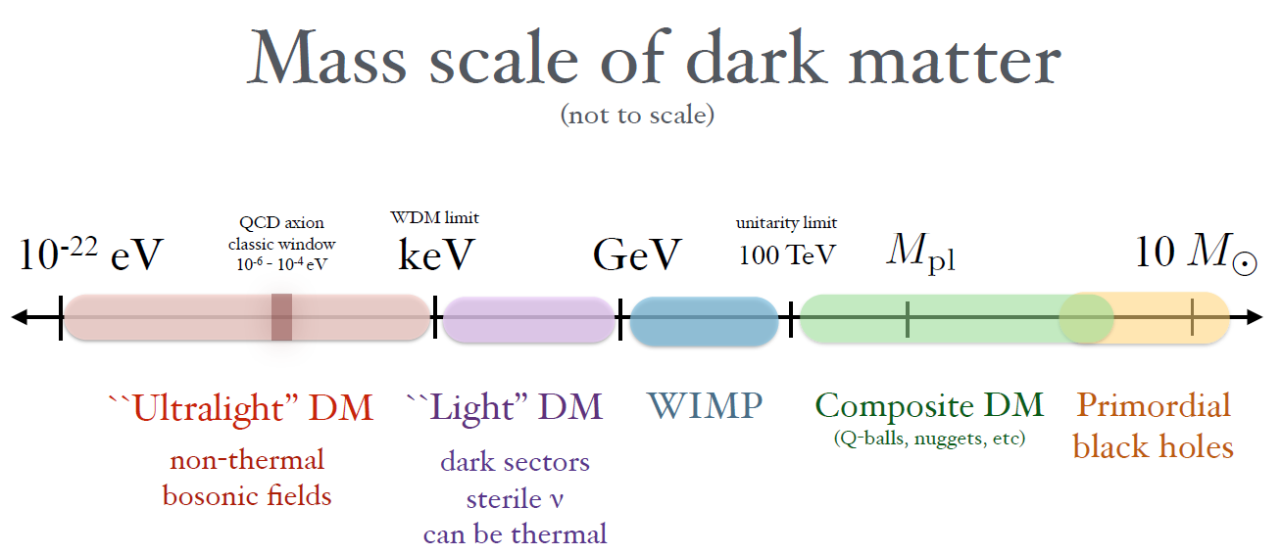
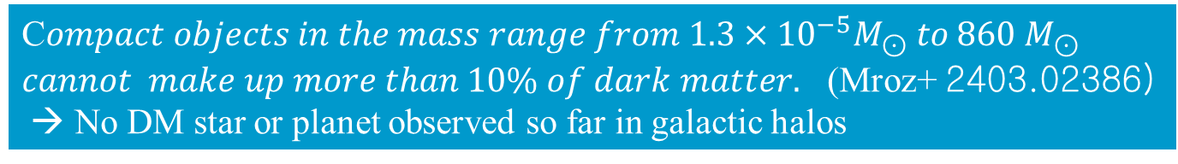
TASI lectures by Lin arXiv:1904.07915
SIDM
J. KIM
Cold!
Wave!
HDM
WDM
|→ CDM
S. Sin
Ben. Lee
MACHO
ULDM = Fuzzy, ULA, BEC, Wave, Scalar Field, ψ, Superfluid, quantum … ← PNGB, moduli, dilaton, ALP…
C$ompact objects in the mass range from 1.3×{10}^{−5}M_{⊙} to 860 M_{⊙} cannot make up more than 10\% of dark matter.$ (Mroz+ 2403.02386)
→ No DM star or planet observed so far in galactic halos

Slide 5
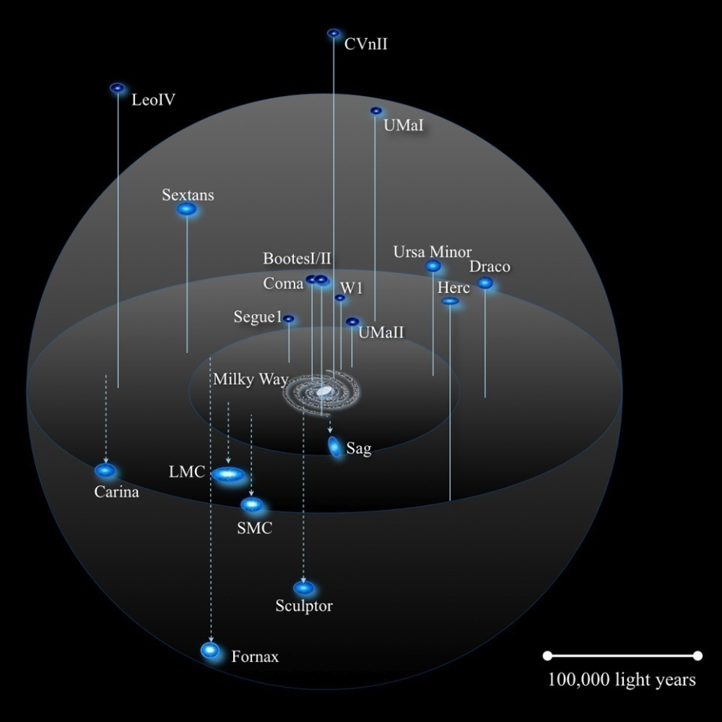
Galaxies observed
satellite plane
Minimum mass
~ 10⁶ Ms
dwarf galaxies
J. Bullock+
Any good DM model should explain observed galaxies!
5

Slide 6
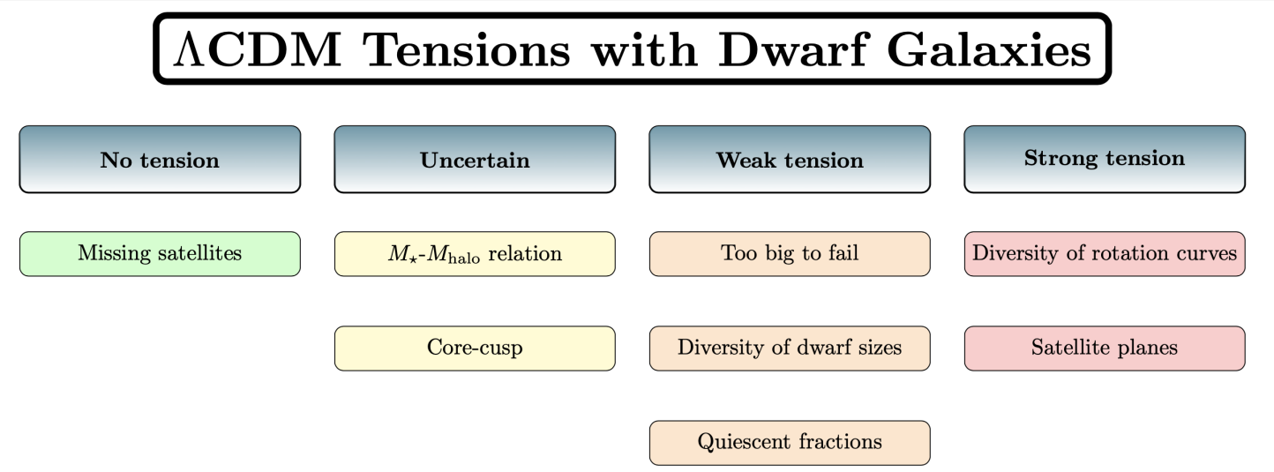
:2206.05295
Small scale issues with CDM
Sales+ 2206.05295
√
no DM model solved
√
BTFR,
L catastrophe
√
√
WDM
Park+ Jcap 2022
Key problem is how to suppress small scale structures < dwarf galaxies.
→ we need a new CDM → ULDM with m~ 10⁻²² eV might solve many of these
Still unsolved problems seem to be related to Baryon-DM relation
Can baryon physics + more precise numerical simulation + more observations
save CDM?

Slide 7

Solutions to Small scale problems
CDM : m ~ G eV (can’t solve the problems)
→ need baryon physics (SN, BH jets,…)
$∗σ/m≈{10}^{−{26}^{}}{ cm}^{2}/g$ ( 100 GeV WIMP)
SIDM: σ/m ~ 0.5-1 (Cluster), 5 (dwarf) [cm²/g],
→ velocity dependent σ?
WDM : m ~ k eV
→ Catch 22 problem (cusp)
Suppression of the power spectrum prohibiting the formation of the dwarf galaxy
ULDM: m ~ 10⁻²² eV
→ Lyman alpha favors m > 10⁻²¹ eV ?

Slide 8
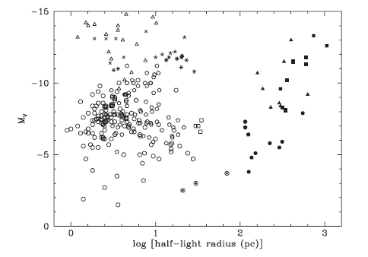
Characteristic size & mass
of dwarf galaxies
Star clusters
(baryon dominated)
Galaxies
(DM dominated)
There are no known stable galaxies with half-light radius smaller than 120 pc while the maximum size for star clusters deprived of DM is about 30 pc.
The minimal observed mass of a stable dwarf galaxy is on the order of 10⁷ Ms.
The minimal observed mass of SMBHs is on the order of 10⁵ Ms.
Max mass of SMBHs and galaxies~ 10¹¹ Ms.
→ What is the origin of these scales (gaps)?

Slide 9
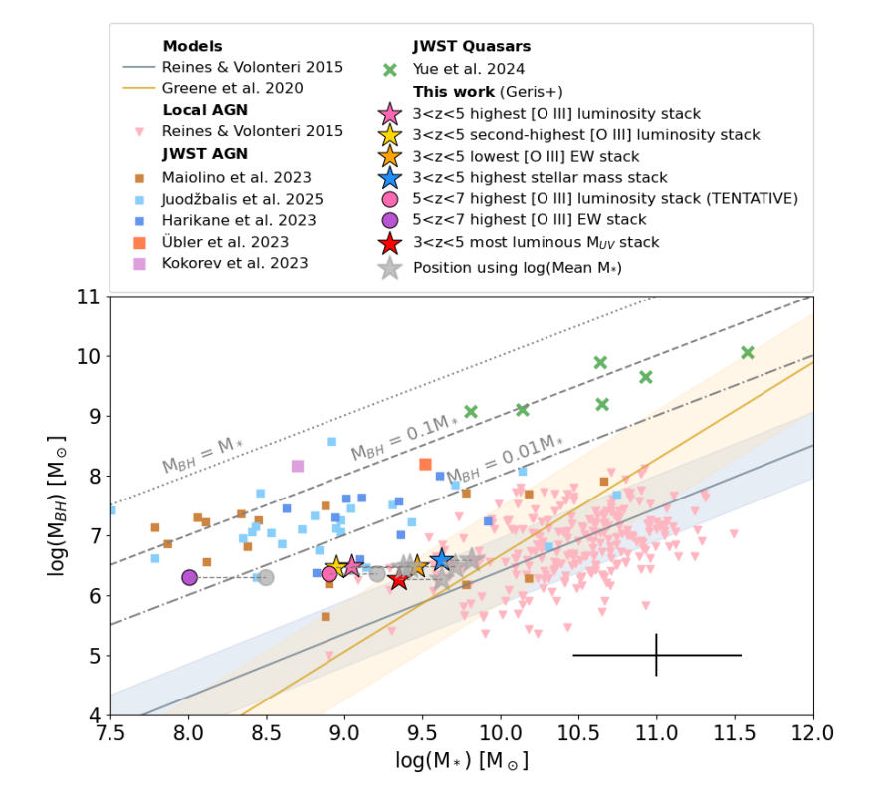
Mass gap of SMBHs is similar to that of Galaxies
mass gap
Geris+ 2506.22147

Slide 10
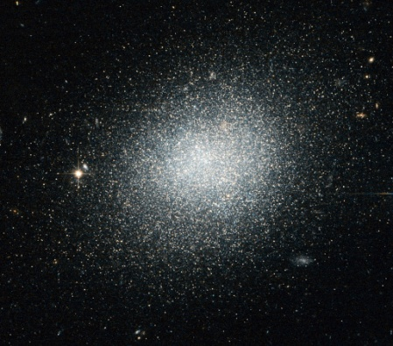
Galactic DM halos in ULDM
Galactic DM halos (cores) are made of BEC ultra-light bosons described by macroscopic wave fn (similar to solitons).
Quantum pressure (from uncertainty principle) prevents collapse
Acts as CDM on super-galactic scales and solves small scale crisis of CDM
DM wave fn. of halo
$$\text{uncertainty} \text{principle} ξ×p>ℏ \\ \text{min}\text{. }\text{halo} \text{siz}e ξ≈λdB=\frac{h}{mv}\sim kpc$$ $→m\sim 10^{−22}eV$ for $v$ ~ 10km/s
$$ψ$$
$ξ$=$λdB$
Halo size
$$ξ$$
~kpc
Self-gravitating potential well V
$$ρ_{v}$$
visible matter density
Schroedinger
-Poission Eq
(SPE), nonlinear
$$\left\{\begin{matrix}iℏ∂_{t}ψ=−\frac{ℏ^{2}}{2m}∇^{2}ψ+mVψ & \\ ∇^{2}V=4πG(ρ_{d}+ρ_{v}), & \begin{matrix} & ρ_{d}=m^{2}{\left|ψ\right|}^{2} & \end{matrix}\end{matrix}\right.$$
DM density

Slide 11
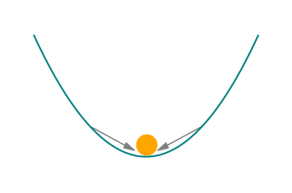
Features of ULDM
$$ϕ\left(t,x\right)=\frac{1}{\sqrt{2m}}\left[e^{−imt}ψ\left(t,x\right)+e^{imt}ψ^{∗}\left(t,x\right)\right]$$
fast (bg), slow (galaxy)
T~yr T~ Myr
Typical galaxy size ~ λ_{dB} ~ kpc
→ min. mass & max mass of galaxies
wave nature → gravitational cooling, interf.
small dynamical friction
bg oscillation with f~ m ~ nHz
to explain DM relic density
→ GUT scale field value
➔ can explain many mysteries of galaxies
T ~ yr

Slide 12


How did cosmic structures form?: Jeans length ~ sound v. $(c_{s})$* ff time
density
1) $λ<λ_{J}$
perturbation
pressure
δ ~10⁻⁵
$\overline{ρ}$
$$λ$$
Oscillate & disperse
$$λ_{J}$$
Jeans length
δ= δρ/ $\overline{ρ}$
2) $λ>λ_{J}$
perturbation
Collapse → DM halo
$$λ$$
DM
$$λ_{J}$$
Baryon
Baryon
fluid
$$\left(∂_{t}^{2}−c_{s}^{2}∇_{r}^{2}\right)δρ=4πG\overline{ρ}δρ$$
Growth
$$k_{J}=\frac{\sqrt{4πG\overline{ρ}}}{c_{s}}=2π/{λ_{J}}$$
Jeans length

Slide 13



Linear pert. Of ULDM
FDM has only 2 parameters m and bg density $ρ_{0} (or F)$
(+ λ for ϕ⁴ self-interacting ULDM)
a=scale factor
Nonrelativistic
$$iℏ(\frac{∂ψ}{∂t}+\frac{3}{2}Hψ)=−\frac{ℏ^{2}}{2ma^{2}}Δψ+mVψ+\frac{λ|ψ|^{2}ψ}{2m_{}^{2}} \\ perturbation \text{with} ψ=\sqrt{ρ}e^{iS}, v≡\frac{ℏ}{ma}∇S⇒ \\ \left\{\begin{aligned}&∂_{t}ρ+3Hρ+\frac{1}{a}∇⋅(ρv)=0 \\ &∂_{t}v+\frac{1}{a}v⋅∇v+Hv+\frac{1}{ρa}∇p+\frac{1}{a}∇V+\frac{ℏ^{2}}{2m^{2}a^{3}}∇\left(\frac{Δ\sqrt{ρ}}{\sqrt{ρ}}\right)=0\end{aligned}\right. \\ \text{perturbation} δ=δ_{k}=δρ/ρ_{0} \\ ⇒∂_{t}^{2}δ+2H∂_{t}δ+\left(\left(\frac{ℏ^{2}k^{2}}{4m^{2}a^{2}}+c_{s}^{2}\right)\frac{k^{2}}{a^{2}}−4πGρ_{0}\right)δ=0$$
self-int
Madelung
representation
Quantum Pressure
Density contrast
(k space)
Hubble drag
gravity
Quantum Jeans length
$λ_{QJ}=\frac{2π}{k_{J}}a=π^{3/4}ℏ^{1/2}(Gρ_{0}m^{2})^{−1/4}∝1/\sqrt{mH}$ ~ 10 kpc
CDM-like on super-galactic scale (for a small k < k_{J})
Suppress sub-galactic structure (for a large k> k_{J})
→ ULDM is an ideal alternative to CDM

Slide 14





Galaxy mass from DM particle mass m
SIDM (particle)
$M_{J}=\frac{π\overline{ρ}}{6}{\left(\frac{πc_{S}^{2}}{G\overline{ρ}}\right)}^{3/2}$ ← $λ_{J}=c_{S}\sqrt{\frac{π}{G\overline{ρ}}}\text{←}c_{S}=\sqrt{\frac{dp}{dρ}}$
$$observation σ/m\sim {cm^{2}}/g$$
Baryon (H)
$M_{J}≡\frac{4π}{3}ρ_{0}{\left(\frac{1}{2}λ_{J}\right)}^{3}$ $=26M_{⊙}{\left(\frac{T}{10 K}\right)}^{3/2}{\left(\frac{n}{{10}^{3}{ cm}^{−3}}\right)}^{−1/2}$
${MQ}_{J}=\frac{4π}{3}ρ\left(z\right)λ_{QJ}^{3}\left(z\right)$
$$=1.204×{10}^{8}{\left(\frac{1+z}{m_{22}^{2}}\right)}^{3/4}{\left(\frac{Ω_{dm}}{0.27}\right)}^{1/4}{\left(\frac{h}{0.7}\right)}^{1/2}M_{⊙}$$
Lee & Lim 0812.1342
ULDM
(fuzzy)
$m_{22}≡\frac{m_{}}{{10}^{−22}eV}$
CDM, WDM
collisionless
$$M_{fs}=1010{\left(\frac{m}{1keV}\right)}^{−3.33}Ms$$

Slide 15
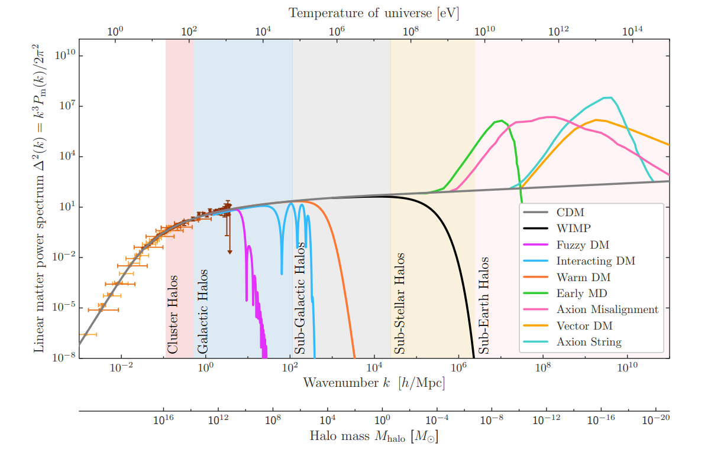
Galaxies are DM dominated and seem to have kpc size scale
2022 Snowmass Summer Study 2203.07354
Triumphs of CDM here
Troubles here
QCD Axion
SIDM
CDM, BH
WIMP
ULDM
WDM
CMB
No cuspy subhalo, DM star or DM planet found so far
→ DM has kpc length scale?

Slide 16
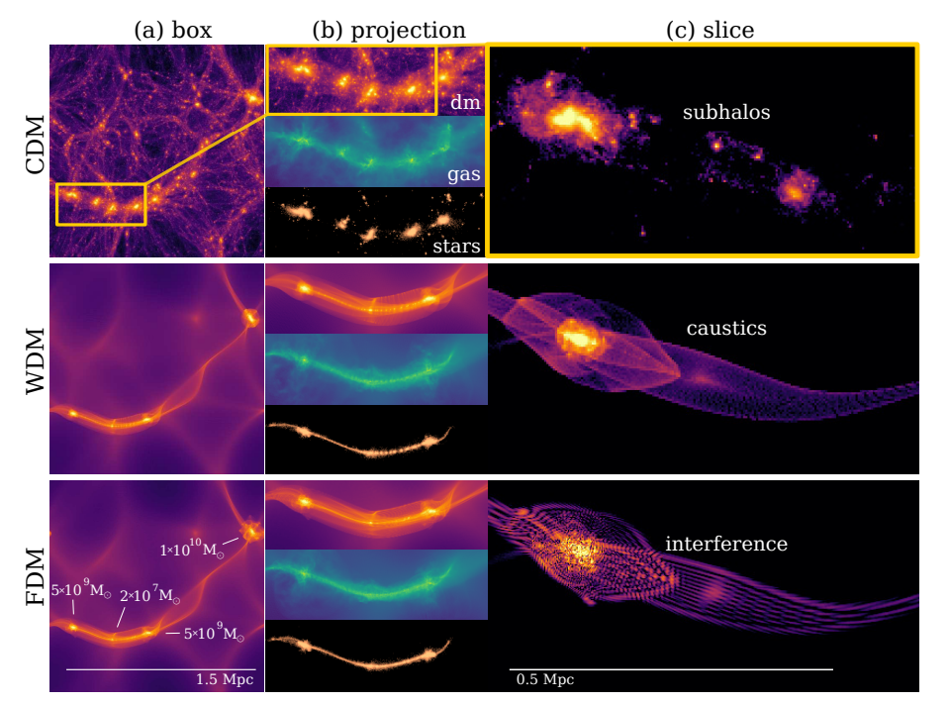
Mocz+ 1910.01653

Slide 17
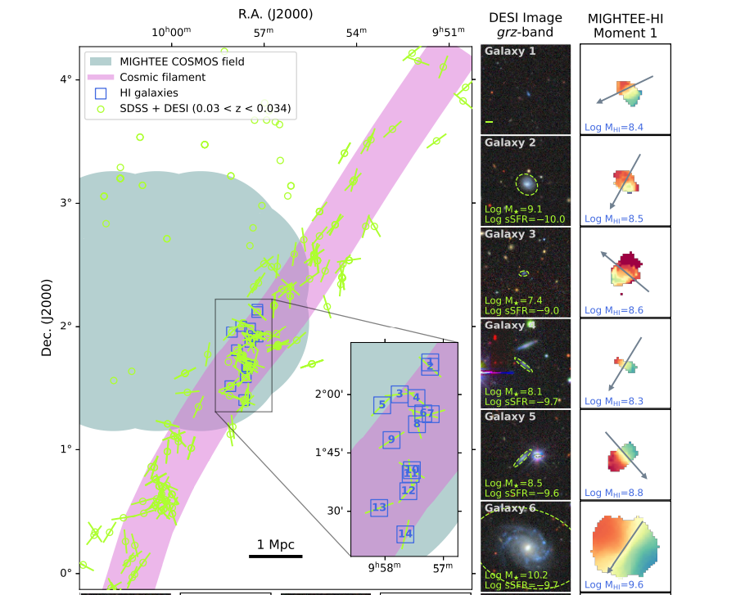
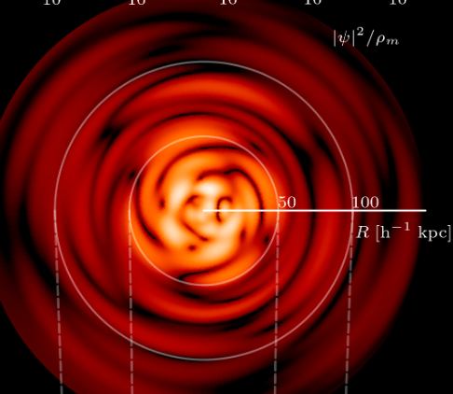
filament
Tudorache+2508.13053
from vortex?
15 Mpc

Slide 18
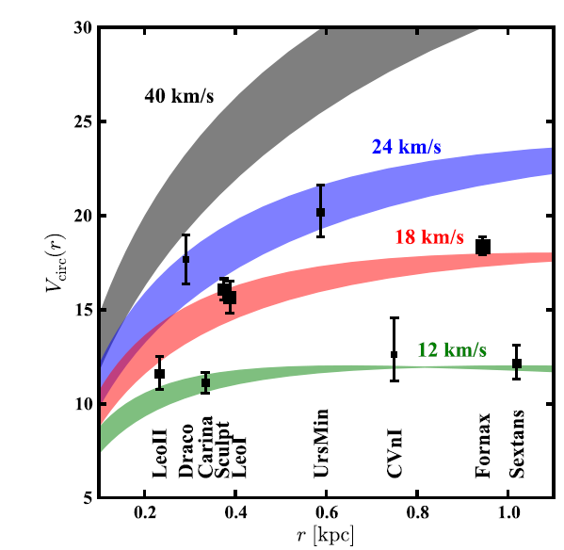
Too big to fail= no dense satellite
Where are these bright satellites?
CDM
ULDM
WDM
Marsh & Silk 2013
Boylan etal 2012

Slide 19
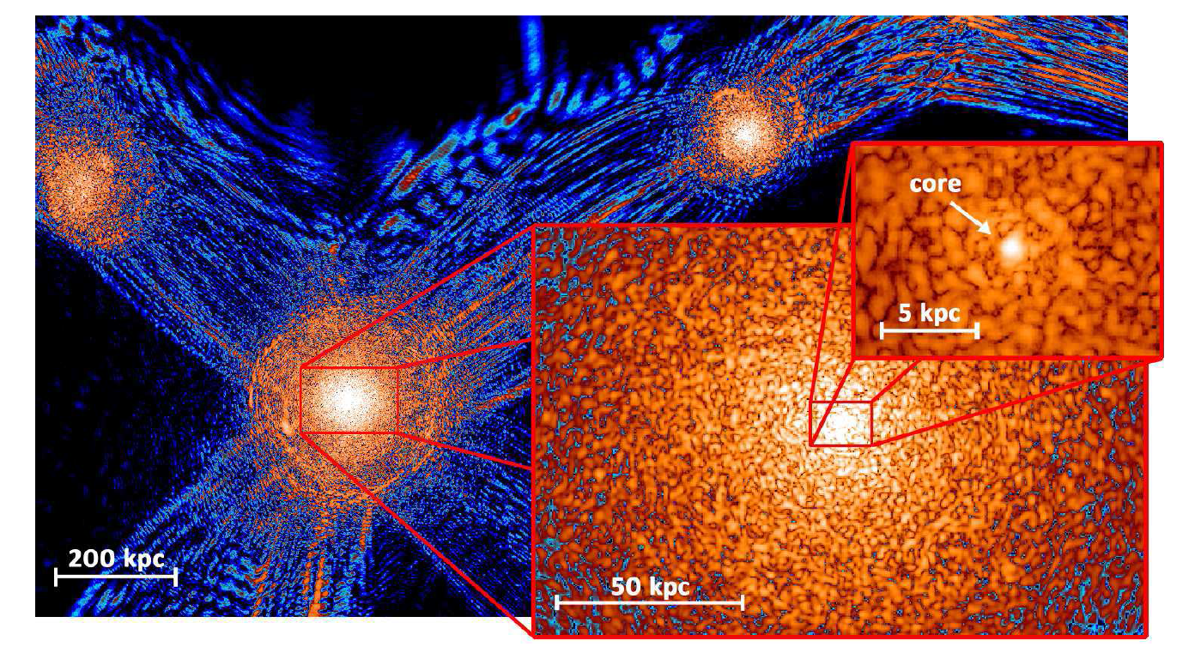
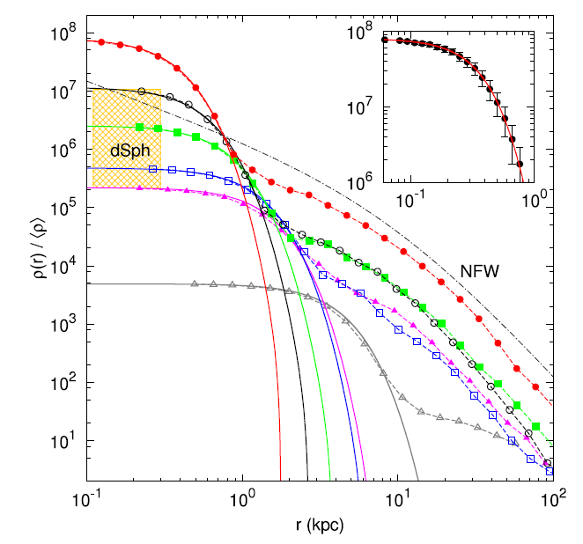
ULDM simulation
(soliton)
granules
halo
core size ~ granule size~ typical length
~ Q. Jeans length (kpc)
Schive+ , Nature physics 2014
19

Slide 20
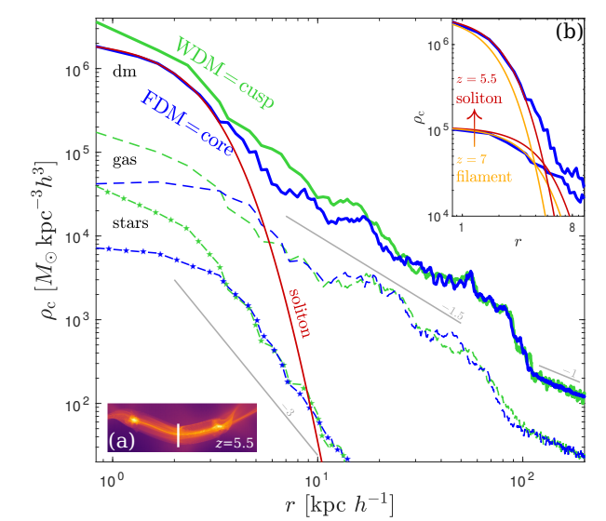
Mocz+ 1910.01653

Slide 21
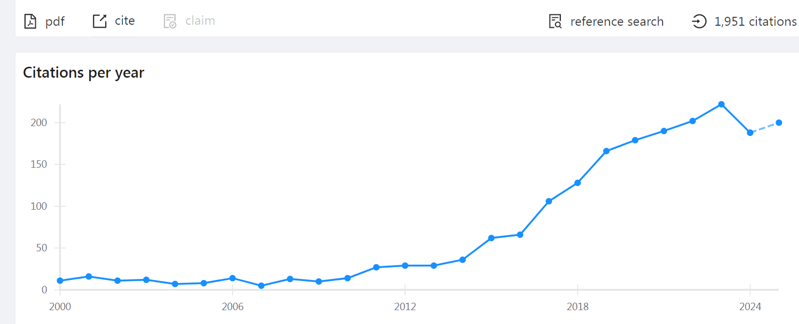
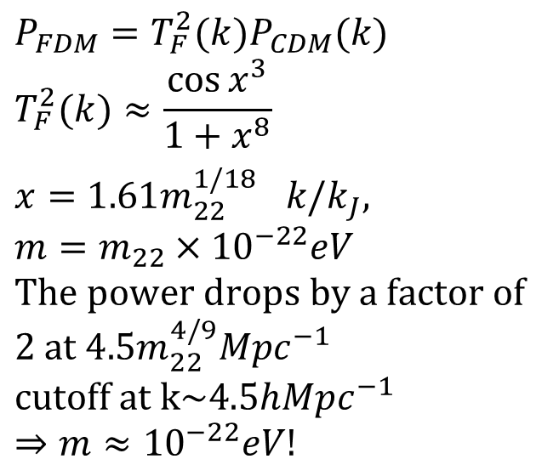
Can FDM solve small scale issues?
Hu et al PRL 2000 (Fuzzy DM)
$$P_{FDM}=T_{F}^{2}(k)P_{CDM}(k) \\ T_{F}^{2}(k)≈\frac{\cos{x^{3}}}{1+x^{8}} \\ x=1.61{m_{22}^{1/18}}^{}k/k_{J}\text{, }$$
$$m=m_{22}×10^{−22}eV \\ \text{The} \text{power} \text{drops} \text{by} \text{a} \text{factor} \text{of}\text{ 2 }\text{at} 4.5m_{22}^{4/9}Mpc^{−1} \\ \text{cutoff} \text{at} \text{k}\text{\sim }4.5hMpc^{−1} \\ ⇒m≈10^{−22}eV!$$
Marsh
To solve the cusp and missing satellites suppression at small scale needed
Park etal PRD 2012

Slide 22
favor m ~10⁻²² eV ULDM
over CDM
ULDM well reproduce
lens of radio objects
CDM
Armurth+2023
favor m > 4.4x10⁻²¹ eV
Powell+2023

Slide 23
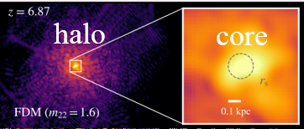

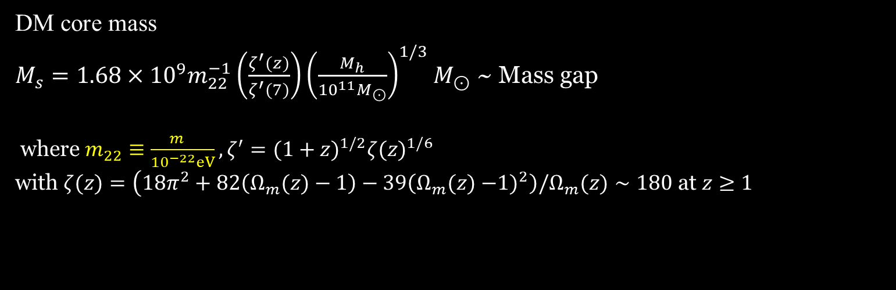

core-halo relation of ULDM
$$Q. Jeans mass$$
$${MQ}_{J}=\frac{4π}{3}ρ(z)λ_{QJ}^{3}(z)=1.204×{10}^{8}{\left(\frac{1+z}{m_{22}^{2}}\right)}^{3/4}{\left(\frac{Ω_{dm}}{0.27}\right)}^{1/4}{\left(\frac{h}{0.7}\right)}^{1/2}M_{⊙}$$
~ M_{h} halo mass
DM core size
$$r_{s}=0.135m_{22}^{−1}{\left(\frac{\left.ζ^{′}(z\right)}{\left.ζ^{′}(7\right)}\right)}^{−1}{\left(\frac{M_{h}}{{10}^{11}M_{⊙}}\right)}^{−1/3}kpc$$
DM core mass
$M_{s}=1.68×{10}^{9}m_{22}^{−1}\left(\frac{ζ^{′}(z)}{ζ^{′}(7)}\right){\left(\frac{M_{h}}{{10}^{11}M_{⊙}}\right)}^{1/3}M_{⊙}$ ~ Mass gap
where $m_{22}≡\frac{m_{}}{{10}^{−22}eV},ζ^{′}=(1+z)^{1/2}ζ(z)^{1/6}$ with $ζ(z)=\left(18π^{2}+82\left(Ω_{m}(z)−1\right)−39\left(Ω_{m}(z)−\right.\right.\left.1)^{2}\right)/Ω_{m}(z)∼180$ at $z≥1$

Slide 24
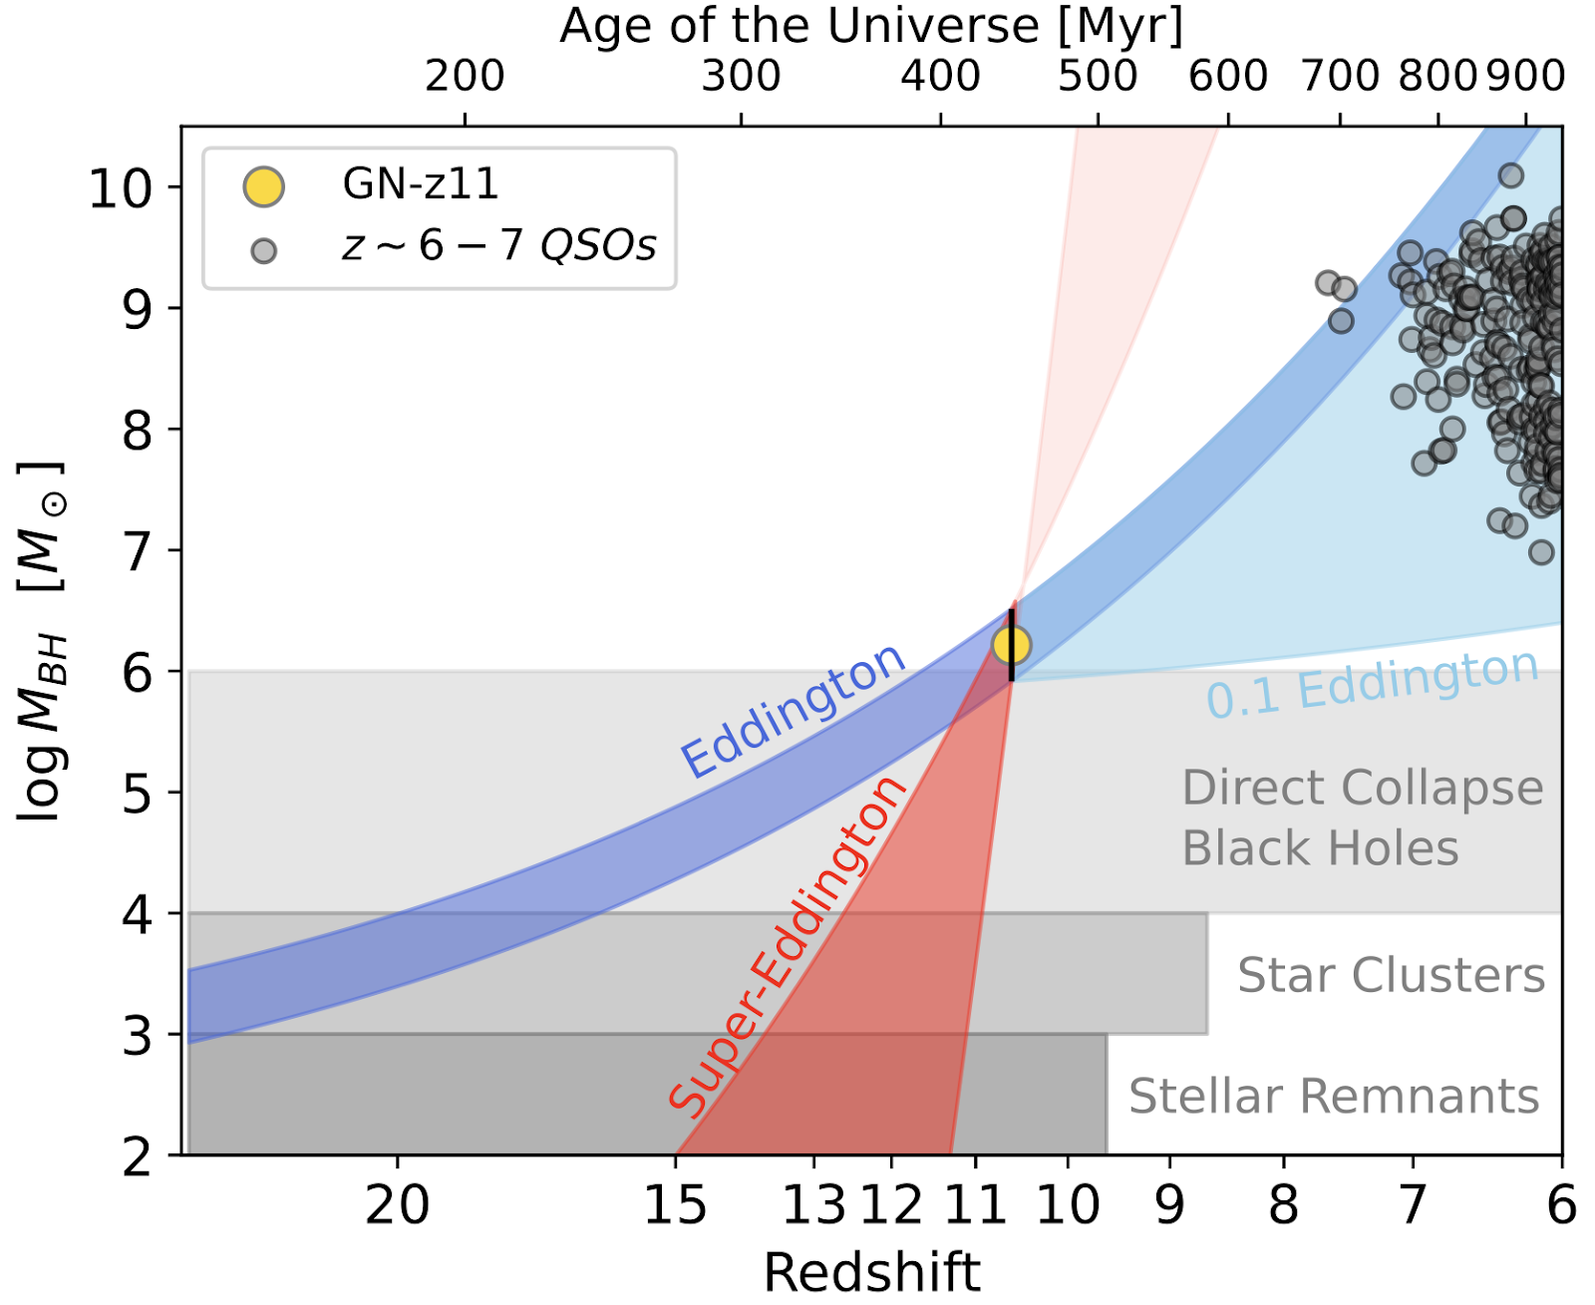
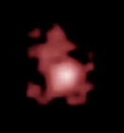
Impossibly early SMBH?
SMBHs (Quasar) with M~10⁶ M_{s} were already mature at around z=11 (~0.45 Gyr)
GN-z11 (Maiolino+ 2305.12492)
z =10.6, M_{BH}=10^{6.2} $M_{⊙}$
Cosmic
chicken-egg
problem
mass gap
IMBH

Slide 25
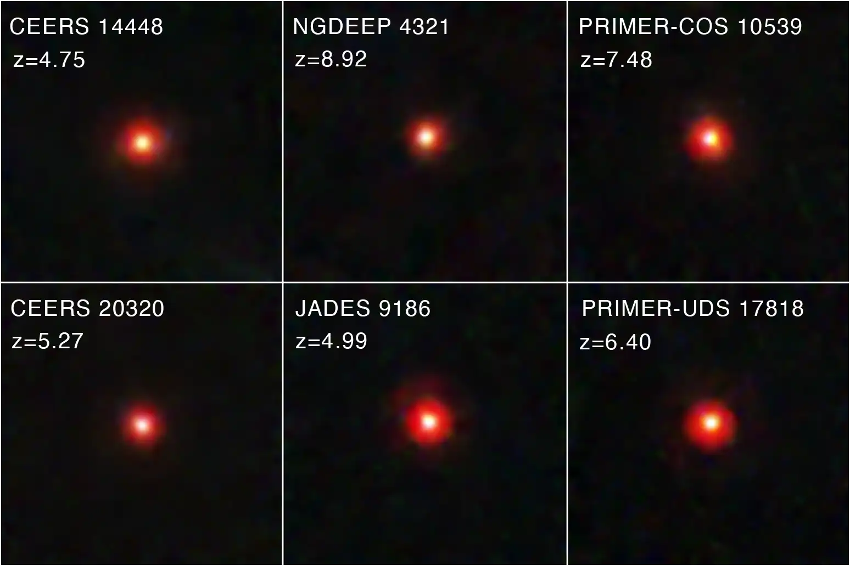
Little Red Dots
Size: less than a few hundred light-years (smaller, older than quasar hosts)
Color: Red; influenced by redshift and dust absorption?
Epoch of Formation: Approximately 0.6–1.5 billion years after the Big Bang
Central Structure: Rapid gas rotation → high likelihood of hosting an AGN
Observational Features: Weak X-ray emission, no photometric variability
Possible Models: Obscured AGN?, supermassive stars? Black hole stars?
JWST

Slide 26
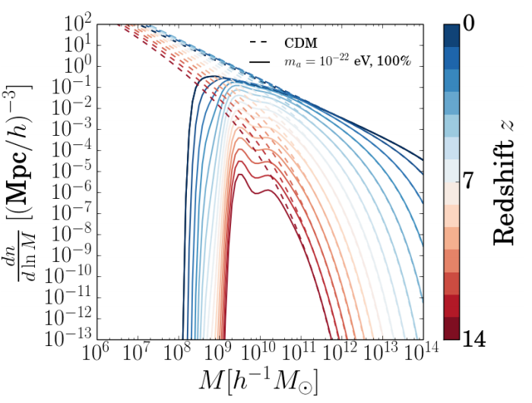




Halo mass function
Bozek+ 1409.3544
Sheth-Tormen mass function
$${MQ}_{J}$$
$$M_{h}=α^{3}{MQ}_{J}$$
suppress
small halos
${\left.\frac{dn}{dln{M}}\right|}_{FDM}={\left.\frac{dn}{dln{M}}\right|}_{CDM}{\left[1+{\left(\frac{M_{h}}{M_{0}}\right)}^{−1.1}\right]}^{−2.2}$ $M_{0}=1.6×{10}^{10}m_{22}^{−4/3}M_{⊙}$
$${\left.\frac{dn}{dln{M}}\right|}_{CDM}∝f(ν)=A\sqrt{\frac{1}{2π}}\sqrt{q}ν\left[1+(\sqrt{q}ν{\left)\right.}^{−2p}\right]exp\left(−\frac{qν^{2}}{2}\right)\frac{1}{ν}$$
$$ν=\frac{1.69}{σ\left(M\right)}$$

Slide 27
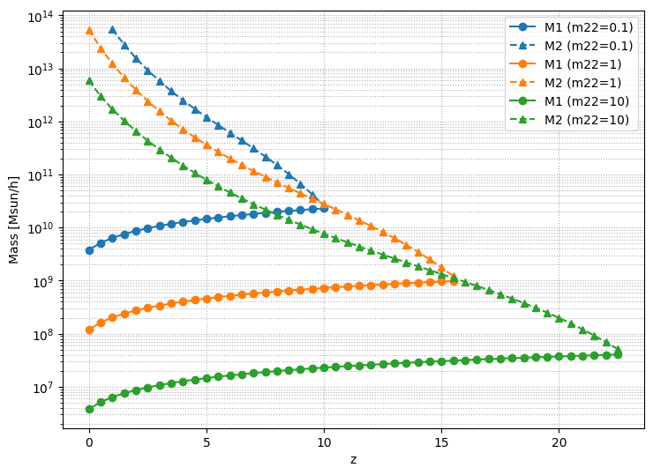

Slide 28
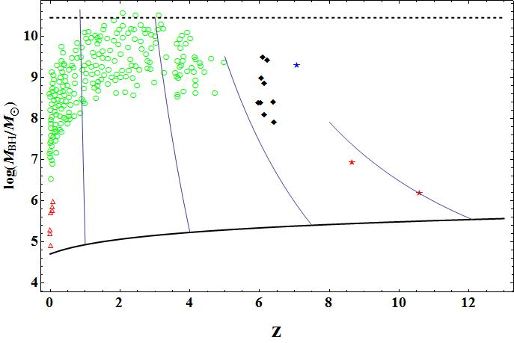

Evolution of SMBHs from ULDM
Max. mass (independent of z)
$$M_{max}≃0.633\frac{M_{P1}^{2}}{m}≃8.5×{10}^{11}M_{⊙}\left(\frac{{10}^{−22}eV}{m}\right)$$
downsizing
GN-z11
Min. mass
Seed BHs in ULDM halos
IMBH

Slide 29
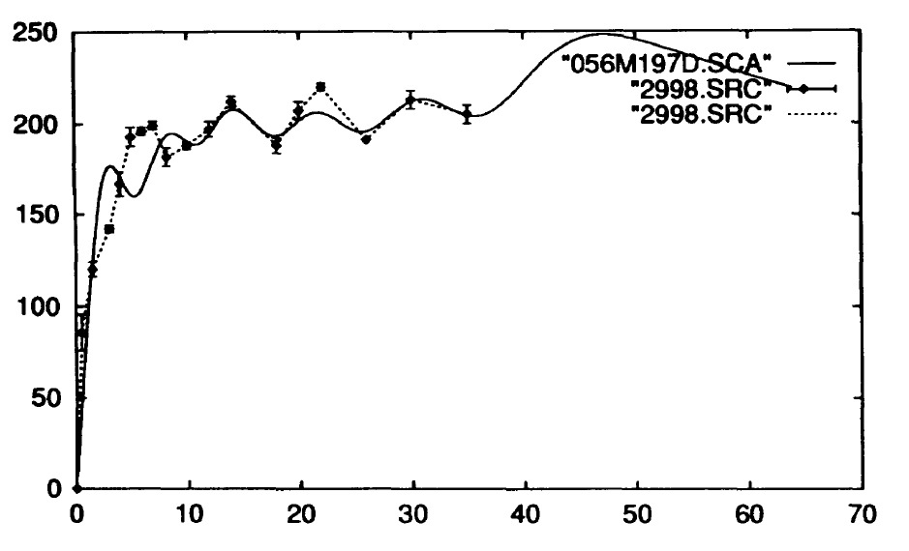
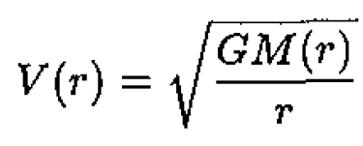
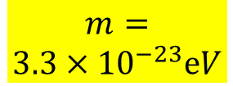
S. Sin PRD 1994
BEC DM
6 nodes excited state solution
rescaled
u(r)
NGC2998
Gravitational Bohr radius
$$m=$$
$$3.3×{10}^{−23}ⅇV$$
Flat RC & Ripples
Total mass

Slide 30
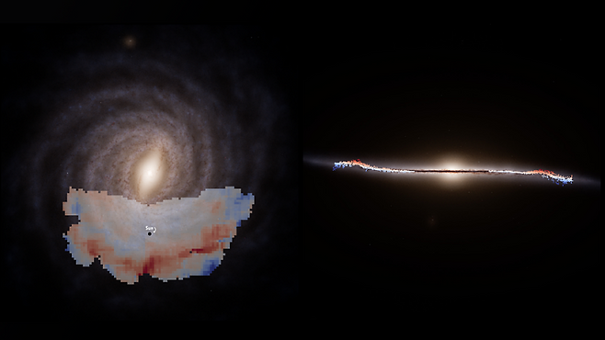
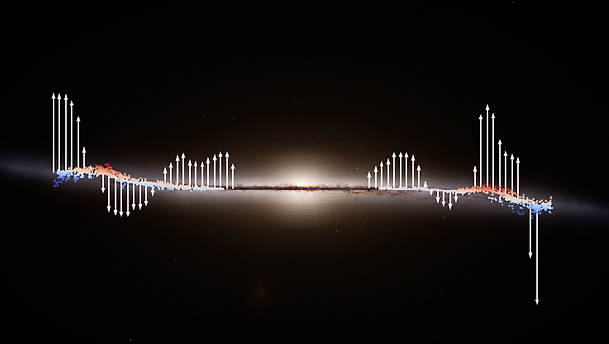
Warp, Ripple, Wave
Poggio+ 2407.18659

Slide 31
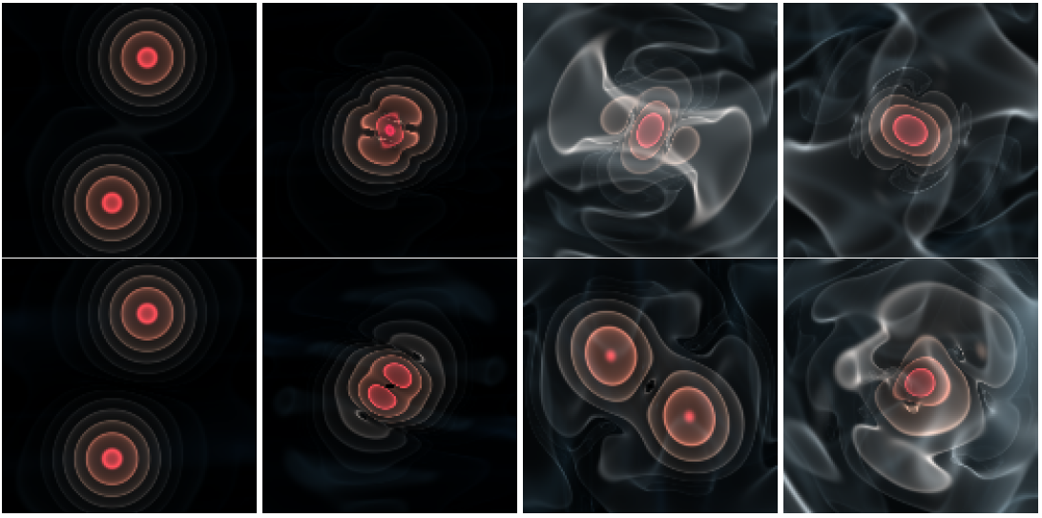
Gravitational cooling of FDM
Unique and efficient dissipation mechanism of FDM
Schwabe et al
arXiv:1606.05151
Seidel, Suen PRL 72
DM halo (wave) collision → nonlinear interference
creation of high momentum (k) modes
escape of waves carrying E, p, L a way

Slide 32


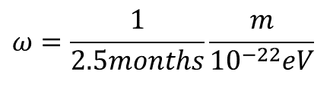

Oscillation of ULDM
$$ω=\frac{1}{2.5months}\frac{m}{10^{−22}eV}$$
$$φ(x,l)=\overset{‾}{φ}(l)+δφ(x,l)$$
where
$\overset{‾}{φ}(l)$ : spatially homogeneous cosmic background field,
$δφ(x,l)$ : inhomogeneous part forming nonlinear galactic halos.
For a scalar potential
$$V(φ)=\frac{1}{2}m^{2}φ^{2}+\frac{λ}{4}φ^{4}$$
$$\overset{¨}{φ}+3H\overset{˙}{φ}−\frac{1}{a^{2}}∇^{2}φ+m^{2}φ+λφ^{3}=0$$
Inserting $φ=\overset{‾}{φ}+δφ$ and spatially averaging, the background satisfies
$$\overset{¨}{\overset{‾}{φ}}+3H\overset{˙}{\overset{‾}{φ}}+m^{2}\overset{‾}{φ}+λ{\overset{‾}{φ}}^{3}+λ\overset{‾}{φ}\left\langle δφ^{2}\right\rangle +…=0.$$
The local perturbation $φ_{h}≡δφ$ obeys
$${\overset{¨}{φ}}_{h}+3H{\overset{˙}{φ}}_{h}−\frac{1}{a^{2}}∇^{2}φ_{h}+m^{2}φ_{h}+3λ{\overset{‾}{φ}}^{2}φ_{h}+…=0$$
this simplifies to
$${\overset{¨}{φ}}_{h}−∇^{2}φ_{h}+m^{2}φ_{h}+λφ_{h}^{3}=0.$$
$$\overset{¨}{\overset{‾}{φ}}+m^{2}\overset{‾}{φ}=0$$

Slide 33
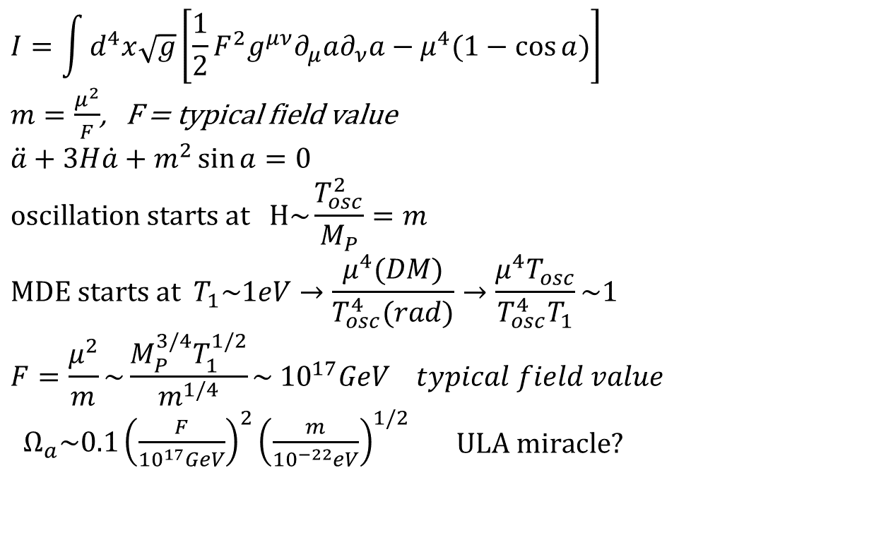
ULA miracle
Hui et al 2017
$$I=\int{d^{4}x\sqrt{g}\left[\frac{1}{2}F^{2}g^{μν}∂_{μ}a∂_{ν}a−μ^{4}(1−\cos{a})\right]}$$ $m=\frac{μ^{2}}{F}$, F = typical field value $$\ddot{a}+3H\dot{a}+m^{2}\sin{a}=0 \\ \text{oscillation} \text{starts} \text{at} \text{H}\text{\sim }\frac{T_{osc}^{2}}{M_{P}}=m \\ \text{MDE} \text{starts} \text{at} T_{1}\sim 1eV→\frac{μ^{4}(DM)}{T_{osc}^{4}(rad)}→\frac{μ^{4}T_{osc}}{T_{osc}^{4}T_{1}}\sim 1 \\ F=\frac{μ^{2}}{m}\sim \frac{M_{P}^{3/4}T_{1}^{1/2}}{m^{1/4}}\sim 10^{17}GeV typical field value$$ $Ω_{a}\sim 0.1{\left(\frac{F}{10^{17}GeV}\right)}^{2}{\left(\frac{m}{10^{−22}eV}\right)}^{1/2}\begin{matrix} & \text{ULA} \text{miracle}\text{?}\end{matrix}$
m > H
F
ULDM naturally explains DM density with GUT scale.
This holds for ULDM with a quadratic pot.

Slide 34
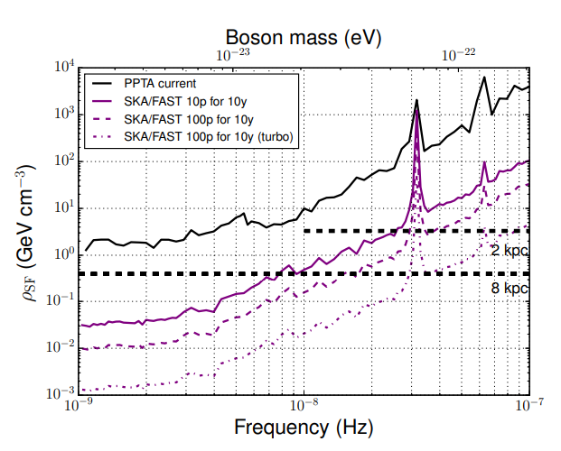
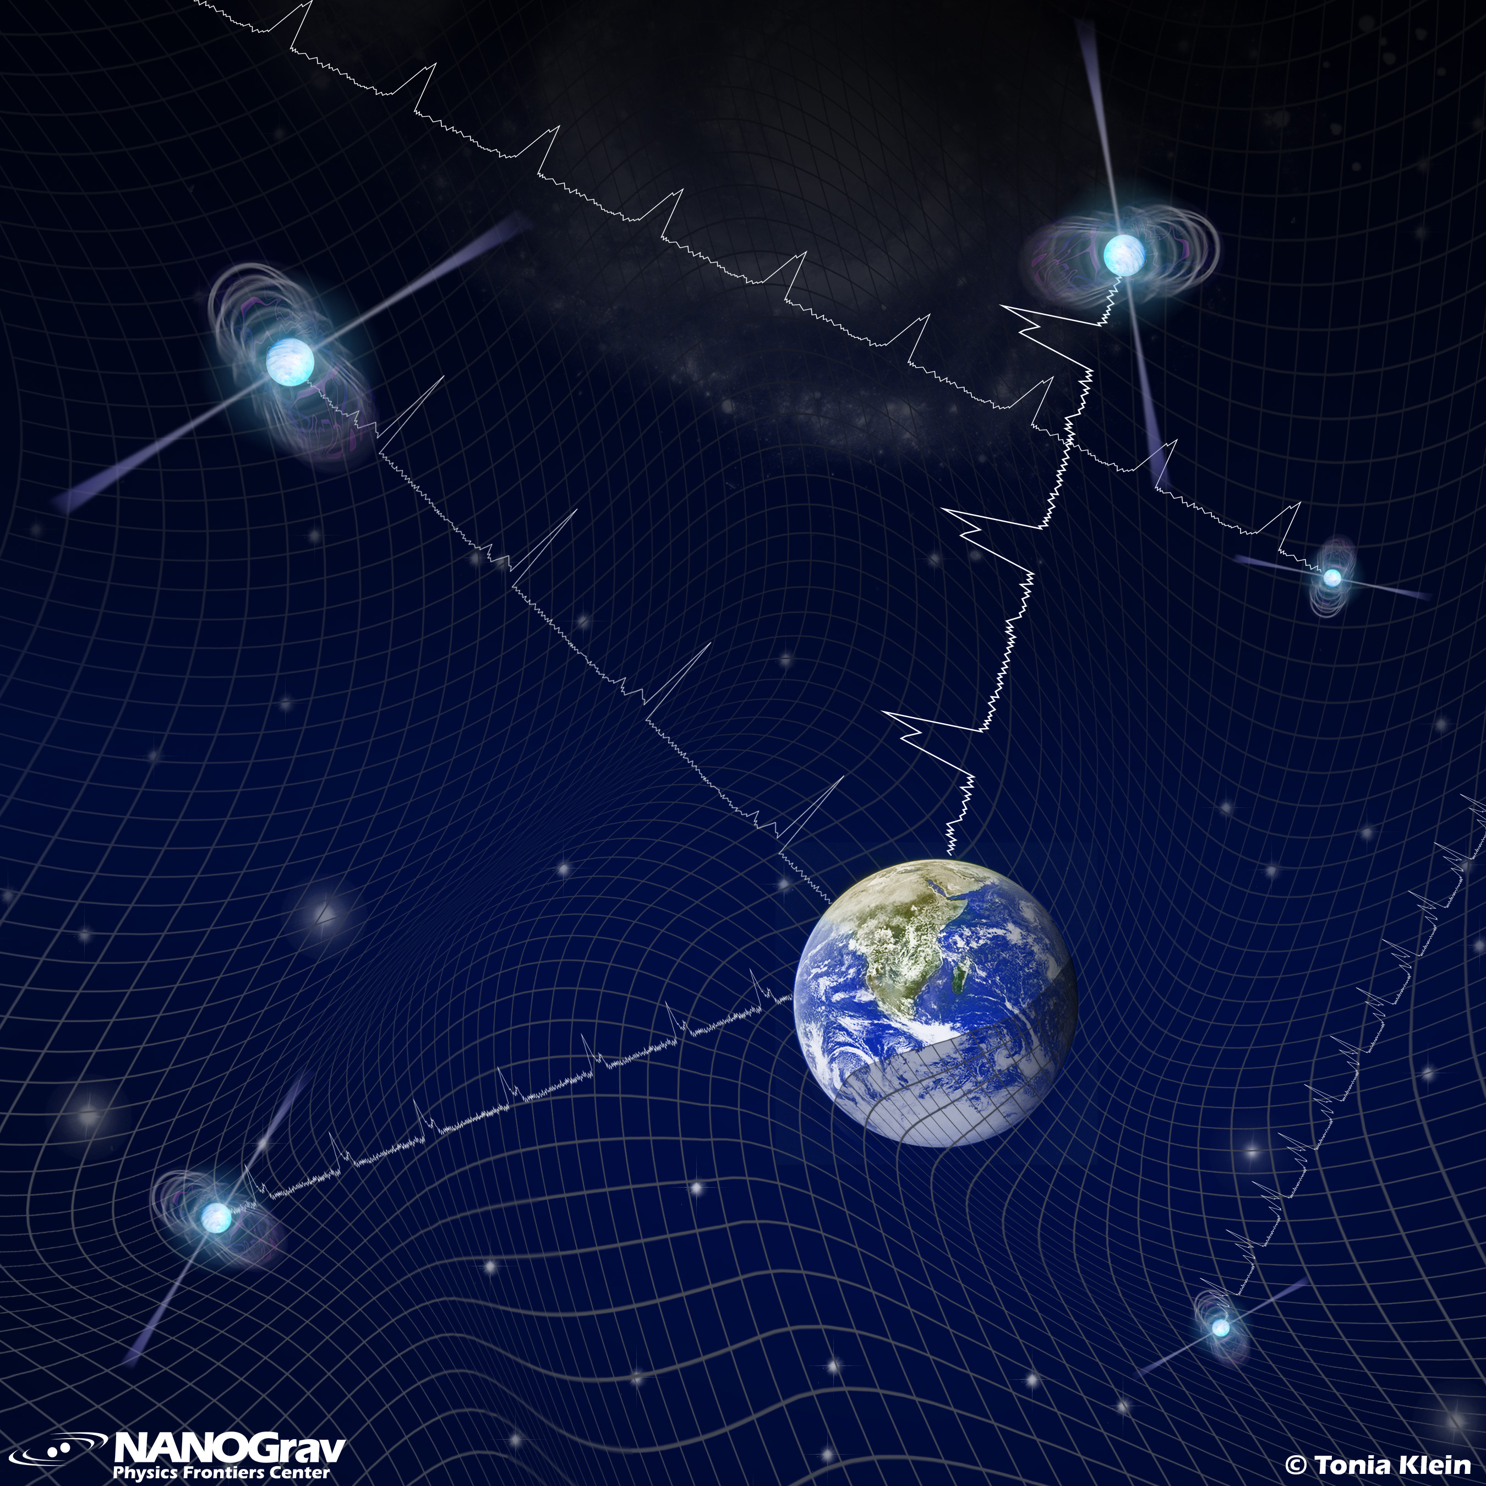
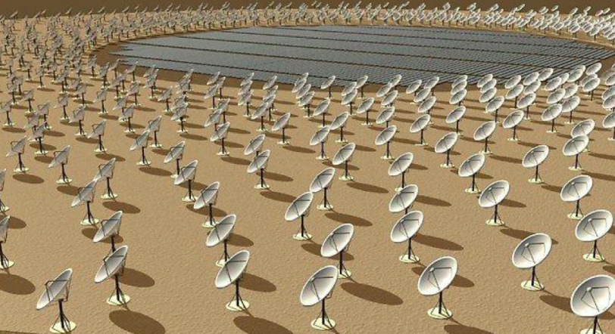




GW background detected by pulsar timing array
1810.03227
$$Ψ\left(t−D,x^{p}\right)$$
$$Ψ\left(t,x^{e}\right)$$
ULDM has
intrinsic osc time scale
1/m ~ yrs
$$\overset{¨}{\overset{‾}{φ}}+m^{2}\overset{‾}{φ}=0$$
$$ω=\frac{1}{2.5months}\frac{m}{10^{−22}eV}$$

Slide 35
Gravitational atom
BH
ULDM
cloud
$$\left(g^{αβ}∇_{α}∇_{β}−μ^{2}\right)Φ\left(t,r\right)=0$$
ansatz
$$Φ\left(t,r\right)= \frac{1}{\sqrt{2μ}}\left[ψ\left(t,r\right){ⅇ^{−ⅈμt}}^{}+ψ^{∗}\left(t,r\right)ⅇ^{ⅈμt}\right]$$
$ⅈ∂_{t}ψ\left(t,r\right)=\left(−\frac{1}{2μ}∇^{2}−\frac{α}{r}+O\left(α^{2}\right)\right)ψ\left(t,r\right)$
$$ψ_{nlm}\left(t,r\right)=R_{nl}\left(r\right)Y_{lm}\left(θ,φ\right)ⅇ^{ⅈ\left(μ−ω_{nlm}\right)t}$$
Schroedinger equation
with a Coulomb-like
central potential
hydrogen atom like
solution
gravitational
fine structure constant
$α≡\frac{r_{g}}{λ_{c}}=\frac{GMμ}{ℏc}≈0.1\left(\frac{M}{{10}^{11}M_{S}}\right)\left(\frac{μ}{{10}^{−22}ⅇV}\right)$ << 1
Occupation # is huge, presence of horizon

Slide 36


Superradiance (Penrose process)
ULDM waves
$$Ω$$
GW
BH
ULDM cloud
potential confinement when $λ_{c}\sim rg$
growing mode if $ω_{nlm}$ $<mΩ$ → BH spin decreases
can change GW patterns from a BH and BH binary
magnetic q. number
See Zhang & Yang 2018, 1908.10370, 2208.06408

Slide 37
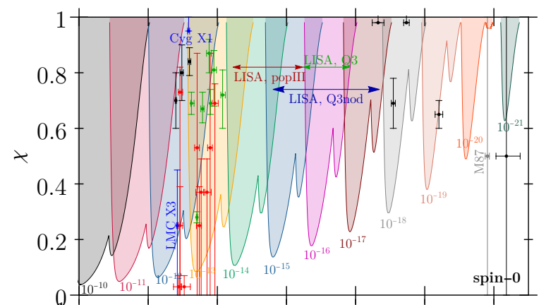
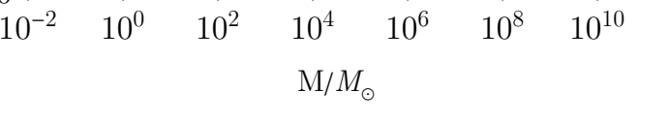
Bounds from BH-spin measurements (Regge plane)
=cJ/M²G
Brito+ 1501.06570

Slide 38
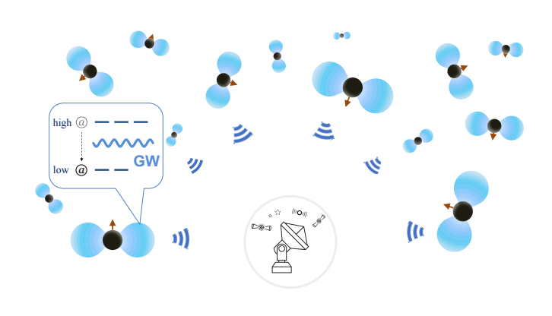
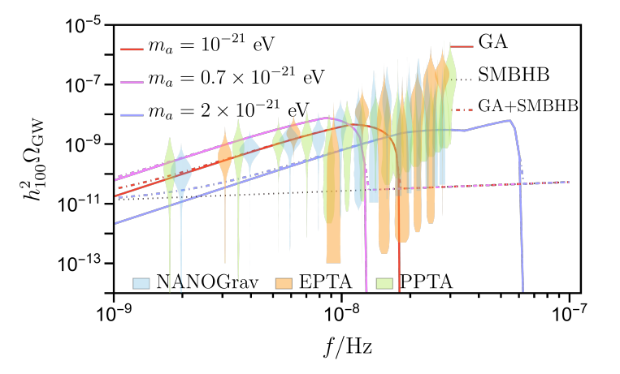
nano-Hertz stochastic GW background
Yang+ 2306.17113
Gravitational atom
superradiance

Slide 39
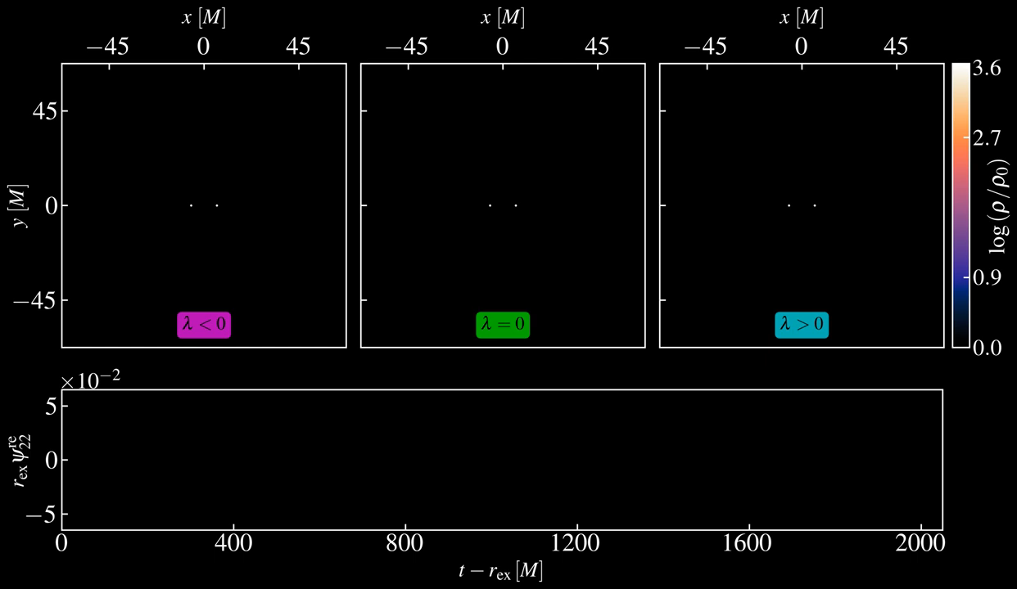
Aurrekoetxea+ PRD 2024

Slide 40
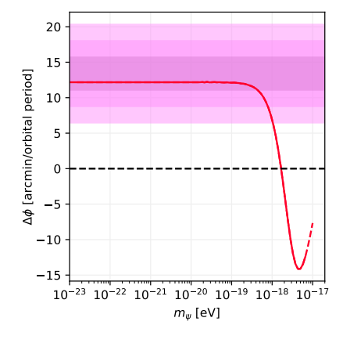
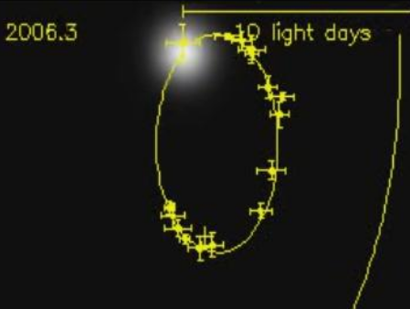


S2
Monica+ 2305.10242
$$ds^{2}=−F(r)dt^{2}+\frac{1}{\left.F(r\right)}dr^{2}+r^{2}\left(dθ^{2}+\sin^{2}{θ}dφ^{2}\right)$$
$$m_{ψ}≲3.2×{10}^{−19}eV$$
$$F(r)=exp\left(\frac{4πρ_{c}r_{c}^{3}}{91α^{8}r}\left({\left(\frac{r_{c}}{r}\right)}^{13}ℱ−\frac{3003πα^{\frac{13}{2}}}{2048}\right)\right)−\frac{2M}{r},$$

Slide 41
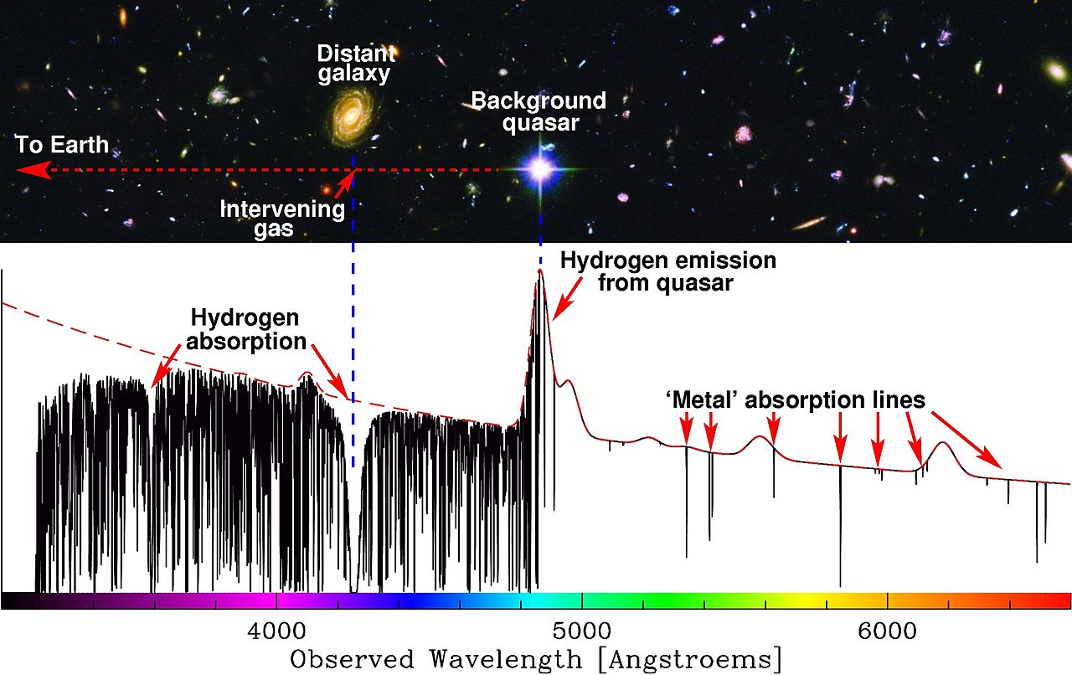
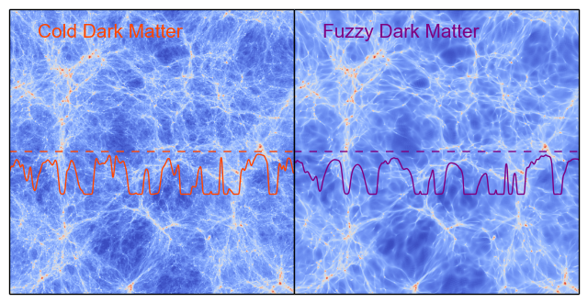
Lyman alpha tension?
m > 10⁻²¹eV
PRL 2017 (Irisic et al)
Hydrosimulation uncertainty
is large
WDM (1, 3.3) keV ~ FDM (1, 20) x 10⁻²²eV

Slide 42



UFD constraints
6.1σ tension?
$$r_{c}∝\frac{1}{M}$$
Urrutia 2502.12030

Slide 43

Constraints on FDM (free ULDM) mass
Solve small
scale issues
favors m > 10⁻²¹ eV?
need baryon?
heating
profile
https://www.mpa-garching.mpg.de/898225/hl202012?c=1004481

Slide 44
Merits of studying self-interacting ULDM
We can
allow wider mass range
→avoid some tensions of FDM
study direct, or indirect detection of ULDM
calculate abundance
understand particle model
explain other mysteries like Hubble tension
& EW scale …

Slide 45

Constraints on particle SIDM
Tulin & Yu 1705.02358

Slide 46







Self-Interacting ULDM (SIULDM, SFDM)
Lee and Koh (PRD 53, hep-ph/9507385)
Galactic DM halo is described by coherent scalar field with self-interaction
Action
Metric
Field
Exact
ground
state
(soliton)
$$\begin{matrix}S=\int{ }\sqrt{−g}d^{4}x\left[\frac{−R}{16πG}−\frac{g^{μν}}{2}φ_{;μ}^{∗}φ_{;ν}−\frac{m^{2}}{2}|φ|^{2}−\frac{λ}{4}|φ|^{4}\right] \\ \begin{aligned} \\ ds^{2}=−B(r)dt^{2}+A(r)dr^{2}+r^{2}dΩ \text{Spherical}\text{. }\end{aligned}\end{matrix}$$
$$\tilde{m}≡\frac{m}{λ^{\frac{1}{4}}}$$
$$φ(r,t)={(4πG)}^{−\frac{1}{2}}σ(r)e^{−iωt}$$
$Λ≡\frac{λm_{P}^{2}}{4πm^{2}}$ , $Λ>>1\begin{matrix} & (\text{Newtonian}\text{ \& }\text{TF} \text{limit})\end{matrix}$
$$New constant length scale RTF≈\frac{\sqrt{Λ}}{m}=\sqrt{\frac{πℏ^{3}λ}{8cGm^{4}}} \sim {\tilde{m}}^{−2}$$
${\& mass scale M}_{max}$= ${\sqrt{Λ}\frac{m_{P}^{2}}{m}}_{}$
$$σ_{∗}=\sqrt{\frac{γ_{0}\operatorname{Sin}\left(\sqrt{2}r_{∗}\right)}{\sqrt{2}r_{∗}}}$$
$$r_{∗}=rΛ^{−1/2}$$
Even tiny self-interaction drastically changes the scales!
allows wider range for m to fit observations
$\tilde{m} determines all scales$

Slide 47


Alberto Diez-Tejedor etal PRD 2014
$3 eV<\tilde{m}=\frac{m}{λ^{\frac{1}{4}}}$ < 7 eV

Slide 48



Universal RC with SIULDM
RCs of the most dark matter dominated galaxies in the SPARC database
$$V_{DM}(x)=\sqrt{x^{−1}erf(x)−2π^{−\frac{1}{2}}exp\left(−x^{2}\right)}$$
$$x=r/{r_{c}}$$
Delgado+ 2201.12418

Slide 49






$$ξ_{G}=\frac{ℏ^{2}}{GMm^{2}}$$
$$𝔐=ℏ\sqrt{\frac{3π}{8Gma_{s}}}$$
$$r_{c}=\sqrt{9π/8}\left(1+\sqrt{1+{{(M}/𝔐)}^{2}}\right)ξ_{G}$$
TF
Fuzzy
Delgado+ 2201.12418
$$best fit m≃2.2×{10}^{−22}eV, { a}_{s}=\frac{λ}{8πm}≃7.8×{10}^{−77} meter$$
$→\tilde{m}=$ 5.72 eV

Slide 50



Timing problem of GC
$$\overset{‾}{τ}=\frac{3}{4πρ_{c}G^{2}M_{GC}}×\left\{\begin{matrix}c_{s}^{3} & \text{ (}\text{Thomas} \text{Fermi} \text{limit}\text{) } \\ \frac{1}{\sqrt{2}}{\left(\frac{ℏv_{0}}{m_{φ}r_{0}}\right)}^{3/2} & \text{ (}\text{FDM} \text{limit}\text{). }\end{matrix}\right.$$
Koo & Lee
JCAP 2026
$1.17×{10}^{−22}eV≤m_{φ}≤4.68×{10}^{−22}eV$ (FDM)
$$3.75eV≤\frac{m_{φ}}{λ^{1/4}}≤5.57eV (GC3, TF)$$

Slide 51


Shapiro+ 2106.13244
$$λ_{J} fixed$$
$$M_{J}∝a^{−3}$$
weak suppression
weak missing
satellites
may avoid Lyman
alpha tension
weak suppression

Slide 52






Our new proposal
$$\text{Phase} \text{I}$$
$$\text{Phase} \text{II}$$
$$\text{Phase} \text{III}$$
$$\frac{m^{2}}{2}|φ|^{2}+\frac{λ}{4}|φ|^{4}$$
JLee
2502.11568
$V(φ)∝φ^{n}$ decays with an equation of state $w=\frac{(n−2)}{(n+2)}$
or stiff
$$\left\{\begin{aligned}\begin{matrix}\begin{aligned}{DE−like \left(slow−roll\right)for z}_{osc}<z\text{ (}\text{Phase} \text{I}\text{)} \\ \text{Dark} \text{rad}\text{−}\text{like}\text{ ( }φ4>φ2) \text{or} z_{m}<z<z_{osc}\text{ (}\text{Phase} \text{II}\text{)}\end{aligned} \\ \begin{aligned}\text{CDM}\text{ ( }φ4<φ2) \text{or} z<z_{m}\text{ (}\text{Phase} \text{III}\text{)}\end{aligned} \\ \end{matrix}\end{aligned}\right.$$
SIULDM alone is enough!

Slide 53

$$\text{Phase} \text{I}\text{ (}\text{DE}\text{)}$$
ULDM
$\text{Phase} \text{II}$ (Dark rad)
CDM
$$\text{Phase} \text{III}\text{ (}\text{CDM}\text{−}\text{like}\text{)}$$
SIULDM acts as a natural extra radiation comp. just before ls
We don’t need exotic matter or fine tuning?

Slide 54








Cosmological evolution
Li etal 1310.6061
stiff phase
Time varying Eq. of state
1) $z_{eq}$=3390
$$⇒m^{4}/λ>4.7×10^{−7}eV^{4}$$
$$\frac{ΔN_{eff}}{N_{eff,\text{standard}}}=\frac{3.71_{−0.45}^{+0.47}−3.046}{3.046}=\frac{ρ_{SFDM}}{ρ_{ν}}$$
2) Big Bang
Nucleosynthesis
$$→2.6eV≤\frac{m}{λ^{1/4}}≤9.5eV$$

Slide 55




cosmological constraints
$$Garcia+ 2304.10221$$
$1 eV<\tilde{m}=\frac{m}{λ^{\frac{1}{4}}}$ < 10 eV
$\tilde{m}$~ 7eV
$\tilde{m}$~ 1eV

Slide 56


Detection of interacting ULDM
Using atomic clocks to detect ULDM by mimicking time variations of fundamental constants
dilatonic coupling
Oscillation of fine structure constant
Due to nuclear and atomic structure Yb and Cs have different frequency dependency on α
(special relativistic effects)
Calmet
AIST

Slide 57




$$ω=\frac{1}{2.5months}\frac{m}{10^{−22}eV}$$
$\frac{1}{4g^{2}}F_{μv}F^{μν}$+ $\frac{φde}{4g^{2}}F_{μv}F^{μν}$
pulsar array
Arvanitaki+1405.2925

Slide 58
Direct detection
* The common low-energy effective interaction is
$$ℒ_{φ}=κφ𝒪_{SM},$$
where $κ≡\sqrt{4π}/M_{Pl}$ and
$$𝒪_{SM}=d_{e}\frac{F_{μν}F^{μν}}{4}−d_{g}\frac{β_{3}}{2g_{3}}G_{μν}^{A}G^{Aμν}−d_{me}m_{e}\overset{‾}{e}e−\sum_{i}{ }d_{m_{i}}m_{i}{\overset{‾}{ψ}}_{i}ψ_{i}$$
1) Atomic, Molecular, Nuclear Clocks
Detect tiny oscillations of the fine-structure constant $α$ and electron-proton mass ratio.
Frequency ratios of different clocks vary as $φ(t)∝cos\left(m_{φ}t\right)$.
Effective Lagrangian:
$$ℒ⊃κφ\left[d_{e}\frac{F_{μν}F^{μν}}{4}+d_{me}m_{e}\overset{‾}{e}e+d_{\overset{ˆ}{m}}\left(m_{u}\overset{‾}{u}u+m_{d}\overset{‾}{d}d\right)\right]$$
2) Optical Interferometers (including GW detectors)
Sensitive to oscillations of $α$ that change optical path length or refractive index.
Effective Lagrangian:
$$ℒ⊃κφd_{e}\frac{F_{μν}F^{μν}}{4}.$$
Atom Interferometers
Detect variations of atomic mass $m_{A}$ and gravitational potential.
Effective Lagrangian:
$$ℒ⊃κφ\left[d_{\overset{ˆ}{m}}\sum_{q}{ } m_{q}\overset{‾}{q}q+d_{g}\frac{β_{3}}{2g_{3}}G_{μν}^{A}G^{Aμν}\right].$$

Slide 59
Torsion Balances and Equivalence Principle Tests
Search for fifth forces and tiny composition-dependent accelerations.
Effective Lagrangian:
$$ℒ⊃κφd_{g}\frac{β_{3}}{2g_{3}}G_{μν}^{A}G^{Aμν}$$
LC Oscillators and Mechanical Resonators
Look for oscillations of electrical or mechanical resonance frequencies.
Effective Lagrangian:
$$ℒ⊃κφd_{e}\frac{F_{μν}F^{μν}}{4}$$
Haloscopes (cavity, plasma, dielectric)
Probe scalar or axion-like couplings to photons.
Scalar case:
$$ℒ⊃κφd_{e}\frac{F_{μν}F^{μν}}{4}$$
Pseudoscalar (axion-like) case:
$$ℒ⊃\frac{g_{φγγ}}{4}φF_{μν}{\overset{˜}{F}}^{μν}.$$
Spin-Based Sensors
Measure shifts in Larmor precession of electron or nuclear spins.
Effective Lagrangian:
$$ℒ⊃κφd_{me}m_{e}\overset{‾}{e}e.$$

Slide 60

Miller 2503.02607

Slide 61




neutrino oscillation with ULDM
$η_{φ}≡\frac{\sqrt{2ρ_{φ}^{⊙}}}{Λm_{φ}}$ ~ $\frac{φ}{Λ}$ ~10⁻⁵
Krnjaic+ 1705.06740
$$\begin{matrix} & Δm^{2}(t)=Δm_{0}^{2}⋅\left[1+η_{φ}⋅cos\left(m_{φ}t\right)\right] \\ & θ(t)=θ_{0}+δη_{φ}⋅cos\left(m_{φ}t\right)\end{matrix}$$
$$ℒ_{\text{eff} }=−m_{ν}\left(1+y1\frac{φ}{Λ}\right)νν, φ(x,t)≃\frac{\sqrt{2ρ_{φ}^{⊙}}}{m_{φ}}cos\left[\left.m_{φ}(t−\vec{v}⋅\vec{x}\right)\right]$$

Slide 62
But we need to consider effective self-interaction
Snowmass 2021 White Paper

Slide 63

Conclusions
ULDM with m~10⁻²¹ eV or
self-interacting ULDM with $\frac{m}{λ^{1/4}}\sim 1eV$
seems to be a viable alternative to CDM
might solve many mysteries of cosmology
and astrophysics.
→ can be detected soon!

Slide 65
detection
Oscillation of fine structure constant
Filzinger+ 2301.03433

Slide 66








$H_{0}$ estimation from CMB
$θ_{s}=\frac{r_{s}}{DA}$ is a standard ruler with 0.04% precision. (fixed)
$θ_{s}$~$1^{o}$
$$r_{s}$$
$$D_{A}$$
CMB(last scattering)
$$Sound Horizon { r}_{s}=\frac{c}{\sqrt{3}H_{ls}}{\int{}}_{z_{ls}}^{∞} \frac{dz}{{\left[ρ(z)/ρ\left(z_{ls}\right)\right]}^{1/2}(1+R(z){\left)\right.}^{1/2}}$$
$D_{A}=\frac{c}{H_{0}}\int_{0}^{{z_{ls}}_{}}{\frac{dz}{{\left[ρ\left(z\right)/ρ_{0}\right]}^{1/2}}}$ ~ $\frac{1}{H_{0}}$
Angular distance
$r_{s}$ & $D_{A}$ depend on expansion history (matter contents $ρ\left(z\right)$)

Slide 67





$$H_{0}=θ_{s}{H_{ls}}_{}\frac{\int_{{z_{ls}}_{}}^{0_{}}{\frac{c dz}{{\left[ρ{\left(z\right)}/{ρ_{0}}\right]}^{1/2}}}}{\int_{∞}^{{z_{ls}}_{}}{\frac{c_{s}\left(z\right) dz}{{\left[ρ{\left(z\right)}/ρ\left(z_{\text{ls}}\right)\right]}^{1/2}}}}$$
late time (decrease $ρ(z))$
early time (increase $ρ(z))$
To increase H₀ we can ( $θ_{s}=\frac{r_{s}}{DA} fixed)$
1) in early time solutions (decrease r_{s} to decrease D_{A} )
• increase $ρ(z)$ (extra radiation, EDE) just before ls
→ but need more perturbation
→ worsen S₈ tension, ad hoc matter, coincidence?
2) in late time solutions (r_{s} & D_{A} fixed, increase the integral)
• decrease $ρ(z)$ by decaying DM after ls and/or increase DE to increase the integral
late evolution changes
tensions with BAO, SN; null energy violation; fine tuning
Do we need both solutions?
$$D_{A}=\frac{c}{H_{0}}\int_{0}^{{z_{ls}}_{}}{\frac{dz}{{\left[ρ\left(z\right)/ρ_{0}\right]}^{1/2}}}$$

Slide 68

McLure+ 0310267

Slide 69

ΛCDM
simulation
S₈ = 0.76 (WL)
Can ULDM solve both H₀ and S₈ ?
→ need extra DE & ULDM with m < 10⁻²⁴ eV
Ye+ 2107.13391

Slide 70

GW
2501.08930

Slide 71


Diversity of rotation curves
Sales+ 2206.05295
a wide range of sizes at fixed stellar mass
No DM models is successful
in reproducing RCs of
all galaxies so far.

Slide 72
Other cosmological Constraints
BEC phase transition before nucleosynthesis: m < 10² eV
field oscillation before equality m > 10⁻²⁸eV
Maximum mass of galaxies from BS theory
spiral 1.04 x10¹²Ms < O(1) M_{p}²/m → m < O(1) 1.28x 10⁻²²eV
elliptical 1x10¹³Ms < O(1) M_{p}²/m → m < O(1) 1.28x 10⁻²³eV
Lyα forest m > 10⁻²¹eV
high-redshift galaxy luminosity → m > 1.2x10⁻²²eV
Stella subpopulations in Fornax → m < 1.1x10⁻²²eV
Ultra-faint dSphs → m ~3.7-5.6 x10⁻²²eV
fiducial value m ~ 10⁻²²eV

Slide 73

ULDM galactic cores > 10⁷ Ms
> 10⁵ Ms
H Gas
> 10⁶ Ms
ULDM halos
in collaboration with Dongsu BAK (Seoul city Univ.)

